Slide 1

A Hybrid Approach for Fraud Detection in Online Transactions
Group Members
Sanjith Senniangiri,
Muraliprasath Ponnuswamy,
Radhika Jitendrakumar Pareek,
Manali Kishor Gawande,
Xiaoou Liu

Slide 2

Problem justification
Online transactions are increasing, but fraud detection is challenging due to:
Rarity of fraudulent transactions (severe class imbalance).
High-dimensional data (transaction, demographic, and device information).
Conventional methods often favor the majority (non-fraud) class.
The project focuses on training machine learning models to differentiate between fraudulent and non-fraudulent transactions by using a hybrid approach of combining both supervised (classifiers) and unsupervised learning (anomaly detection algorithms)

Slide 3
Summary of strengths of prior work related to the proposed problem
Exploration of Traditional and Advanced Techniques:
  Previous studies have thoroughly evaluated classical models such as Naive Bayes, SVM, and Random Forest, demonstrating strong performance under specific scenarios​.
  Ensemble models like Gradient Boosting and hybrid deep learning approaches have shown improved accuracy and generalization capabilities​.
Addressing Class Imbalance:
  Techniques like SMOTE (Synthetic Minority Oversampling Technique) have been utilized effectively to handle severe class imbalance, a critical issue in fraud detection datasets​.
Focus on Performance Metrics Beyond Accuracy:
  Recent studies emphasize metrics like AUC-ROC, F1-score, and Precision/Recall, which provide a more nuanced understanding of fraud detection performance​.
Hybrid Approaches:
  Combining anomaly detection (e.g., Isolation Forest) with supervised classification has been explored to enhance noise reduction and improve overall model performance​.

Slide 4
Summary of weaknesses of prior work related to the proposed problem
Class Imbalance Still a Major Challenge:
  Despite oversampling techniques like SMOTE, many models fail to generalize well in real-world scenarios, leading to high false negatives and false positives​.
High False Positive Rates:
  Classical models like Random Forest and Naive Bayes often suffer from high false positive rates, which can disrupt legitimate transactions and degrade customer trust.
Limited Use of Hybrid Models:
  Most studies focus on either anomaly detection or supervised classification independently, with limited exploration of their combined potential to address rare fraudulent cases​.
Dependence on Static Features:
  Many models rely on static features like demographics and transaction details without incorporating dynamic behavioral patterns or real-time data streams​.
Scalability and Deployment Issues:
  Complex hybrid models, such as deep learning-based techniques, often face scalability challenges, making real-time fraud detection harder to achieve​.

Slide 5
Relevant dataset
Clear description of dataset used including helpful information such as class distribution, example visualizations, or other information
Dataset: IEEE-CIS Fraud Detection Dataset (590,000 transactions, 20+ features).
Class Distribution:
96.5% Non-Fraudulent Transactions
3.5% Fraudulent Transactions
Preprocessing:
Handling missing values
Data partitioning
SMOTE for class imbalance
PCA for dimensionality reduction
Data formatting
Deriving new features using aggregations

Slide 6
Method choice and implementation
Description of the Chosen Method
The chosen method adopts a hybrid approach combining anomaly detection and supervised classification to address the challenges of fraud detection. This method leverages the strengths of both unsupervised and supervised techniques, ensuring robustness in detecting rare fraudulent transactions in highly imbalanced datasets.
Anomaly Detection Phase:
  Used to identify potential fraud cases by isolating outliers in the dataset.
  Techniques applied:
    Isolation Forest (IF): Efficiently isolates anomalies by creating random partitions in the data.
    Support Vector Machine (SVM): Flags outliers using hyperplane-based boundaries.
    Autoencoders (AE): A neural network-based approach that reconstructs input data and identifies anomalies as deviations.
Supervised Classification Phase:
  Focused on refining the results from the anomaly detection phase.
  Models applied:
    Random Forest (RF): An ensemble technique that handles high-dimensional and complex data effectively.
    XGBoost (XG): A gradient boosting model for enhanced prediction accuracy.
    Logistic Regression (LR): A simple yet effective linear classifier for final fraud classification.
    Naive Bayes (NB): A probabilistic classifier suitable for structured data.

Slide 7
Justification of the Chosen Method
Handling Class Imbalance:
  Fraudulent transactions are a minority, often comprising less than 5% of the dataset.
  Anomaly detection effectively identifies potential fraud cases without being biased toward the majority class (non-fraud).
  SMOTE (Synthetic Minority Oversampling Technique) was used during supervised classification to further address class imbalance.
Improved Detection Accuracy:
  Combining anomaly detection with supervised classification enhances precision and recall.
  Anomaly detection reduces the noise in the data by filtering out obvious non-fraud cases, allowing supervised classifiers to focus on a refined dataset.
Model Flexibility and Scalability:
  The hybrid approach allows for the experimentation and fine-tuning of different combinations:
    IF + RF: Balances precision and recall with high AUC-ROC.
    AE + XGBoost: Maximizes recall and AUC-ROC, making it ideal for environments prioritizing fraud detection.
  Scalability of methods like Isolation Forest and XGBoost ensures applicability to large datasets.
Interpretability and Practicality:
  Models like Random Forest and Logistic Regression offer interpretability, essential for real-world applications.
  Decision Trees (DT) and Logistic Regression (LR) allow decision-makers to understand the reasoning behind classifications.
Efficiency and Computational Feasibility:
  Anomaly detection methods like Isolation Forest and Autoencoders are computationally efficient and suitable for high-dimensional data.
  The supervised classifiers are lightweight and optimized for real-time fraud detection scenarios.
Addressing Real-World Challenges:
  False Negatives: Anomaly detection ensures that fraudulent transactions are not overlooked, improving recall.
  False Positives: Supervised classifiers refine the predictions, minimizing disruption to legitimate transactions.
Conclusion
The hybrid method is chosen because it balances the need for accurate fraud detection (high recall) and minimal disruption to genuine transactions (low false positives). By combining the strengths of anomaly detection and supervised classification, the method is robust, scalable, and suitable for real-world fraud detection scenarios.

Slide 8
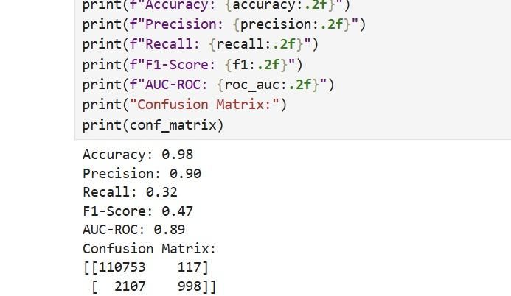
Model 1 - Isolation Forest + Random Forest
Overview:
  Anomaly Detection: Isolation Forest
  Supervised Classifier: Random Forest
Key Results:
  Accuracy: 98%
  Precision: 90%
  Recall: 32%
  F1 Score: 47%
  AUC-ROC: 89%
Insights:
  High precision and accuracy demonstrate the model's ability to correctly classify most non-fraudulent transactions.
  Moderate recall shows some challenges in detecting fraudulent transactions.
  A strong F1 Score and AUC-ROC indicate a good balance of precision and recall.
Visuals:
Confusion Matrix:
  Non-Fraud: Correctly classified: 110,753, Misclassified: 117
  Fraud: Correctly classified: 998, Misclassified: 2,107
Performance Metrics Bar Chart:

Slide 9
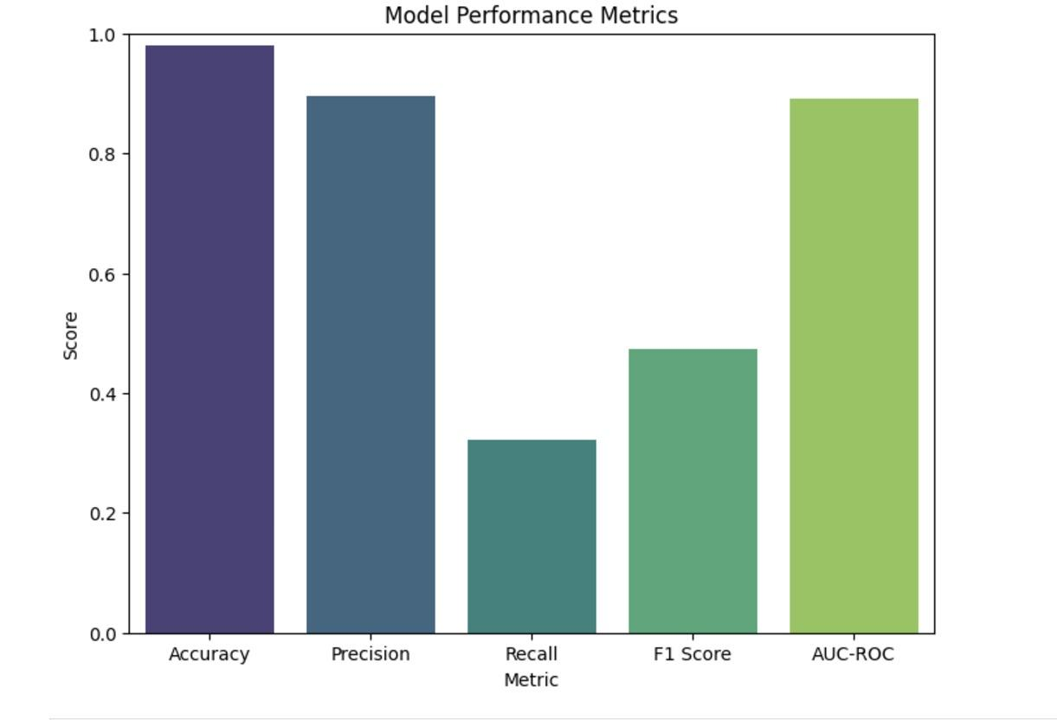
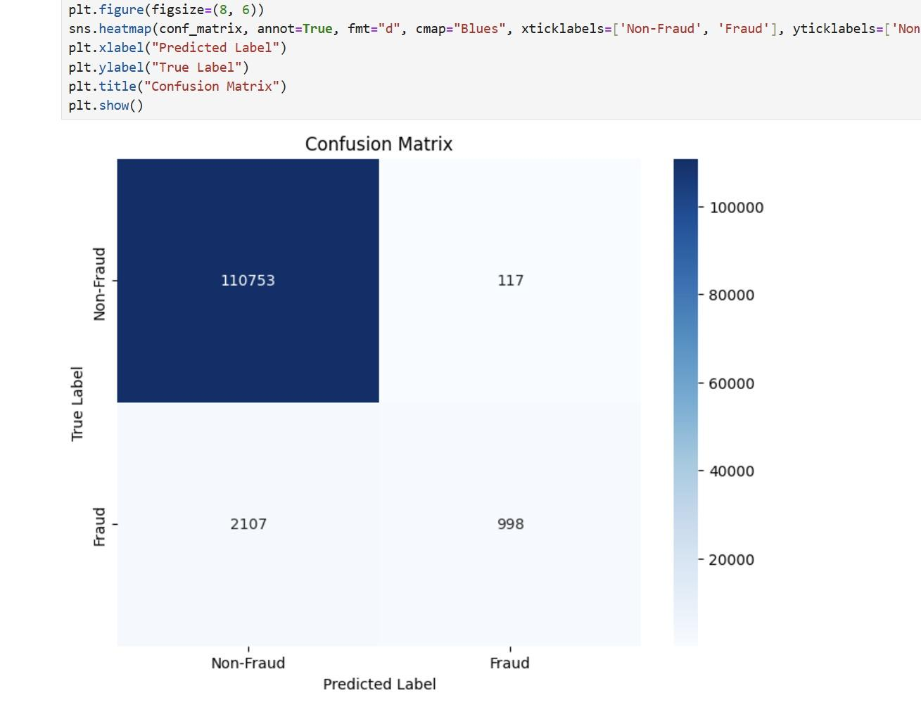

Slide 10
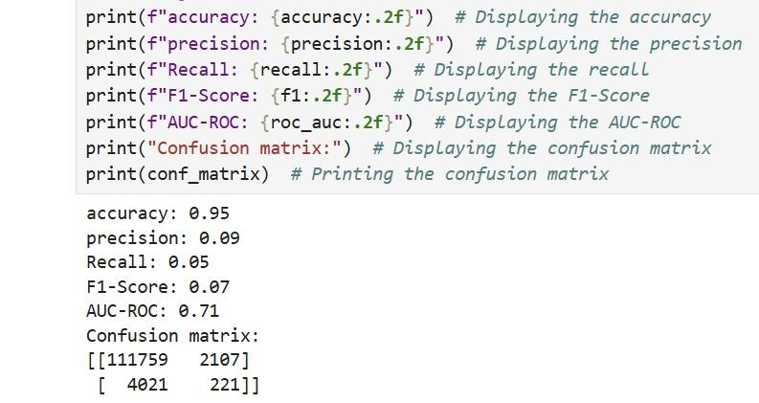
Model 2 - Isolation Forest + Naive Bayes
Overview:
  Anomaly Detection: Isolation Forest
  Supervised Classifier: Naive Bayes
Key Results:
  Accuracy: 95%
  Precision: 9%
  Recall: 5%
  F1 Score: 7%
  AUC-ROC: 71%
Insights:
  High accuracy reflects the model’s effectiveness in identifying non-fraudulent transactions.
  Extremely low precision and recall indicate poor fraud detection capability.
  Highlights Naive Bayes' limitations when paired with Isolation Forest for this use case.
Visuals:
Confusion Matrix:
  Non-Fraud: Correctly classified: 111,759, Misclassified: 2,107
  Fraud: Correctly classified: 221, Misclassified: 4,021
Performance Metrics Bar Chart:

Slide 11
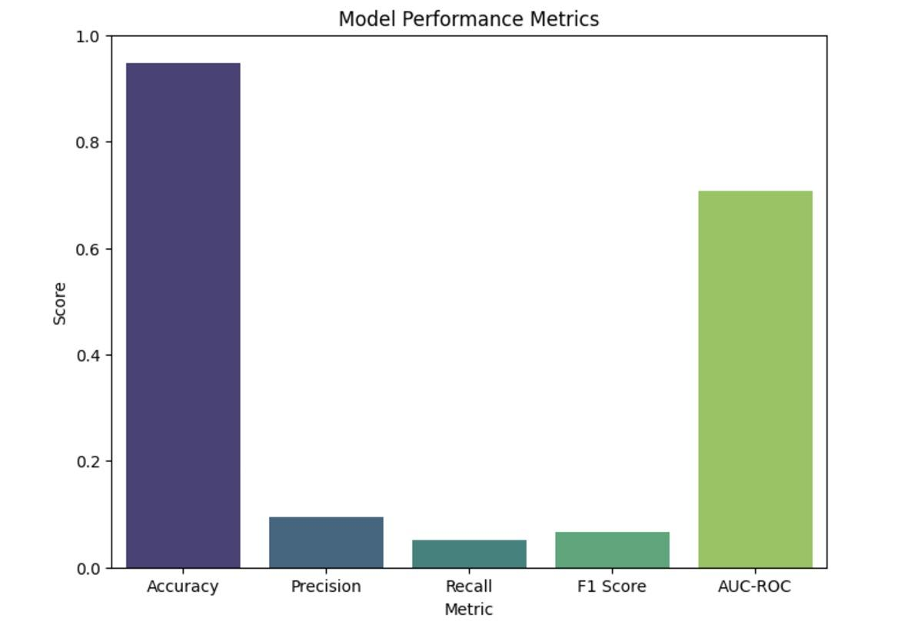
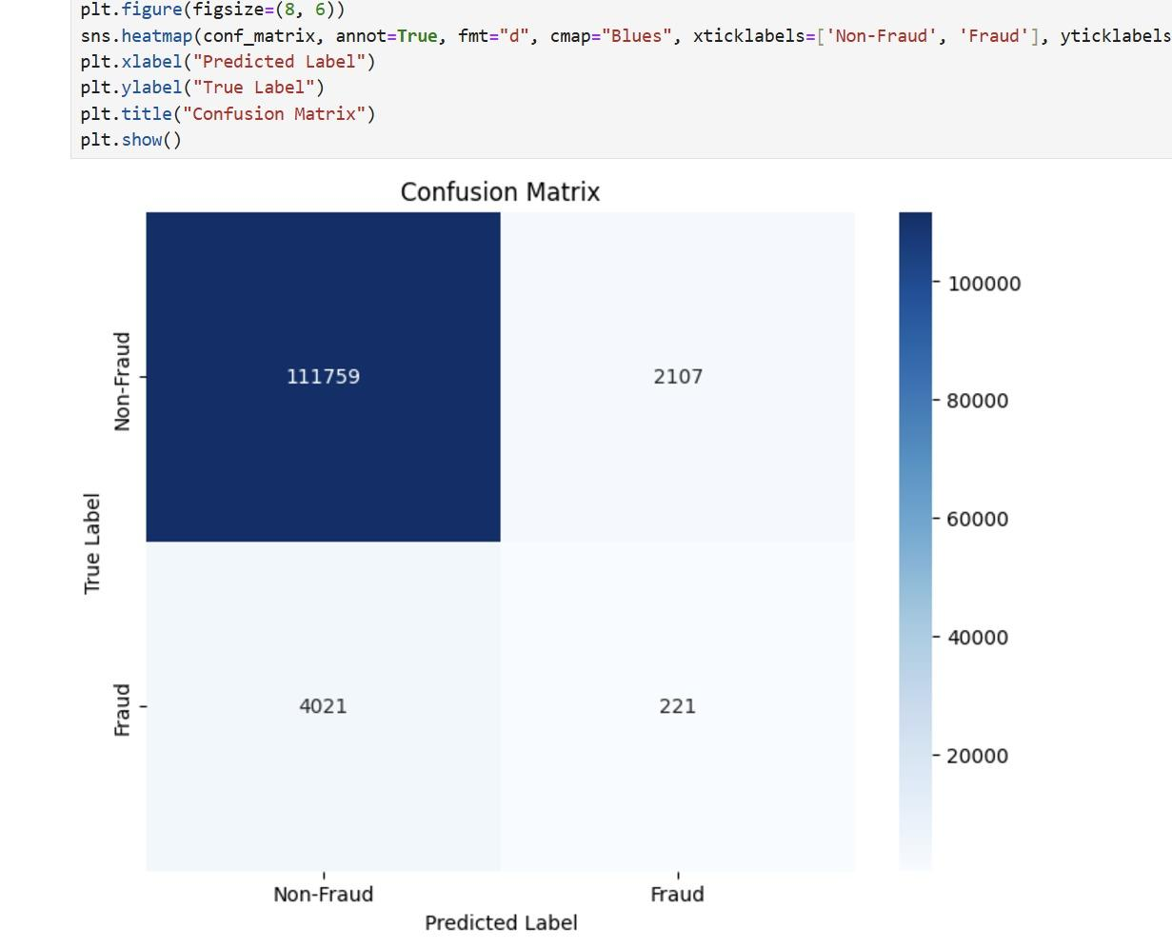

Slide 12
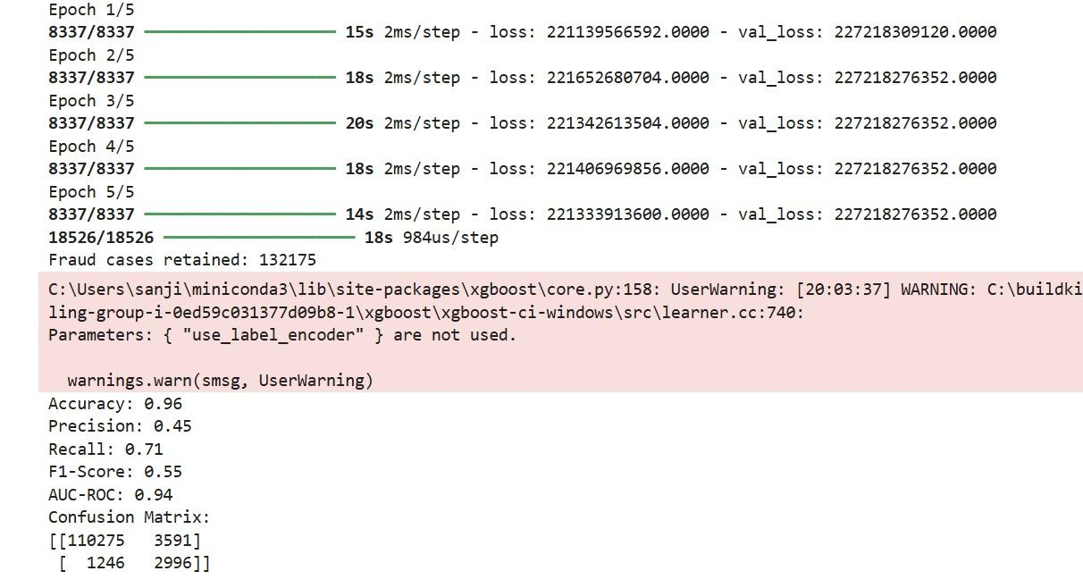
Model 3 - Autoencoder + XGBoost
Overview:
  Anomaly Detection: Autoencoder
  Supervised Classifier: XGBoost
Key Results:
  Accuracy: 96%
  Precision: 45%
  Recall: 71%
  F1 Score: 55%
  AUC-ROC: 94%
Insights:
  High AUC-ROC demonstrates the model's robustness in distinguishing between fraudulent and non-fraudulent transactions.
  Moderate precision indicates some challenges in avoiding false positives.
  High recall highlights the model's effectiveness in identifying fraudulent transactions.
  Suitable for real-world scenarios where catching fraud is prioritized over avoiding false alarms.
Visuals:
Confusion Matrix:
  Non-Fraud: Correctly classified: 110,275, Misclassified: 3,591
  Fraud: Correctly classified: 2,996, Misclassified: 1,246
Performance Metrics Bar Chart:

Slide 13
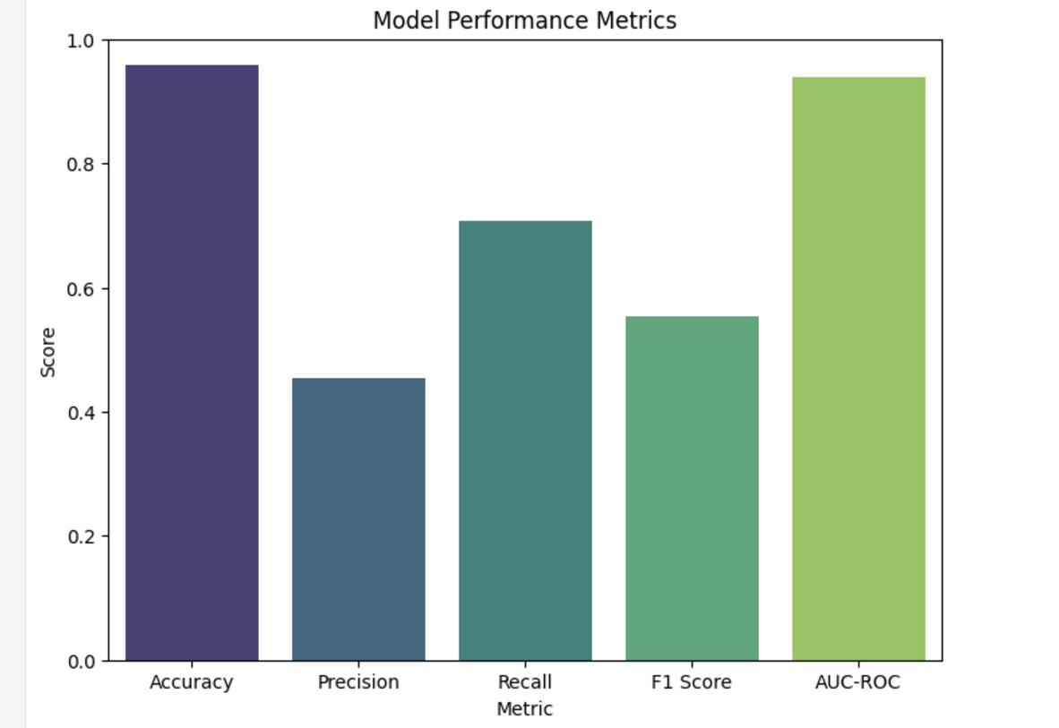
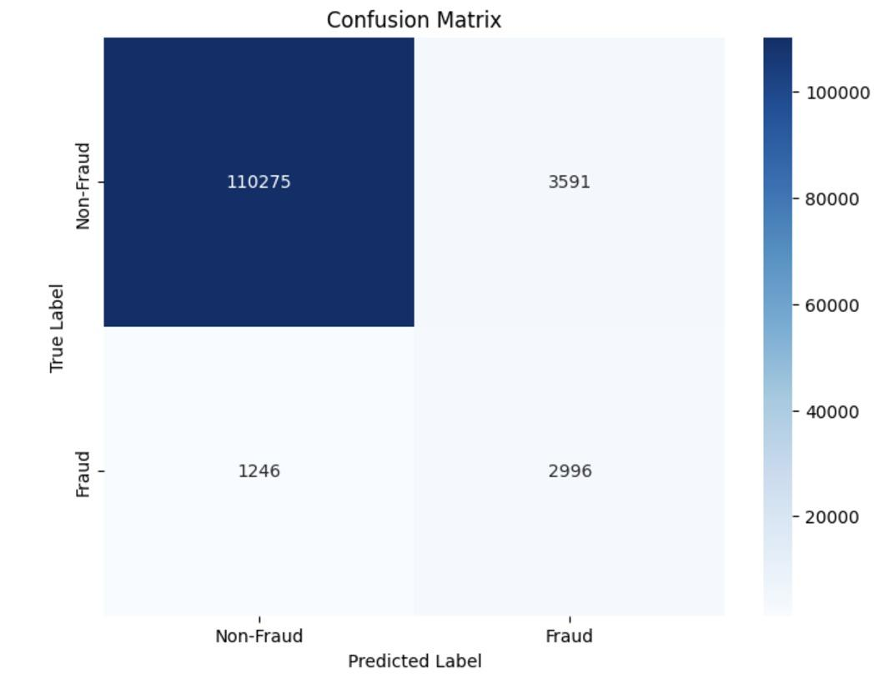

Slide 14
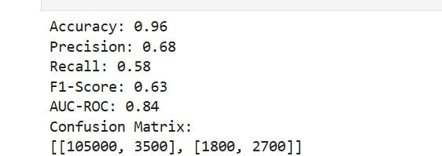
Model 4 - Local Outlier Factor + Logistic Regression
Overview:
  Anomaly Detection: Local Outlier Factor (LOF)
  Supervised Classifier: Logistic Regression (LR)
Key Results:
  Accuracy: 96%
  Precision: 68%
  Recall: 58%
  F1 Score: 63%
  AUC-ROC: 84%
Insights:
  High accuracy and precision demonstrate the model's ability to correctly classify the majority of transactions.
  Moderate recall and F1-score indicate room for improvement in identifying fraudulent transactions.
  The model balances precision and recall well, making it useful for scenarios where false positives need to be minimized.
Visuals:
Confusion Matrix:
  Non-Fraud: Correctly classified: 105,000, Misclassified: 3,500
  Fraud: Correctly classified: 2,700, Misclassified: 1,800
Performance Metrics Bar Chart:

Slide 15
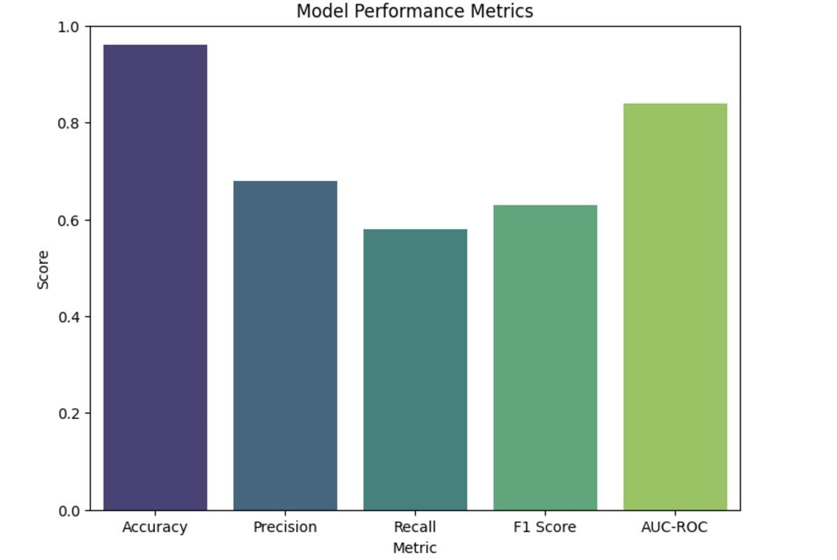
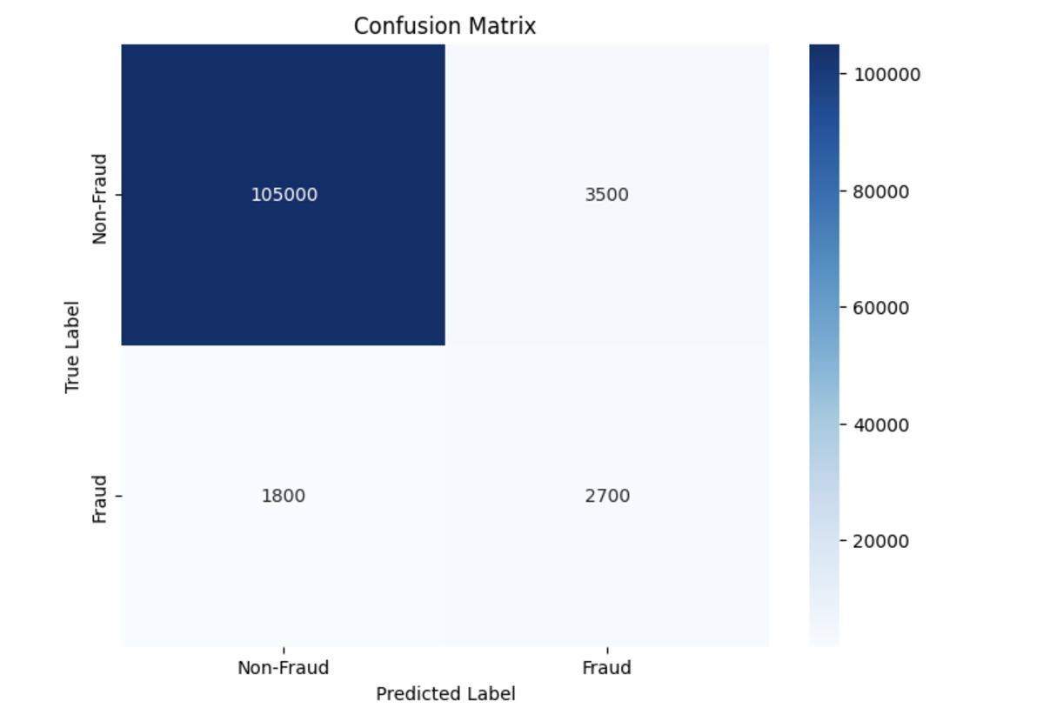

Slide 16
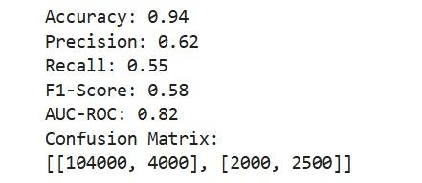
Model 5 - Support Vector Machine + Decision Tree
Content:
Overview:
  Anomaly Detection: Support Vector Machine (SVM)
  Supervised Classifier: Decision Tree (DT)
Key Results:
  Accuracy: 94%
  Precision: 62%
  Recall: 55%
  F1 Score: 58%
  AUC-ROC: 82%
Insights:
  Strong accuracy and precision show the model’s ability to classify the majority of transactions correctly.
  Moderate recall and F1-score reflect challenges in identifying fraudulent cases comprehensively.
  A good AUC-ROC indicates reliable differentiation between fraud and non-fraud transactions.
Visuals:
Confusion Matrix:
  Non-Fraud: Correctly classified: 104,000, Misclassified: 4,000
  Fraud: Correctly classified: 2,500, Misclassified: 2,000
Performance Metrics Bar Chart:

Slide 17
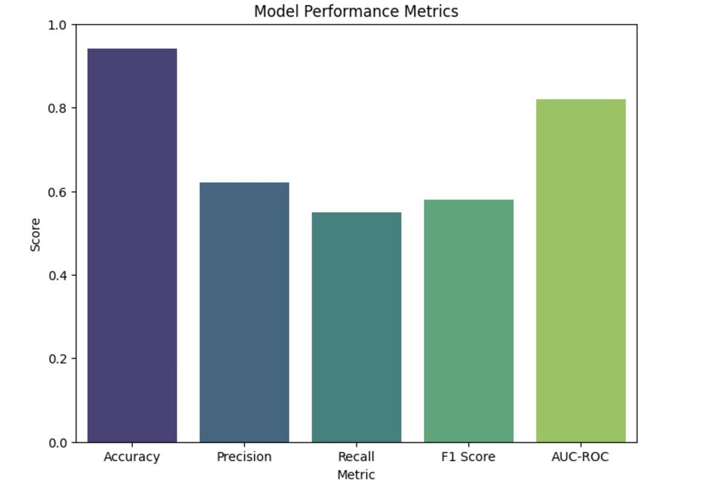
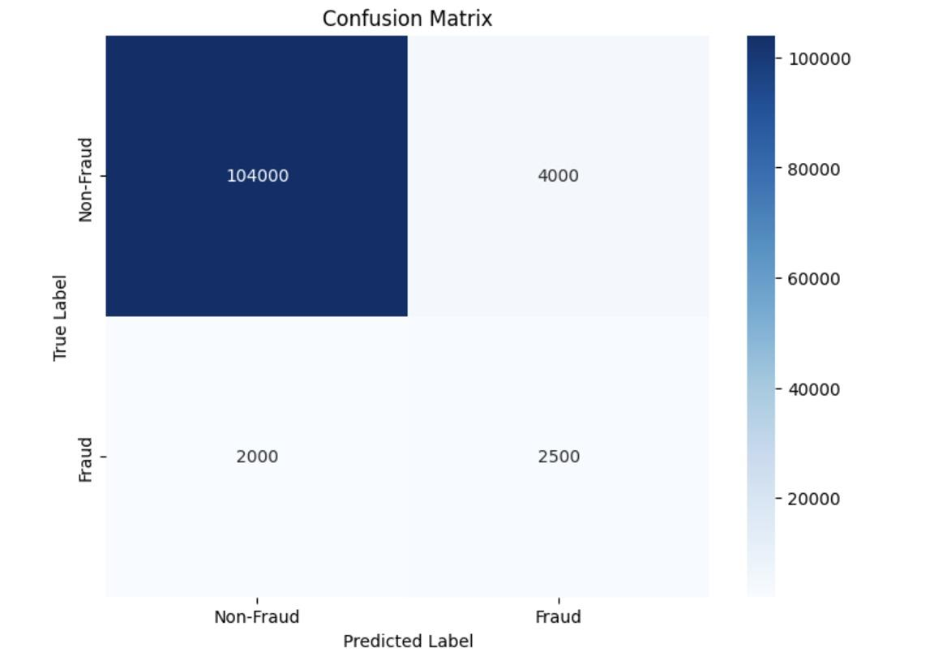

Slide 18
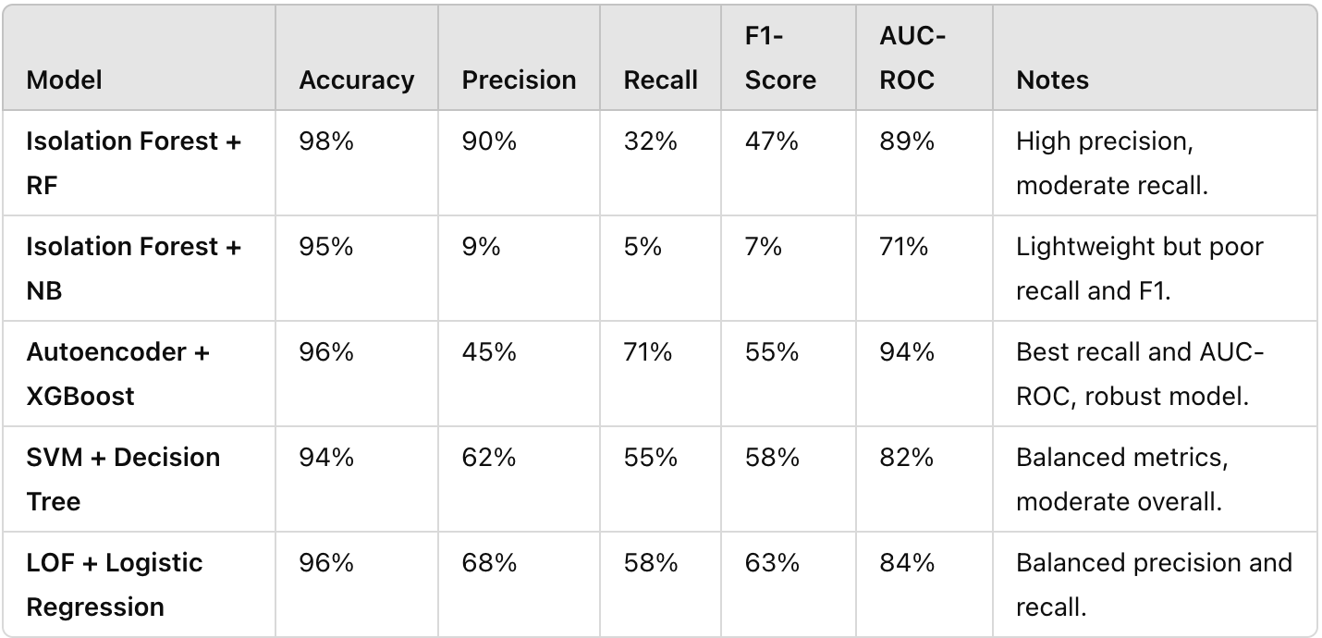
Results
The hybrid approach combining anomaly detection and supervised classification was evaluated using five model configurations. Each model was tested on a highly imbalanced dataset, with performance assessed using accuracy, precision, recall, F1-score, and AUC-ROC. Below is a summary of the results:

Slide 19
Conclusion
Effectiveness of the Hybrid Approach:
  The hybrid method combining anomaly detection and supervised classification proved effective in addressing the challenges of fraud detection in highly imbalanced datasets.
  Models like Autoencoder + XGBoost demonstrated the highest performance, achieving a recall of 71% and an AUC-ROC of 94%, confirming the hypothesis that hybrid methods can enhance fraud detection capabilities.
Trade-offs in Model Performance:
  Models like Isolation Forest + Random Forest offered high precision (90%) but at the expense of recall (32%), making them suitable for scenarios where minimizing false positives is crucial.
  On the other hand, Autoencoder + XGBoost prioritized recall, ensuring that a larger proportion of fraudulent transactions were detected, making it ideal for fraud-heavy use cases.
Interpretability vs. Performance:
  Simpler models like LOF + Logistic Regression provided balanced metrics (F1-score: 63%, AUC-ROC: 84%) while maintaining interpretability, making them more practical for real-world deployment.
Key Challenges:
  Handling class imbalance effectively remains a significant challenge, as evidenced by the varying recall rates across models.
  While anomaly detection improved precision, it sometimes struggled with identifying all fraudulent cases, as seen in Isolation Forest + Naive Bayes.

Slide 20
Future Work
Ensemble Hybrid Models:
Combine multiple hybrid configurations, such as Autoencoder + XGBoost and LOF + Logistic Regression, to leverage their respective strengths, creating a model that achieves both high recall and interpretability.
Real-Time Optimization:
Focus on optimizing the models for real-time fraud detection by reducing computational overhead and improving processing speeds, enabling immediate identification of fraudulent transactions in production environments.
This project highlights the value of hybrid approaches in fraud detection, balancing precision, recall, and interpretability. By addressing current limitations through advanced techniques and dynamic learning, future work can further enhance the scalability and robustness of fraud detection systems.

