Slide 1
MINI PROJECT
Name | Meghana D Duttargi Sanjith R Prajwal K V
Registration Numbers | 241059042 | 241059044 | 241059047
Branch | ME in Cyber Security
Project Title | Secure Code Chatbot For C
Guide | Mrs. Keerthana B K Mr. Satyanarayan Shenoy Mr. Ankith

Slide 2
CONTENTS
Introduction
Objective
Literature Review
Operational Flow
Functional Requirements
Work Done
Results
Future Implementation
References

Slide 3
INTRODUCTION
C offers speed and versatility, but without careful coding, it opens doors to vulnerabilities like buffer overflows and memory mismanagement.
Buffer overflows and pointer errors can lead to major security breaches, making secure coding essential in C development.
A smart tool that helps developers detect vulnerabilities and apply best practices, ensuring safer, more secure C code with real-time feedback.

Slide 4
OBJECTIVE
Implement static analysis techniques (data flow, control flow) for vulnerability detection.
Incorporate tools such as GCC, Clang, Flawfinder, Splint.
Address challenges like false positives and scalability.
Develop an interactive chatbot to help developers detect security vulnerabilities in C code.
Provide secure coding best practices and explore machine learning-based enhancements

Slide 5
LITERATURE REVIEW
No | Name of the paper | Tools Used | Method | Parameters
1 | A Comparative Study of Static Code Analysis tools for Vulnerability Detection in C/C++ and JAVA Source Cod | Flawfinder , RATS CPPCheck , CPPCheck , PMD | Static Code Analysis , Juliet Test Suite , APACHE Tomcat | Categories (CWE Categories) , Ratio (Detection Ratio) , Accuracy (False Positives)
2 | A Comparison of Static Analysis Tools for Vulnerability Detection in C/C++ Code | Static Code Analysis - Juliet Test Suite Apache Tomcat - | Static Code Analysis , Juliet Test Suite , Juliet Test Suite | Categories – CWE vulnerability types. Ratio - Vulnerability detection rate. Accuracy - Measures false positives.

Slide 6
No | Name of the paper | Tools Used | Method | Parameters
3 | Beg Bunch – Benchmarking for C Bug Detection Tools | BegBunch Parfait, Splint, Clang Static Analyzer, UNO | Accuracy Suite, Scalability Suite | Precision: True positives Recall: True positives Accuracy:-measure balancing Scalability: Build and analysis time across codebases.
4 | An Empirical Evaluation of GitHub Copilot’s Code Suggestions | GitHub Copilot, LeetCode , SonarQube | Correctness Testing, Understandability Assessment | Correctness: Test case pass rate on LeetCode. Understandability: Measured by cognitive and cyclomatic complexity (via SonarQube). 4o

Slide 7
OPERATIONAL FLOW
Start
Greet User
User Uploads C Code
Secure Chat Bot Workflow
Analysis of Code(Cppcheck)
Identify Vulnerabilities
Provide Feedback and suggestion
End

Slide 8
FUNCTIONAL REQUIREMENTS
Software Requirements
Programming Language : Python
Operating System : Windows 7 and above
IDE : PyCharm
Libraries and Frameworks: tkinter (for GUI),,Cppcheck
Hardware Requirements
Processor : Core i3 and later versions
RAM : 4GB and above
Hard Disk : 500GB

Slide 9
IMPLEMENTATION
Front-End:
Tkinter GUI: Allows easy C code upload.
Interactive Console: Greets users and performs code analysis.
Error Highlighting: Displays results and highlights errors in the code.
Back-End:
Cppcheck Integration: Analyzes the code for issues.
Vulnerability Detection: Identifies buffer overflows and other vulnerabilities.

Slide 10
WORK DONE
GUI: Built a Tkinter interface for chatbot interaction and C code analysis.
File Upload: Added file selection and validation for C files.
Vulnerability Detection: Used regex to identify common security flaws (e.g., unsafe functions, buffer overflows).
Code Display: Highlighted vulnerabilities in uploaded code with detailed analysis.
Chatbot Interaction: Guided users through file upload and analysis with timed messages.
User Flow: Enabled starting new conversations and re-analyzing code.

Slide 11
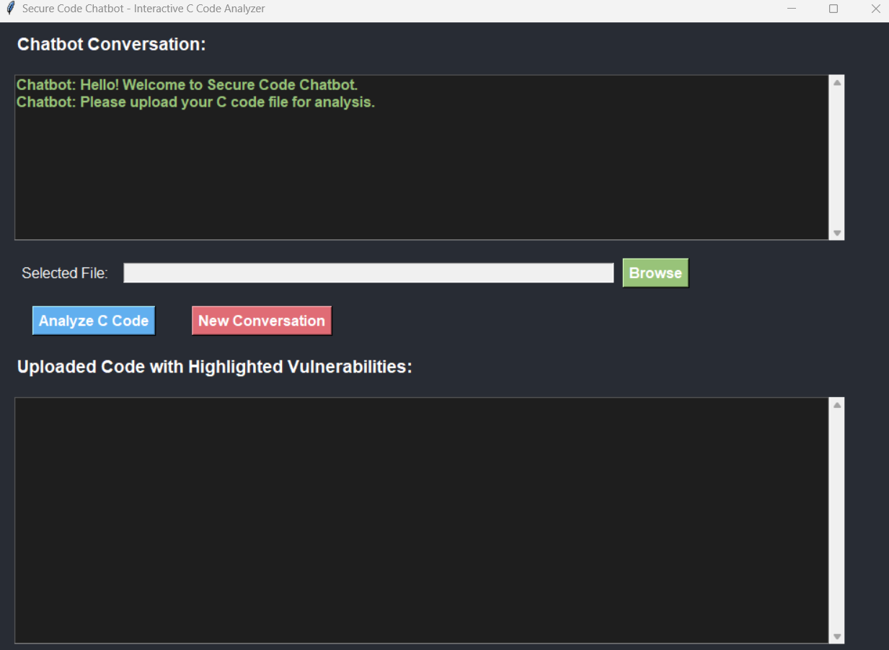
RESULTS
Fig 7.1 -

Slide 12
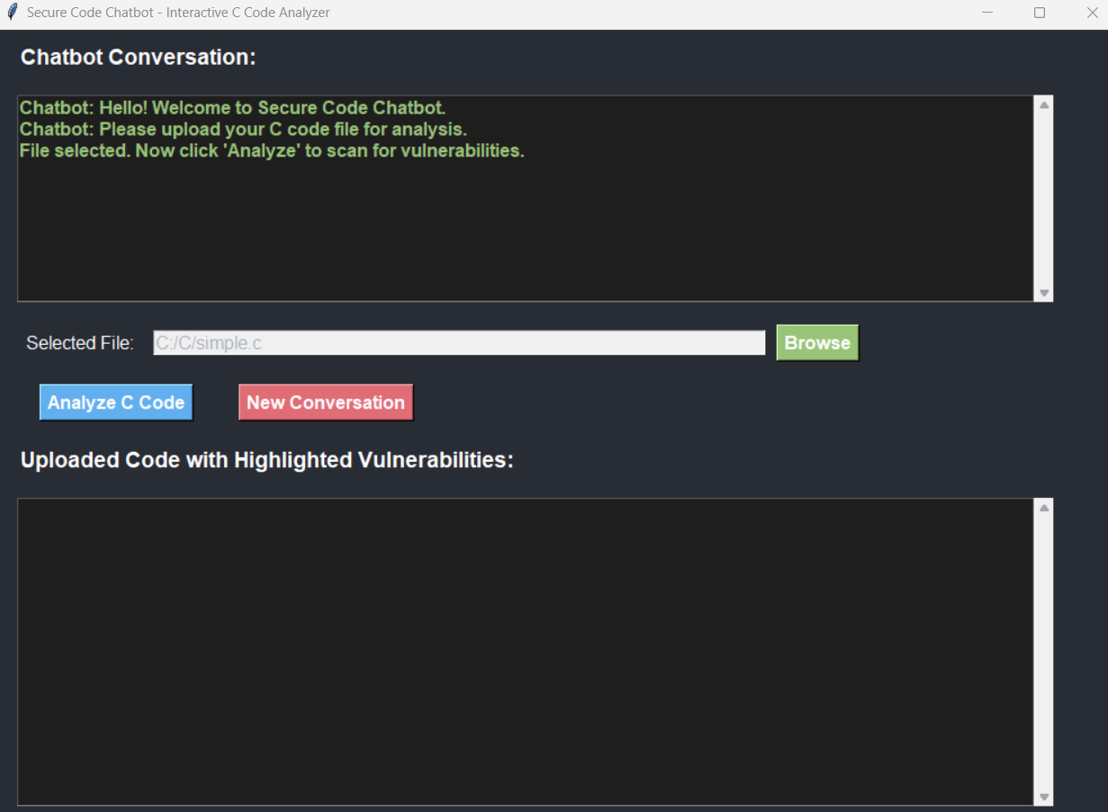
RESULTS
Fig 7.2 -

Slide 13
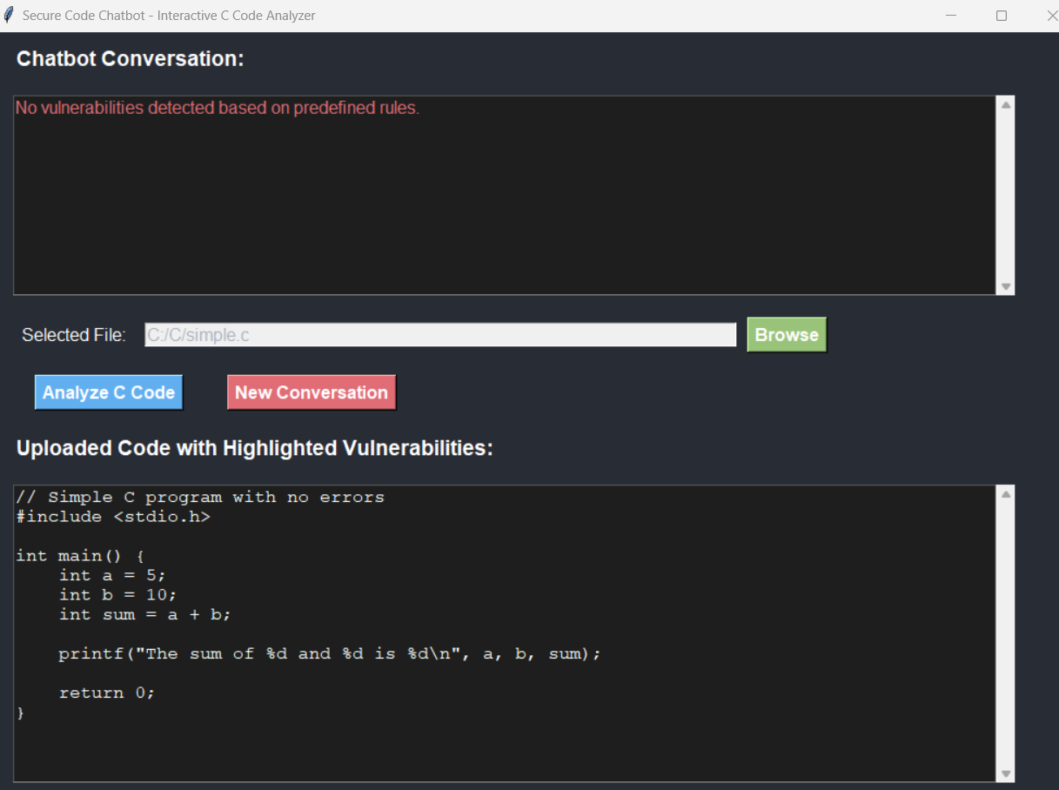
RESULTS
Fig 7.3 -

Slide 14
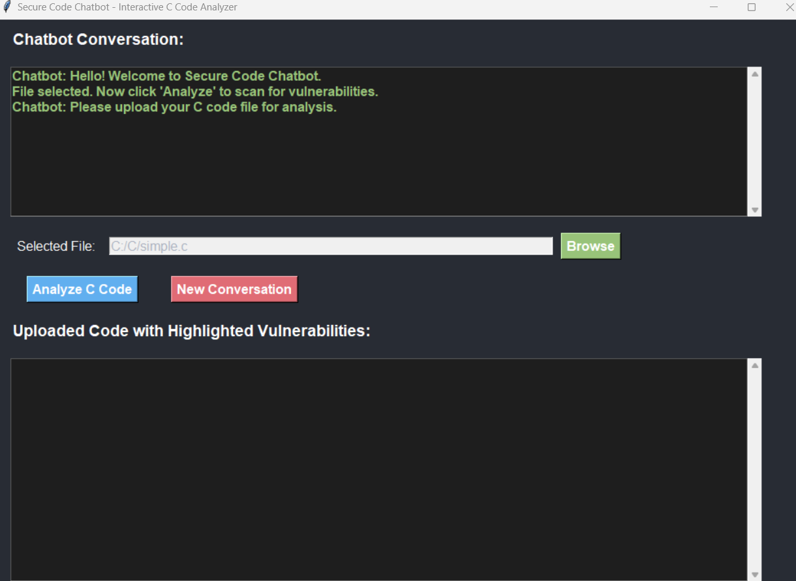
RESULTS
Fig 7.4 -

Slide 15
WORK DONE
GUI: Built a Tkinter interface for chatbot interaction and C code analysis.
File Upload: Added file selection and validation for C files.
Vulnerability Detection: Used regex to identify common security flaws (e.g., unsafe functions, buffer overflows).
Code Display: Highlighted vulnerabilities in uploaded code with detailed analysis.
Chatbot Interaction: Guided users through file upload and analysis with timed messages.
User Flow: Enabled starting new conversations and re-analyzing code.

Slide 16
WORK DONE
GUI: Built a Tkinter interface for chatbot interaction and C code analysis.
File Upload: Added file selection and validation for C files.
Vulnerability Detection: Used regex to identify common security flaws (e.g., unsafe functions, buffer overflows).
Code Display: Highlighted vulnerabilities in uploaded code with detailed analysis.
Chatbot Interaction: Guided users through file upload and analysis with timed messages.
User Flow: Enabled starting new conversations and re-analyzing code.

Slide 17
REFERENCES
A Comparison of Static Analysis Tools for Vulnerability Detection in C/C++ Code (Andrei Arusoaie et al.)
An Empirical Evaluation of GitHub Copilot’s Code Suggestion (Nhan Nguyen & Sarah Nadi ,2022)
A Comparative Study of Static Code Analysis tools for Vulnerability Detection in C/C++ and JAVA Source Code ( Arvinder Kaura & Ruchikaa Nayyar)
BegBunch – Benchmarking for C Bug Detection Tools (Cristina Cifuentes, Christian Hoermann et al.)
A Comparative Study of Static Analysis Tools for Vulnerability Detection in C Code" by S. K. Goyal et al. (2019)
Program Dependence Learning (Aashish Yadavally and Tien N. Nguyen

Slide 18
THANK YOU

