Slide 1
Experiment-8,9
Interface Ultrasonic sensor with Raspberry Pi (Integrate ultrasonic sensor to LED output)
Identify the MQ2 sensor output through the buzzer

Slide 2
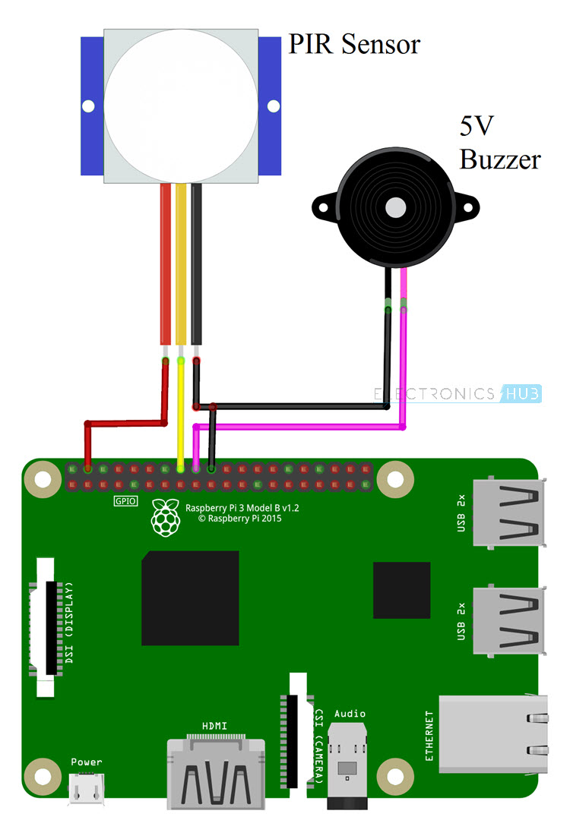
Interfacing Buzzer with Raspberry Pi 4
import RPi.GPIO as GPIO
import time
# Set GPIO mode
GPIO.setmode(GPIO.BOARD)
# Set the pin numbers for PIR sensor and buzzer
pir_pin = 17
buzzer_pin = 18
# Setup PIR pin as input
GPIO.setup(pir_pin, GPIO.IN)
# Setup buzzer pin as output
GPIO.setup(buzzer_pin, GPIO.OUT)
try:
print("PIR Module Test (CTRL+C to exit)")
time.sleep(2) # Allow sensor to settle
print("Ready")
while True:
if GPIO.input(pir_pin): # Check if motion is detected
print("Motion detected!")
GPIO.output(buzzer_pin, GPIO.HIGH) # Activate the buzzer
time.sleep(1) # Sound the buzzer for 1 second
GPIO.output(buzzer_pin, GPIO.LOW) # Deactivate the buzzer
else:
print("No motion detected")
time.sleep(0.1) # Check for motion every 0.1 second
except KeyboardInterrupt:
pass
GPIO.cleanup()

Slide 3
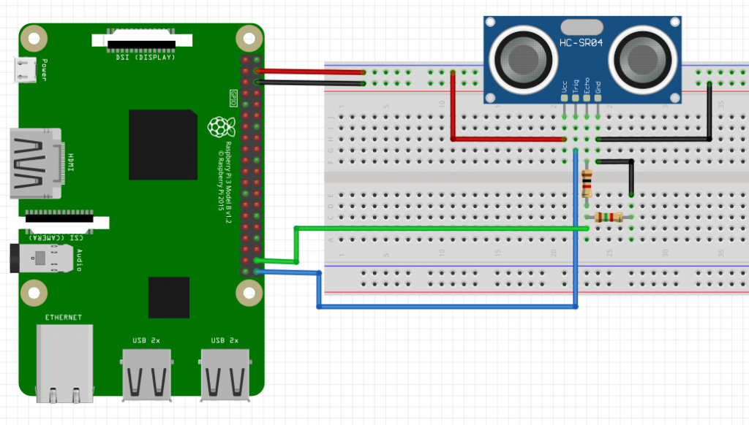
Interfacing Ultrasonic Sensor with Raspberry Pi 4
import RPi.GPIO as GPIO
import time
# Set GPIO mode
GPIO.setmode(GPIO.BOARD)
# Set the pin numbers for the ultrasonic sensor
trigger_pin = 23
echo_pin = 24
# Setup ultrasonic sensor pins
GPIO.setup(trigger_pin, GPIO.OUT)
GPIO.setup(echo_pin, GPIO.IN)
try:
while True:
# Send a pulse to trigger the ultrasonic sensor
GPIO.output(trigger_pin, GPIO.HIGH)
time.sleep(0.00001)
GPIO.output(trigger_pin, GPIO.LOW)
# Wait for the echo pin to go high
while GPIO.input(echo_pin) == 0:
pulse_start_time = time.time()
# Wait for the echo pin to go low
while GPIO.input(echo_pin) == 1:
pulse_end_time = time.time()
# Calculate pulse duration
pulse_duration = pulse_end_time - pulse_start_time
# Calculate distance in centimeters
distance = pulse_duration * 17150
distance = round(distance, 2)
print("Distance:", distance, "cm")
time.sleep(1)
except KeyboardInterrupt:
pass
GPIO.cleanup()

Slide 4
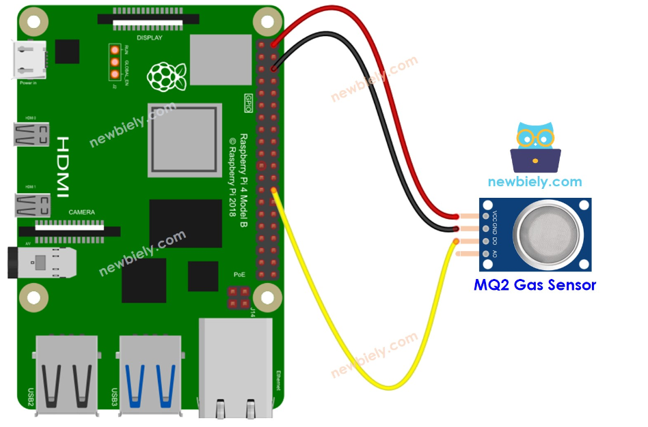
Interfacing Gas Sensor (MQ2) with Raspberry Pi 4
import RPi.GPIO as GPIO
import time
# Set up the GPIO mode
GPIO.setmode(GPIO.BCM)
# Set up the GPIO pin for reading the DO output
DO_PIN = 7 # Replace with the actual GPIO pin number
GPIO.setup(DO_PIN, GPIO.IN)
try:
while True:
# Read the state of the DO pin
gas_present = GPIO.input(DO_PIN)
# Determine if gas is present or not
if gas_present == GPIO.LOW:
gas_state = "Gas Present"
else:
gas_state = "No Gas"
# Print the gas state
print(f"Gas State: {gas_state}")
time.sleep(0.5) # Wait for a short period before reading again
except KeyboardInterrupt:
print("Gas detection stopped by user")
finally:
# Clean up GPIO settings
GPIO.cleanup()

