Slide 1


Bank of Baroda Hackathon - 2022
Date : 20-09-2022
Technology Partner
Your Team Name : Zizzle Stark
Your team bio: The main vision is to implement the advanced ML techniques to bring the best of the best solution.
Team member names :
Sanjjushri Varshini R
Madhushree T
Yoga Priya K
Priyadharshini R

Slide 2
Problem Statement?
Why did you decide to solve this Problem statement?
Problem chosen: Call Center Analytics
Call Center Analytics is one of the crucial issues in our daily life, that include use of complex ML tools.
Dealing with audio data is interesting.
This problem requires a solution to provide text output to the audio which contains many languages in a single recording (majorly for Indian languages), which does not have a existing solution with better results.
Working with unstructured data is a task of learning to the next level.
This solution will not only help the bank but also the people who are struggling to communicate in non-native language.

Slide 3
User Segment & Pain Points
Which user /advertiser segment would be early adopter of your product & why?
The bank and the user will both be our product's early adopters.
The product will assist the bank in better comprehending the demands of its consumers.
With the solution, language will no longer be an obstacle to meeting client demands, and the bank can focus on areas that genuinely call for change.
Bank can increase satisfaction, efficiency and revenue customer services.
Due to the rapid satisfaction of their demands and inquiries, this will directly benefit the consumers.

Slide 4
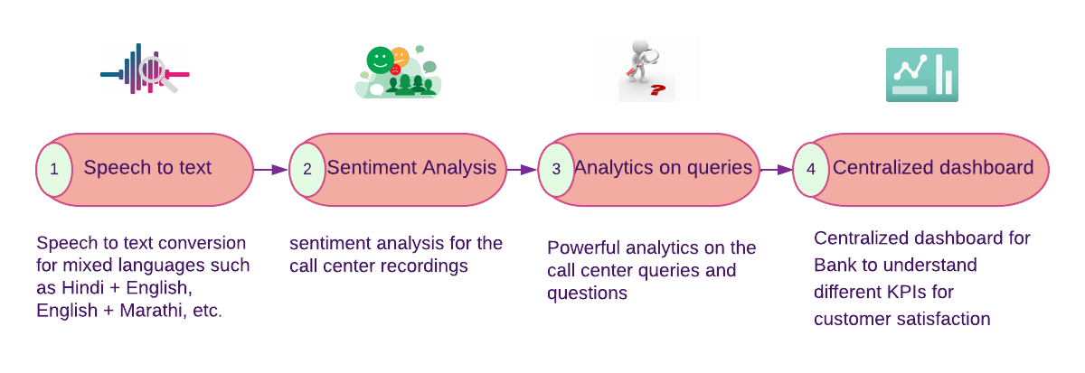
Pre-Requisite
What are the alternatives/competitive products for the problem you are solving?
Some of the voice analytics alternatives are CloudTalk, Five9, Talkdesk, Mediafly Coach360 (formerly ExecVision), NICE CXone, Genesys Cloud CX, Observe.AI and Infinity Call Tracking.
There are platforms such as knowlarity that provide a programmable speech analytics platform for improved Business Intelligence services like ready-to-use Speech Analytics with multilingual support.
Fig 1 . Prerequisite /requirements for Call center analytics

Slide 5
Azure tools or resources
Azure tools or resources which are likely to be used by you for the prototype, if your idea gets selected
Speech to text
Azure Pipelines
Speech translation
Azure Cloud Shell – dashboard
Azure Databricks – Analytics services
Azure Cognitive Service – language detection

Slide 6
Any Supporting Functional Documents
Our Solution:
Firstly, the recorded calls of bilingual Indian languages are converted into unilingual text of bank’s choice.
Then Sentimental analysis is provided for the text converted which may be in any unilingual Indian languages and classifies the user needs, new queries that are needed for customer.
The Dashboard is created with result and analytics obtained from the previous step, it has various features such as call data quality, customer satisfaction, call hygiene and unique queries from customer which helps the bank to improve their services.
Dashboard also achieves in providing better understanding about the customer queries and how far the answer reaches and helps them.

Slide 7
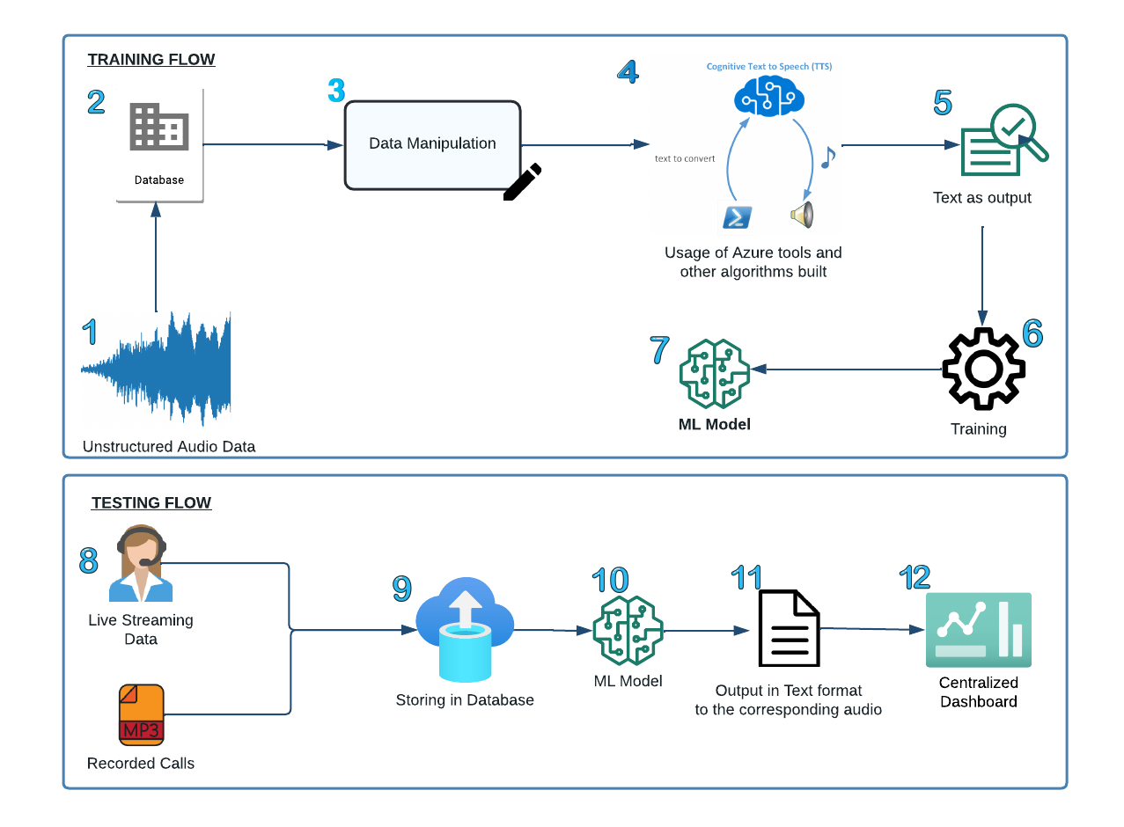
Methodology

Slide 8
TRAINING FLOW:
Raw Data: The audio data of call recording
Database: The data is stored in the database
Data Preprocessing: The data is being processed to detect and reduce unwanted noice
Tools: Azure tools as well the tools and algorithm created is explicitly employed
Output: The output is received in the text format i.e., Audio → Text
Training: The training of the Machine Learning model is performed
Model: The model generated is stored and used for live data as well for recorded audio calls
TESTING FLOW:
8. Data : The data can be live streaming or recorded one.
9. Database : The stored data is retrieved from the database.
10. ML Model : The new testing data is given to the model for further analysis.
11. Output : The text format of the corresponding audio is displayed in the preferred language.
12. Dashboard : Centralized dashboard for Bank to understand different KPIs for customer satisfaction

Slide 9
Key Differentiators & Adoption Plan
How is your solution better than alternatives and how do you plan to build adoption?
We are developing a solution that will offer mixed language call analysis, in addition to multilingual support offered by other voice analytics platforms.
Our conversion of voice recordings to text is more accurate .
This tool helps the bank pinpoint the problems of regular customers.
By providing sentiment analysis for text format speech data, we help banks gain better business insights and increase customer satisfaction.

Slide 10
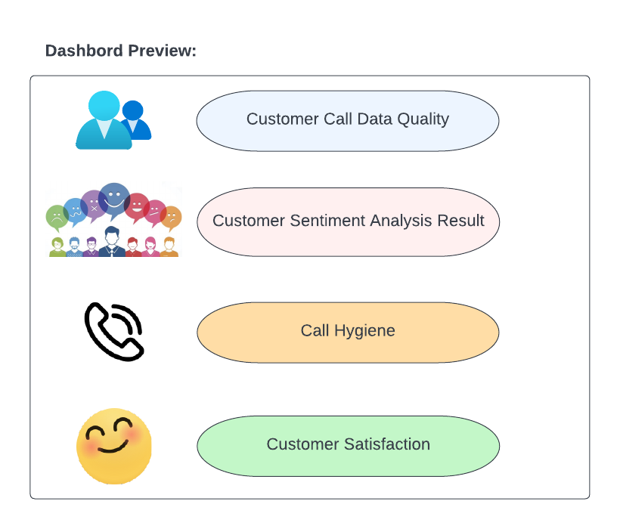
GitHub Repository Link & supporting diagrams, screenshots, if any
How far it can go?
Our idea is practical and economically scalable for the banks rather than going to an third party organisation for the results.
This platform is specifically dedicated to banks with unique qualities to analyse for improving their service which has best outcome.
The project enhances both customer and bank interaction , it’ll be the most optimum way for dealing this problem.

