Slide 1

Adaptive Quiz
AI-Powered Web Platform for Personalized Learning
Submitted by
Sanjna Rathour · UID: O24MCA11201
Project Guide
Vikas Kumar Atray
Master of Computer Applications (AI & ML) · Chandigarh University, Mohali · 2025–2026

Slide 2
Agenda
• Problem statement and motivation
• Project objectives and scope
• Technology stack and system architecture
• Design diagrams (DFD, Use Case, UML, ER, Sequence, Activity)
• Database schema and the adaptive engine
• AI tutor feedback and mid-attempt safety
• Two quiz-taking flows (adaptive vs linear)
• Testing, results, and how we compare
• Future scope and conclusion
Adaptive Quiz — AI-Powered Web Platform for Personalized Learning
2 / 22

Slide 3
The Problem
One-size-fits-all online quizzes punish slow learners and bore fast ones.
• Static quizzes show every student the same questions in the same order.
• Slow learners hit hard questions before they're ready and disengage.
• Fast learners breeze through easy questions and lose interest.
• Teachers get aggregate scores but no signal on per-student difficulty fit.
• Wrong answers receive no explanation — learning rarely happens at the moment of failure.
Adaptive Quiz — AI-Powered Web Platform for Personalized Learning
3 / 22

Slide 4
Objectives
• Build a web platform that personalises question difficulty in real time.
• Provide separate, role-aware experiences for students and teachers.
• Snapshot every attempt so mid-attempt teacher edits do not corrupt history.
• Generate AI-tutor feedback on wrong answers using Google Gemini.
• Expose per-student and per-quiz analytics with score distribution charts.
• Ship a containerised stack — FastAPI + React + PostgreSQL — runnable in one command.
Adaptive Quiz — AI-Powered Web Platform for Personalized Learning
4 / 22

Slide 5
Technology Stack
Backend
Frontend
• Python 3.11+ with FastAPI (REST + Swagger)
• SQLAlchemy 2.x — sync sessions, eager loads
• Alembic — 3 reversible migrations
• PostgreSQL 16 — UUID PKs, native ENUMs, partial unique indexes
• JWT auth — 15-min access + 7-day refresh tokens
• bcrypt 4.2.1 — password hashing
• Google Gemini (gemini-2.5-flash) — wrong-answer feedback
• pytest — 66 tests, 95% coverage
• React 18 + TypeScript (strict)
• Vite — instant HMR + production build
• Tailwind CSS v4 — utility-first styling
• TanStack Query v5 — server-state caching
• React Router v6 — role-guarded routes
• Headless UI + custom components
• Responsive across mobile / tablet / desktop
• Bundle ~270 KB (~81 KB gzipped)
Adaptive Quiz — AI-Powered Web Platform for Personalized Learning
5 / 22

Slide 6
System Architecture
React Client
FastAPI Backend
PostgreSQL + Gemini
TypeScript • Tailwind • TanStack Query
Responsive UI • Role-aware routing
→
JWT auth • REST + Swagger
Adaptive engine • Snapshot service
→
8 tables • 3 migrations
Background AI feedback (free tier)
Single docker-compose.yml orchestrates four services: frontend, backend, database, and (optionally) adminer.
Adaptive Quiz — AI-Powered Web Platform for Personalized Learning
6 / 22

Slide 7
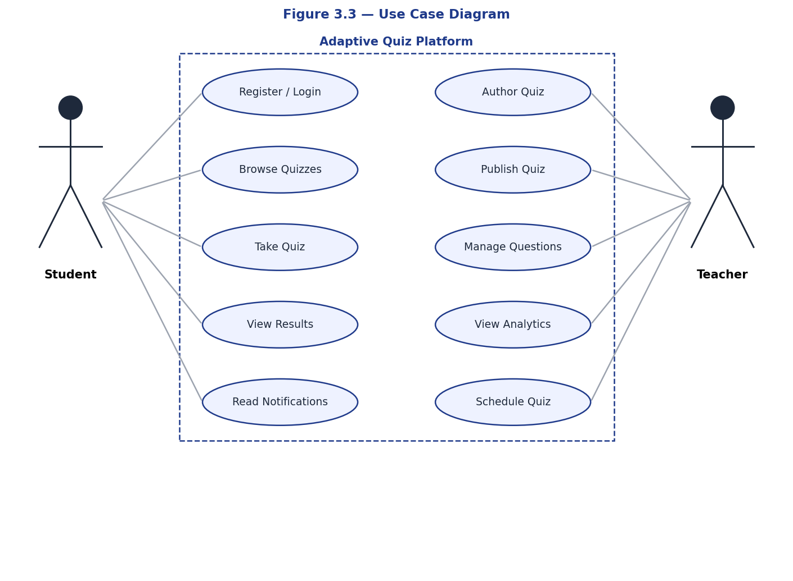
Use Case Diagram
Actors and capabilities
Adaptive Quiz — AI-Powered Web Platform for Personalized Learning
7 / 22

Slide 8
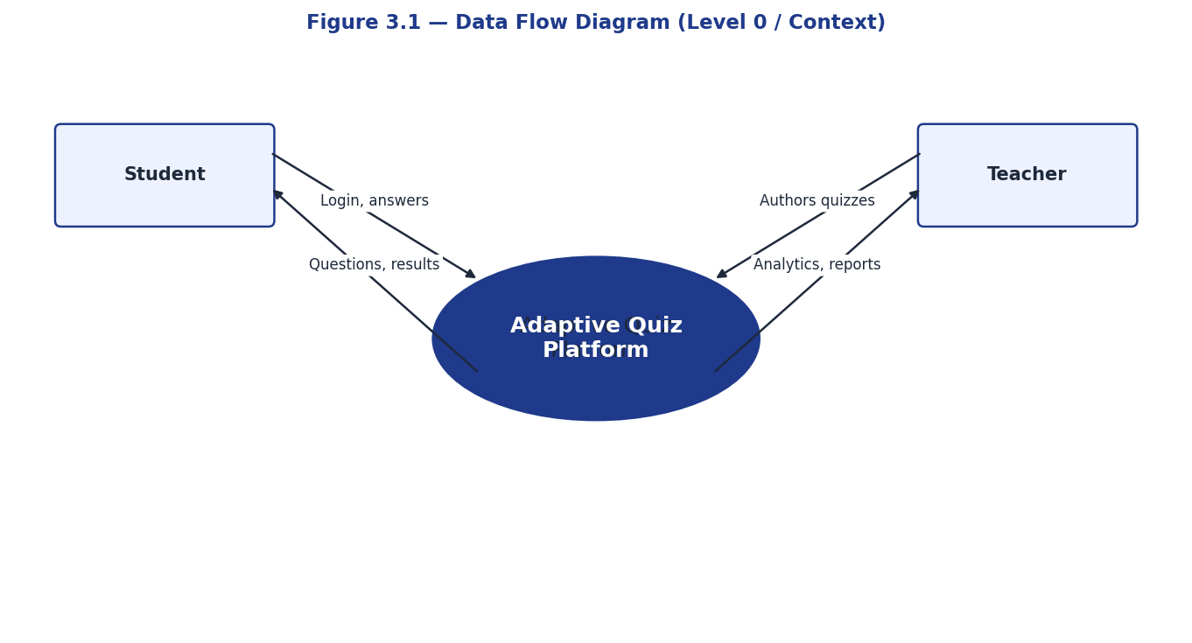
DFD — Level 0 (Context)
Adaptive Quiz Platform as a single system seen by external actors
Adaptive Quiz — AI-Powered Web Platform for Personalized Learning
8 / 22

Slide 9
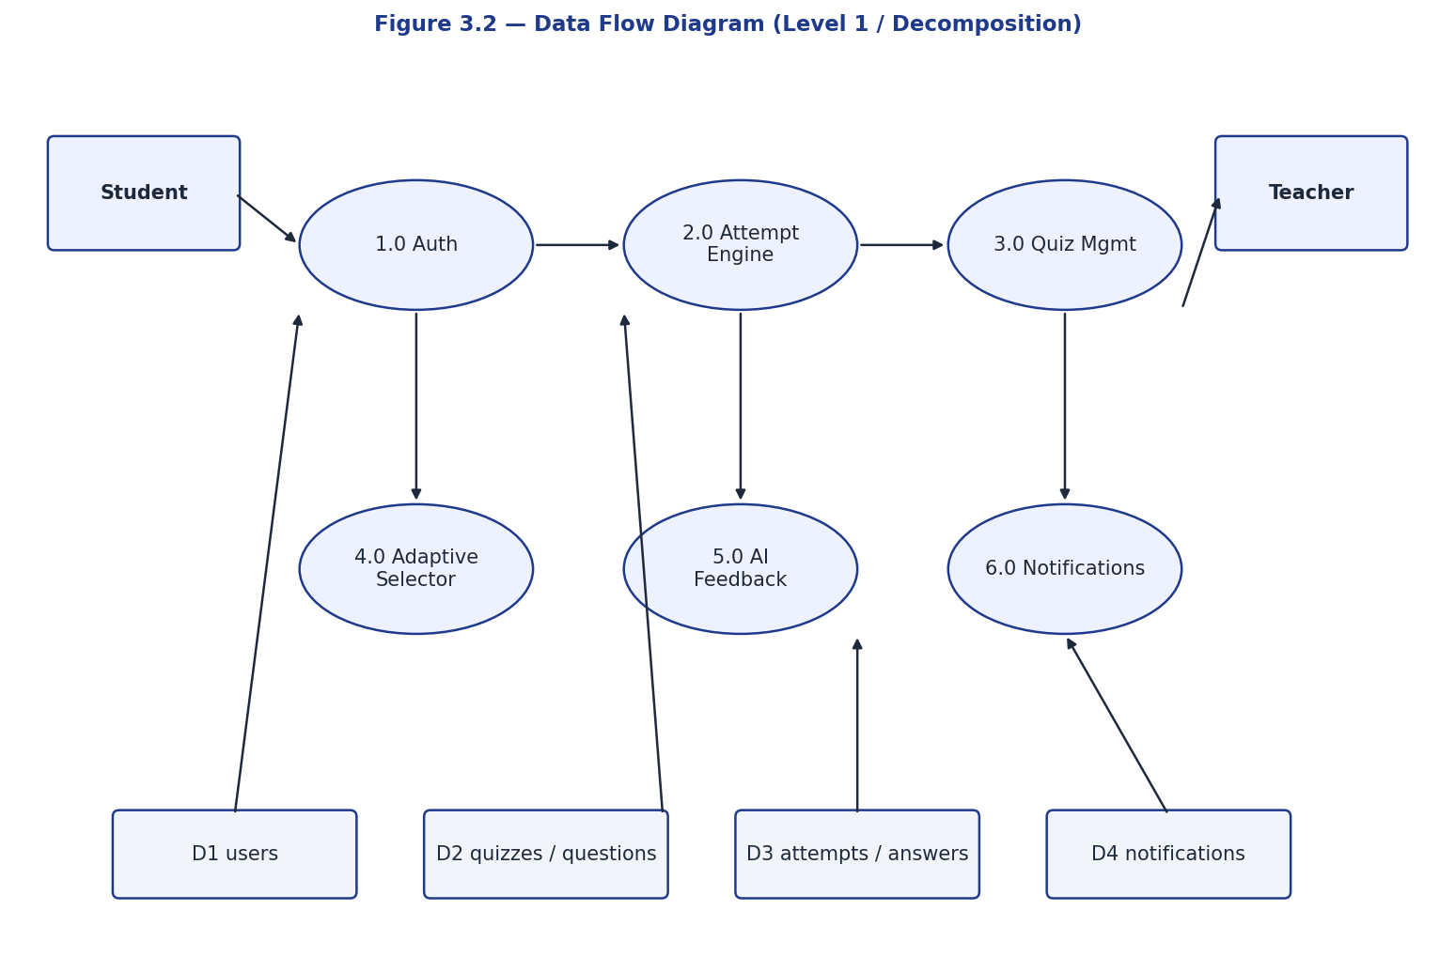
DFD — Level 1 (Decomposition)
Six internal processes and four data stores
Adaptive Quiz — AI-Powered Web Platform for Personalized Learning
9 / 22

Slide 10
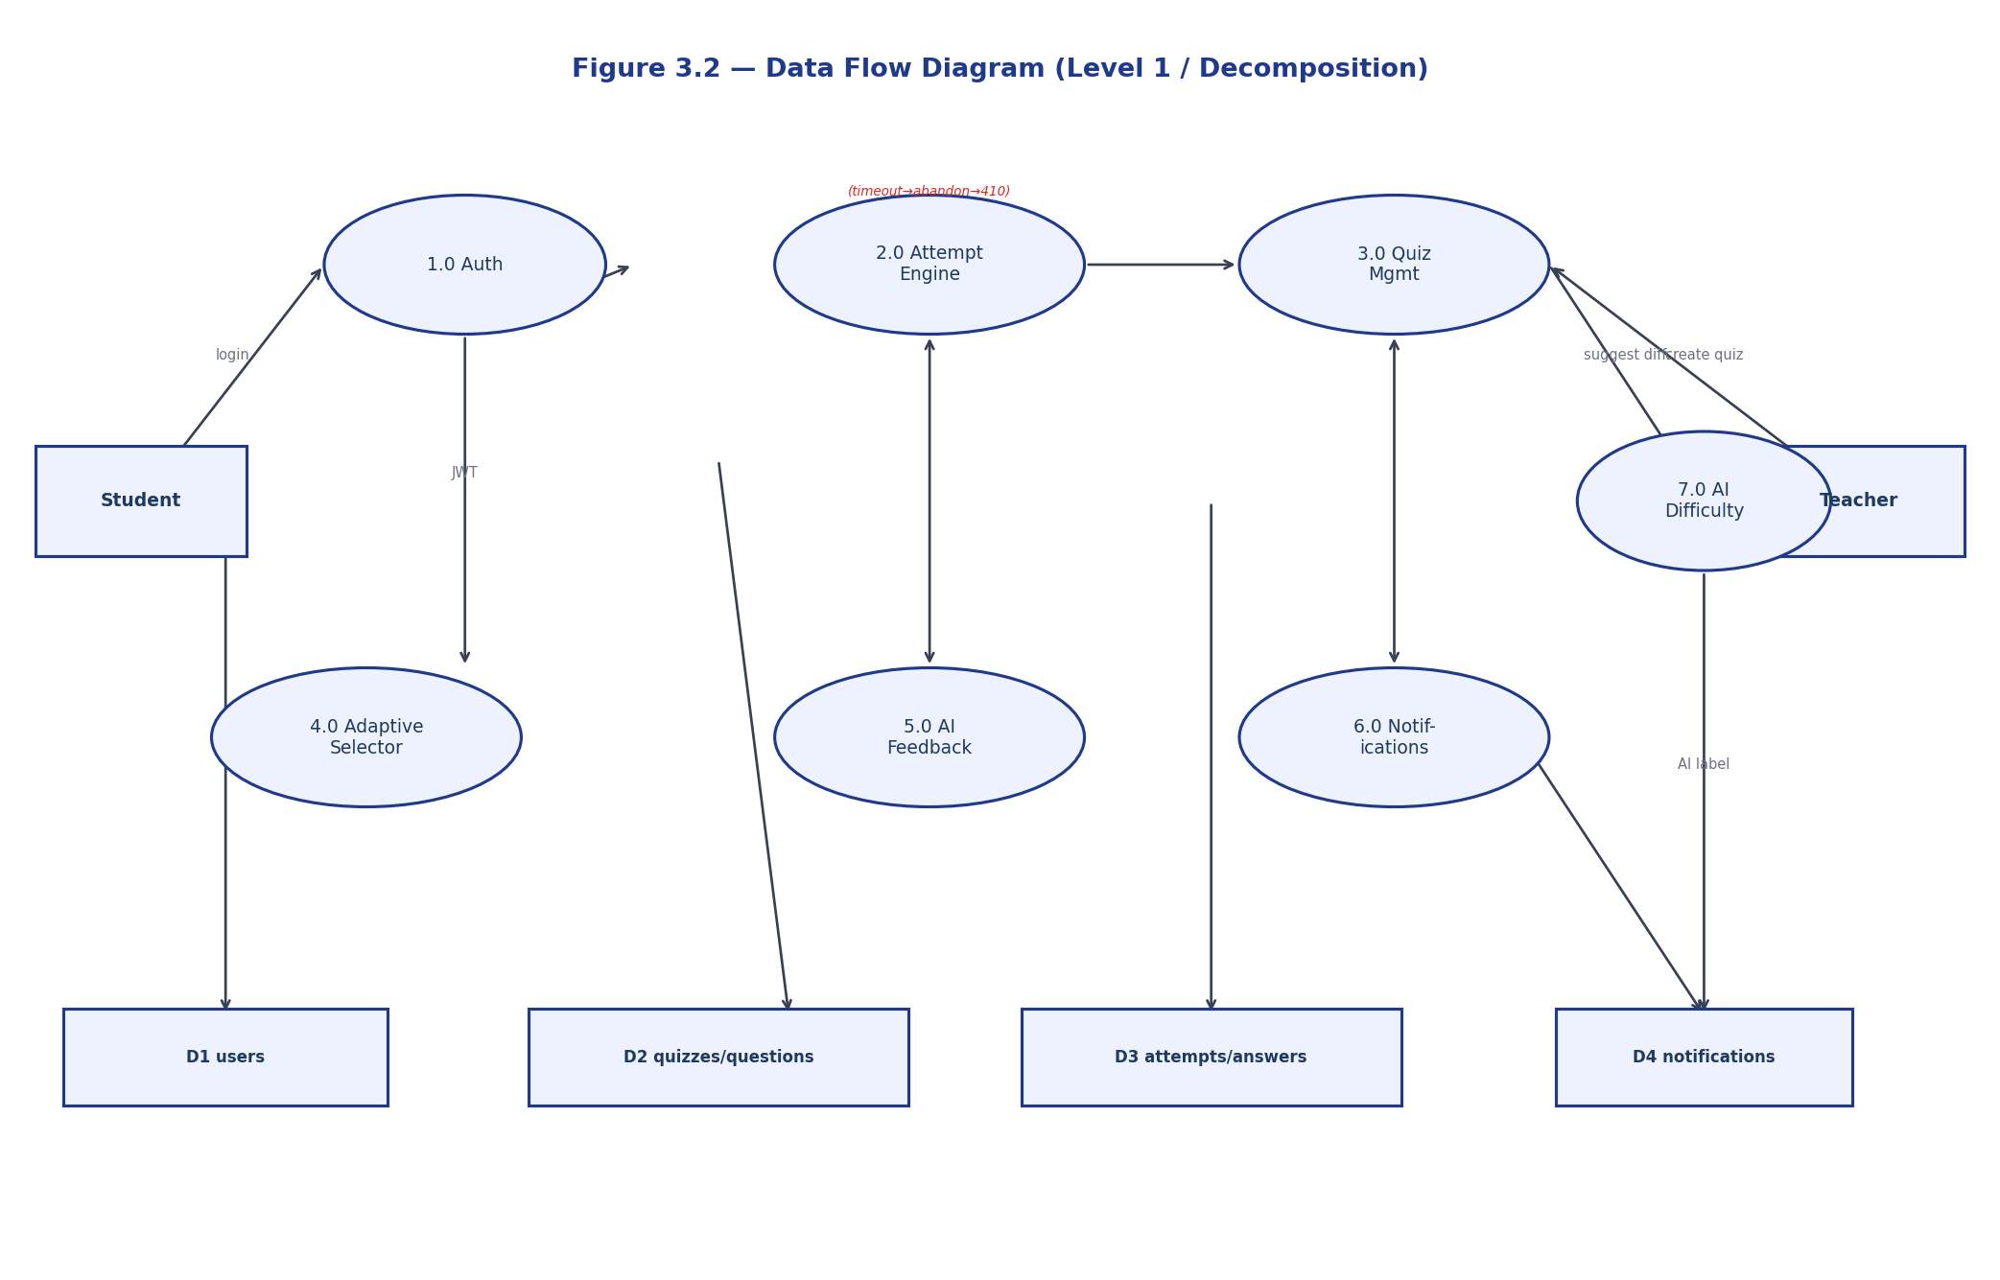
UML Class Diagram
Six core domain classes with attributes, methods, and associations
Adaptive Quiz — AI-Powered Web Platform for Personalized Learning
10 / 22

Slide 11
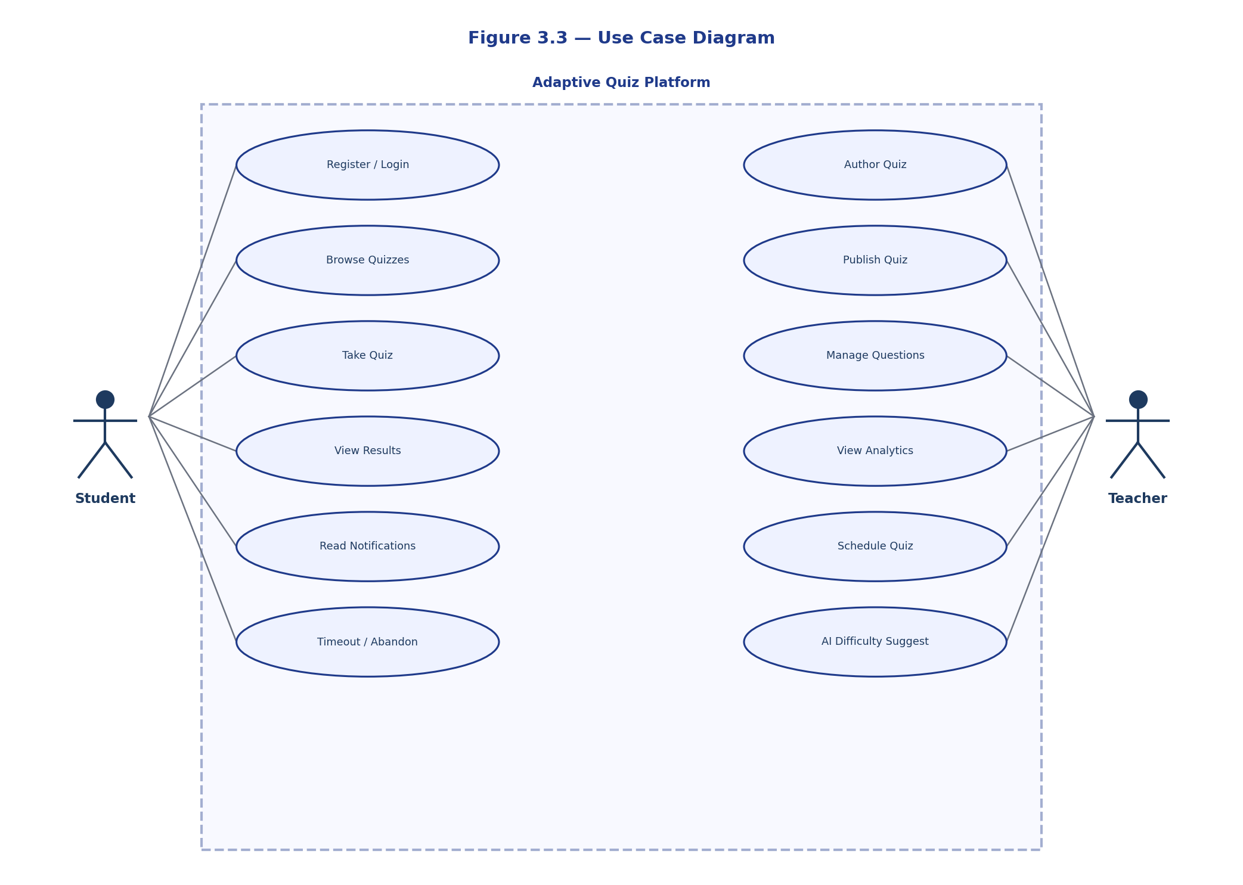
Entity Relationship Diagram
Eight tables, 1:N relationships throughout
Adaptive Quiz — AI-Powered Web Platform for Personalized Learning
11 / 22

Slide 12
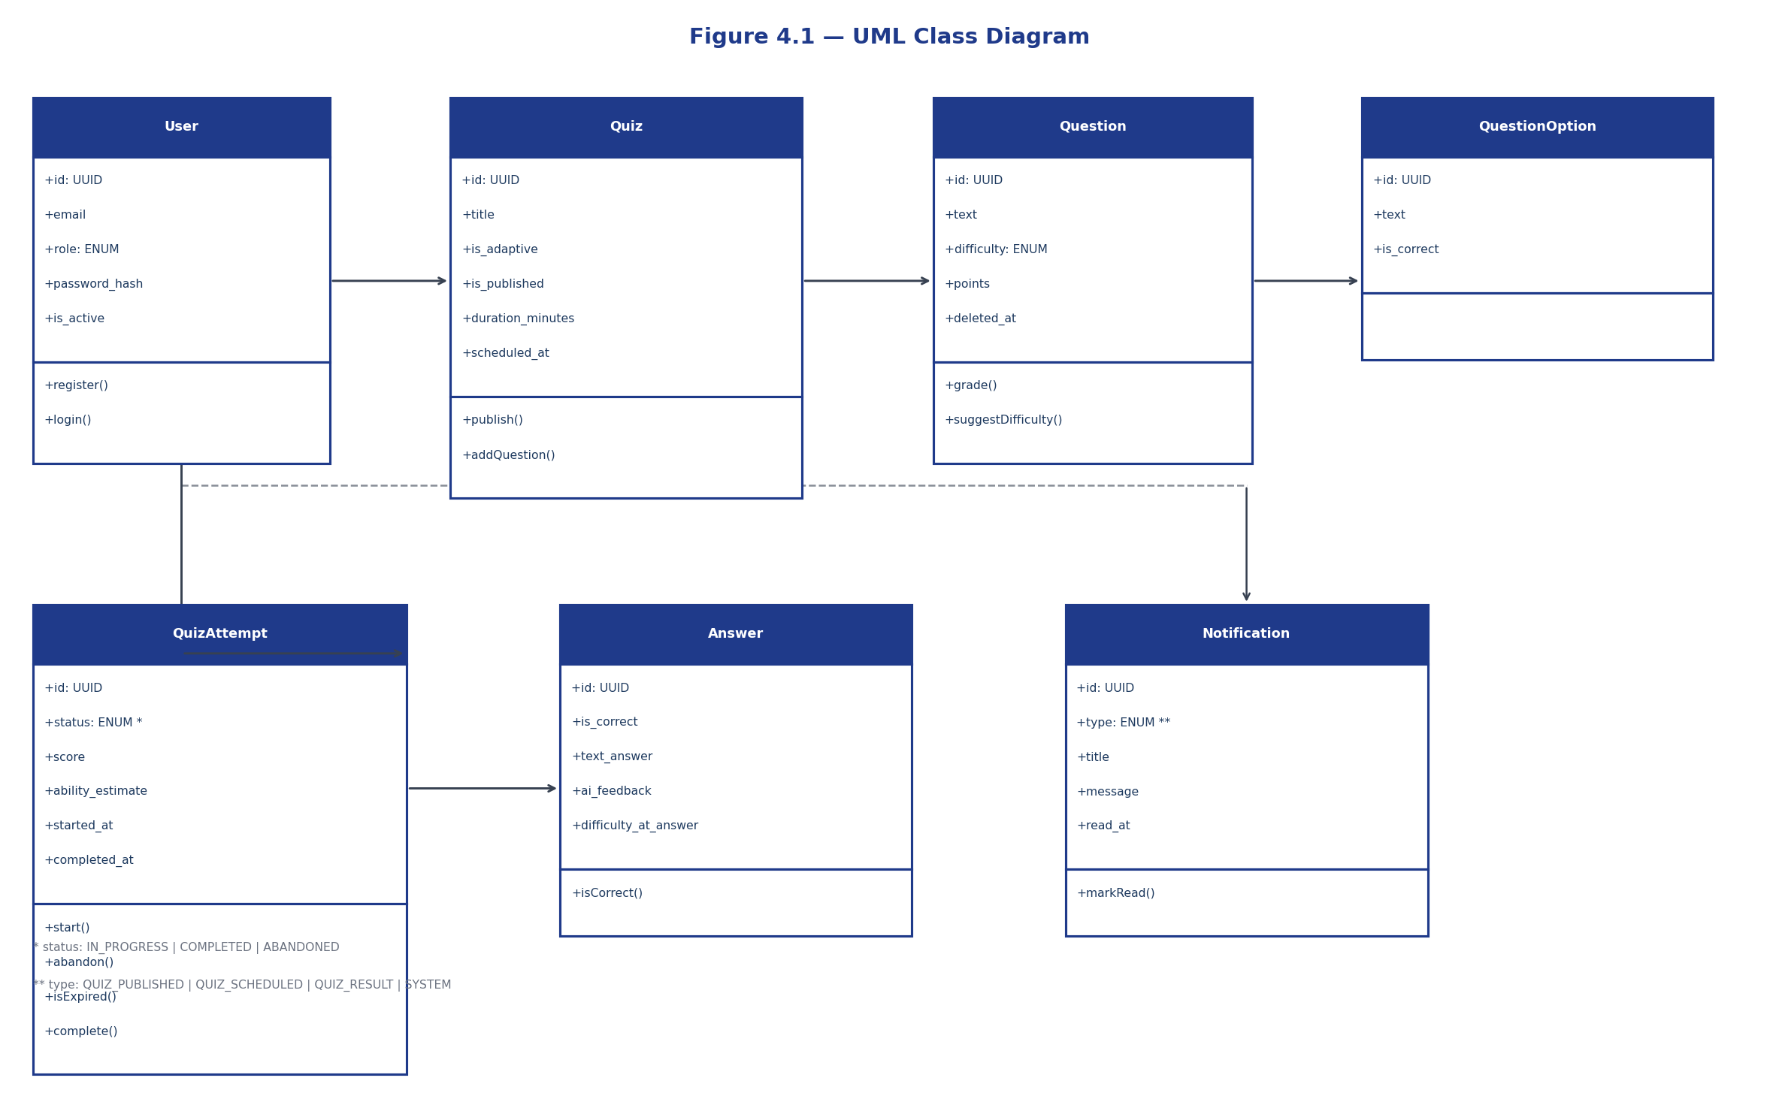
Sequence Diagram — Student Takes an Adaptive Quiz
Adaptive endpoint flow across React → FastAPI → engine → DB
Adaptive Quiz — AI-Powered Web Platform for Personalized Learning
12 / 22

Slide 13
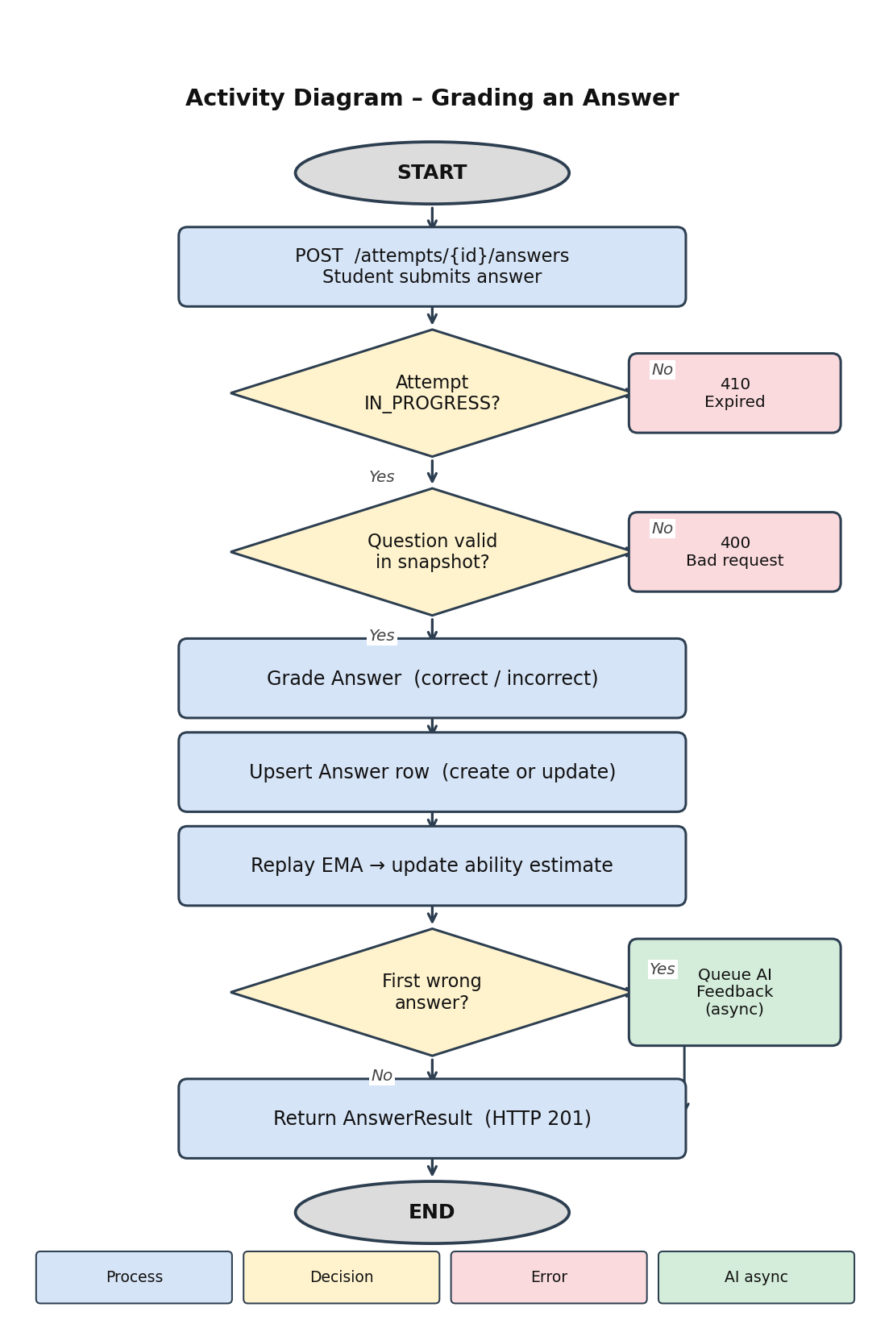
Activity Diagram — Grading an Answer
Upsert path with AI-feedback branch for first wrong submission
Adaptive Quiz — AI-Powered Web Platform for Personalized Learning
13 / 22

Slide 14
Database Schema (8 tables · 3 migrations)
users
id, email, role (ENUM), password_hash
quizzes
id, title, is_adaptive, is_published, scheduled_at
questions
id, text, difficulty (ENUM), points, deleted_at (soft delete)
question_options
id, question_id, text, is_correct, order_index
quiz_attempts
id, quiz_id, student_id, status, score, ability_estimate
attempt_questions
id, attempt_id, question_id ← snapshot, RESTRICT FK
answers
id, attempt_id, question_id, selected_option_id, is_correct
notifications
id, user_id, type, message, related_quiz_id, read_at
Adaptive Quiz — AI-Powered Web Platform for Personalized Learning
14 / 22

Slide 15
Endpoint: POST /quizzes/questions/suggest-difficulty (teacher-only, Gemini classifies text -> EASY/MEDIUM/HARD)
Adaptive Engine — EMA Update Rule
new_ability = α · target(difficulty, is_correct) + (1 − α) · prior
where α = 0.4 and target lookup table is asymmetric (rewards harder correct, punishes harder wrong)
• Each student starts with ability = 0.5 (MEDIUM tier).
• After every answer, ability is replayed in creation order so re-submissions stay consistent.
• Difficulty tier picked by ability range: <0.4 → EASY · <0.75 → MEDIUM · ≥0.75 → HARD.
• Engine is pure-Python and unit-tested independently of the database layer.
• Next-question tier decided by Google Gemini (last 6 answers + ability score) via ai_difficulty.recommend_difficulty — EMA tier used as fallback when AI is off.
difficulty_override: AI-recommended tier overrides EMA; fallback order still applies if tier exhausted
Teacher difficulty suggestion: POST /quizzes/questions/suggest-difficulty -> {difficulty, ai_used}; 'AI set' badge shown on blur
Adaptive Quiz — AI-Powered Web Platform for Personalized Learning
15 / 22

Slide 16
AI Tutor Feedback — Google Gemini
Flow
Sample feedback
• Student submits a wrong answer for the first time.
• Backend enqueues a background task with the question + selected option.
• Gemini 2.5 Flash returns ≤300 token explanation.
• Feedback stored on the answer row, surfaced in /results.
• If Gemini fails, the answer is still graded — no blocking.
• Teacher difficulty suggestion: on question text blur, Gemini classifies EASY/MEDIUM/HARD → difficulty dropdown auto-filled, 'AI set' badge shown; teacher can override.
Teacher: question text blur -> POST /suggest-difficulty -> Gemini -> EASY/MEDIUM/HARD; ai_used flag drives 'AI set' badge
"Photosynthesis happens in chloroplasts, not in mitochondria. Mitochondria are the powerhouses that produce ATP from glucose; chloroplasts capture light energy and synthesise glucose. A handy mnemonic: chloroplasts CHARGE (create energy), mitochondria DISCHARGE (release energy)."
Adaptive Quiz — AI-Powered Web Platform for Personalized Learning
16 / 22

Slide 17
Mid-Attempt Safety: Soft Delete + Snapshot
• questions.deleted_at — soft delete instead of DROP, keeps history intact.
• attempt_questions — every attempt freezes its own snapshot of questions.
• RESTRICT FK from attempt_questions.question_id prevents accidental physical removal.
• Adding a question after an attempt started → only future attempts see it.
• Soft-deleting a question mid-attempt → skipped silently; existing answers preserved.
• Partial unique index UNIQUE (quiz_id, student_id) WHERE status='IN_PROGRESS' blocks duplicate attempts.
Adaptive Quiz — AI-Powered Web Platform for Personalized Learning
17 / 22

Slide 18
Two Quiz-Taking Flows
Adaptive Mode (strict)
Linear Mode (free navigation)
• One question at a time, picked by EMA engine.
• No going back — visible banner explains.
• Backend endpoint: GET /attempts/{id}/next-question
• Difficulty escalates with correct answers.
• Ends when no more questions match target tier.
Resume detection: IN_PROGRESS check before POST; amber banner shown if resuming
• Countdown timer (MM:SS) shown in header; pulses red at ≤60 s.
Auto-abandon: deadline enforced at request time; HTTP 410 redirects student out; SYSTEM notification sent.
• Full snapshot loaded up-front.
• Prev/Next + jump-to grid; upsert on each save.
• Backend endpoint: GET /attempts/{id}/questions
• Submit prompts a confirmation modal first.
• Re-submission replays ability for consistency.
Notification bell: mark-read on click; no auto-redirect (removed to prevent mid-flow disruption)
• Countdown timer shared across both modes; same expiry logic applies.
Auto-abandon: next-question & submit-answer both check is_time_expired(); abandon_attempt() + HTTP 410 on expiry.
Adaptive Quiz — AI-Powered Web Platform for Personalized Learning
18 / 22

Slide 19
Testing & Quality
Backend tests
91 pytest tests · 95% coverage
Frontend type check
TypeScript strict · 14 Vitest UI tests · no errors
Production build
Vite bundle 270 KB · 81 KB gzipped
Database CI
alembic up → down → up against real Postgres
Smoke test
Full student & teacher journeys, mobile + desktop
Lint
ruff (curated rules) · zero warnings
Adaptive Quiz — AI-Powered Web Platform for Personalized Learning
19 / 22

Slide 20
How We Compare
Feature
Kahoot
Quizizz
Google Forms
Khan
Adaptive Quiz
Adaptive difficulty
—
Partial
—
Strong
Strong
Open-source / self-hostable
—
—
—
—
✓
AI feedback on wrong
—
—
—
—
✓ (Gemini)
Snapshot mid-attempt
—
—
—
—
✓
Role-aware UX
Basic
Basic
Basic
Strong
Strong
Adaptive Quiz — AI-Powered Web Platform for Personalized Learning
20 / 22

Slide 21
Future Scope
• Item Response Theory (IRT) model once enough calibration data is collected.
• Question-bank reuse: shared questions across quizzes with version control.
• Real-time multi-player mode via FastAPI WebSockets (Kahoot-style sync rooms).
• Native mobile apps using React Native — share TypeScript types with web.
• Cached AI feedback keyed on (question_id, wrong_option_id) to cut Gemini cost.
• Single-sign-on (Google, Microsoft) for institutional rollouts.
Adaptive Quiz — AI-Powered Web Platform for Personalized Learning
21 / 22

Slide 22
Thank you
Questions and discussion welcome
Sanjna Rathour · UID: O24MCA11201
Project Guide: Vikas Kumar Atray

