Slide 1

Extension: CVaR Distributional Agent
Work | Approach | Gap left open | How this extension responds
Schnaubelt (2022) | DDQN vs PPO, limit orders, replay | No reactive book, no tail metrics | Same pair in a calibrated reactive book, CVaR95 reported
Espana et al. (2025) | DDQN in a queue-reactive model | Risk-neutral, no shocks, no PPO | Risk-sensitive agents; shocks; DDQN, PPO and QR-DDQN
Min, Moallemi & Maglaras (2022) | CVaR-optimal execution by dynamic programming | Stylised model, no learning | CVaR-sensitive RL in a data-calibrated book
Dabney et al. (2018); Lim & Malik (2022) | QR-DQN; CVaR-greedy is not CVaR-optimal | Never applied to execution | QR-DDQN, CVaR(0.25)-greedy and threshold-CVaR arms
Design (pre-registered) | 6 arms × 10 paired seeds, 250k steps, 'mixed' | Primary: CVaR95 and mean IS vs DDQN | Smallest tail effect 1.0 bps; mean margin +0.3 bps
To our knowledge, the first controlled comparison of value-based, policy-gradient and CVaR-sensitive distributional agents for optimal execution in a data-calibrated queue-reactive book with liquidity shocks, linking tail cost to forced end-of-horizon liquidation
Novelty is the combination; each ingredient has precedents (literature check: docs/v2/literature_check.md)
Notes:
QR-DDQN keeps DDQN's body, replay, epsilon schedule and budget; only the head (40 quantiles) and the action rule change. CVaR-greedy is described as CVaR-sensitive because per-step CVaR selection is not static-CVaR optimal (Lim and Malik, 2022); the threshold arm is the method that targets static CVaR.

Slide 2
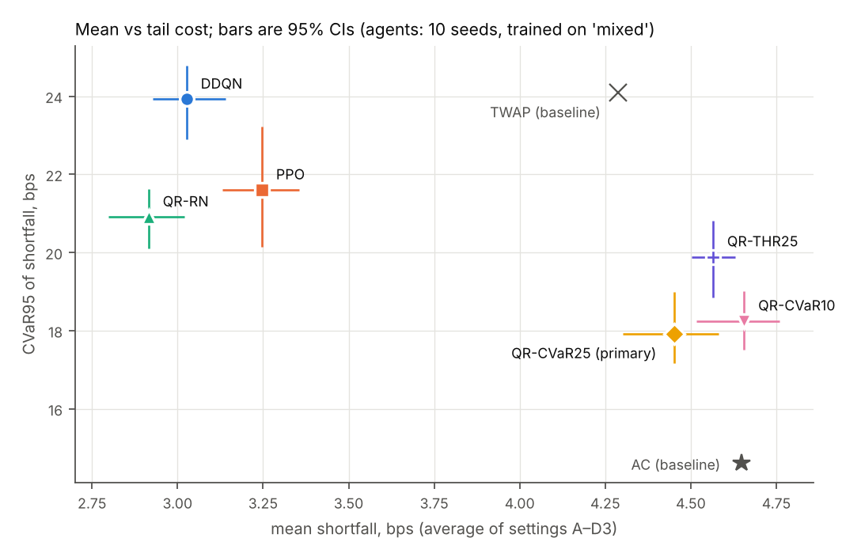
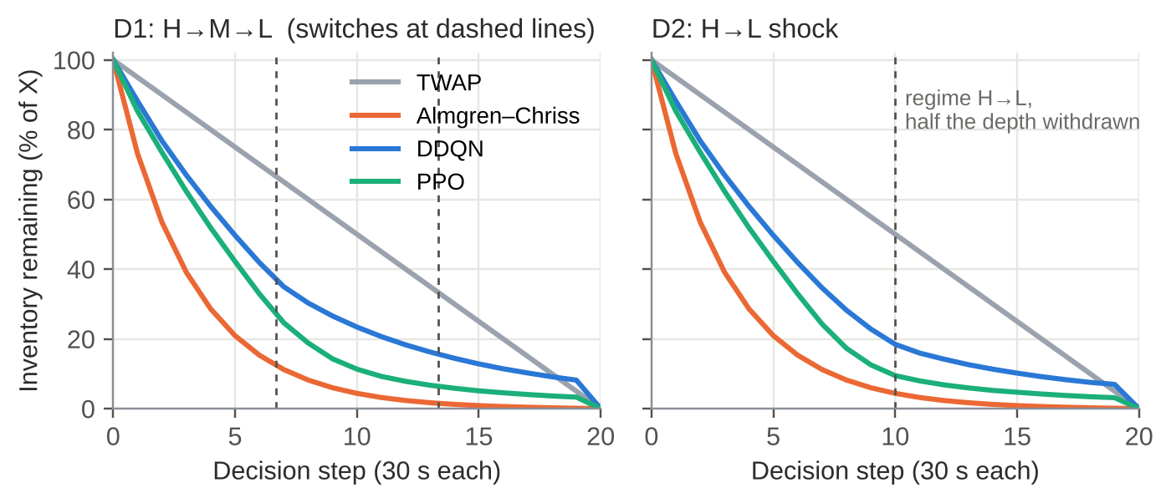
Results: Tail Down, Mean Up
Agent | Mean IS | CVaR95 | Forced
DDQN | 3.03 | 23.92 | 8.4%
PPO | 3.25 | 21.60 | 3.3%
QR-RN | 2.92 | 20.91 | 5.1%
QR-CVaR25 | 4.45 | 17.93 | 0.4%
QR-CVaR10 | 4.66 | 18.25 | 0.3%
QR-THR25 | 4.56 | 19.89 | 12.2%
Pre-registered contrasts, QR-CVaR25 minus DDQN, 10 paired seeds, 95% CI
Mean IS and CVaR95 in bps, averaged over A–D3; Forced = share of X sold by the forced order at T
AC baseline still has the thinnest tail: 4.65 mean, 14.62 CVaR95
CVaR95 −6.00 bps
Mean +1.42 bps
[−7.27, −4.59]; beyond the 1.0 bps threshold
[+1.26, +1.58]; not within the +0.3 bps margin
Notes:
The CVaR agent buys tail protection with mean cost: both pre-registered tests are decisive, in opposite directions. It does not reach the Almgren-Chriss schedule's tail either. Numbers from out_v2/report.

Slide 3
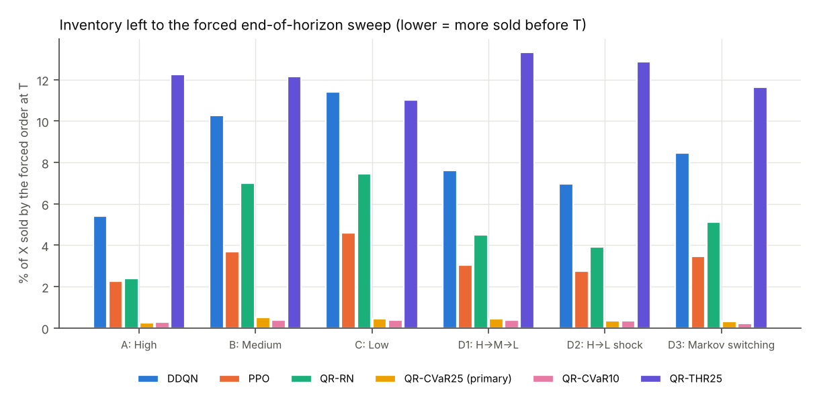
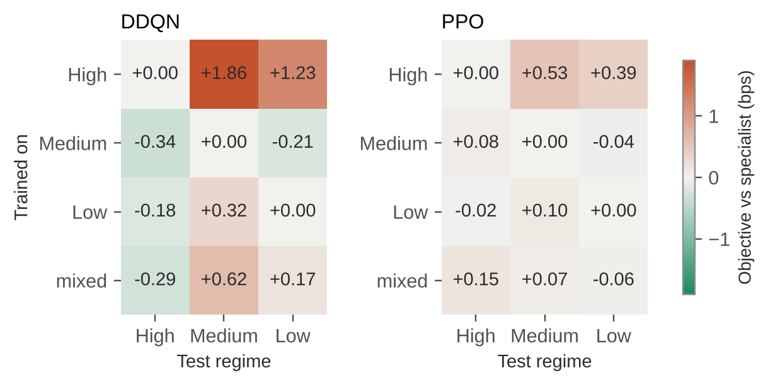
Mechanism: The Forced Sweep
Tail = forced sweep
DDQN's worst 5% of episodes sell 46% of X at T, vs 6% in the rest
QR-CVaR25 leaves 0.4% to the sweep: limit orders 77% → 20%, inventory at the shock 19% → 2%
Risk rule, not distribution
Same hyperparameters: CVaR rule moves CVaR95 by −5.09 bps
Risk-neutral QR at DDQN's update rate: −0.91 bps, CI spans 0 (exploratory)
Answer to the open question, and limits
Changing only the action rule moves the tail more than the DDQN–PPO gap: the tail follows risk-aversion, not the algorithm family
Limits: one stock, one day; 10 seeds; threshold rule weaker; learned quantiles understate the tail
Notes:
Front-loading and marketable orders are the correct risk-averse response (Almgren-Chriss), and paying the spread on more of the order is where the extra mean cost comes from.

