Slide 1
ANN-CLASSIFICATION
Presented by
Tetali Ram subba reddy
Enroll id - 4751

Slide 2
Table of content
1)What is Artificial neural network?How neural networks work?How it is different from machine learning?
2)Structure of neuron and its components
3)Idea of Back propagation,Whole maths behind neural networks?
4)Types of activation functions,loss functions.
5)Hyper-parameters in Ann
6)Problems in neural networks
7)How to solve overfitting issue?

Slide 3
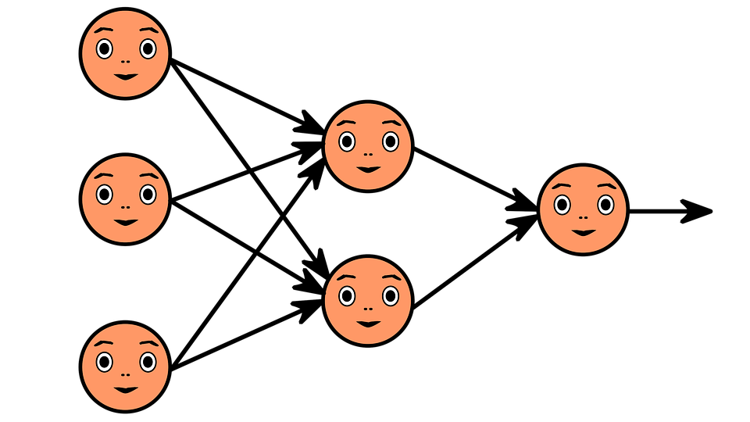
What is neural network?
1)Neural networks, also known as artificial neural networks (ANNs) or simulated neural networks (SNNs), are a subset of machine learning and are at the heart of deep learning algorithms. Their name and structure are inspired by the human brain, mimicking the way that biological neurons signal to one another.
2)Artificial neural networks (ANNs) are comprised of a node layers, containing an input layer, one or more hidden layers, and an output layer. Each node, or artificial neuron, connects to another and has an associated weight and threshold. If the output of any individual node is above the specified threshold value, that node is activated, sending data to the next layer of the network. Otherwise, no data is passed along to the next layer of the network.

Slide 4
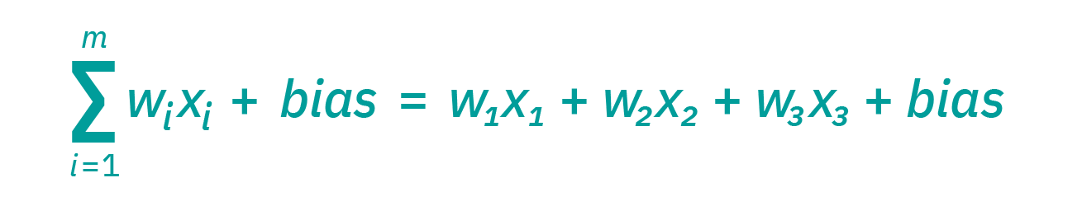
How neural networks work?
Step1)Each node is composed of input data,weights,bias and an output.Once an input layer is determined, weights are assigned. These weights help determine the importance of any given variable
Step2)All inputs are multiplied by their respective weights and summed up with their respective biases.

Slide 5
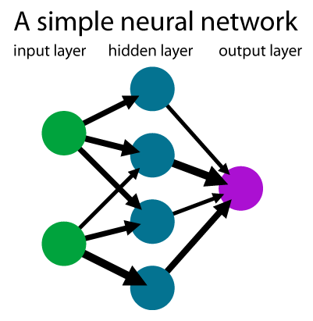
step7)Now weighs,bias are updated by multiplication with our step size and the resulting value is subtracted from old value and new value becomes are again optimized iteratively until it reaches global minima.
In this picture there are two input nodes and
One hidden layer with 4 nodes and an output
With two nodes.So when a input is sent thro
Input layer to hidden layers it predicts and
Output value is optimized until its near to
That value using back propagation.

Slide 6
step3)Now the resulting sum of weights with input and bias is sent into a hidden layer where we specify a activation function.
step4)The bent line inside the activation function is the one which helps to fit a squiggle inside the data.It can be shaped by a parameter value.
step5)each node in hidden layer uses different portions of a activation function.Generally,weights in neural network are initialized using zero initialization,Random initialization…etc.
step6)Now depending upon the loss function we use the optimization process takes place by the method of back propagation where each weight,bias is updated through partial derivative method by updating through each step.Here use of chain rule becomes and essential part as the derivative of our loss with respect to each weight and bias is updated accordingly.

Slide 7
How neural networks id different from ml?
1. Machine Learning uses advanced algorithms that parse data, learns from it, and use those learnings to discover meaningful patterns of interest. Whereas a Neural Network consists of an assortment of algorithms used in Machine Learning for data modelling using graphs of neurons.
2. While a Machine Learning model makes decisions according to what it has learned from the data, a Neural Network arranges algorithms in a fashion that it can make accurate decisions by itself. Thus, although Machine Learning models can learn from data, in the initial stages, they may require some human intervention.Neural networks do not require human intervention as the nested layers within pass the data through hierarchies of various concepts, which eventually makes them capable of learning through their own errors.

Slide 8
.
3. As we mentioned earlier, Machine learning models can be categorized under two types – supervised and unsupervised learning models. However, Neural Networks can be classified into feed-forward, recurrent, convolutional, and modular Neural Networks.
4. An ML model works in a simple fashion – it is fed with data and learns from it. With time, the ML model becomes more mature and trained as it continually learns from the data. On the contrary, the structure of a Neural Network is quite complicated. In it, the data passes through several layers of interconnected nodes, wherein each node classifies the characteristics and information of the previous layer before passing the results on to other nodes in subsequent layers.
5. Since Machine Learning models are adaptive, they are continually evolving by learning through new sample data and experiences. Thus, the models can identify the patterns in the data. Here, data is the only input layer. However, even in a simple Neural Network model, there are multiple layers.

Slide 9
Idea of back propagation and whole maths behind nn?
The maths involved behind neural network include few topics such as
1)Dot product
2)Chain rule
3)Gradient descent
4)partial derivatives during back propogation

Slide 10
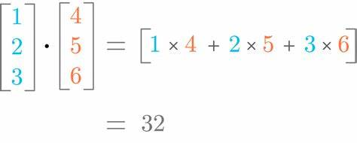
Dot product
Input feature values are multiplied by their respective weight and as the multiplication takes place here is in form of matrix,so dot product is done here.

Slide 11
Chain rule
The rule applied for finding the derivative of the composite function (e.g. cos 2x, log 2x, etc.) is basically known as the chain rule. It is also called the composite function rule. The chain rule is applicable only for composite functions. So before starting the formula of the chain rule, let us understand the meaning of composite function and how it can be differentiated.
Let f represent a real valued function which is a composition of two functions u and v such that:
f = v(u(x))
Let us assume u(x) = t
Now if the functions u and v are differentiable and dt/dx and dv/dt exist, then the composite function f(x) is also differentiable. This can be done as given below.
Using notation, we can express the differentiation of the above function as
df/dx = (dv/dt) × (dt/dx)
As the name suggests, chain rule means differentiating the terms one by one in a chain form, starting from the outermost function to the innermost function.

Slide 12
Gradient descent
Optimization refers to the task of minimizing/maximizing an objective function f(x) parameterized by x. In machine/deep learning terminology, it’s the task of minimizing the cost/loss function J(w) parameterized by the model’s parameters w ∈ R^d.
Optimization algorithms (in the case of minimization) have one of the following goals:
1)Find the global minimum of the objective function. This is feasible if the objective function is convex, i.e. any local minimum is a global minimum.
2)Find the lowest possible value of the objective function within its neighborhood. That’s usually the case if the objective function is not convex as the case in most deep learning problems.

Slide 13
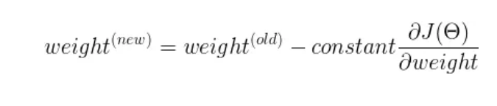
Steps in gradient descent
1)Randomly initialize weights
2)Update values.
3)Repeat until slope =0
A derivative is a term that comes from calculus and is calculated as the slope of the graph at a particular point. The slope is described by drawing a tangent line to the graph at the point. So, if we are able to compute this tangent line, we might be able to compute the desired direction to reach the minima.

Slide 14
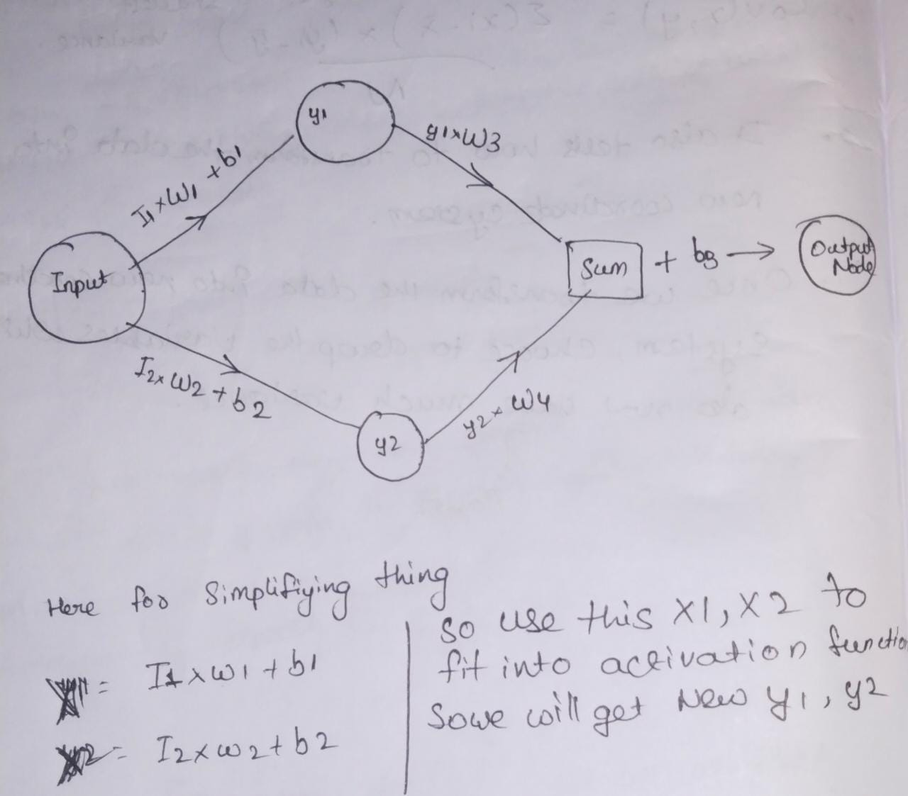
Back propagation
SO to explain back propagation i will take a neural network with one input node and one hidden layer with two nodes and a output layer with one node.

Slide 15
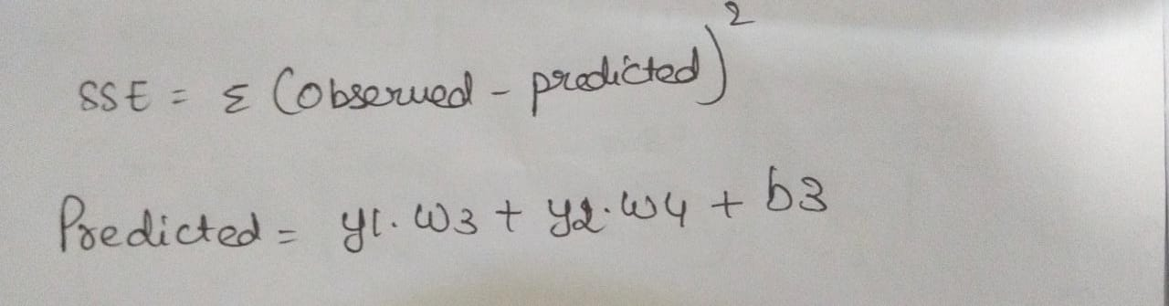
Optimization of w1,w2,w3,w4,b1,b2,b3 using chain rule and gradient descent
Loss metric we are going to use here is SSR.After finding ssr we will use gradient descent method to optimize each parameter and update them until we reach global minima with the help of using chain rule by using derivative of each parameter with respect to total error.it helps us to see how much error a parameter is contributing to total error.

Slide 16
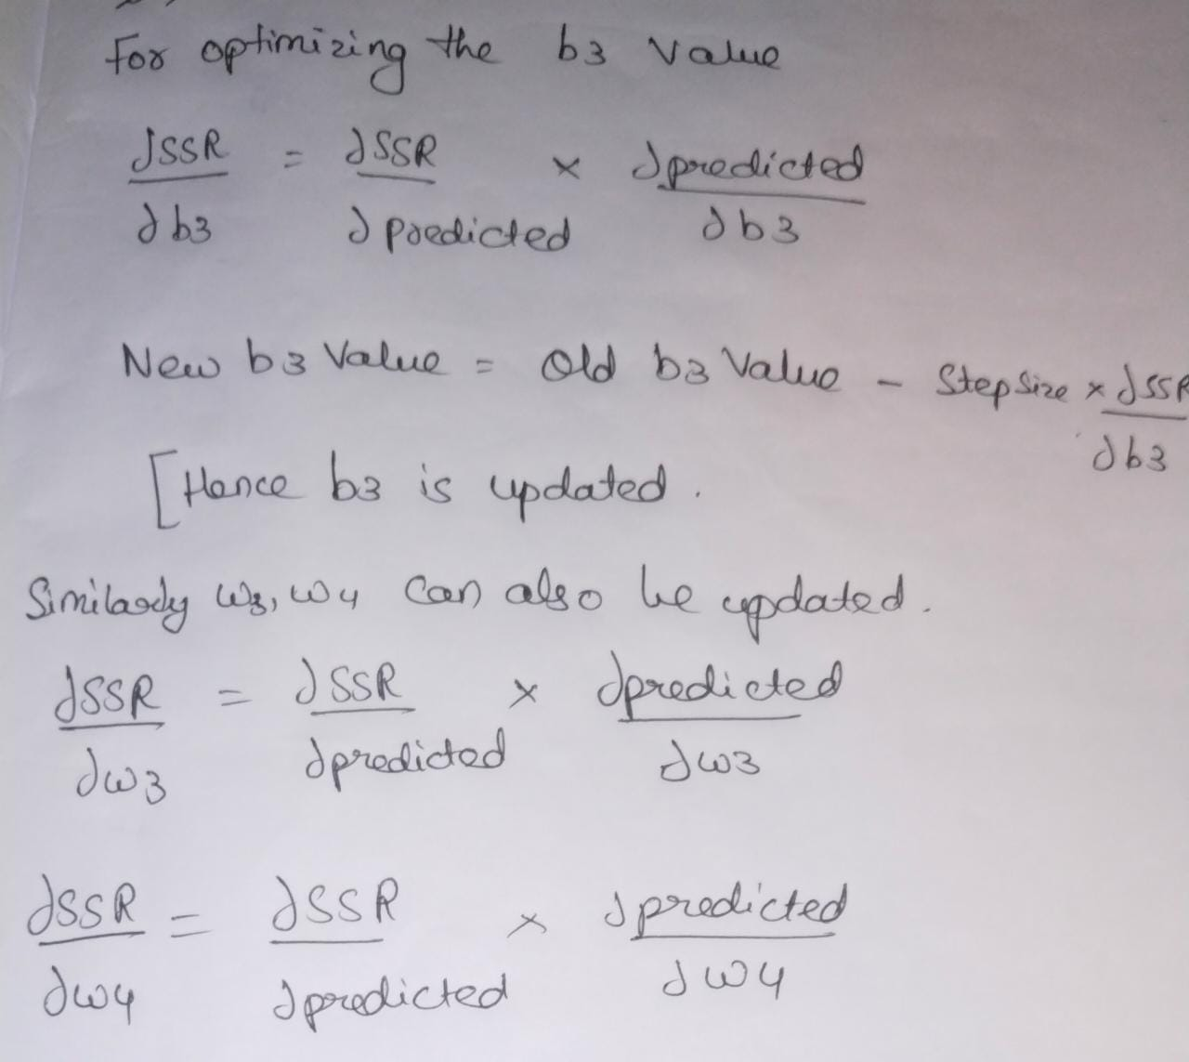
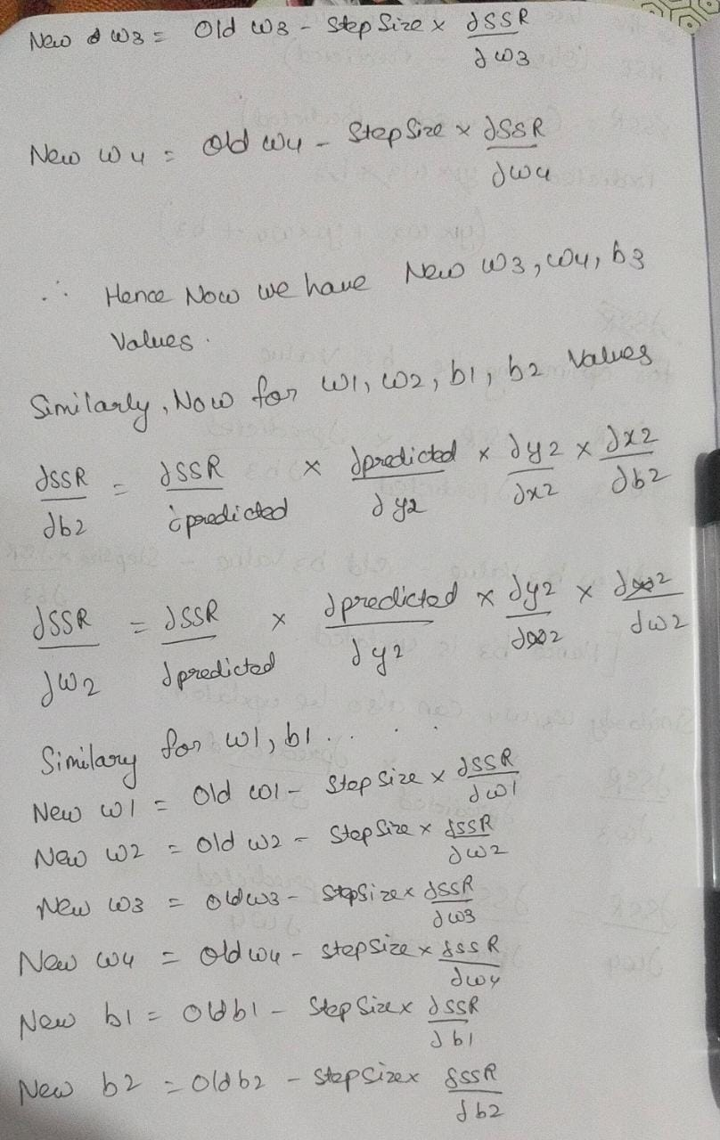
s
m

Slide 17
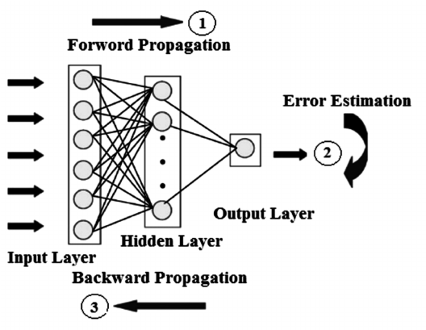
All the weights,biases are updated for each iteration are updated until a minimum loss is acquired.

Slide 18
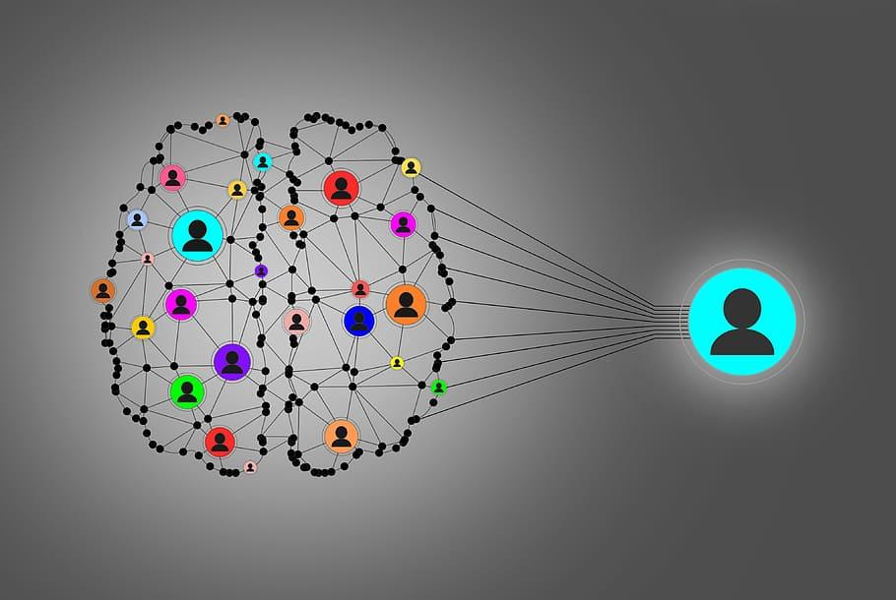
Types of activation functions
1)Step Function
2)Sigmoid function
3)Relu function
4)Leaky relu
5)softmax
6)Argmax
7)Linear function

Slide 19
Relu function
It Stands for Rectified linear unit. It is the most widely used activation function. Chiefly implemented in hidden layers of Neural network.
Equation :- A(x) = max(0,x). It gives an output x if x is positive and 0 otherwise.
Value Range :- [0, inf)
Nature :- non-linear, which means we can easily backpropagate the errors and have multiple layers of neurons being activated by the ReLU function.
Uses :- ReLu is less computationally expensive than tanh and sigmoid because it involves simpler mathematical operations. At a time only a few neurons are activated making the network sparse making it efficient and easy for computation.
In simple words, RELU learns much faster than sigmoid and Tanh function.

Slide 20
sigmoid
It is a function which is plotted as ‘S’ shaped graph.
Equation : A = 1/(1 + e-x)
Nature : Non-linear. Notice that X values lies between -2 to 2, Y values are very steep. This means, small changes in x would also bring about large changes in the value of Y.
Value Range : 0 to 1
Uses : Usually used in output layer of a binary classification, where result is either 0 or 1, as value for sigmoid function lies between 0 and 1 only so, result can be predicted easily to be 1 if value is greater than 0.5 and 0 otherwise.

Slide 21
softmax
The softmax function is also a type of sigmoid function but is handy when we are trying to handle multi- class classification problems.
Nature :- non-linear
Uses :- Usually used when trying to handle multiple classes. the softmax function was commonly found in the output layer of image classification problems.The softmax function would squeeze the outputs for each class between 0 and 1 and would also divide by the sum of the outputs.
Output:- The softmax function is ideally used in the output layer of the classifier where we are actually trying to attain the probabilities to define the class of each input.
The basic rule of thumb is if you really don’t know what activation function to use, then simply use RELU as it is a general activation function in hidden layers and is used in most cases these days.
If your output is for binary classification then, sigmoid function is very natural choice for output layer.
If your output is for multi-class classification then, Softmax is very useful to predict the probabilities of each classes.

Slide 22
Linear function
Linear Function
Equation : Linear function has the equation similar to as of a straight line i.e. y = x
No matter how many layers we have, if all are linear in nature, the final activation function of last layer is nothing but just a linear function of the input of first layer.
Range : -inf to +inf
Uses : Linear activation function is used at just one place i.e. output layer.
Issues : If we will differentiate linear function to bring non-linearity, result will no more depend on input “x” and function will become constant, it won’t introduce any ground-breaking behavior to our algorithm.

Slide 23
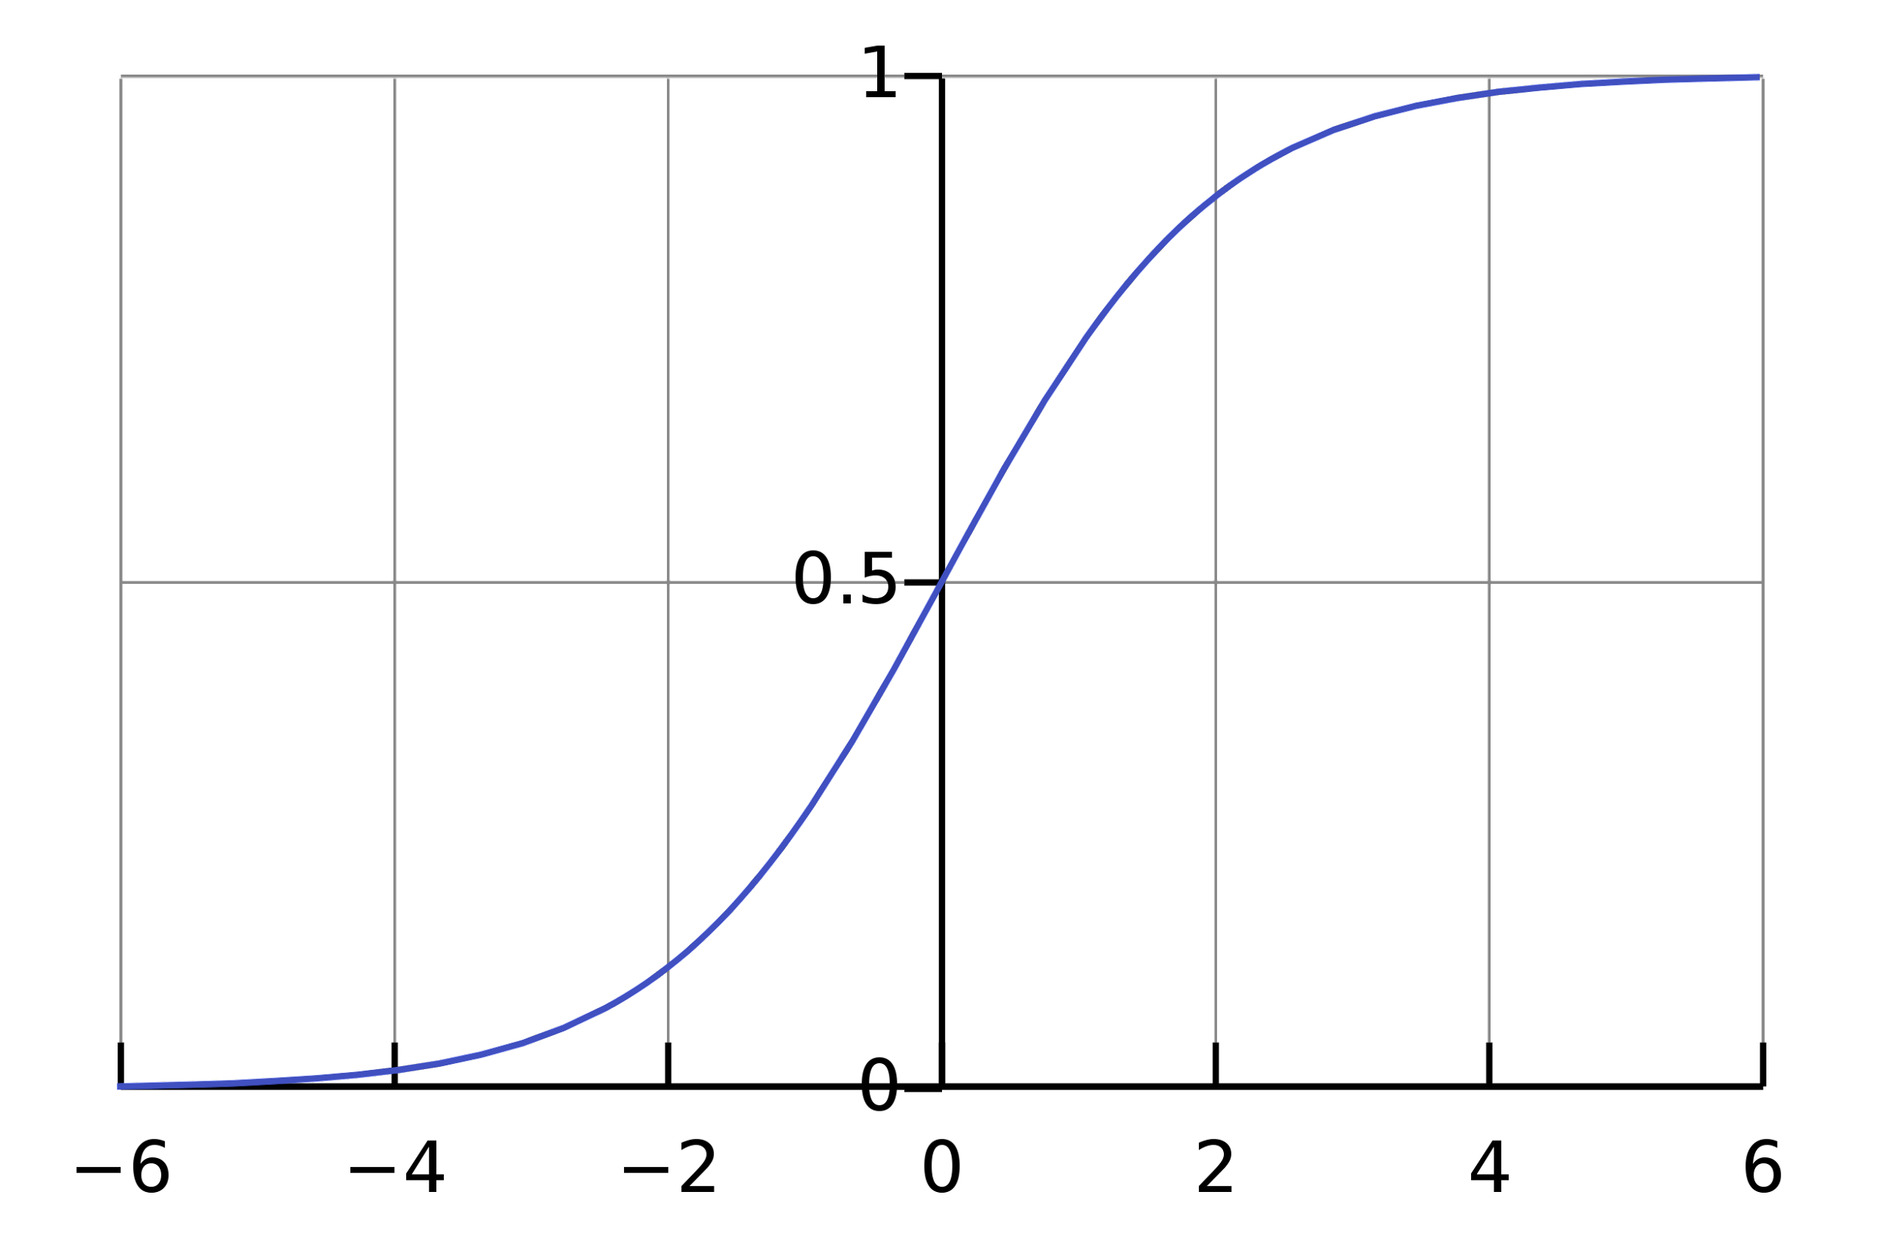
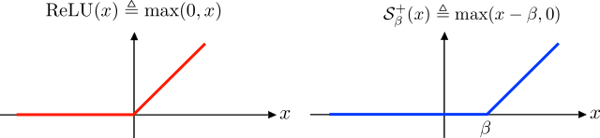
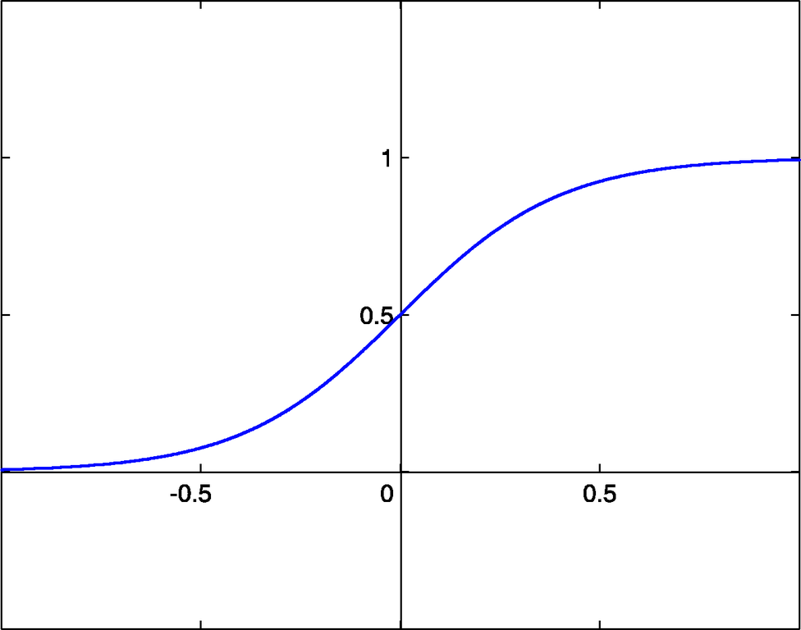
Displaying different activation functions
1)sigmoid function 2)Relu function
3)softmax function

Slide 24
Loss functions in NN?
The 2 major types of neural networks: regression and classification loss functions
Regression Loss Functions — used in regression neural networks; given an input value, the model predicts a corresponding output value (rather than pre-selected labels); Ex. Mean Squared Error, Mean Absolute Error.
Classification Loss Functions — used in classification neural networks; given an input, the neural network produces a vector of probabilities of the input belonging to various pre-set categories — can then select the category with the highest probability of belonging; Ex. Binary Cross-Entropy, Categorical Cross-Entropy

Slide 25
Binary cross-Entropy
This is the loss function used in binary classification models — where the model takes in an input and has to classify it into one of two preset categories.Classification neural networks work by outputting a vector of probabilities — the probability that the given input fits into each of the preset categories; then selecting the category with the highest probability as the final output.In binary classification, there are only two possible actual values of y — 0 or 1. Thus, to accurately determine loss between the actual and predicted values, it needs to compare the actual value (0 or 1) with the probability that the input aligns with that category (p(i) = probability that the category is 1; 1 — p(i) = probability that the category is 0)

Slide 26
Categorical class entropy
In cases where the number of classes is greater than two, we utilize categorical cross-entropy — this follows a very similar process to binary cross-entropy.
Binary cross-entropy is a special case of categorical cross-entropy, where M = 2 — the number of categories is 2.

Slide 27
Hyperparameters in Ann-classification
Hyperparameters are the parameters that manipulate the training of an Artificial Neural Network, by tuning those we could be able to produce high-quality solutions. Hyperparameters are not produced by the model during the training process unlike the weights of the model. The hyperparameters don’t change over training time and remain constant and manipulate the training process of a model. Finding optimal hyperparameters is a search problem, by utilizing which we might or might not end up with the best possible solution which is global optima.
The hyperparameters are evaluated based on the losses of the model predictions, viz. the hyperparameters are set on the model, the model is trained on the data, and the performance of the model is evaluated based on the loss function.

Slide 28
Hyperparameters of an Artificial Neural Network
Number of layers to choose
Number of neurons in a layer to choose
Choice of the optimization function
Choice of the learning rate for optimization function
Choice of the loss function
Choice of metrics
Choice of activation function
Choice of layer weight initialization

Slide 29
Types of optimizers
Gradient Descent
Stochastic Gradient Descent
Adagrad
Adadelta
RMSprop
Adam

Slide 30
problems in neural networks
∙ Vanishing gradients: as we add more and more hidden layers, back-propagation becomes less and less useful in passing information to the lower layers. In effect, as information is passed back, the gradients begin to vanish and become small relative to the weights of the networks.
∙ Difficulty in Optimization: In deeper networks the parameter space is large, and surface being optimized has complex structures. Gradient descent becomes very inefficient.
∙ Overfitting: perhaps the central problem in Machine Learning. Briefly, over-fitting describes the phenomenon of fitting the training data too closely, maybe with hypotheses that are too complex. In such a case, your learner ends up fitting the training data really well, but will perform much, much more poorly on real example

Slide 31
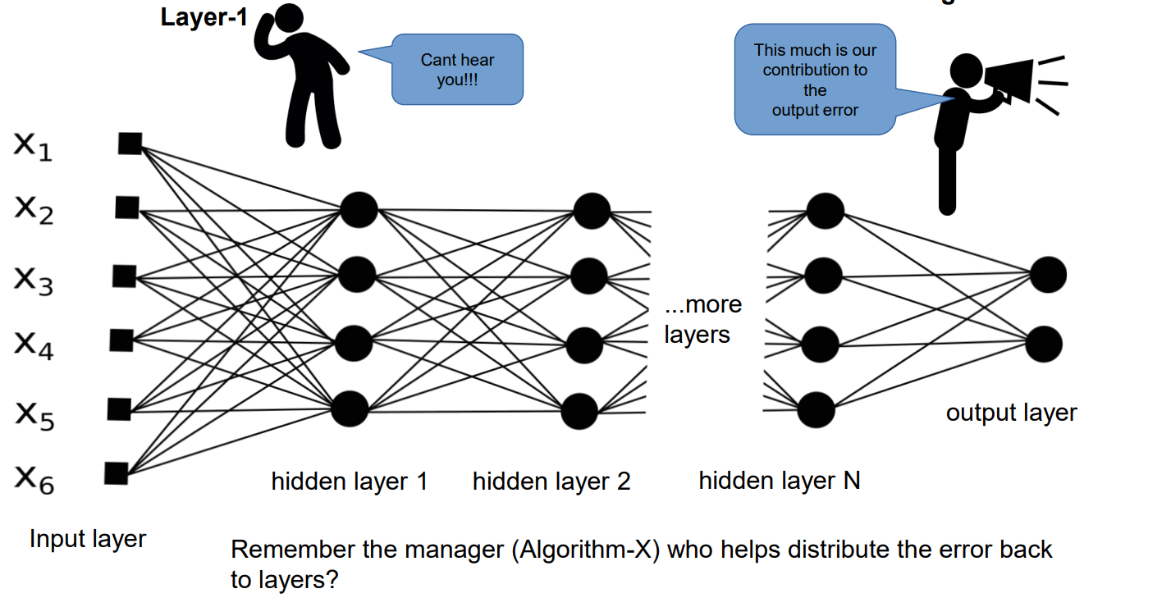
Vanishing gradient
Given the N is very large, the back propagation of error to initial layers in the network is almost zero and thereby no learning.

Slide 32
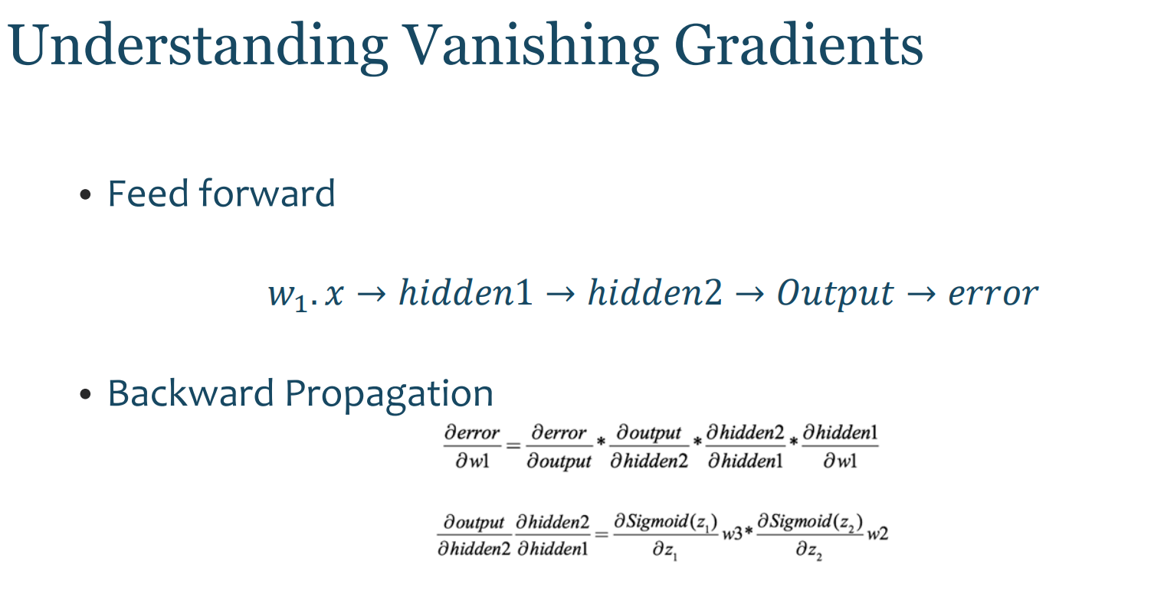

Slide 33
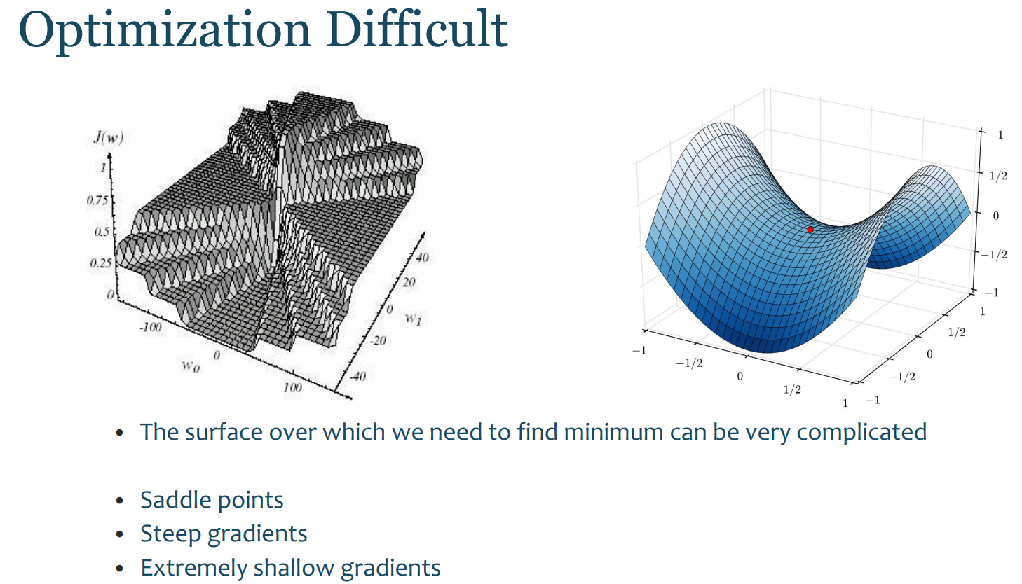
D

Slide 34
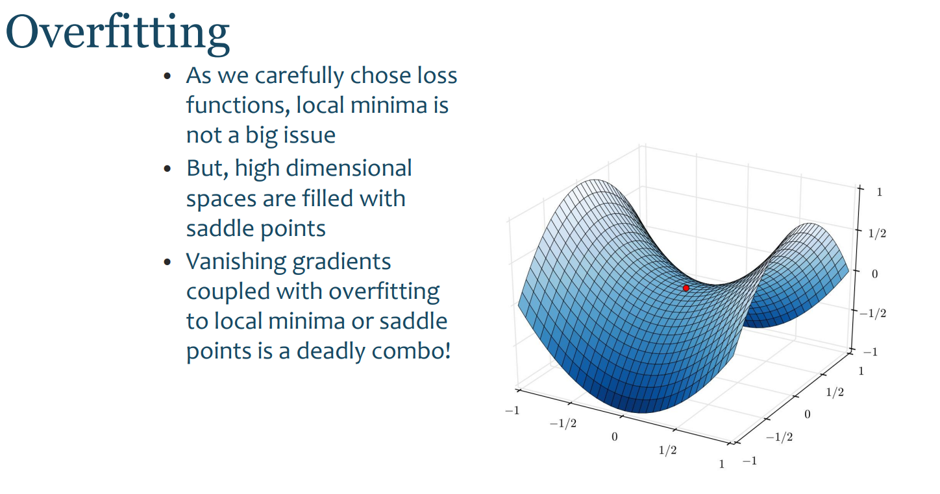

Slide 35
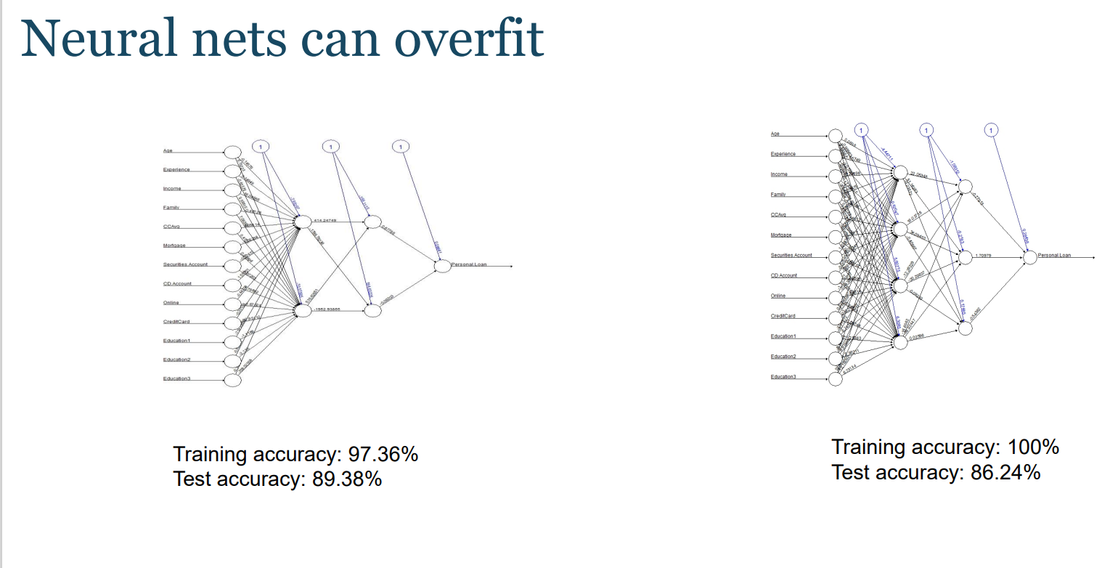

Slide 36
