Slide 1

Heart Disease Prediction Using Machine Learning Algorithms

Slide 2
About me
About me Background
I am a 4th-year B.Tech student pursuing Computer Science Engineering.
Why you want to learn Data Science
I want to learn Data Science to develop strong skills in data analysis, visualization, and problem-solving using real-world data. As a computer science student, I am interested in data-driven decision-making and aim to pursue a career in data-related roles.
Any work experience
Fresher with hands-on experience in Excel, EDA , PowerBI and SQL-based data analysis projects, with a strong interest in data analytics roles.
LinkedIn : https://www.linkedin.com/in/sanjanagorli/
GitHub : https://github.com/Sanju0714 .

Slide 3
Business Problem
Heart disease is one of the leading causes of death worldwide.
Early prediction helps identify high-risk patients before serious complications occur.
Manual risk assessment using multiple health factors can be complex and time-consuming.
A machine learning model can assist healthcare professionals in making faster and more accurate predictions.
Early diagnosis supports timely treatment and improves patient outcomes.

Slide 4
Problem Statement
Predict whether a patient is likely to develop Coronary Heart Disease (CHD) within the next 10 years.
Use the Framingham Heart Study dataset for prediction.
Preprocess the data by handling missing values, duplicates, and outliers.
Perform Exploratory Data Analysis (EDA) to understand the dataset.
Train and compare three machine learning models.
Evaluate models using Accuracy, Precision, Recall, and F1-Score.
Select the best-performing model for heart disease prediction.

Slide 5
Objectives
Predict the likelihood of Coronary Heart Disease (CHD) within the next 10 years using machine learning.
Analyze and understand the Framingham Heart Study dataset.
Handle missing values and preprocess the dataset for model training.
Perform Exploratory Data Analysis (EDA) to identify patterns and relationships.
Train and compare Logistic Regression, Decision Tree, and Random Forest models.
Evaluate model performance using Accuracy, Precision, Recall, and F1-Score.
Identify the best-performing model for heart disease prediction.

Slide 6
CRISP-ML(Q) Methodology
Business Understanding
Defined the problem of predicting heart disease risk.
Data Understanding
Explored the dataset and analyzed missing values, duplicates, and data types.
Data Preparation
Handled missing values, detected outliers, scaled features, and selected important features.
Model Building
Trained Logistic Regression, Decision Tree, and Random Forest models.
Evaluation
Compared models using Accuracy, Precision, Recall, F1-Score, and Confusion Matrix.
Deployment
Saved the best-performing model as a Pickle (.pkl) file for future predictions.

Slide 7
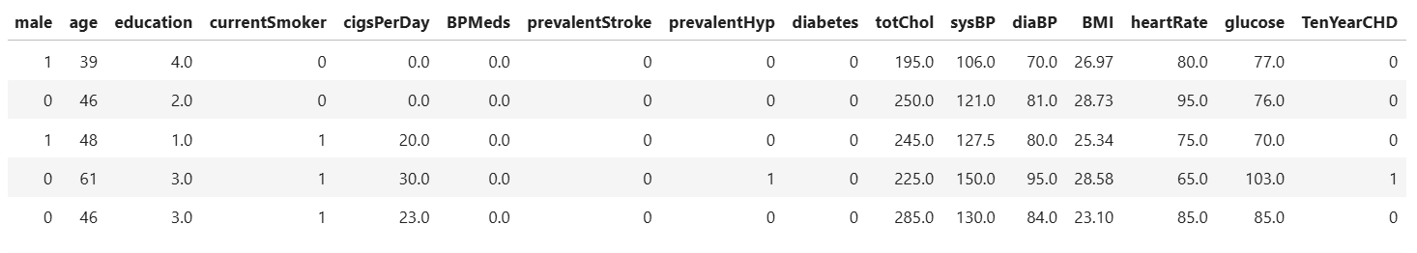
Dataset Overview
Dataset Information
Dataset: Framingham Heart Study Dataset
Domain: Healthcare
Prediction Type: Binary Classification
Target Variable: TenYearCHD
0 → No Heart Disease
1 → Heart Disease
Dataset Statistics
Total Records: 4,238
Total Features: 16 (including target variable)
Data Types: 9 Float, 7 Integer

Slide 8
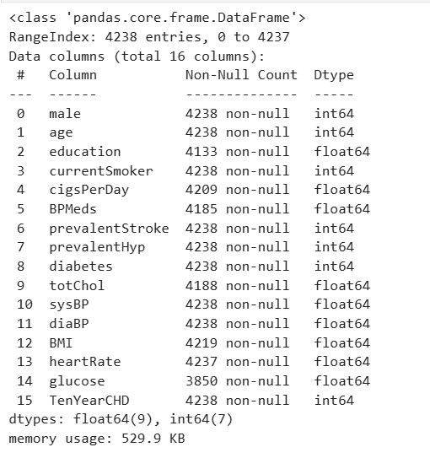
Data Understanding
Explored the dataset using df.info(), df.describe(), and df.isnull().sum().
Verified the dataset structure, data types, and target variable.
Identified missing values in different features.
Analyzed the statistical summary of numerical features.
Used these insights to guide the data preprocessing process.
Key Observations
Total Records: 4,238
Total Features: 16 (including the target variable)
Target Variable: TenYearCHD (Binary Classification)
Data Types: 9 Float, 7 Integer
Missing Values: Found in Education, CigsPerDay, BPMeds, Total Cholesterol, BMI, Heart Rate, and Glucose.
No missing values in the target variable (TenYearCHD).

Slide 9
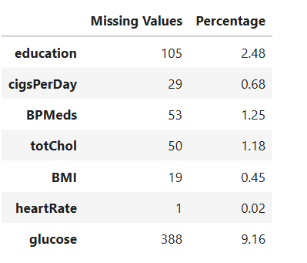
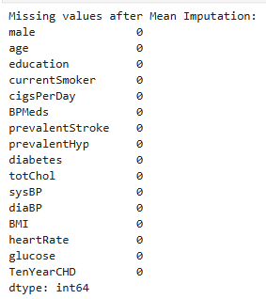
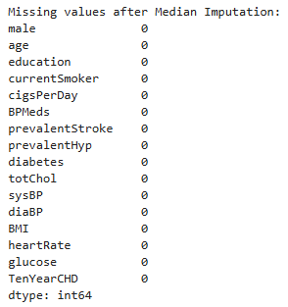
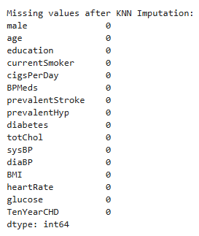
Data Preprocessing
Steps Performed
Checked the dataset for missing values.
Compared Mean, Median, and KNN Imputation techniques to handle missing data.
Selected Median Imputation for the final model as it is less affected by outliers.
Checked for duplicate records.
Detected potential outliers using Box Plots.
Applied StandardScaler to normalize numerical features before model training.
Key Outcomes
Missing values were successfully handled.
No duplicate records were found.
Numerical features were standardized to improve model performance.
The dataset was cleaned and prepared for machine learning.

Slide 10
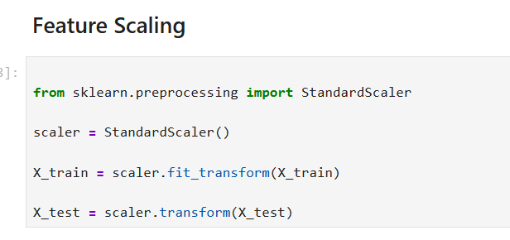
Feature Scaling
Technique Used
Applied StandardScaler to numerical features.
Standardized features before model training.
Purpose
Bring all numerical features to a common scale.
Prevent features with larger values from dominating the model.
Improve the performance of machine learning algorithms.
Outcome
Features were standardized with a mean of 0 and a standard deviation of 1.
Scaled data was used for training and testing.

Slide 11
Exploratory Data Analysis (EDA)
Analysis Performed
Analyzed the distribution of numerical features.
Identified relationships between different variables.
Visualized feature distributions using histograms.
Examined feature correlations using a heatmap.
Detected potential outliers using box plots.
Key Insights
Most numerical features showed a normal or slightly skewed distribution.
Some features contained outliers, identified using box plots.
Certain features showed stronger correlations with the target variable than others.
EDA provided valuable insights for data preprocessing and model building.

Slide 12
Feature Selection
Technique Used
Applied SelectKBest for feature selection.
Used the ANOVA F-test (f_classif) to evaluate the relationship between each feature and the target variable.
Selected the top 8 important features for model training.
Purpose
Identify the most relevant features.
Remove less important or irrelevant features.
Reduce model complexity.
Improve model performance and efficiency.
Outcome
Features were ranked based on their ANOVA F-scores.
The top 8 features were selected for building the machine learning models.

Slide 13
Model Building
Machine Learning Models Used
Logistic Regression
Used as the baseline classification model.
Simple, fast, and interpretable.
Decision Tree
Classifies data using decision rules.
Easy to understand and visualize.
Random Forest
Ensemble learning algorithm that combines multiple decision trees.
Reduces overfitting and improves prediction accuracy.
Training Process
Split the dataset into 80% Training and 20% Testing.
Trained all three models using the training dataset.
Compared model performance on the testing dataset.

Slide 14
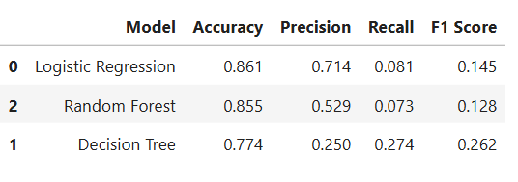
Model Evaluation & Results
Evaluation Metrics
Accuracy – Measures the overall correctness of the model.
Precision – Measures how many predicted positive cases are actually positive.
Recall – Measures how many actual positive cases are correctly identified.
F1-Score – Harmonic mean of Precision and Recall.

Slide 15
Conclusion
Project Summary
Successfully developed a machine learning model for Heart Disease Prediction.
Performed data preprocessing, including missing value handling and feature scaling.
Conducted Exploratory Data Analysis (EDA) to understand the dataset.
Trained and compared Logistic Regression, Decision Tree, and Random Forest models.
Evaluated models using Accuracy, Precision, Recall, and F1-Score.
Logistic Regression achieved the best overall performance with the highest accuracy (86.1%) and was selected as the final model.

Slide 16
Future Scope
Perform hyperparameter tuning to improve model performance.
Train on larger and more diverse healthcare datasets.
Deploy the model as a web application using Flask or Streamlit.
Integrate the model into clinical decision support systems.

Slide 17
Real-World Applications
Hospitals & Clinics: Assist doctors in identifying patients at high risk of heart disease for early intervention.
Preventive Healthcare: Help detect high-risk individuals before severe cardiac events occur.
Health Monitoring Apps: Integrate with mobile or wearable health applications to provide personalized risk assessments.
Clinical Decision Support: Support healthcare professionals by providing an additional prediction tool during diagnosis.
Health Screening Programs: Help prioritize patients who require further medical tests and monitoring.
Healthcare Research: Analyze patient data to study risk factors and improve preventive healthcare strategies.

Slide 18

THANK YOU

