Slide 1
GOVERNMENT FIRST GRADE COLLEGE SORAB DEPARTMENT OF BCA
PRESENTATION ON
SIGN LANGUAGE DETECTION USING ML & NLP
SUBMITTED BY
SANJAY M – U06Go21S0019
GUIDED BY
Mrs Madhura Yadav m p. M.Phil,Ph.D

Slide 2
SIGN LANGUAGE IS THE NOBLEST GIFT GOD HAS GIVEN TO DEAF PEOPLE

Slide 3
INTRODUCTION
This project focuses on developing a real-time sign language detection system, leveraging python for robust backend processing and tensorflow for machine learning model integration.
Tensorflow is utilized for loading and employing a convolutional neural network (CNN) model, which is trained to recognize various hand gestures corresponding to sign language alphabets.
Opencv is employed for real-time video capture and image preprocessing, ensuring that the captured hand gestures are accurately normalized and resized for model prediction.
Additionally, pyttsx3, a text-to-speech engine, is integrated to convert the recognized gestures into spoken language, providing an auditory output that enhances communication.

Slide 4
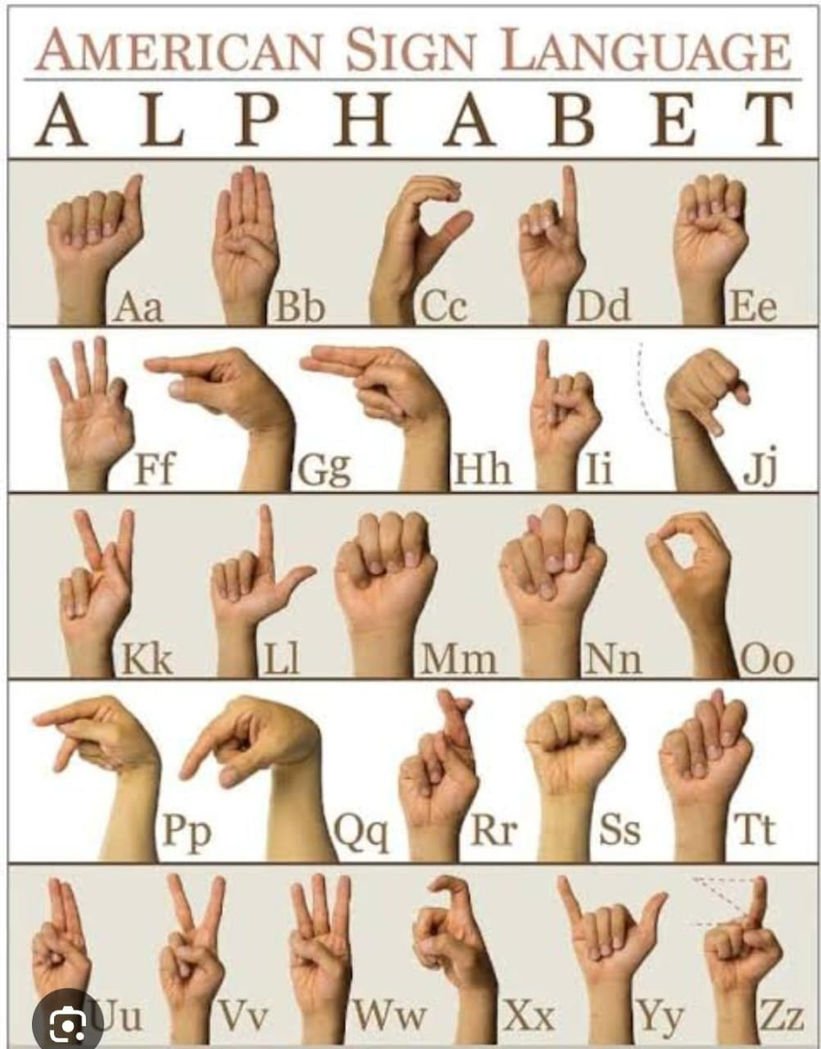
ALPHABETICAL SIGNS

Slide 5
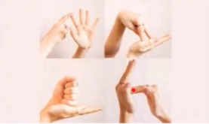
Feasibility Study
Sign Language Detection deals with detecting the hand Gesture
acquisition and continues till text or speech is generated for
corresponding hand gestures.
Deaf and dumb people use Sign Language as their primary means
to express their ideas and thoughts with their own community
and with other people with hand and body gesture.
Sign Language Detection is an attempt to recognize these hand gestures and convert them to the corresponding text to speech.

Slide 6
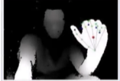
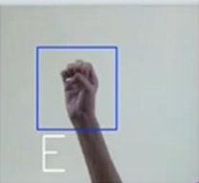
Data Acquisition :
Data acquisition is the process of sampling signals that measure
realworld physical phenomena and converting them into a digital
Form that can be manipulated by computer and software.
Gesture Recognition :
Gesture recognition facilitates effective communication between
individuals who are deaf or hand of hearing community.

Slide 7
requirements
FUNCTIONAL REQUIREMENTS:
User Interface :
The application will provide a user-friendly web interface allowing users to interact seamlessly with the sign language detection system.
Rael time video capture :
The application must capture video input from a webcam in real-time. The video capture functionality should start automatically upon launching the application.
Hand detection :
The system must detect and track hand gestures in the captured video frames using the cvzone HandTrackingModule.
Image preprocessing :
The system must preprocess the isolated hand region by resizing, normalizing, and adjusting the aspect ratio to fit the input requirements of the CNN model.
NON-FUNCTIONAL REQUIREMENTS:
Performance :
The system must process video frames in real-time, with minimal latency between capturing the video frame, detecting the gesture, and producing the spoken output.
Usability :
The user interface must be intuitive and easy to use, even for users with minimal technical knowledge.
Accessibility :
The system should be accessible to users with disabilities, adhering to relevant accessibility standards and guidelines.
Security :
The application must ensure the security and privacy of user data, particularly any captured video streams or personal information.

Slide 8
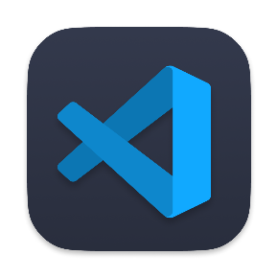
Software components
Visual studio code :
Visual Studio Code (VS Code) is a powerful, open-source code editor developed by Microsoft. It's designed to provide a streamlined and efficient coding environment for developers, offering a range of features that enhance productivity and code quality.

Slide 9

Software description
Frontend – Development
Hyper Text Markup Language :
HTML is the standard markup language used to create and structure content on the web. It serves as the backbone of web pages, providing the basic structure and elements that define the content.

Slide 10
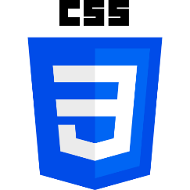
Cascading style sheet :
CSS defines how HTML elements should be displayed in terms of colours, fonts, spacing, positioning, and overall visual effects

Slide 11
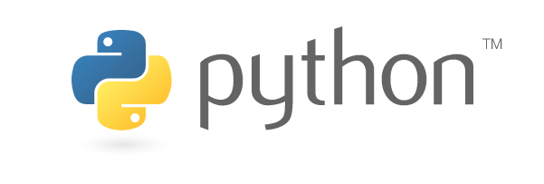
Backend – Development :
Python :
Python is a high-level, interpreted programming language known for its simplicity and readability. Developed by Guido van Rossum and first released in 1991. Python supports multiple programming paradigms, including procedural, object-oriented, and functional programming, and comes with a comprehensive standard library that supports a wide range of tasks, from web development and data analysis to artificial intelligence and scientific computing.

Slide 12
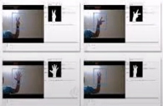
Libraries Overview
Open CV :
OpenCV is an open-source computer vision and machine learning software library.
Image Processing: OpenCV provides a comprehensive set of tools for manipulating images, including filtering, edge detection, thresholding, and geometric transformations like resizing, rotation, and perspective correction.
Video Analysis: It supports processing and analyzing video feeds, including tasks like object detection, motion detection, background subtraction, and tracking.

Slide 13
NumPy :
NumPy is a crucial library for scientific computing in Python, providing powerful tools for handling and processing numerical data.
Threading :
The threading module in Python is a powerful tool that enables concurrent execution within a program by allowing multiple threads to run in parallel.
TensorFlow :
TensorFlow is a comprehensive open-source library developed by Google that is widely used for machine learning and deep learning applications. It provides a flexible platform for building and deploying machine learning models, from research prototypes to production systems.
cvzoneHandTrackingModule :
The cvzone.HandTrackingModule is a specialized module within the cvzone library that simplifies the process of hand detection and tracking using computer vision techniques.
Flask :
Flask is a lightweight and flexible web framework for Python that is widely used for building web applications, APIs, and microservices.

Slide 14
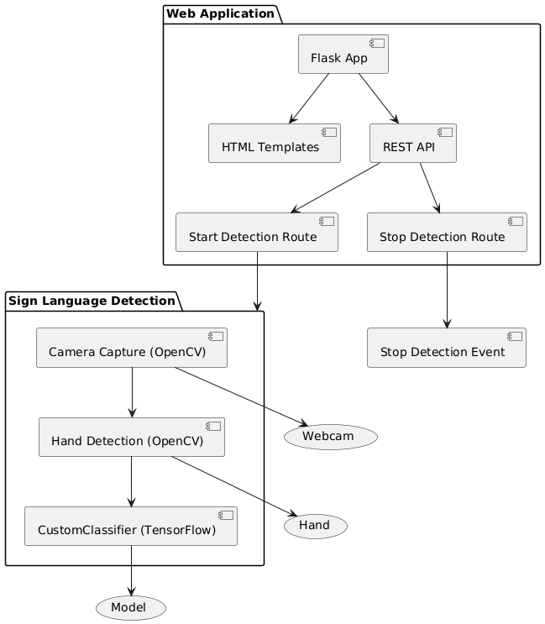
ARCHITECTURE DIAGRAM
This diagram illustrates the architecture of a sign language detection web application that is built using Flask for the web interface and OpenCV/TensorFlow for hand gesture detection.The web application consists of a Flask App that manages two main components: HTML templates for rendering the web pages and a REST API to handle detection-related actions. The API has two primary routes:
Camera Capture (OpenCV): The system accesses the webcam to capture a live video feed. This is achieved using OpenCV, which provides the interface for video input.
Hand Detection (OpenCV): After capturing the video, OpenCV is used to detect the hand within the video frames. The hand is then isolated for further analysis.
Custom Classifier (TensorFlow): The detected hand is passed to a custom-trained classifier built using TensorFlow. This classifier processes the hand's image and matches it against the pre-trained model to recognize the sign language gesture.
The output of the CustomClassifier is then used to interpret the detected sign

Slide 15
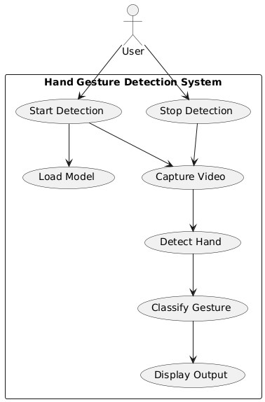
USE CASE DIAGRAM
use case diagram provides a comprehensive overview of how a hand gesture detection system operates from the user's perspective. It delineates the different functionalities the system offers and how they interact based on user actions.

Slide 16
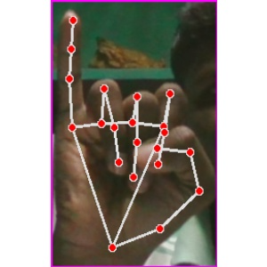
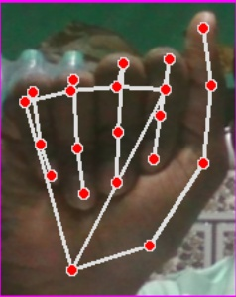
Collecting signs
Collected Sign = I
Collected Sign = A

Slide 17
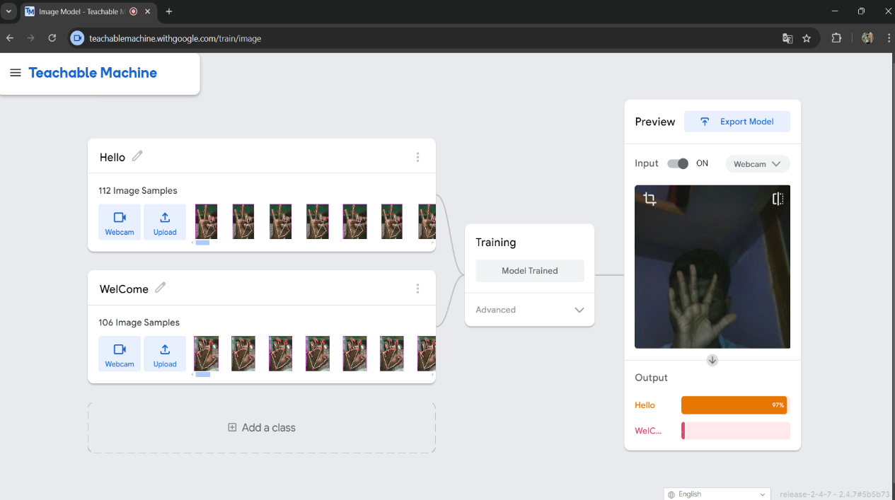
Data Training
Google AI Train Learning :
Google AI provides a comprehensive suite of resources to facilitate learning and application in machine learning (ML). At the heart of these offerings is the Google AI Platform, which supplies cloud-based tools for building, training, and deploying ML models, integrating seamlessly with popular frameworks like TensorFlow
Teachable Machine – Google :
Teachable Machine, developed by Google, is an accessible tool designed to simplify the process of creating machine learning models for users of all skill levels.

Slide 18

TOOLS AND DEPENDENCIES :
keras
Keras is an open-source software library that provide a python interface for artificial neural networks.
Keras is a popular deep learning framework widely used for various machine learning tasks, including sign language detection.
It is a high-level API built on top of other machine learning frameworks such as TensorFlow.

Slide 19
THANK YOU

