Slide 1

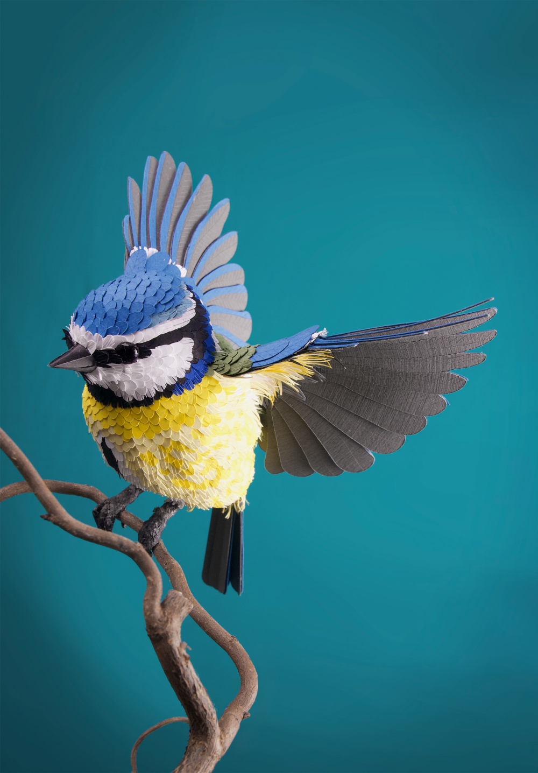
Bird Species Classification Using ResNet
By:
Attili Sanjeet
(18100011)

Slide 2
Roadmap
About the
Dataset
Results
Introduction
1
3
5
2
4
Motivation
Implementation

Slide 3
Introduction
1

Slide 4
Numerous people visit bird sanctuaries to see various birds and to enjoy the beautiful variants of colors and characteristics of the birds, People barely have the knowledge about the various species and hence cannot easily distinguish the characteristics and the species name without the expertise in the field of ornithology.
Bird watching is usually considered to be a good recreational activity that most of the people do practice besides their usual life style.

Slide 5
Motivation
2

Slide 6
Identification of species requires the assistance of manual bird books.
It also requires expertise in the field to identify the species accurately.
Few Species of Birds look very familiar in their appearances thus identifying the exact species by humans may be difficult.
The automatic identification and classification of birds by making use of the modern deep learning techniques motivates the development of this project.

Slide 7
About the Dataset
3

Slide 8
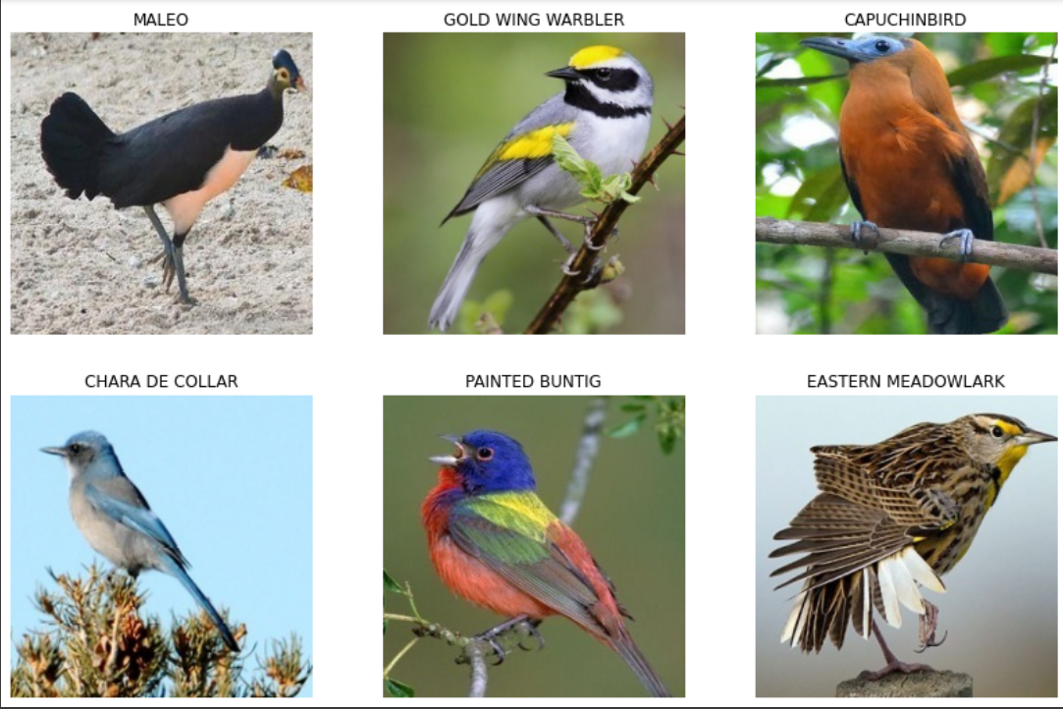

This Dataset was taken from Kaggle which contains around 250 different bird species in total
The dataset contains:
Each Image has a dimension of 224x224x3

Slide 9
Some of the species include Parrot, Crow, Harpy eagle, Long-eared owl, Turkey, Honeycreeper, Golden wing Warbler, Kakapo, and many more..
The dataset has no class imbalance problem, each species have equal number of images associated
The dataset size was around ~1.5-2GB. Hence I have used the kaggle API to launch the dataset directly through Google Colab notebook

Slide 10
Implementation

Slide 11
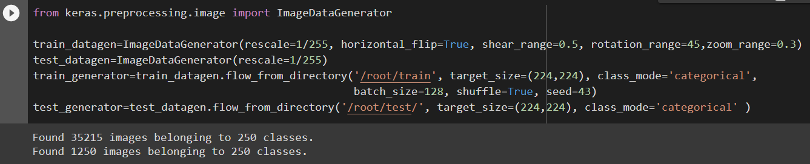
First we introduce the ImageDataGenerator for preparing the train, test images from the following command:
Next we will be creating a basic CNN model for classifying the birds and we will be using this as a benchmark model to compare with the ResNet Model.

Slide 12
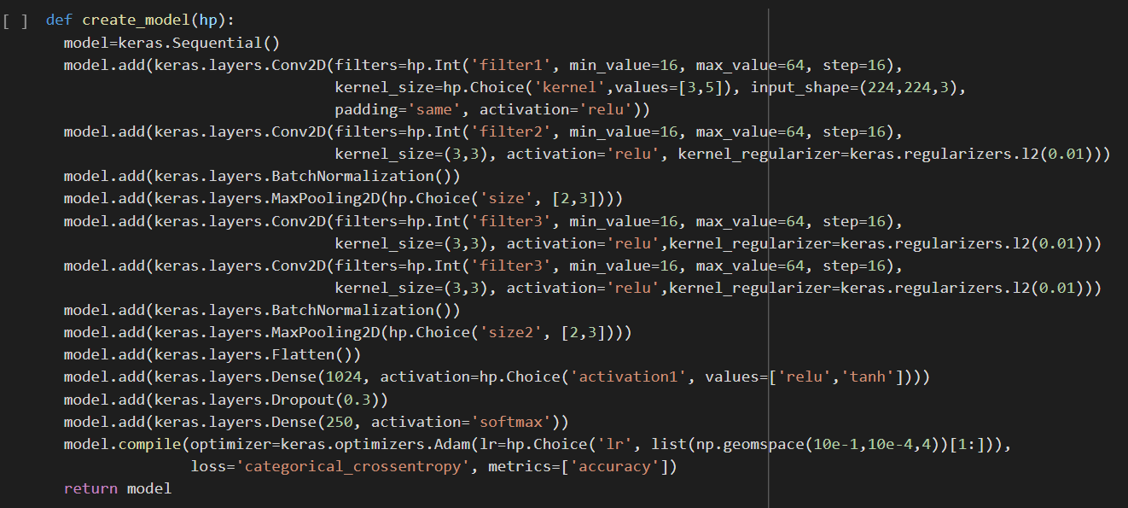
Below is the skeleton for CNN model and we will be fine-tuning this model with the help of keras-tuner

Slide 13
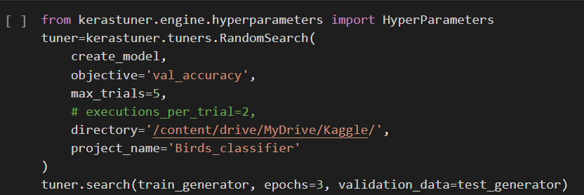
Hyperparameters: Hyperparameters are the variables which determines the network structure(In our case: Number of Hidden Units, dropout_rate, filter size, no. of filters, etc) and the variables which determine how the network is trained(Eg: Learning Rate). These are set before training.
Fine-tuning: In general, means making small adjustments to a process to achieve the desired output or performance.
Below is the Hyperparameter-tuning procedure for the basic CNN model, this process takes about 1.5 hours.

Slide 14
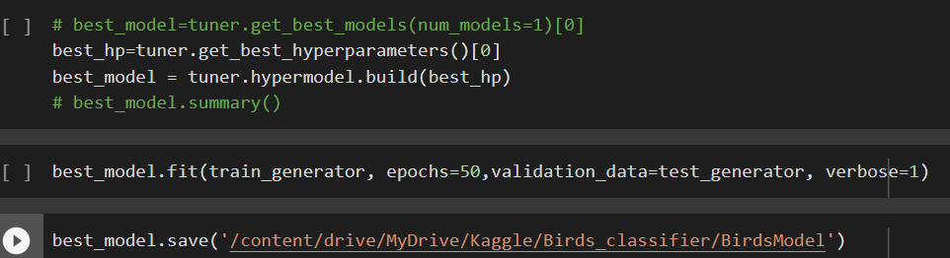
Finally, building the CNN model with the best hyperparameters found via the previous process.
After this the model is fit and trained for over 50 epochs the train and validation accuracies were close to 50% (as a basic model). Finally we save this model
Now we create ResNet Model and compare our results with this basic CNN model’s performance.

Slide 15
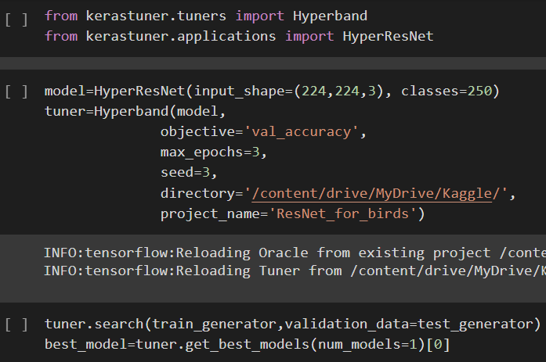
Now we will be introducing the ImageDataGenerator for preparing the train, test images from the same commands as done before for CNN
Next we will be loading up the hyperparameter fine-tuning procedure for ResNet architecture
Now we tune for best set of hyperparameters and finally return the best model

Slide 16
Results
5

Slide 17
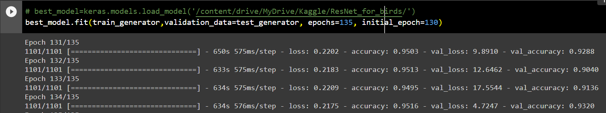
After getting the right set of hyperparameters, the model was trained for over more than 140 epochs (which took about 48 hrs despite the use of GPU!) and achieved an validation accuracy of 95% !! Which was way better than the basic CNN model (~50%)
Finally we save this model with the following command from Keras

Slide 18
Note:
The present dataset has been updated to 265 Bird species on the Kaggle, this code works even for that!!
Due to this update all tuning related files won’t be of any use to share, hence one needs to run the whole code again :)
New API token needs to be generated from Kaggle (if u want to use the dataset without downloading on your local PC)
Link to the Dataset: https://www.kaggle.com/gpiosenka/100-bird-species/data
Link to the Code: https://colab.research.google.com/drive/1NKr9ydTMtOH58yOTdd1ReeNmT5inQ2ow?usp=sharing

Slide 19
Thank You !

