Slide 1
Gender | Count
Male | 10
Female | 7
Others | 9
B | 6

Slide 2
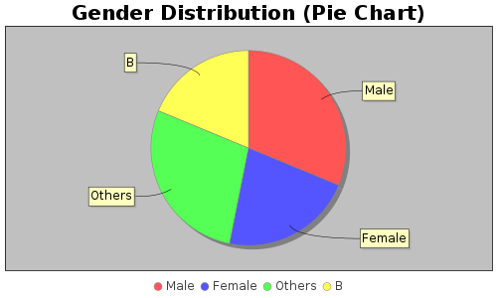
Pie Chart

Slide 3
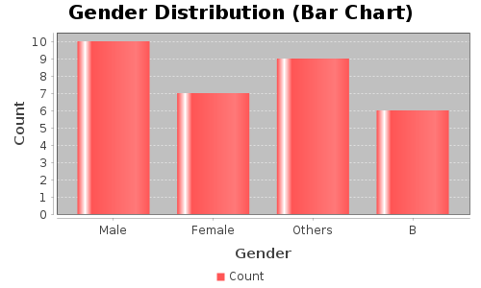
Bar Chart

