Slide 1
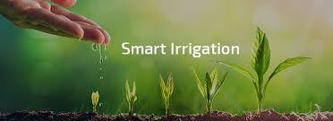
ST-09 Smart Irrigation Water Management System for Farmers
Team members:
Sanju -2303A52313
Srinidhi -2303A53023
Hemanth -2303A52259
Hanush Vardhan-2303A52169

Slide 2
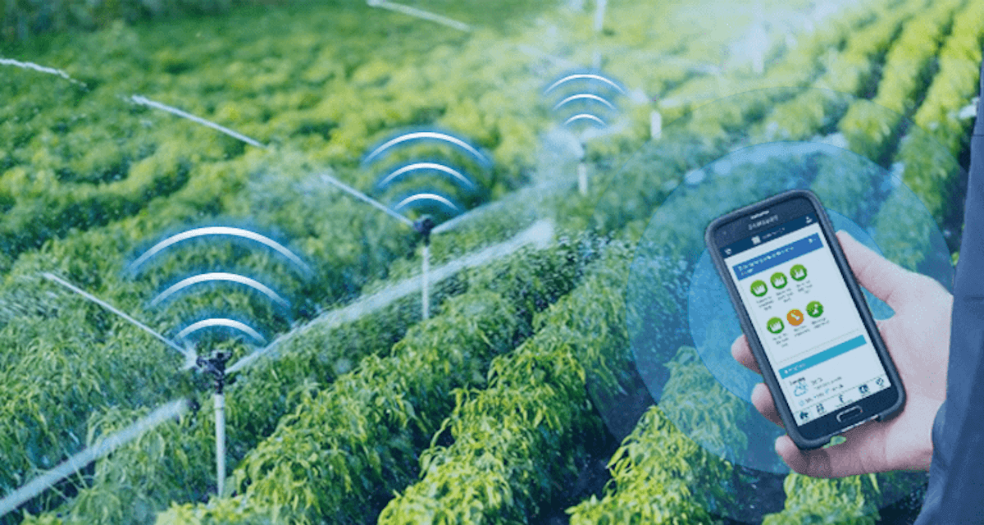
Smart Irrigation Optimization System
Smart Irrigation System aims to reduce water and electricity wastage by replacing fixed irrigation schedules with a data-driven decision system.
It uses real-time inputs such as soil moisture, weather forecast, and crop requirements.
The system works based on three key decision layers, as follows:
Soil Moisture Intelligence
Measures real-time soil moisture
Prevents irrigation if moisture is sufficient
Weather-Aware Irrigation
Uses weather APIs to predict rainfall
Avoids irrigation before rain
Crop-Based Optimization
Calculates exact water needs based on crop stage
Ensures precise irrigation duration

Slide 3
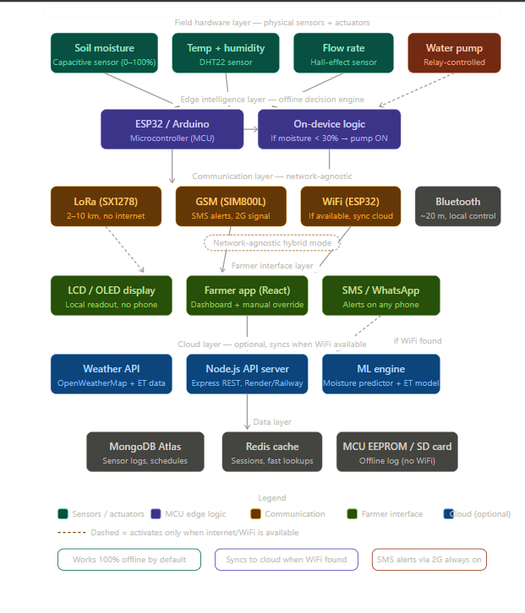
APPROACH:

Slide 4
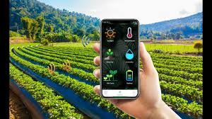
Technical Feasibility
Uses existing technologies (Frontend, Backend, Weather APIs)
Works without hardware using manual input (demo-ready)
Can be easily extended to Arduino/IoT sensors in future
Simple rule-based logic ensures fast and reliable decisions
Economic Viability
Reduces 30–50% water usage
Saves 25–40% electricity consumption
Low implementation cost (only smartphone required initially)
High Return on Investment (ROI) for farmers
Economic & Practical
Solutions
Supports offline/manual input mode
Simple interface → only shows Irrigate / Skip
Future integration with low-cost sensors
Can be used by officers/family members if needed
Challenges
Limited internet connectivity in rural areas
Initial resistance to new technology
Cost of sensors for full hardware deployment

Slide 5
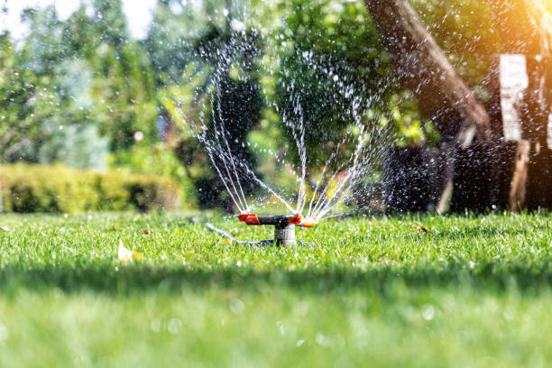
IMPACTS AND BENEFITS
By replacing fixed irrigation schedules with real-time data, the system ensures water is used only when required, improving both water and energy efficiency.
Serves as a smart irrigation assistant, allowing farmers to optimize water usage, reduce wastage, and improve efficiency over time.
1. Efficient Water Conservation
2. Reduced Electricity Consumption
Provides a simple and accessible tool for farmers and agricultural officers to monitor irrigation needs and take timely actions for better crop management.
By empowering farmers with insights into soil conditions, weather forecasts, and crop needs, the system supports better decision-making in day-to-day farming activities.
3. Smart Farming Adoption
4. Data-Driven Decision Making
5. Sustainable Agriculture Growth

Slide 6
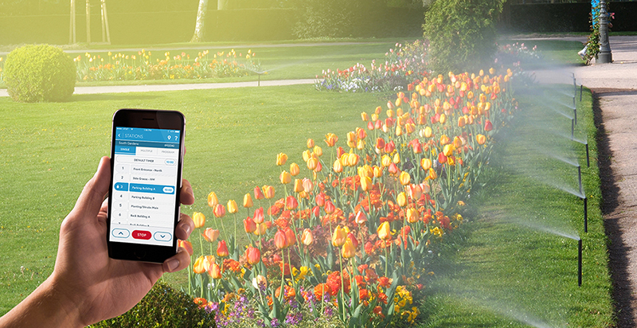
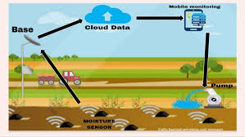
INNOVATION & UNIQUENESS:
Condition-Based Irrigation
Replaces fixed schedules with real-time decisions
Multi-Factor Analysis
Uses soil moisture, weather forecast, and crop data
Software-First Approach
Works without hardware using manual input (demo-ready)
Hardware-Ready Design
Can integrate with Arduino/ESP32 and sensors
Simple Farmer-Friendly Output
Clear result: Irrigate / Skip / Delay
Scalable & Cost-Effective
Easy to deploy and expand for large-scale use

Slide 7
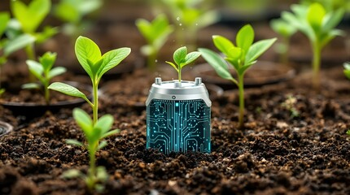
CONCLUSION:
Converts irrigation from guesswork to data-driven decisions
Reduces water and electricity wastage
Improves crop efficiency and productivity
Works as a practical and scalable solution

Slide 8

Thank you

