Slide 1

G2M Insight for Cab Investment Firm
Presented By
Sanjukta Choudhury
LISUM12
08-16-2022

Slide 2

Agenda
Problem Statement
Approach
EDA
EDA Summary
Recommendations

Slide 3
Problem Statement
XYZ is a private firm in US. Due to remarkable growth in the Cab Industry in last few years and multiple key players in the market, it is planning for an investment in Cab industry and as per their Go-to-Market(G2M) strategy they want to understand the market before taking final decision.
The objective is to analyze the details of the Cab Firms and provide actionable insights to help XYZ firm in identifying the right company for investment.
Data Available:
Cab Data: Includes details of transaction for the two cab companies.
Transaction ID: Mapping table that contains transaction to customer mapping and payment mode.
Customer ID: Mapping table that contains a unique identifier which links the customer’s demographic details.
City: Contains list of US cities, their population and number of cab users.

Slide 4

Data Exploration and Approach
Dataset
4 datasets with 19 unique features (5 derived).
Time period for data: 31/01/2016 to 31/12/2018.
Total data points: 359,393.
Approach
The datasets were all combined to create one master dataset.
Profit of a trip is calculated using the difference between Cost of Trip and Price Charged
Month and Year were derived from Date of Travel Feature
Cab_Data
City
Transaction_ID
Customer_ID
Master Data

Slide 5
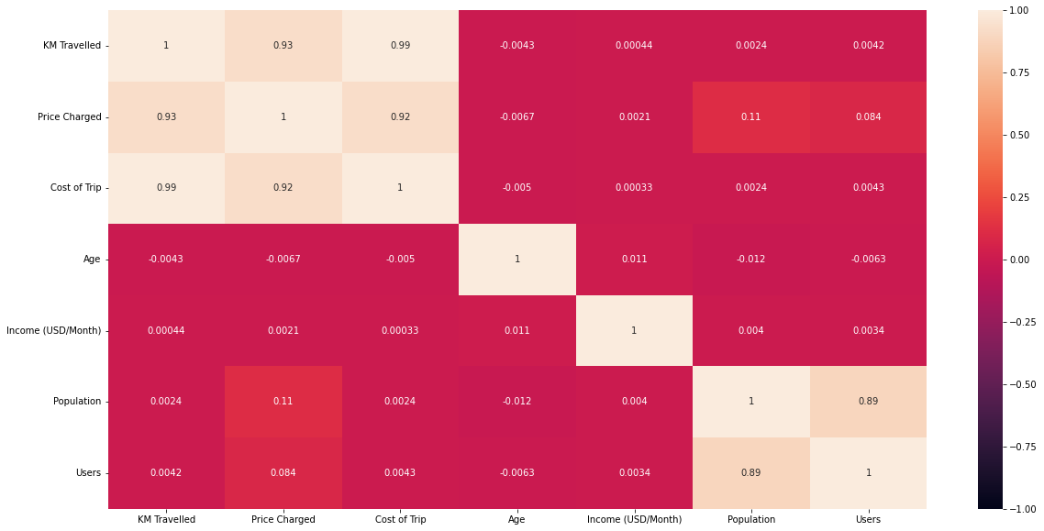
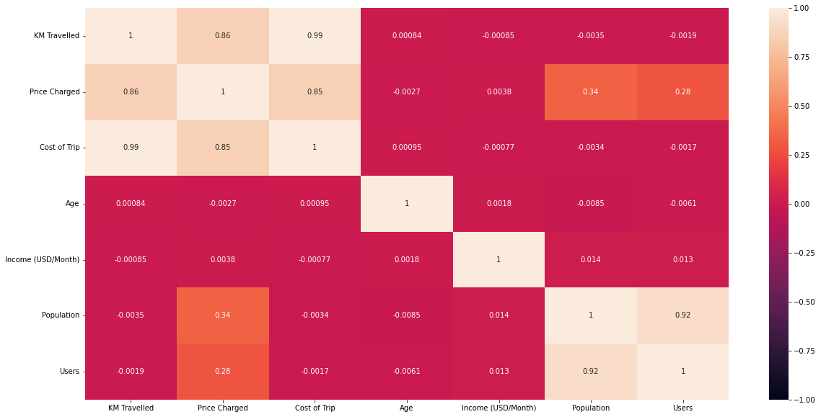
Correlations
Pink Cab
Yellow Cab
From the figures it is seen that for both Pink and Yellow Cabs KM Travelled, Price Charged, Cost of Trip are directly correlated to each other

Slide 6
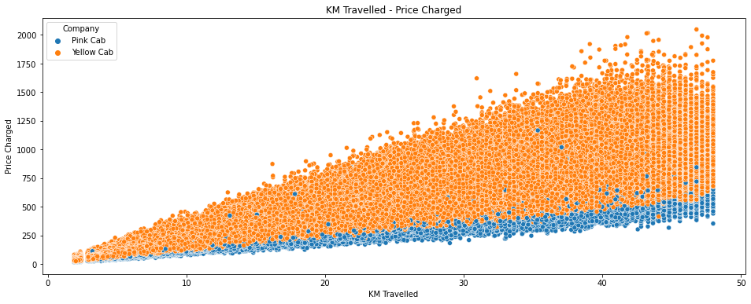
KM Travelled – Price Charged Relation

Slide 7
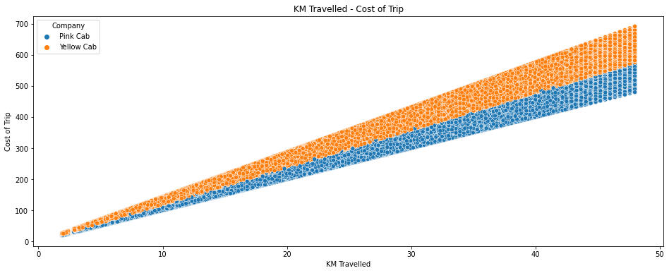
KM Travelled – Cost of Trip Relation

Slide 8
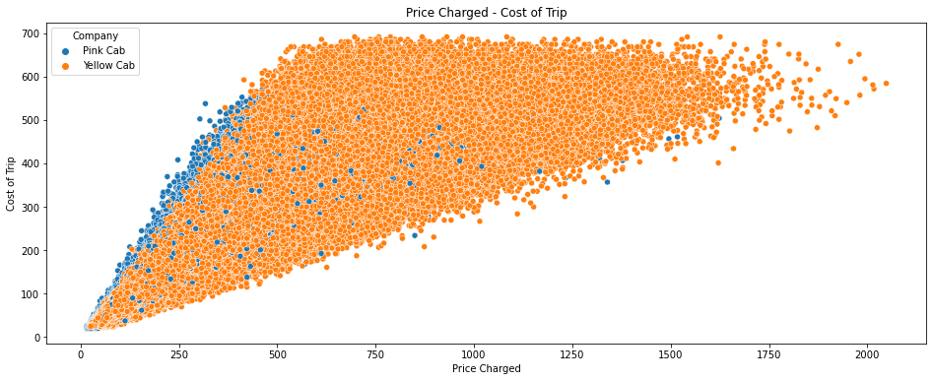
Price Charged – Cost of Trip Relation

Slide 9
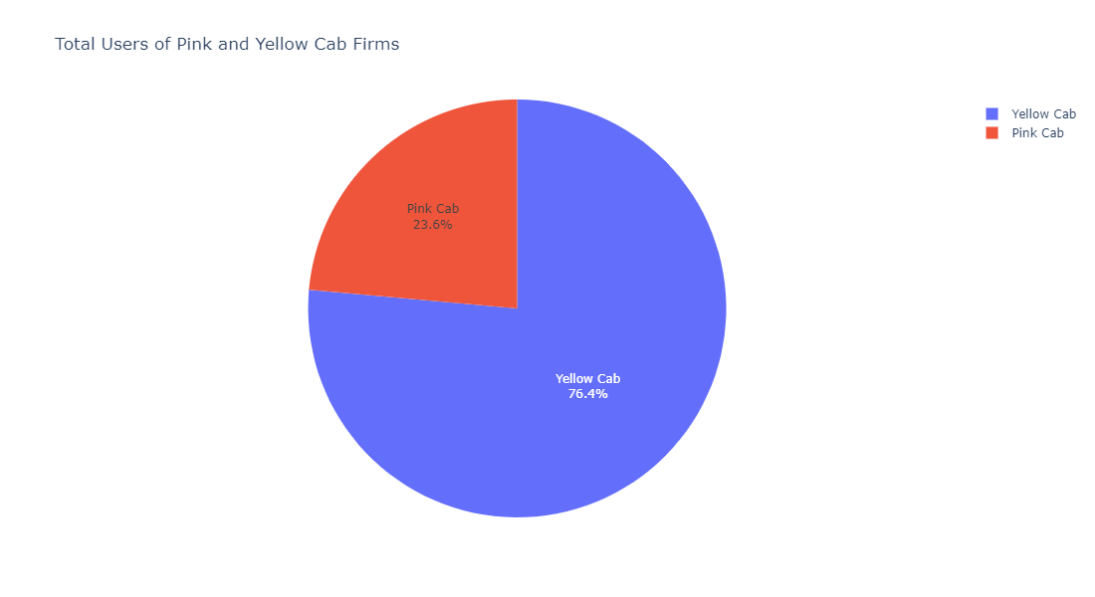
Total Users of Pink and Yellow Cab Firms
The total number of users for Yellow cab is 3 times that of Pink cab

Slide 10
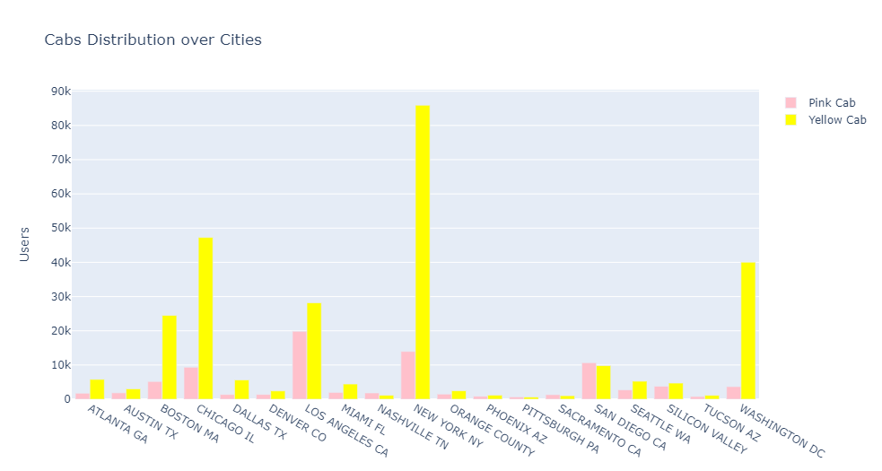
City Wise Cab Users
The Yellow Cab has the highest number of users for almost all the cities. New York being the highest followed by Chicago and Washington DC

Slide 11
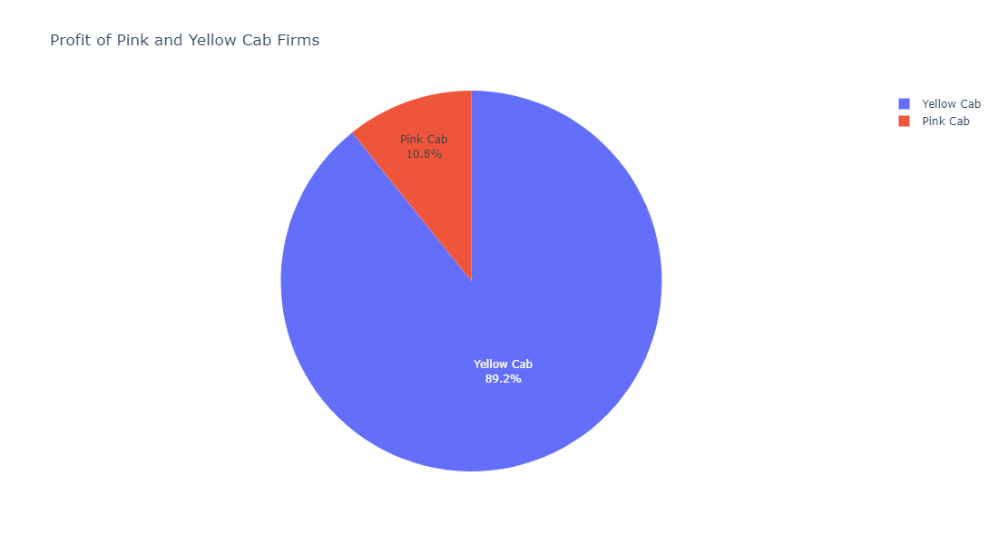
Profit shares of Cab Firms
The profit share of Yellow Cab is 9 times that of Pink Cab

Slide 12
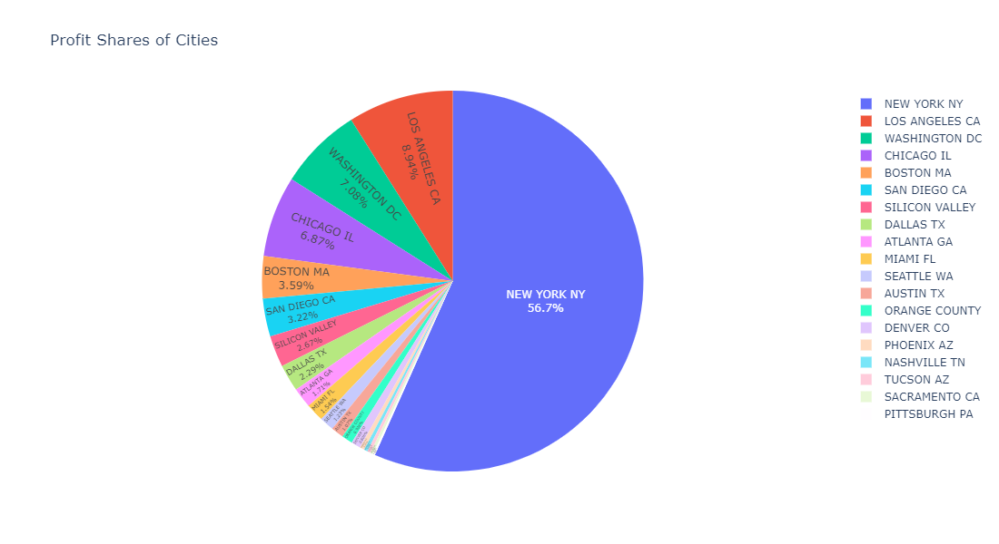
City Wise Profit Share
New York City has the maximum profit of more than 50 % of the total value

Slide 13
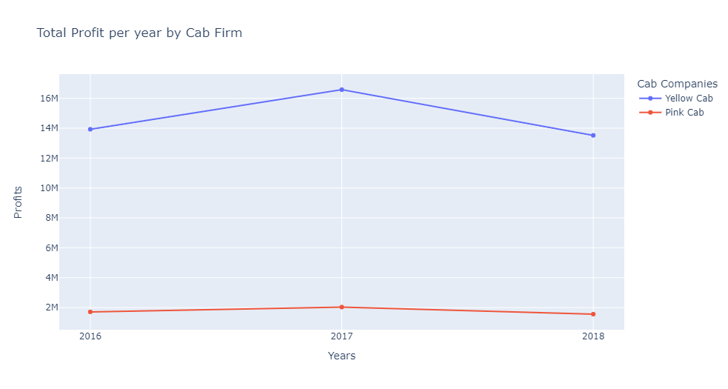
Yearly Profit Analysis
Profit for Yellow Cab has been for more for 2016-2018 range. 2017 has the highest profit margin for Yellow Cab

Slide 14
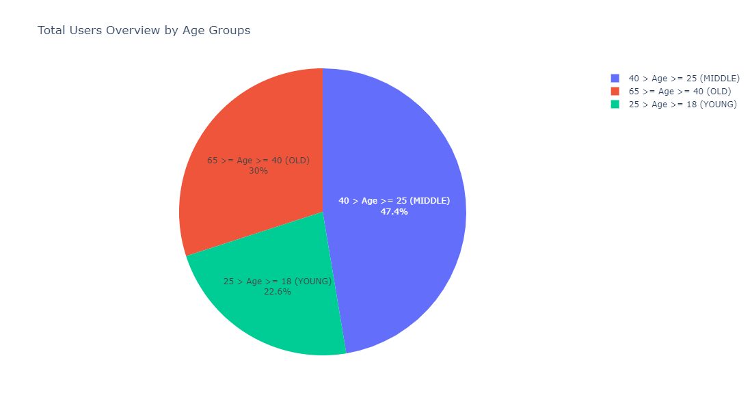
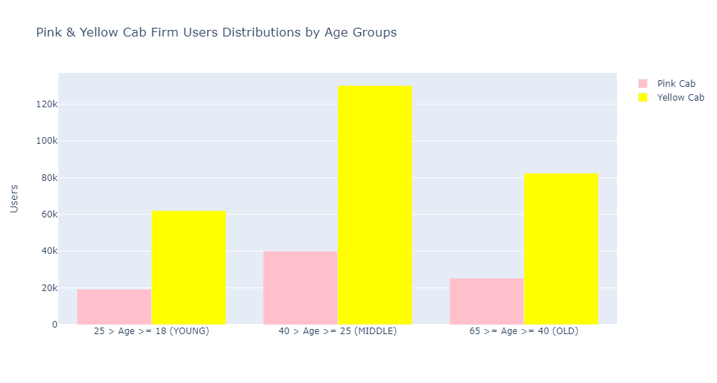
Age Distribution Analysis of Cab Firms
Almost half the cab users belong to age 25 to 40. Yellow Cab firms has the greatest number of users in that age range

Slide 15
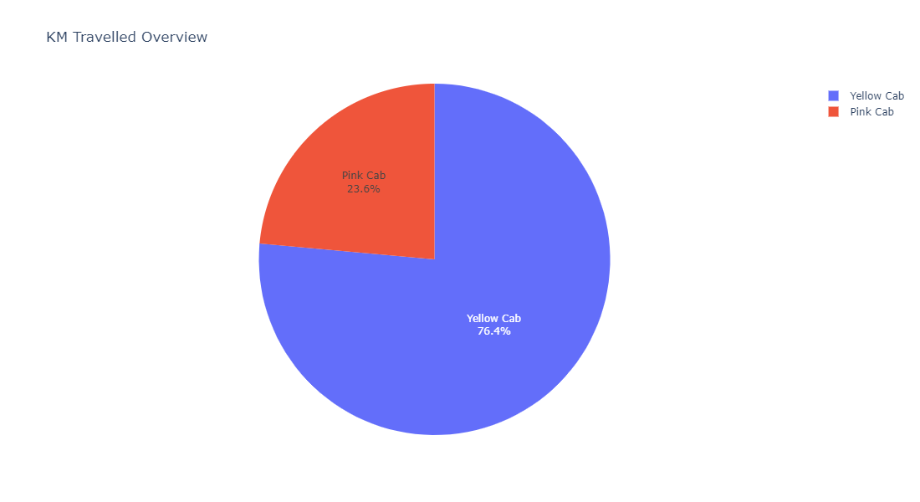
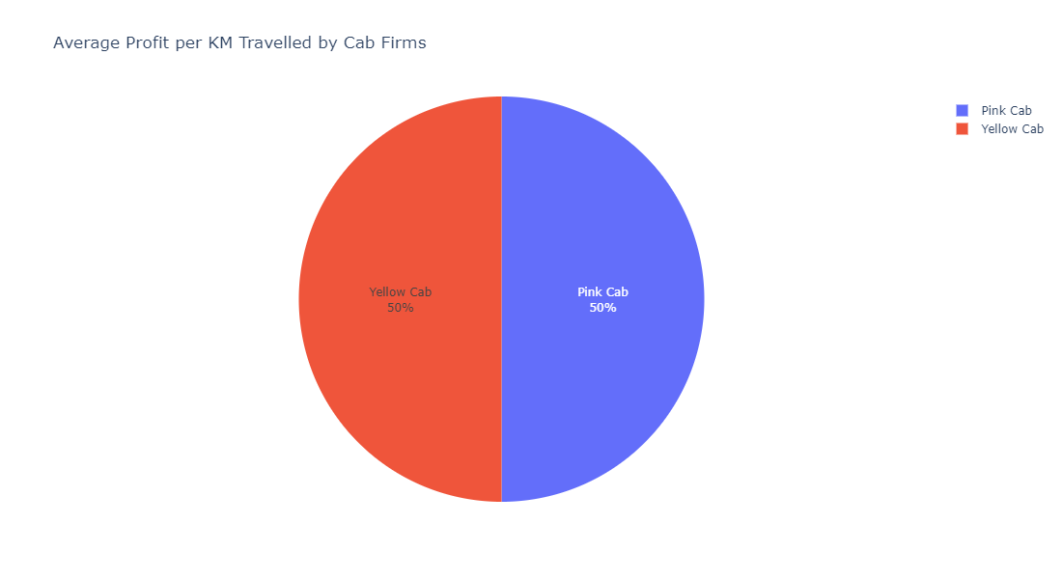
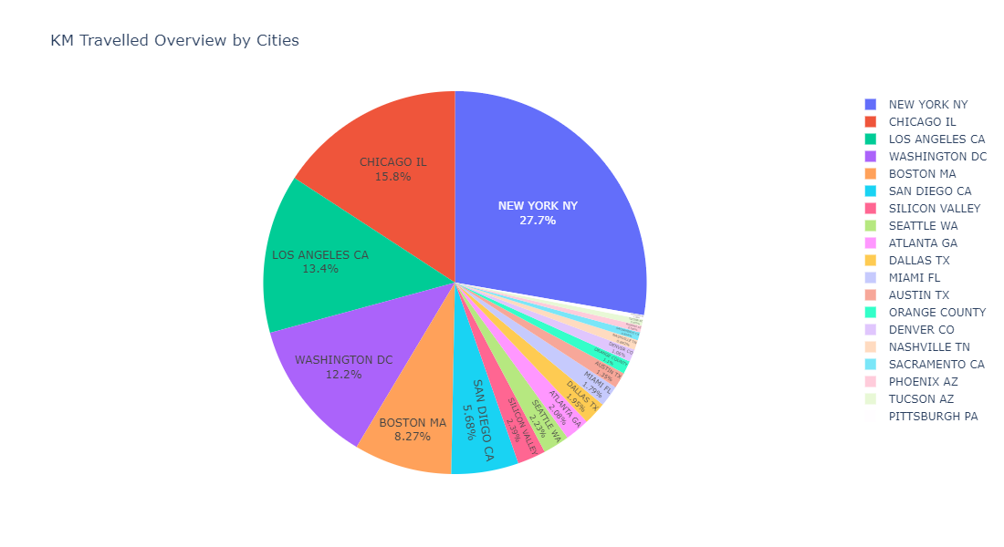
Profit and Customer Analysis based on Distance Travelled

Slide 16
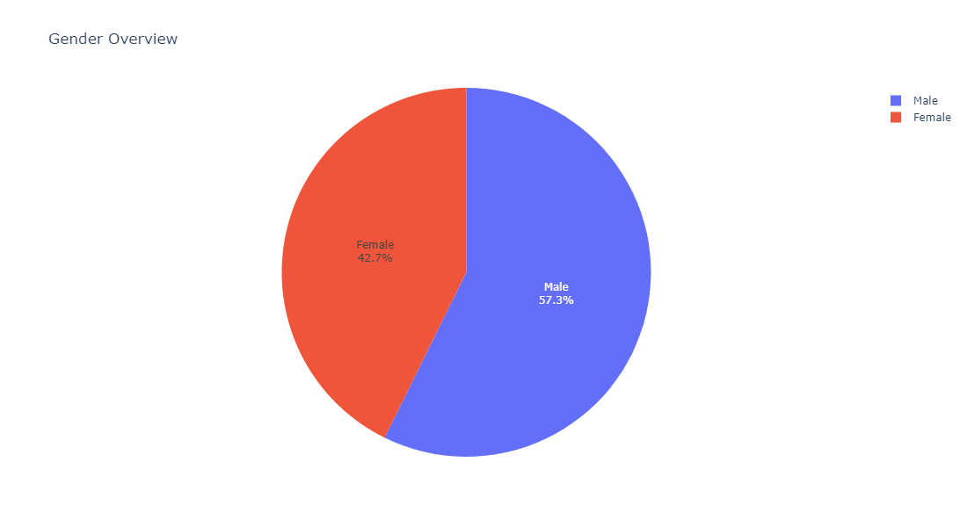
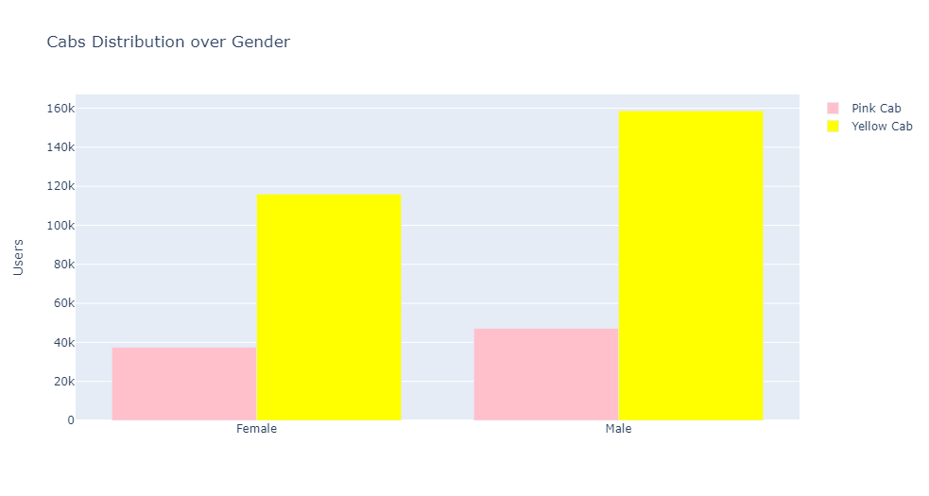
Gender Wise Analysis of Cab Firms
Cab usage is more for Male Users. For both Male and Female Yellow Cab has more users than Pink Cab

Slide 17
Recommendation
Users : Yellow Cab has 3 times more users than Pink cab
Profit share : Profit for Yellow Cab is 9% more than Pink Cab.
Yearly Profit : Yellow Cab has more profit for all the 3 years starting from 2016 to 2018. 2017 saw the highest profit for Yellow Cab
Cities : New York has both the highest number of Users as well as highest profit for Yellow Cab
Gender Aspect : Yellow Cab users are more for both male and female
Age Wise Distribution : For all the age range Yellow Cab has more users. The middle-aged Group has larger number of users for Yellow Cab
Hence Yellow Cab Firm is better for Investment

Slide 18
Thank You

