Slide 1


Voice2Venture
A Contextual-Bandit-Driven Multi-Agent System for Adaptive Livelihood-Growth Recommendation
Presented By
Bhoomika N 4VV23IS038
Sanjula S 4VV23IS194
Shreya BJ 4VV23IS207
Under the Guidance of
Aishwarya T
Assistant Professor
Dept. of ISE, VVCE
1

Slide 2


Contents
  Introduction
  Problem Statement
  Objectives
  Literature Review
  Methodology
  Conclusion
2

Slide 3

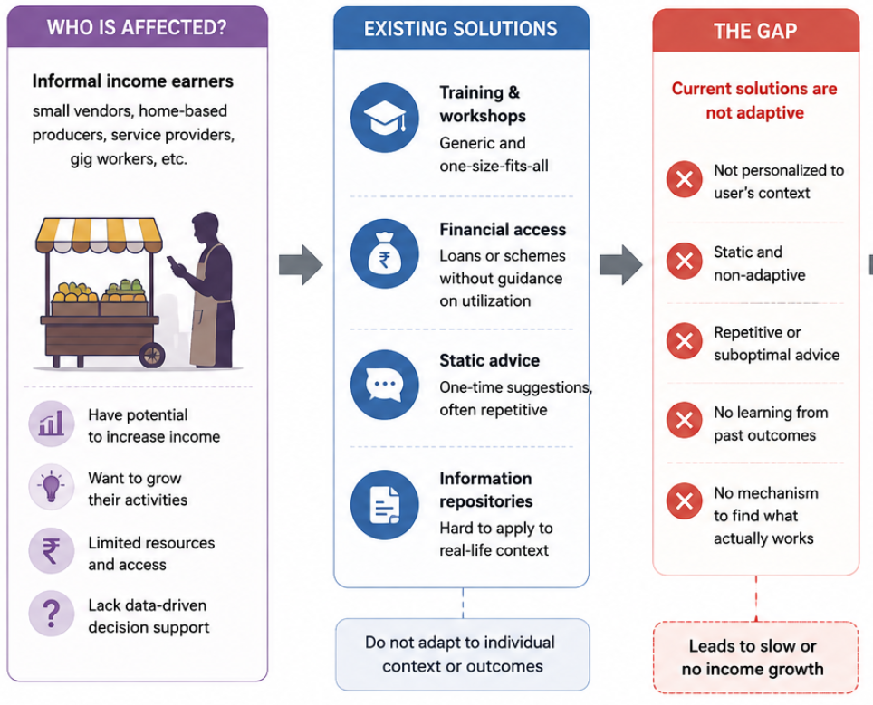
Introduction
  Informal activities are an important source of livelihood. Growth decisions are often uncertain and context-dependent.
  Pricing, scaling, reach, and reinvestment require informed decisions.
  The impact of each decision varies across individuals.
  Without learning from outcomes, sustainable growth is difficult.
  A personalized, data-driven approach is needed for better income growth.
3

Slide 4

Objectives
1. Capture users’ income-generating activities and context through voice/text input.
Personalize growth recommendations based on user activity, history, and
circumstances.
Develop an adaptive contextual-bandit recommendation framework that learns
from feedback and outcomes.
4. Evaluate growth and reinvestment opportunities using financial and ROI analysis.
Compare and evaluate the adaptive system against static and LLM-only
approaches using recommendation, personalization, adaptation, and efficiency
metrics.
4

Slide 5

Literature Review

Slide 6
Sl no | Author and Published Year | Paper Title | Methodology Used | Problem Solved | Advantages | Inference and Limitations
1 | Lihong Li, John Langford, Robert E. Schapire | A Contextual-Bandit Approach to Personalized News Article Recommendation (2010) | LinUCB (Linear Upper Confidence Bound). | Personalized news recommendation and cold-start problem. | Metric: CTR. Result: CTR increased by ~12.5%; UCB outperformed ε-greedy. | Linear reward model; requires exploration; news-specific evaluation.
2 | Wenhuang Kevin Labille, Xintao Wu | Achieving User-Side Fairness in Contextual Bandits (2022) | Fair-LinUCB. | Reducing reward disparity between user groups. | Metrics: Utility loss, reward difference. Results: Reduced reward disparity with low regret. | Simulated experiments; fairness mainly evaluated at the gender-group level.
3 | Mengyan Zhang, Thanh Nguyen-Tang et al. | Two-Stage Neural Contextual Bandits for Personalized News Recommendation (2022) | NRMS + LinUCB. | Limited exploration and computational inefficiency in large-scale neural recommendation. | Metrics:Cumulative reward, CTR. Results: Higher CTR; two-stage approach outperformed one-stage approach. | MIND-specific; computational overhead.
4 | Shenghao Xu | BanditMF: Multi-Armed Bandit Based Matrix Factorization Recommender System (2021) | Matrix Factorization + K-means + BanditMF. | Cold-start and limited exploration. | Metrics:MSE, CTR, cumulative regret. Results: Thompson Sampling performed best; MF reduced MSE by ~20.7%. | Cluster-dependent; higher model complexity.
5 | Xiaoying Zhang, Hong Xie et al. | Conversational Contextual Bandit: Algorithm and Application (2020) | CONUCB. | Slow preference learning and preference acquisition. | Metrics: Cumulative regret, CTR, accuracy. Results: Lower regret and higher CTR than LinUCB. | Key-term dependent; requires user feedback.
6 | Alekh Agarwal, Sarah Bird et al. | Making Contextual Decisions with Low Technical Debt (2017) | Contextual Bandits; ε-greedy exploration. | Biased feedback and delayed rewards. | Metrics:CTR, latency, throughput. Results: CTR increased by ~25–30%; low latency. | Logging dependent; complex deployment.
7 | Yupeng Hou, Junjie Zhang et al. | Large Language Models Are Zero-Shot Rankers for Recommender Systems (2024) | Zero-shot LLM prompting; prompt engineering. | Task-specific training and position/popularity bias. | Metric: NDCG@K. Results: GPT-4/ChatGPT outperformed traditional baselines. | Prompt-dependent; ranking-only; residual bias.
8 | Chuang Li, Weida Liang et al. | Improving Conversational Recommendation with Contextual Adaptation of External Recommenders and LLM-Based Reranking (2026) | CARE; Transformer-based architecture. | Out-of-domain recommendations and limited learning. | Metrics: Hit@K, NDCG@K. Results:Accuracy improvement of ~54% on ReDial and ~25% on INSPIRED. | External recommender dependency; conversational datasets only.
9 | Dietmar Jannach | Evaluating Conversational Recommender Systems: A Landscape of Research (2023) | Offline, user-based, and field evaluation. | Lack of standardized evaluation procedures. | Metrics: Precision, recall, task completion and subjective measures. Results: Highlights the need for objective + subjective evaluation. | No novel model or experimental validation.
6

Slide 7
Sl no | Author and Published Year | Paper Title | Methodology Used | Problem Solved | Advantages | Inference and Limitations
10 | Xiao Xu, Fang Dong et al. | Contextual-Bandit Based Personalized Recommendation with Time-Varying User Interests (2020) | PSLinUCB with sliding-window change detection. | Changing and non-stationary user preferences. | Metrics: CTR, cumulative regret. Results: CTR improved by ~2–3%; lower regret. | Change-detection cost; assumptions regarding user behavior.
11 | Sara Qassimi, Said Rakrak | Multi-Objective Contextual Bandits in Recommendation Systems for Smart Tourism (2025) | Multi-Objective Contextual MAB (LinUCB-based). | Single-objective optimization and dynamic user preferences. | Metrics:Reward, cumulative regret, CTR, relevance, fairness, diversity. Results: Higher CTR and lower regret. | Tourism-specific; optimization overhead.
12 | Alexander Semenov, Maciej Rysz et al. | Diversity in News Recommendations Using Contextual Bandits (2022) | DivLinUCB — LinUCB with recommendation-frequency-based cost. | Over-exposure of popular articles and limited recommendation diversity. | Metrics: CTR, diversity. Results:Improved recommendation diversity. | Increasing diversity may reduce click performance; evaluated only on news data.
13 | Djallel Bouneffouf, Raphael Feraud | Multi-Armed Bandits Meet Large Language Models (2026) | MAB, contextual bandits, prompt optimization. | Exploration–exploitation in LLM-based decision systems. | Metrics: No unified metric; discusses reward and adaptive performance. | Emerging field; no unified benchmark.
14 | Jianghao Lin, Xinyi Dai et al. | How Can Recommender Systems Benefit from Large Language Models? (2023) | LLMs for features, ranking, interaction, and pipeline control. | Complex preferences and limited open-world knowledge. | Metrics: No single standardized metric; discusses effectiveness and personalization. | Cost, scalability, hallucination, and privacy.
15 | Ardeshir Shojaei, Shahla Asadi et al. | LLMs Integration in Recommender Systems (2026) | CLLM4Rec, knowledge-graph integration, LLMER, and pipeline integration. | Cold-start and personalization challenges. | Results:Improvements reported in semantic understanding and personalization. | Cost, hallucination, and lack of evaluation standardization.
16 | Lu Wang, Chiming Duan, Pu Zhao et al. | ICI Bandit: Relevance Labeling in Advertisement Recommendation Systems via LLM (2025) | ICL-Bandit with reward-based demonstration selection. | Costly labeling and ineffective demonstration selection. | Metrics: Accuracy, F1, CTR, conversion. Results: GPT-4 achieved 80.03% accuracy and 82.57% F1; production CTR increased 3.2% and conversion 2.7%. | Advertisement-specific; proprietary data.
17 | Baihan Lin | Reinforcement Learning and Bandits for Speech and Language Processing (2024) | MAB, contextual bandits, RL, offline RL. | Limited online adaptation. | Metrics: No unified metric; focuses on reward and adaptability. | Reward design and safe exploration challenges.
7

Slide 8
Sl no | Author and Published Year | Paper Title | Methodology Used | Problem Solved | Advantages | Inference and Limitations
18 | Davide Strusani, Georges Vivien | The Role of Artificial Intelligence in Supporting Development in Emerging Markets (2019) | Development analysis and case studies. | High costs, limited services, and digital divide. | Results: Potential for lower costs, improved services, and increased productivity. | Infrastructure and skills gaps.
19 | Sangbu Kim, Christine Zhenwei Qiang | Small AI, Big Impact (2025) | Lightweight, context-specific AI. | Limited connectivity, infrastructure, and technical skills. | Results:Examples demonstrate potential applications in agriculture, health, and education. | Connectivity and affordability constraints.
20 | Catalina Rodriguez Tapia, Nadina Iacob | Working Without Borders (2024) | Survey, platform data, regression, and optimization. | Barriers to digital employment and unstable earnings. | Results: Global earnings below US$0.15/task; U.S. prices ≥3× Bangladesh. | Low earnings, geofencing, and unstable work.
21 | Alec Radford, Jong Wook Kim et al. | Robust Speech Recognition via Large-Scale Weak Supervision (2023) | Transformer; multitask learning. | Improving speech recognition without task-specific fine-tuning. | Metrics:WER, BLEU. Results: Up to 55.2% lower WER; supports 99 languages. | High training cost; weaker performance for some low-resource languages.
22 | Yeongseo Jung, Eunseo Jung, Lei Chen | Towards a Unified Conversational Recommendation System (EMNLP 2023) | Multi-task learning (MTL), conversational knowledge distillation (CKD), Transformer-based PLM. | Separate recommendation and dialogue training can reduce performance. | Metrics: Recall@K, NDCG, response quality. Results: Improved recommendation and response performance. | Requires large pretrained models and high-quality conversational data.
23 | Raghav Gupta, Renat Aksitov et al. | Conversational Recommendation as Retrieval (ACL NLP4ConvAI 2023) | BM25, information retrieval, data augmentation. | Existing CRS models use complex knowledge graphs and can be difficult to scale. | Metrics:Recall@1, Recall@10, Recall@50. Results: Improved recall with approximately 5 minutes of CPU training. | Cold-start problem; depends on user history and metadata.
24 | Paul.K. Rubenstein, Chulayuth Asawaroengchai et al. | AudioPaLM: A Large Language Model That Can Speak and Listen (2023) | PaLM-2+ AudioLM; multimodal LLM. | Separate speech and language models reduce efficiency and integration. | Metrics:BLEU, WER. Results: Improved speech-translation accuracy. | High computational cost.
25 | Yunfei Chu, Jin Xu et al. | Qwen2-Audio Technical Report (2024) | Qwen2 LLM + audio encoder + multimodal Transformer. | Existing models have limited audio comprehension capabilities. | Metrics:WER, BLEU, accuracy. Results: Strong performance across multiple audio tasks. | High training and inference cost.
8

Slide 9
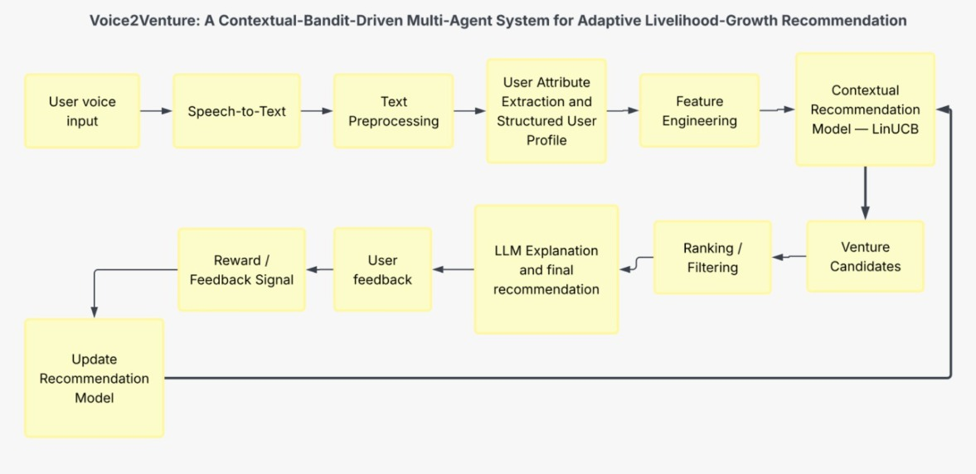
Methodology

Slide 10

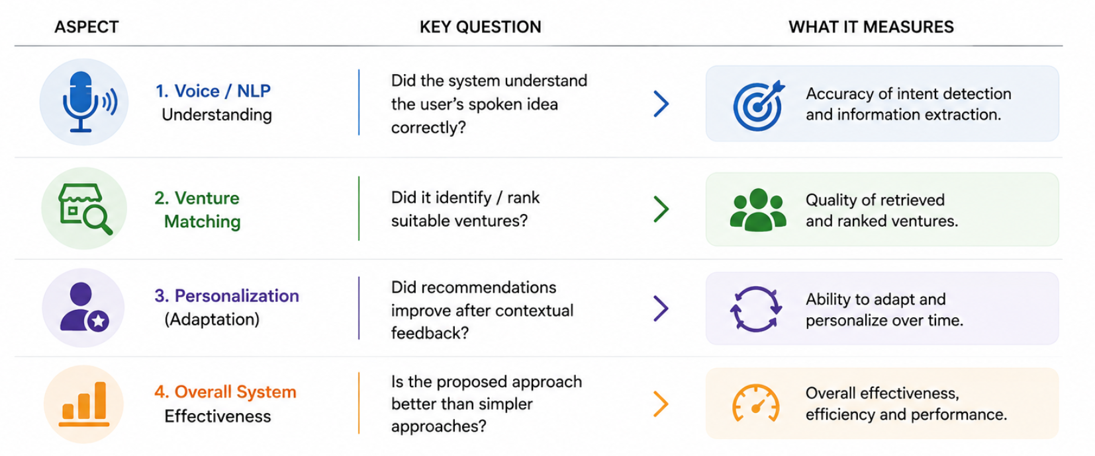
Methodology
Understanding: Input & Intent Accuracy
Matching: Recommendation Relevance
Personalization: Feedback driven improvement

Slide 11
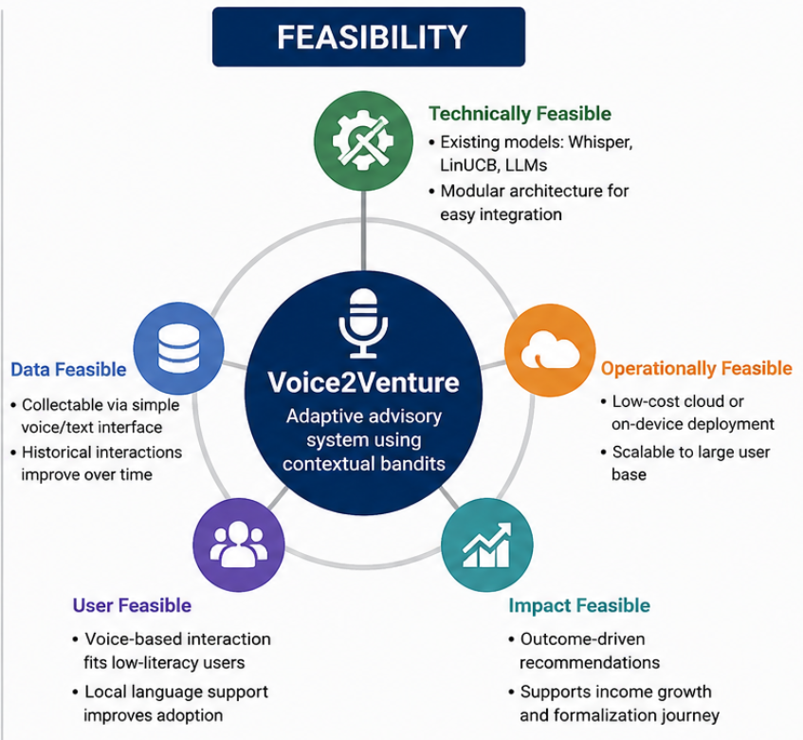
Research Gap
Limited personalization: Existing systems provide generic recommendations.
Static recommendations: Limited learning from user feedback and outcomes.
LLM limitations: LLMs lack reward-based decision optimization.
Limited financial analysis: ROI, investment, risk, and reinvestment are often overlooked.
Fragmented approaches: Voice input, personalization, bandits, and financial analysis are rarely integrated.

Slide 12

Conclusion
  Enables adaptive, personalized growth guidance based on individual user context and outcomes.
  Continuously improves recommendations by using real-world outcomes as feedback.
  Provides a measurable framework to evaluate adaptive recommendations against static or LLM-only approaches.

