Slide 1


Department of Information Science and Engineering
Adaptive Multi-Agent LLM System for Micro-Enterprise Generator
TEAM MEMBERS
Bhoomika N – 4VV23IS038
Sanjula S – 4VV23IS194
Shreya B J – 4VV23IS207
UNDER THE GUIDANCE OF
Prof Aishwarya T
Assistant Professor
Dept. of ISE, VVCE

Slide 2

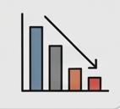

INTRODUCTION
Many rural and semi-urban women are actively involved in daily
productive activities such as cooking, farming, stitching, and
small-scale trading.
However, these efforts often remain informal and unstructured,
and are not converted into consistent or scalable income sources.
The key gaps include:
  Lack of real-time, actionable guidance
  Limited business awareness and market insights
  Absence of continuous support for growth and
  improvement

Slide 3
Problem Statement
Existing solutions focus on:
  Training-based approaches that are not real-time
  Static guidance with no continuous improvement
  Generic recommendations lacking personalization
Current AI systems also have limitations:
  Generate repetitive and generic suggestions
  Fail to track user progress over time
  Lose context across multiple interactions and languages
This leads to a gap between user effort and sustainable income generation

Slide 4

OBJECTIVES
A voice-driven AI system designed for accessibility and ease of use
Converts daily activities into structured income opportunities
Provides:
  Actionable business ideas
  Continuous growth and improvement suggestions
  Simple financial insights and ROI guidance
Ensures:
  Adaptive recommendations
  Progressive evolution of micro-businesses over time

Slide 5
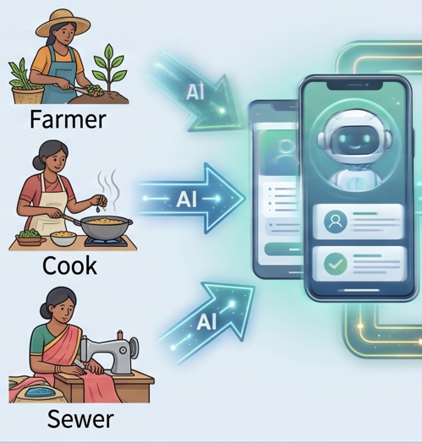
MOTIVATION
Many women have skills and are productive daily but lack ways to convert them into sustainable income.
Existing support systems are:
  Fragmented (training, loans, schemes disconnected)
  Not continuous (no day-to-day guidance)
  Hard to access for low-literacy users
AI advancements create an opportunity to:
  Provide real-time, personalized guidance
  Enable self-driven growth without dependency

Slide 6
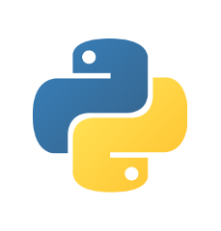

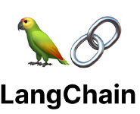



Technology stack
Backend and application logic: Python, Flask
Multi-agent orchestration: Langchain
LLM Layer: Gemini/ Groq API, LLaMA3 for fallback
Memory and context management: MySQL
Cross-lingual support: Google translate API
Frontend (user interaction layer): Streamlit, voice support –> speech-to-text and text-speech

Slide 7
RESEARCH ELEMENT
Research Questions:
Does multi-agent architecture outperform a single LLM for structured recommendations?
Can context memory reduce repetition in iterative interactions?
Does the system improve recommendations progressively over time?
Can context be retained across language switches (cross-lingual consistency)?
Hypothesis:
Multi-agent systems → more structured & diverse outputs than single LLMs
Cross-lingual normalization → consistent context retention
Iterative evolution → progressive improvement in recommendations

Slide 8
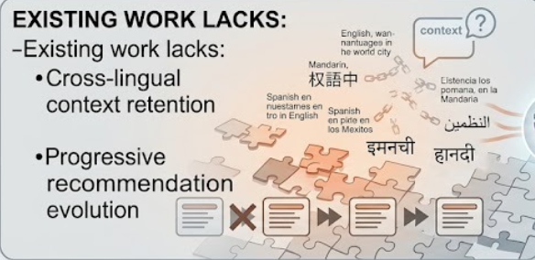
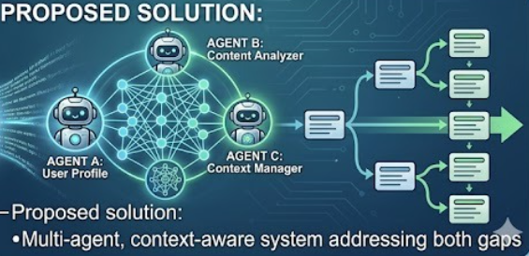

Slide 9
SCOPE
Rural and semi-urban entrepreneurship development
Support for low-literacy users through voice interaction
Application in:
  NGOs
  Self-Help Groups (SHGs)
  Government programs
Scalable across regions and languages

Slide 10
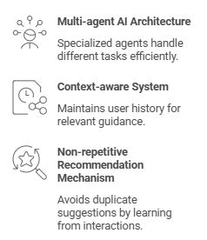
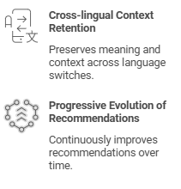
NOVELTY

Slide 11
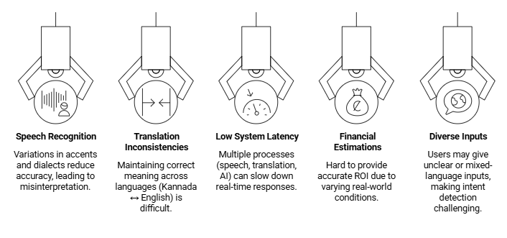
CHALLENGES

Slide 12
THANK YOU

