Slide 1


Voice2Venture
A Contextual-Bandit-Driven Multi-Agent System for Adaptive Livelihood-Growth Recommendation
Presented By
Bhoomika N 4VV23IS038
Sanjula S 4VV23IS194
Shreya BJ 4VV23IS207
Under the Guidance of
Aishwarya T
Assistant Professor
Dept. of ISE, VVCE
1

Slide 2


Contents
  Introduction
  Problem Statement
  Objectives
  Literature Review
  Methodology
  Conclusion
2

Slide 3

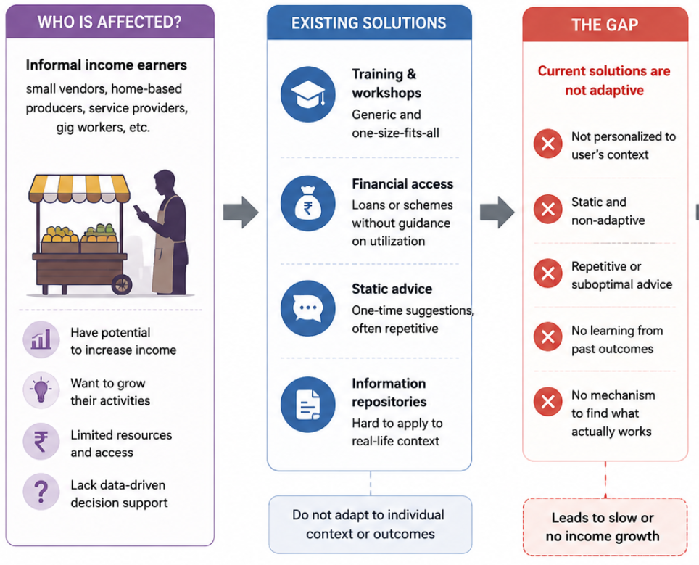
Introduction
  Informal activities are an important source of livelihood. Growth decisions are often uncertain and context-dependent.
  Pricing, scaling, reach, and reinvestment require informed decisions.
  The impact of each decision varies across individuals.
  Without learning from outcomes, sustainable growth is difficult.
  A personalized, data-driven approach is needed for better income growth.
3

Slide 4

Objectives
1. Capture users’ income-generating activities and context through voice/text input.
Personalize growth recommendations based on user activity, history, and
circumstances.
Develop an adaptive contextual-bandit recommendation framework that learns
from feedback and outcomes.
4. Evaluate growth and reinvestment opportunities using financial and ROI analysis.
Compare and evaluate the adaptive system against static and LLM-only
approaches using recommendation, personalization, adaptation, and efficiency
metrics.
4

Slide 5

Literature Review

Slide 6
Sl no | Author and Published Year | Paper Title | Methodology Used | Problem Solved | Advantages | Inference and Limitations
1 | Lihong Li, John Langford, Robert E. Schapire | A Contextual-Bandit Approach to Personalized News Article Recommendation (2010) | LinUCB (Linear Upper Confidence Bound). | Personalized news recommendation and cold-start problem. | Metric: CTR. Result: CTR increased by ~12.5%; UCB outperformed ε-greedy. | Linear reward model; requires exploration; news-specific evaluation.
2 | Wenhuang Kevin Labille, Xintao Wu | Achieving User-Side Fairness in Contextual Bandits (2022) | Fair-LinUCB. | Reducing reward disparity between user groups. | Metrics: Utility loss, reward difference. Results: Reduced reward disparity with low regret. | Simulated experiments; fairness mainly evaluated at the gender-group level.
3 | Mengyan Zhang, Thanh Nguyen-Tang et al. | Two-Stage Neural Contextual Bandits for Personalized News Recommendation (2022) | NRMS + LinUCB. | Limited exploration and computational inefficiency in large-scale neural recommendation. | Metrics:Cumulative reward, CTR. Results: Higher CTR; two-stage approach outperformed one-stage approach. | MIND-specific; computational overhead.
4 | Shenghao Xu | BanditMF: Multi-Armed Bandit Based Matrix Factorization Recommender System (2021) | Matrix Factorization + K-means + BanditMF. | Cold-start and limited exploration. | Metrics:MSE, CTR, cumulative regret. Results: Thompson Sampling performed best; MF reduced MSE by ~20.7%. | Cluster-dependent; higher model complexity.
5 | Xiaoying Zhang, Hong Xie et al. | Conversational Contextual Bandit: Algorithm and Application (2020) | CONUCB. | Slow preference learning and preference acquisition. | Metrics: Cumulative regret, CTR, accuracy. Results: Lower regret and higher CTR than LinUCB. | Key-term dependent; requires user feedback.
6 | Alekh Agarwal, Sarah Bird et al. | Making Contextual Decisions with Low Technical Debt (2017) | Contextual Bandits; ε-greedy exploration. | Biased feedback and delayed rewards. | Metrics:CTR, latency, throughput. Results: CTR increased by ~25–30%; low latency. | Logging dependent; complex deployment.
7 | Yupeng Hou, Junjie Zhang et al. | Large Language Models Are Zero-Shot Rankers for Recommender Systems (2024) | Zero-shot LLM prompting; prompt engineering. | Task-specific training and position/popularity bias. | Metric: NDCG@K. Results: GPT-4/ChatGPT outperformed traditional baselines. | Prompt-dependent; ranking-only; residual bias.
8 | Chuang Li, Weida Liang et al. | Improving Conversational Recommendation with Contextual Adaptation of External Recommenders and LLM-Based Reranking (2026) | CARE; Transformer-based architecture. | Out-of-domain recommendations and limited learning. | Metrics: Hit@K, NDCG@K. Results:Accuracy improvement of ~54% on ReDial and ~25% on INSPIRED. | External recommender dependency; conversational datasets only.
9 | Dietmar Jannach | Evaluating Conversational Recommender Systems: A Landscape of Research (2023) | Offline, user-based, and field evaluation. | Lack of standardized evaluation procedures. | Metrics: Precision, recall, task completion and subjective measures. Results: Highlights the need for objective + subjective evaluation. | No novel model or experimental validation.
6

Slide 7
Sl no | Author and Published Year | Paper Title | Methodology Used | Problem Solved | Advantages | Inference and Limitations
10 | Xiao Xu, Fang Dong et al. | Contextual-Bandit Based Personalized Recommendation with Time-Varying User Interests (2020) | PSLinUCB with sliding-window change detection. | Changing and non-stationary user preferences. | Metrics: CTR, cumulative regret. Results: CTR improved by ~2–3%; lower regret. | Change-detection cost; assumptions regarding user behavior.
11 | Sara Qassimi, Said Rakrak | Multi-Objective Contextual Bandits in Recommendation Systems for Smart Tourism (2025) | Multi-Objective Contextual MAB (LinUCB-based). | Single-objective optimization and dynamic user preferences. | Metrics:Reward, cumulative regret, CTR, relevance, fairness, diversity. Results: Higher CTR and lower regret. | Tourism-specific; optimization overhead.
12 | Alexander Semenov, Maciej Rysz et al. | Diversity in News Recommendations Using Contextual Bandits (2022) | DivLinUCB — LinUCB with recommendation-frequency-based cost. | Over-exposure of popular articles and limited recommendation diversity. | Metrics: CTR, diversity. Results:Improved recommendation diversity. | Increasing diversity may reduce click performance; evaluated only on news data.
13 | Djallel Bouneffouf, Raphael Feraud | Multi-Armed Bandits Meet Large Language Models (2026) | MAB, contextual bandits, prompt optimization. | Exploration–exploitation in LLM-based decision systems. | Metrics: No unified metric; discusses reward and adaptive performance. | Emerging field; no unified benchmark.
14 | Jianghao Lin, Xinyi Dai et al. | How Can Recommender Systems Benefit from Large Language Models? (2023) | LLMs for features, ranking, interaction, and pipeline control. | Complex preferences and limited open-world knowledge. | Metrics: No single standardized metric; discusses effectiveness and personalization. | Cost, scalability, hallucination, and privacy.
15 | Ardeshir Shojaei, Shahla Asadi et al. | LLMs Integration in Recommender Systems (2026) | CLLM4Rec, knowledge-graph integration, LLMER, and pipeline integration. | Cold-start and personalization challenges. | Results:Improvements reported in semantic understanding and personalization. | Cost, hallucination, and lack of evaluation standardization.
16 | Lu Wang, Chiming Duan, Pu Zhao et al. | ICI Bandit: Relevance Labeling in Advertisement Recommendation Systems via LLM (2025) | ICL-Bandit with reward-based demonstration selection. | Costly labeling and ineffective demonstration selection. | Metrics: Accuracy, F1, CTR, conversion. Results: GPT-4 achieved 80.03% accuracy and 82.57% F1; production CTR increased 3.2% and conversion 2.7%. | Advertisement-specific; proprietary data.
17 | Baihan Lin | Reinforcement Learning and Bandits for Speech and Language Processing (2024) | MAB, contextual bandits, RL, offline RL. | Limited online adaptation. | Metrics: No unified metric; focuses on reward and adaptability. | Reward design and safe exploration challenges.
7

Slide 8
Sl no | Author and Published Year | Paper Title | Methodology Used | Problem Solved | Advantages | Inference and Limitations
18 | Davide Strusani, Georges Vivien | The Role of Artificial Intelligence in Supporting Development in Emerging Markets (2019) | Development analysis and case studies. | High costs, limited services, and digital divide. | Results: Potential for lower costs, improved services, and increased productivity. | Infrastructure and skills gaps.
19 | Sangbu Kim, Christine Zhenwei Qiang | Small AI, Big Impact (2025) | Lightweight, context-specific AI. | Limited connectivity, infrastructure, and technical skills. | Results:Examples demonstrate potential applications in agriculture, health, and education. | Connectivity and affordability constraints.
20 | Catalina Rodriguez Tapia, Nadina Iacob | Working Without Borders (2024) | Survey, platform data, regression, and optimization. | Barriers to digital employment and unstable earnings. | Results: Global earnings below US$0.15/task; U.S. prices ≥3× Bangladesh. | Low earnings, geofencing, and unstable work.
21 | Alec Radford, Jong Wook Kim et al. | Robust Speech Recognition via Large-Scale Weak Supervision (2023) | Transformer; multitask learning. | Improving speech recognition without task-specific fine-tuning. | Metrics:WER, BLEU. Results: Up to 55.2% lower WER; supports 99 languages. | High training cost; weaker performance for some low-resource languages.
22 | Yeongseo Jung, Eunseo Jung, Lei Chen | Towards a Unified Conversational Recommendation System (EMNLP 2023) | Multi-task learning (MTL), conversational knowledge distillation (CKD), Transformer-based PLM. | Separate recommendation and dialogue training can reduce performance. | Metrics: Recall@K, NDCG, response quality. Results: Improved recommendation and response performance. | Requires large pretrained models and high-quality conversational data.
23 | Raghav Gupta, Renat Aksitov et al. | Conversational Recommendation as Retrieval (ACL NLP4ConvAI 2023) | BM25, information retrieval, data augmentation. | Existing CRS models use complex knowledge graphs and can be difficult to scale. | Metrics:Recall@1, Recall@10, Recall@50. Results: Improved recall with approximately 5 minutes of CPU training. | Cold-start problem; depends on user history and metadata.
24 | Paul.K. Rubenstein, Chulayuth Asawaroengchai et al. | AudioPaLM: A Large Language Model That Can Speak and Listen (2023) | PaLM-2+ AudioLM; multimodal LLM. | Separate speech and language models reduce efficiency and integration. | Metrics:BLEU, WER. Results: Improved speech-translation accuracy. | High computational cost.
25 | Yunfei Chu, Jin Xu et al. | Qwen2-Audio Technical Report (2024) | Qwen2 LLM + audio encoder + multimodal Transformer. | Existing models have limited audio comprehension capabilities. | Metrics:WER, BLEU, accuracy. Results: Strong performance across multiple audio tasks. | High training and inference cost.
8

Slide 9
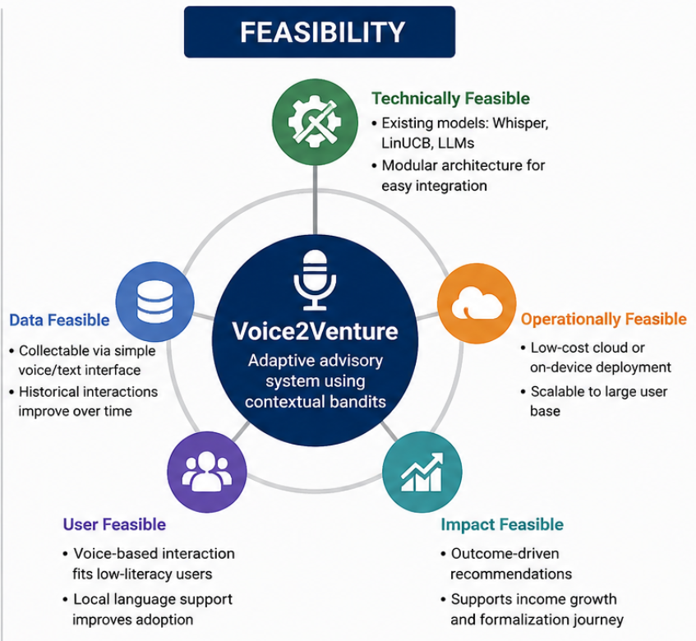
Research Gap
Limited personalization: Existing systems provide generic recommendations.
Static recommendations: Limited learning from user feedback and outcomes.
LLM limitations: LLMs lack reward-based decision optimization.
Limited financial analysis: ROI, investment, risk, and reinvestment are often overlooked.
Fragmented approaches: Voice input, personalization, bandits, and financial analysis are rarely integrated.

Slide 10
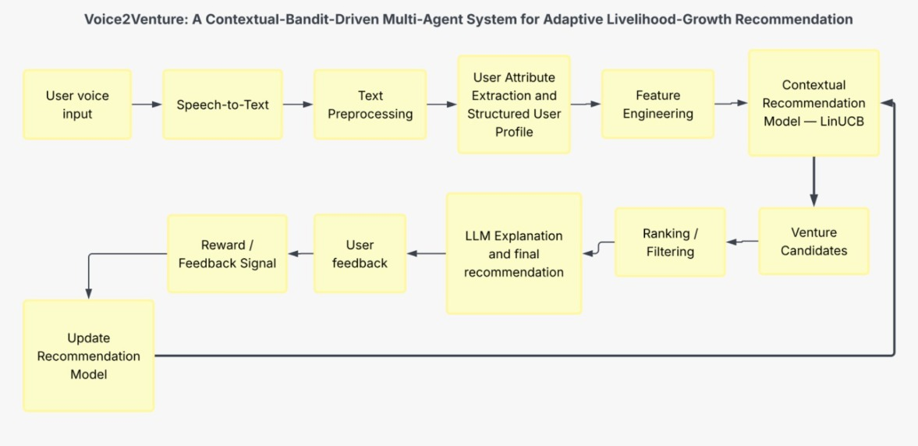
Methodology

Slide 11

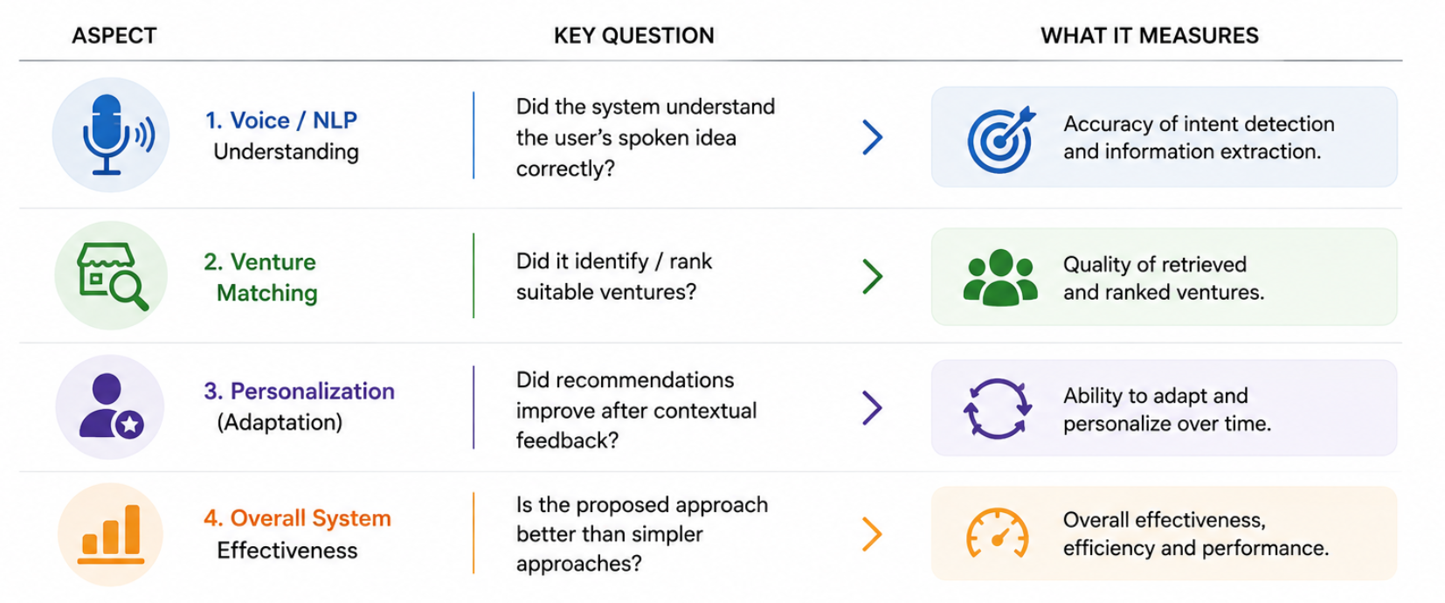
Methodology
Understanding: Input & Intent Accuracy
Matching: Recommendation Relevance
Personalization: Feedback driven improvement

Slide 12

Conclusion
  Enables adaptive, personalized growth guidance based on individual user context and outcomes.
  Continuously improves recommendations by using real-world outcomes as feedback.
  Provides a measurable framework to evaluate adaptive recommendations against static or LLM-only approaches.

