Slide 1


Department of Information Science and Engineering
Title: Adaptive Multi-Agent LLM System for Micro-Enterprise Generator
TEAM MEMBERS
Bhoomika N – 4VV23IS038
Sanjula S – 4VV23IS194
Shreya B J – 4VV23IS207
UNDER THE GUIDANCE OF
Prof Aishwarya T
Assistant Professor
Dept. of ISE, VVCE

Slide 2

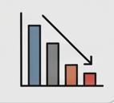

INTRODUCTION
Many rural and semi-urban women are actively involved in daily
productive activities such as cooking, farming, stitching, and
small-scale trading.
However, these efforts often remain informal and unstructured,
and are not converted into consistent or scalable income sources.
The key gaps include:
  Lack of real-time, actionable guidance
  Limited business awareness and market insights
  Absence of continuous support for growth and
  improvement

Slide 3
Problem Statement
Existing solutions focus on:
  Training-based approaches that are not real-time
  Static guidance with no continuous improvement
  Generic recommendations lacking personalization
Current AI systems also have limitations:
  Generate repetitive and generic suggestions
  Fail to track user progress over time
  Lose context across multiple interactions and languages
This leads to a gap between user effort and sustainable income generation

Slide 4
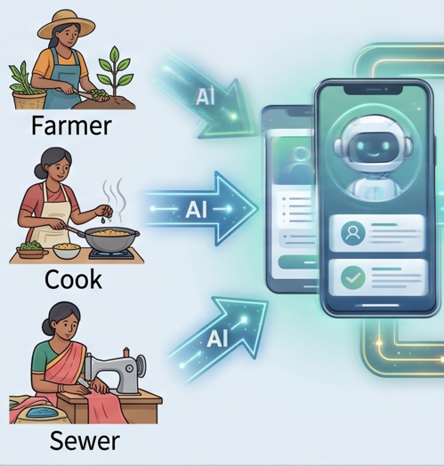
OBJECTIVES
A voice-driven AI system designed for accessibility and ease of use
Converts daily activities into structured income opportunities
Provides:
  Actionable business ideas
  Continuous growth and improvement suggestions
  Simple financial insights and ROI guidance
Ensures:
  Adaptive recommendations
  Progressive evolution of micro-businesses over time

Slide 5
MOTIVATION
Many women already possess skills and daily productivity, but lack the means to convert
them into sustainable income
Existing support systems are:
  Fragmented (training, loans, schemes are disconnected)
  Not continuous (no day-to-day guidance)
  Difficult to access for low-literacy users
There is a clear gap between:
  What people can do
  What they actually earn
Rapid advancements in AI create an opportunity to:
  Provide real-time, personalized guidance
  Enable self-driven growth without dependency

Slide 6
RESEARCH ELEMENT
Title : “Adaptive Multi-Agent LLM System with Cross-Lingual Context Retention for Non-Repetitive and
Progressive Recommendation Generation”
Research Questions
Does a multi-agent architecture outperform a single LLM in generating structured recommendations?
Can context memory reduce repetition in iterative interactions?
Does the system generate progressively improving outputs over time?
Can the system retain context across language switches (cross-lingual consistency)?
Hypothesis
Multi-agent systems produce more structured and diverse outputs than single LLM systems
Cross-lingual normalization enables consistent context retention across languages
Iterative evolution leads to progressive improvement in recommendations
Existing work lacks cross-lingual context retention and progressive recommendation evolution
Our work extends these areas with a multi-agent, context-aware approach

Slide 7
SCOPE
Rural and semi-urban entrepreneurship development
Support for low-literacy users through voice interaction
Application in:
  NGOs
  Self-Help Groups (SHGs)
  Government programs
Scalable across regions and languages

Slide 8
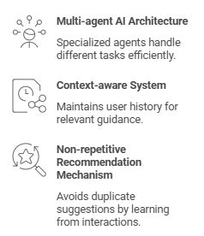
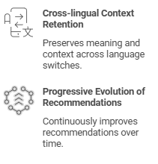
NOVELTY

Slide 9
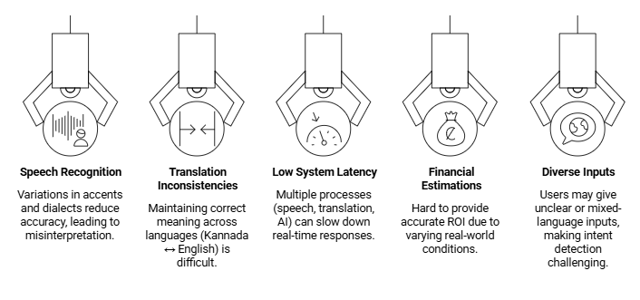
CHALLENGES

Slide 10
THANK YOU

