Slide 1
Modern, Buildable Projects with IBM i Project Explorer and Bob
Edmund Reinhardt
Product Architect - IBM i Application Development
edmund.reinhardt@ca.ibm.com
Sanjula Ganepola
Software Developer
Sanjula.Ganepola@ibm.com

Slide 2
Agenda
Challenges with Building on IBM I
Bob (Better Object Builder) for IBM I
Local Development
IBM i Project Explorer
Demo

Slide 3
Challenges with Building on IBM i

Slide 4
General Challenges
SRC-PF
10 char names
Fixed record length
Not accessible to open ecosystem, including Git and Make
Source of the same type stored in QxxxSRC to avoid name conflicts (member type does not disambiguate)
Libraries
Only 2 level hierarchy to organize, with only short 10 char names
Source control
None (sequence number dates)
Home grown
Proprietary IBM i systems
Cost
Smaller market = less investment
Build system
Individual CRTXXXMOD + CRTPGM
CL Scripts
A couple of vendors have dependency-based build

Slide 5
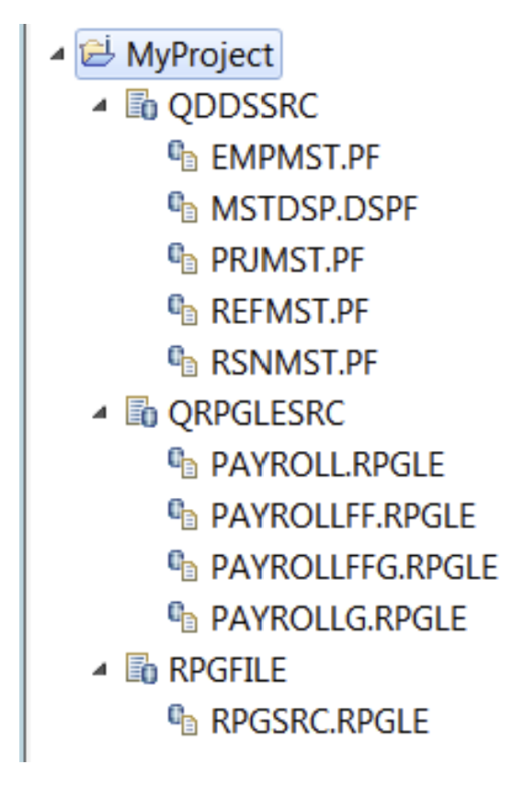
RDi Projects – Lessons Learned
Supports git but …
Mapping from i Project to exactly one library was too inflexible
Some customers target many libraries from one project (program / data / source)
Other customers have huge libraries
Metadata was very hard to maintain
Having a parallel directory hierarchy under .ibmi meant that any time a SRC-PF or member changed names the metadata was lost
Mapping rigidly to SRC-PF meant inheriting all its limitations
Fixed line length
Fixed directory hierarchy of basically 1 level with only 10 characters
Build was very limited
No disambiguating of PGM vs MOD
No understanding of binding relationships
No incremental ability (i.e. only build what had changed)

Slide 6
Existing Bob By S4i
Open-source project by Jeff Berman (https://github.com/s4isystems/Bob)
Incremental compile ability based on gmake
Some level of ILE binding understanding
Not bound to library and SRC-PF structure/naming
Member level specific metadata using gmake variable
Consideration of target EBCDIC CCSID for compiler
Support of old languages whose compilers do not have IFS support yet (DDS, UIM)
Retrieval of all EVFEVENT files to enable compiler feedback
Limitations
Uppercase names required
Single target library
Single directory containing source
No metadata on environment prerequisites (i.e. LIBL, ASP, where to find includes, etc.)
Install was complex – not yum-enabled
No 1 to 1 mapping of file extensions to compile (i.e. are we targeting MOD or PGM)

Slide 7
Bob (Better Object Builder) for IBM i

Slide 8
IBM i Bob
Enhancements
Project definition
Know how to build yourself
Know where to resolve includes
Know how to set up environment
Still flexible so that what is stored in Git does not have to be modified for each developer or deployment scenario
No limit on number of directories and their nesting
No limit on directory naming
No limit on number of object libraries
Unambiguous mapping from file name to compile type
Usability
PASE command line
Windows/Mac command line with rsync/scp to do file transfer
Any VS Code extension for IBM i development (ie. Code for IBM I and Project Explorer)
RDi

Slide 9


Project Structure (Source Code)
my-project
.evfevent
file.evfevent
source.evfevent
.logs
joblog.json
file.splf
source.splf
includes
constants.rpgleinc
MYLIB
QRPGLESRC
PROGRAMA.RPGLE
PROGRAMB.RPGLE
PROGRAMC.RPGLE
QSQLSRC
CUSTOMERS.SQL
INVENTORY.SQL
QCLLESRC
STARTJOB.CLLE
QCMDSRC
STARTJOB.CMD
QRPGLESRC
.ibmi.json
Rules.mk
source.rpgle
QDDSSRC
Rules.mk
file.pf
.env
.gitignore
.ibmi.json
iproj.json
Rules.mk

Slide 10
Project Structure (Metadata)
my-project
.evfevent
file.evfevent
source.evfevent
.logs
joblog.json
file.splf
source.splf
includes
constants.rpgleinc
QRPGLESRC
.ibmi.json
Rules.mk
source.rpgle
QDDSSRC
Rules.mk
file.pf
.env
.gitignore
.ibmi.json
iproj.json
Rules.mk

Slide 11
Project Structure (Build/Compile Output)
my-project
.evfevent
file.evfevent
source.evfevent
.logs
joblog.json
file.splf
source.splf
includes
constants.rpgleinc
QRPGLESRC
.ibmi.json
Rules.mk
source.rpgle
QDDSSRC
Rules.mk
file.pf
.env
.gitignore
.ibmi.json
iproj.json
Rules.mk

Slide 12
Project Structure (Rules.mk)
my-project
.evfevent
file.evfevent
source.evfevent
.logs
joblog.json
file.splf
source.splf
includes
constants.rpgleinc
QRPGLESRC
.ibmi.json
Rules.mk
source.rpgle
QDDSSRC
Rules.mk
file.pf
.env
.gitignore
.ibmi.json
iproj.json
Rules.mk

Slide 13
Build and Compile Process
A
Command | Description
makei init | Create iproj.json
makei cvtsrcpf | Convert QSYS members to Unicode IFS stream files
makei build | Build the entire project
makei b –t <object> | Build target object
makei b –d <directory> | Build all objects in the specified directory (based on Rules.mk)
makei compile -f <stream file> | Compile target object of specified stream file
makei compile –files file1: file2: … | Compile target objects of all specified stream files

Slide 14
Local Development

Slide 15
Different (But Similar) File System
MYLIB
QRPGLESRC
PROGRAMA.RPGLE
PROGRAMB.RPGLE
PROGRAMC.RPGLE
QSQLSRC
CUSTOMERS.SQL
INVENTORY.SQL
QCLLESRC
STARTJOB.CLLE
QCMDSRC
STARTJOB.CMD

Slide 16
/COPY and /INCLUDE

Slide 17
Distributed Development

Slide 18
Version Control with Git

Slide 19
Development with Git

Slide 20
IBM i Project Explorer

Slide 21
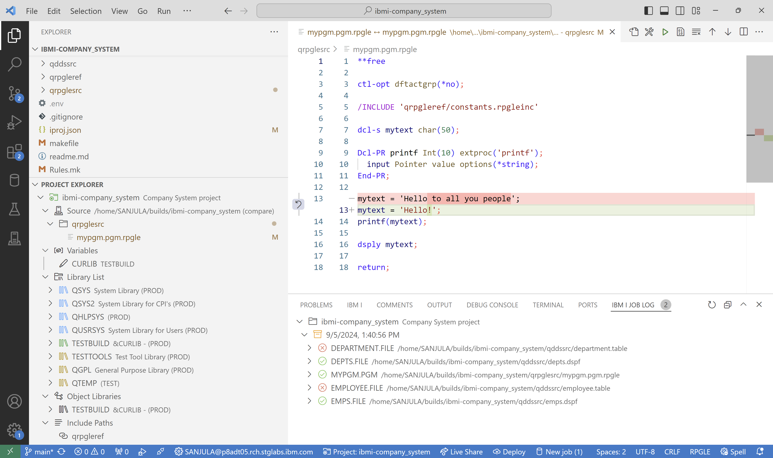
Overview
The ultimate tool for local development on IBM i!
Set variables
Build and Compile
Local source vs. IFS source
Manage library list
Modify include paths
View job logs

Slide 22
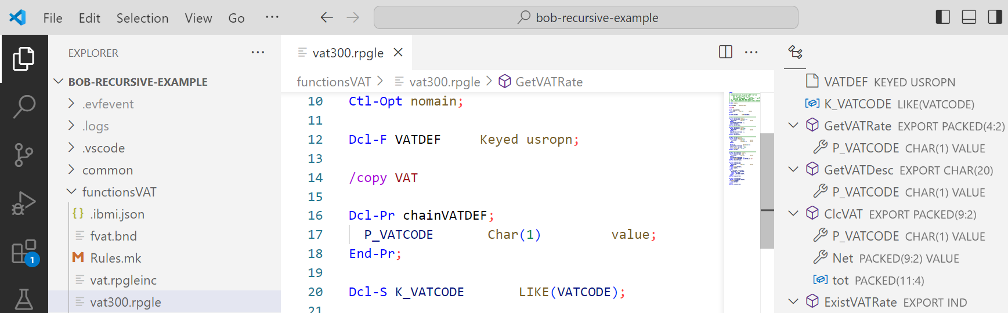

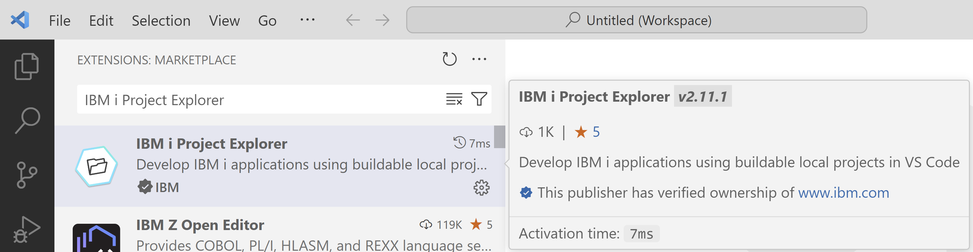

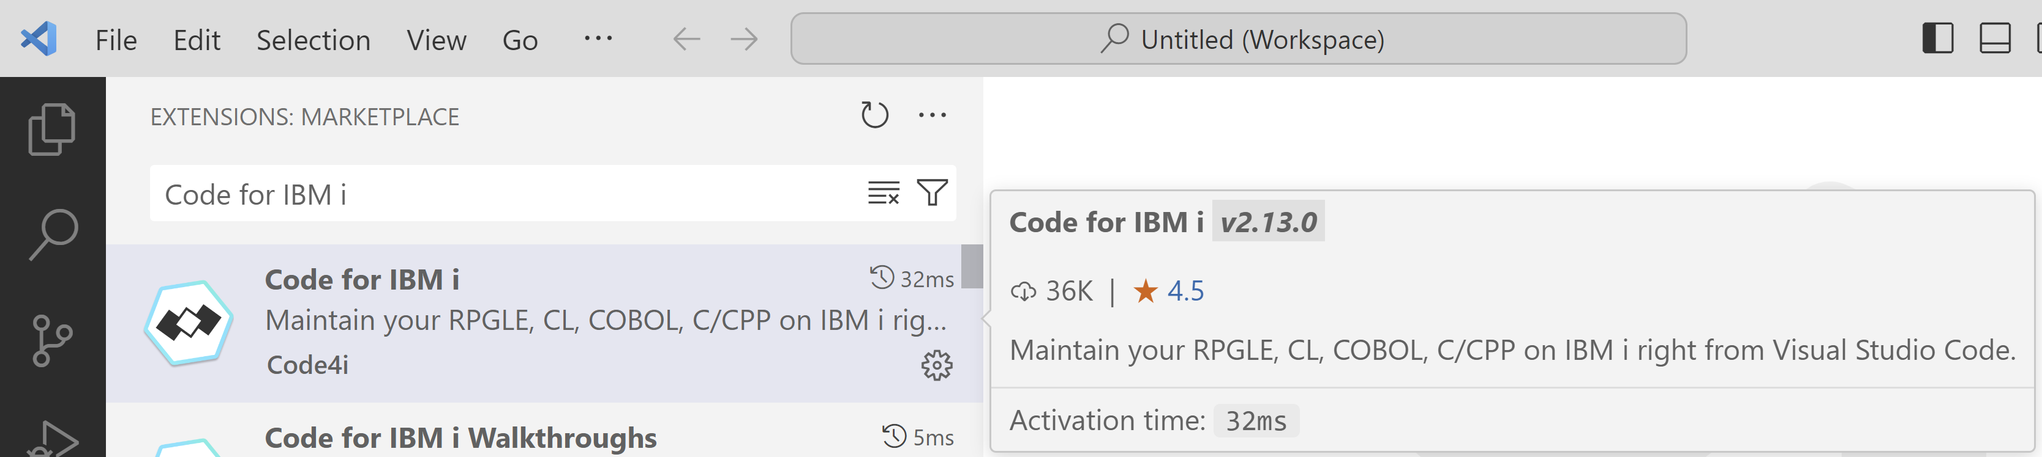

Installation
Download
Visual Studio Code
Download
IBM i Project Explorer
Download
Code for IBM i

Slide 23
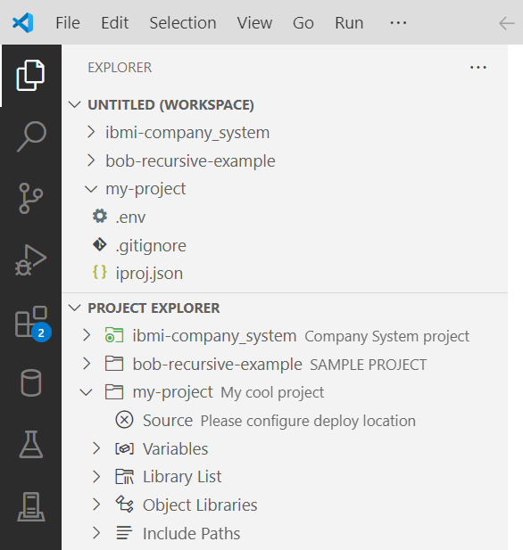
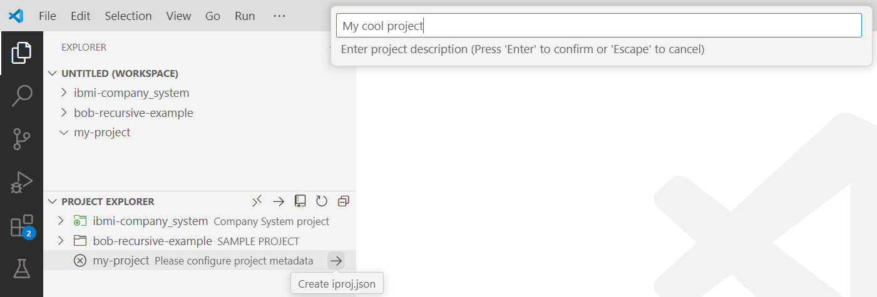
Create a New Project
Create and open a folder for your project
Create an iproj.json
Set the project description
Connect to an IBM i (using Code for IBM i)

Slide 24
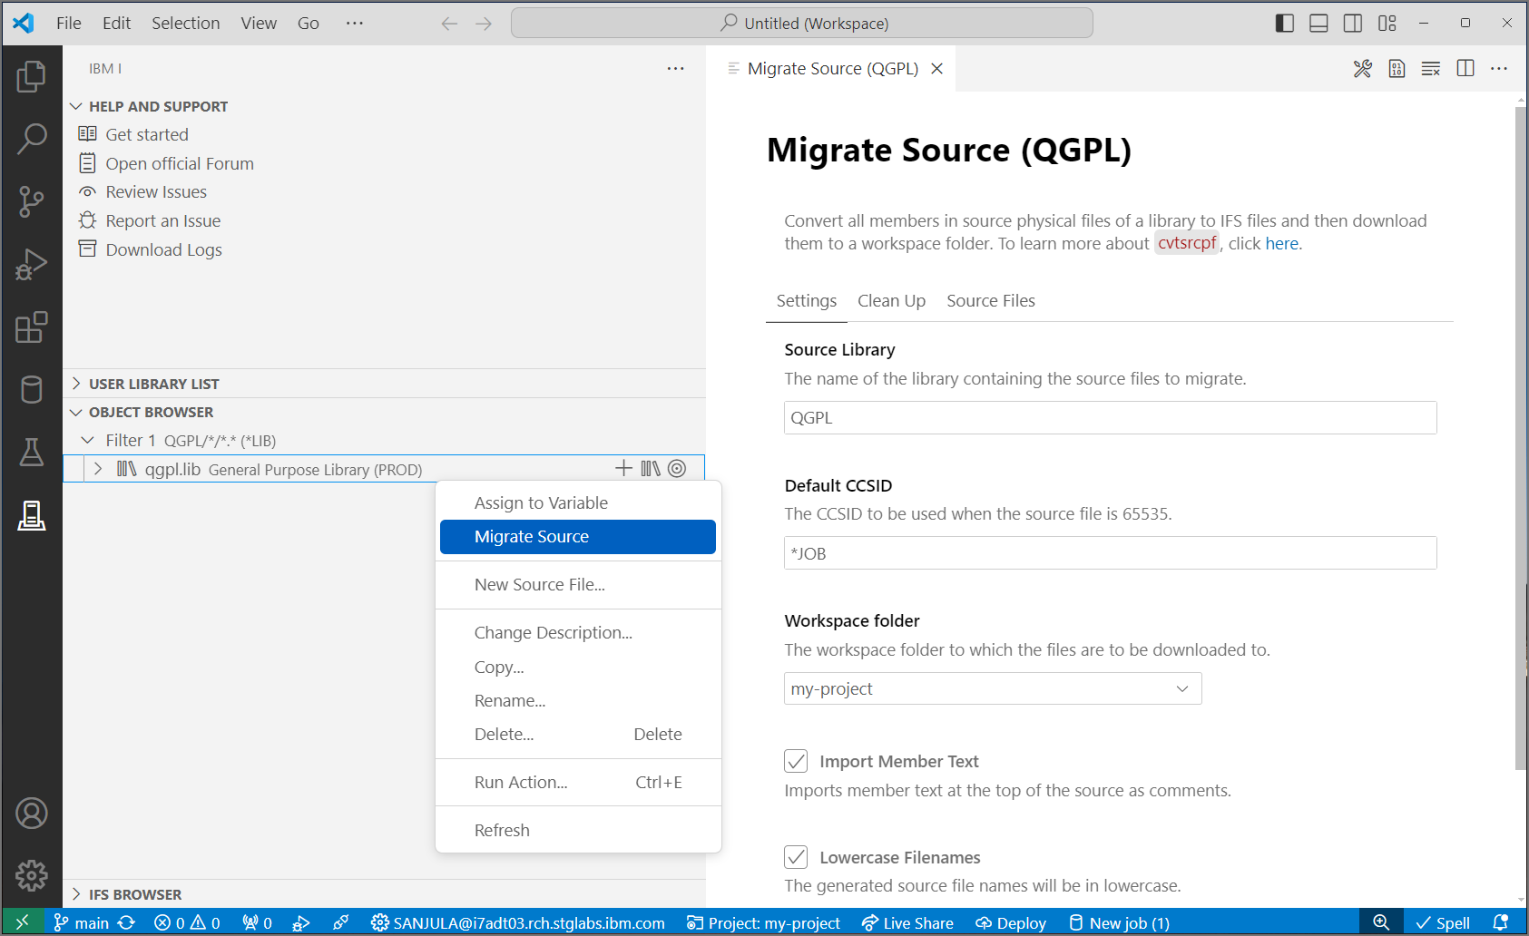


Migrate Source from QSYS
QSYS members in source physical files
↓
Properly encoded, terminated, and named source files in an IFS directory
↓
Download to local project
↓
Rename extensions
↓
Convert includes/copy directives to Unix style paths
CVTSRCPF from BOB
Source Orbit

Slide 25

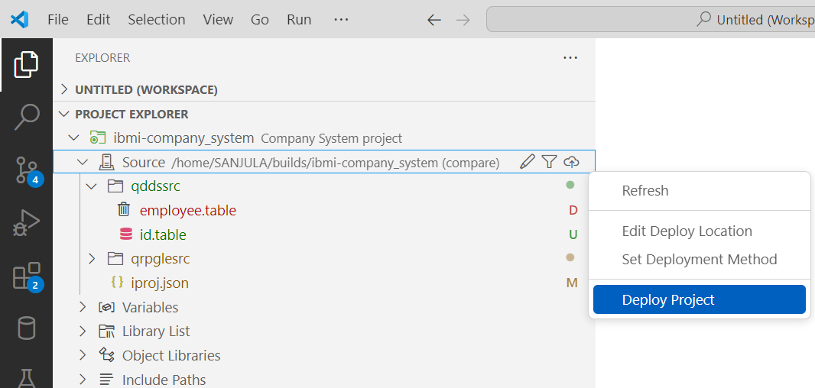
Source and Deployment
Set deploy location
Where source gets uploaded to
Typically set one
Each developer gets a unique location
Each repository gets a unique location
Set deployment method
Compare
Changes
Working Changes
Staged Changes
All
Deploy project
Moves files to deploy location based on deployment method
Deploy
Build
Local Project
IBM i Directory
Target Library

Slide 26
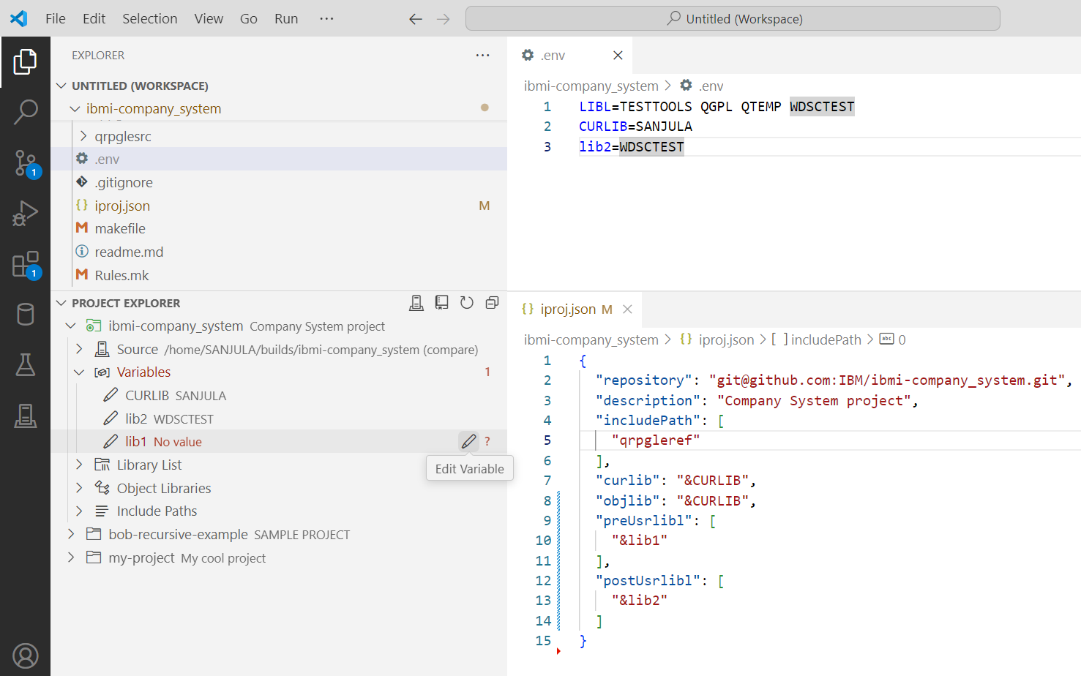
Work with Variables
Manage variables
Browse for libraries and assign values to variables
Configure hardcoded values as variables
Do not push .env file to Git!

Slide 27
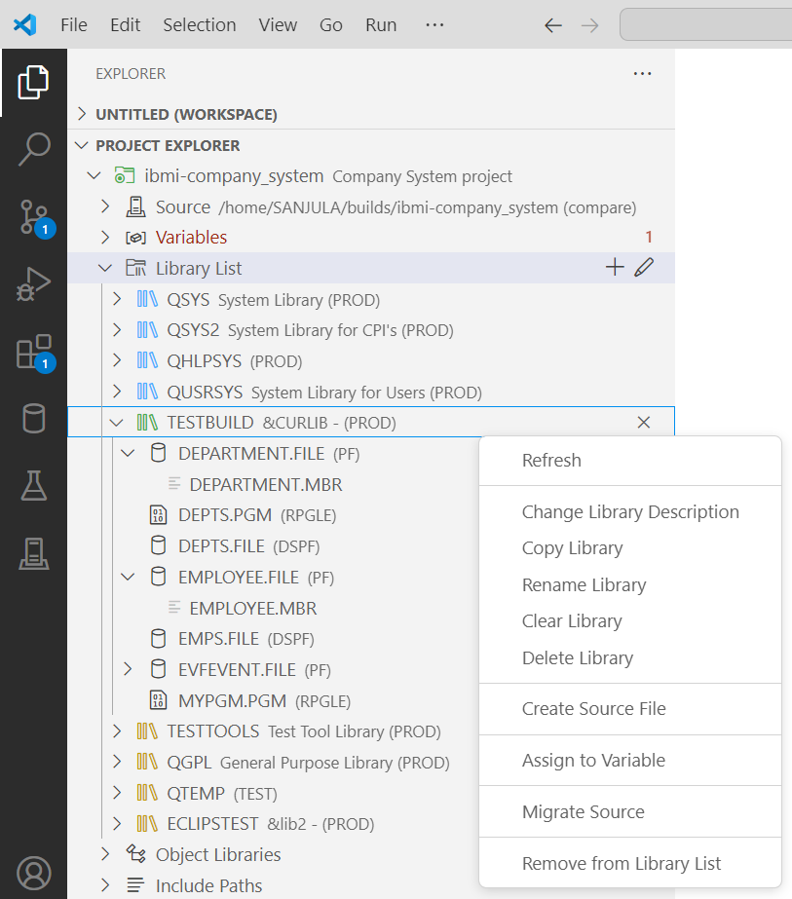
Manage the Library List
Add to library list (preUsrlibl and postUsrlibl in iproj.json)
Set current library (curlib in iproj.json)
Reorder library list
Browse objects and members
Manage libraries, objects, and members

Slide 28
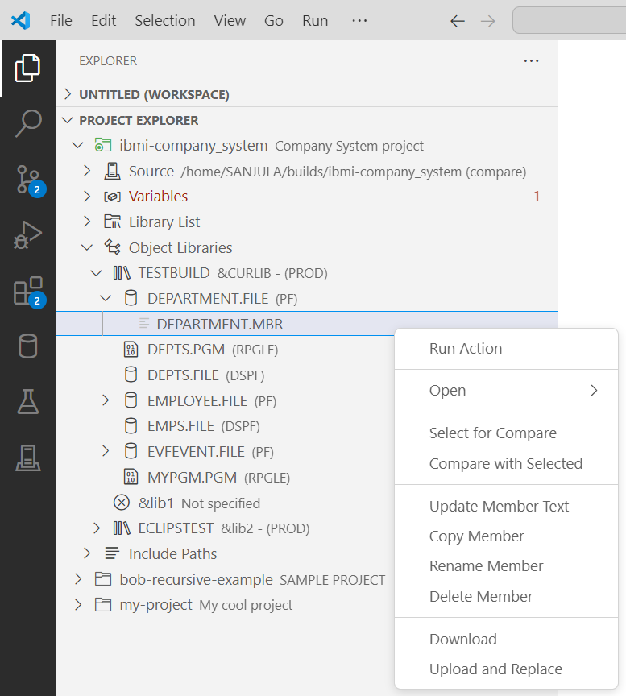
Browse Object Libraries
Another place to manage libraries in iproj.json (curlib, objlib, preUsrlibl, postUsrLibl)
Manage libraries, objects, and members

Slide 29
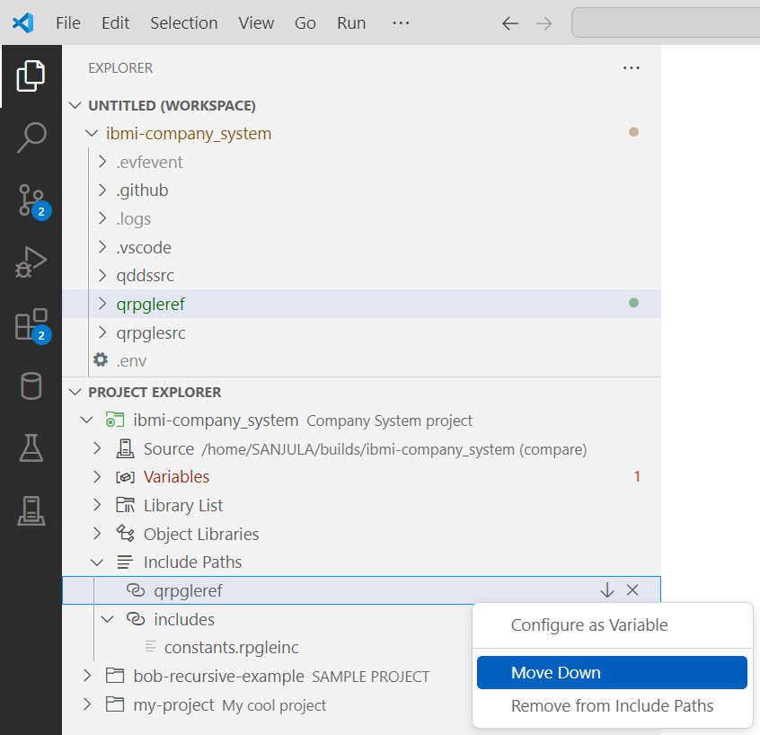
Manage Include Paths
Add, remove, and reorder include paths
Visualize if includes resolve locally or to remote IFS

Slide 30
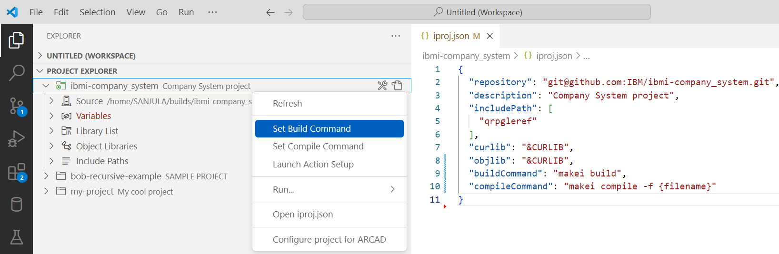
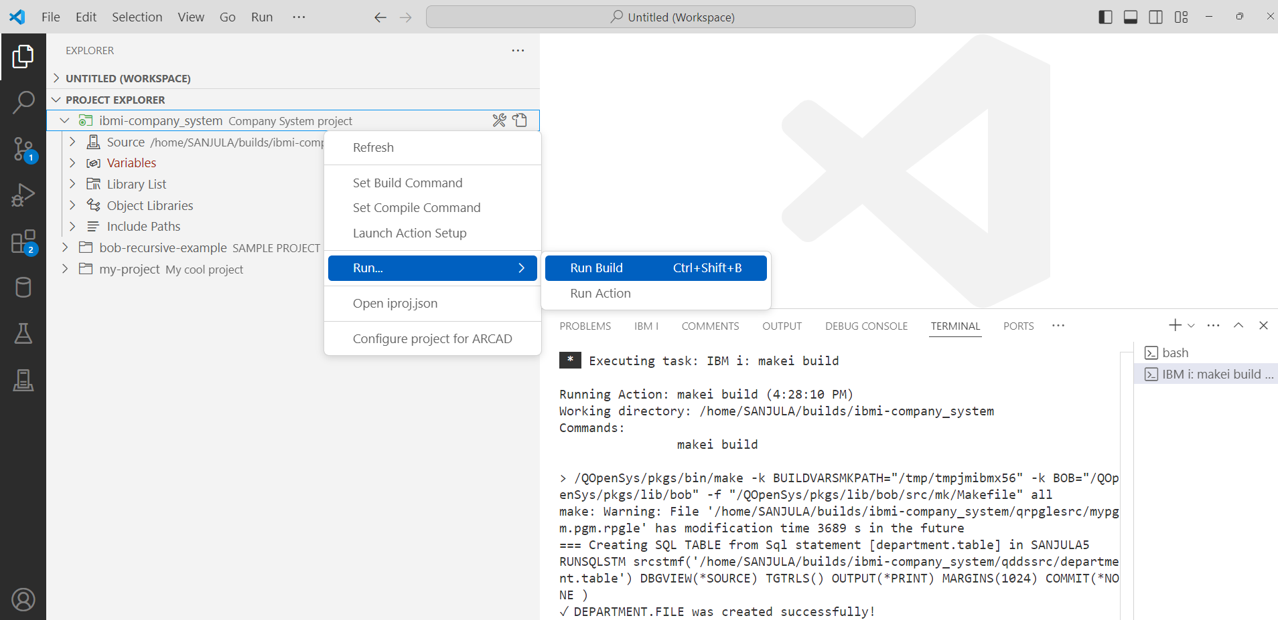
Building and Compiling
Deploy
↓
Run build or compile command
↓
Download logs and evfevent files
Building
Set build command
Run Build
Compiling
Set compile command
Run compile
On active editor
On file or directory in File Explorer
On file or directory in Source

Slide 31
Running Actions
Deploy
↓
Run build or compile command
↓
Download logs and evfevent files
Building
Set build command
Run Build
Compiling
Set compile command
Run compile
On active editor
On file or directory in File Explorer
On file or directory in Source

Slide 32
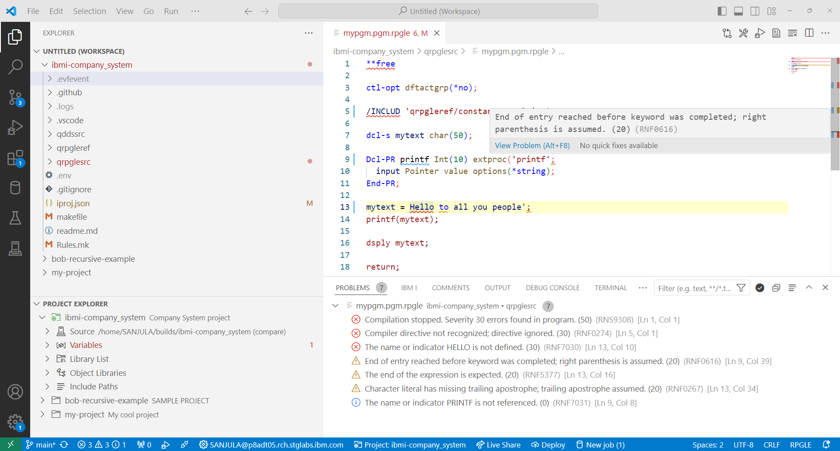
View Diagnostics
Evfevent file diagnostics are dumped in .evfevent directory after a build or compile
Code for IBM i parses and renders them in the Problems view
Diagnostics are also rendered inline in the source file

Slide 33
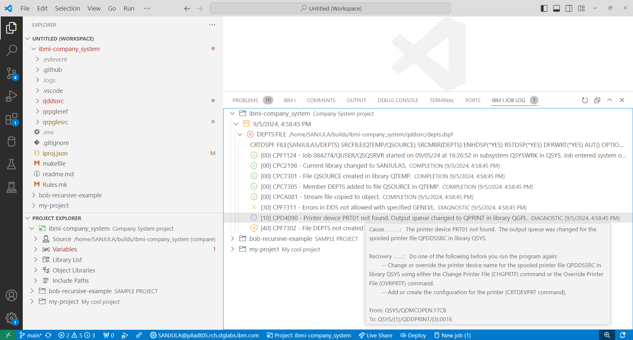
View Job Logs
Job log and spool files are dumped in .logs directory after a build or compile
Job log view is used to visualize and mangae these logs
Track up to 10 of the previous logs in memory
Organized by the ILE objects being built
Filter by failed objects or severity

Slide 34

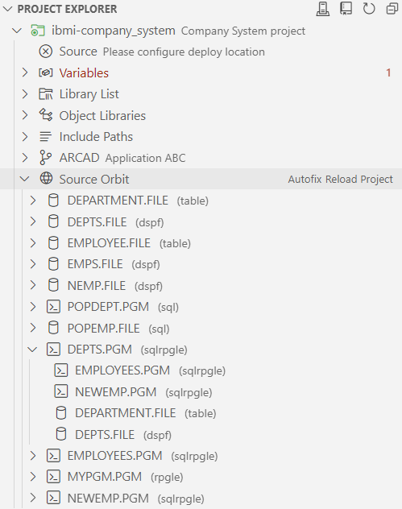
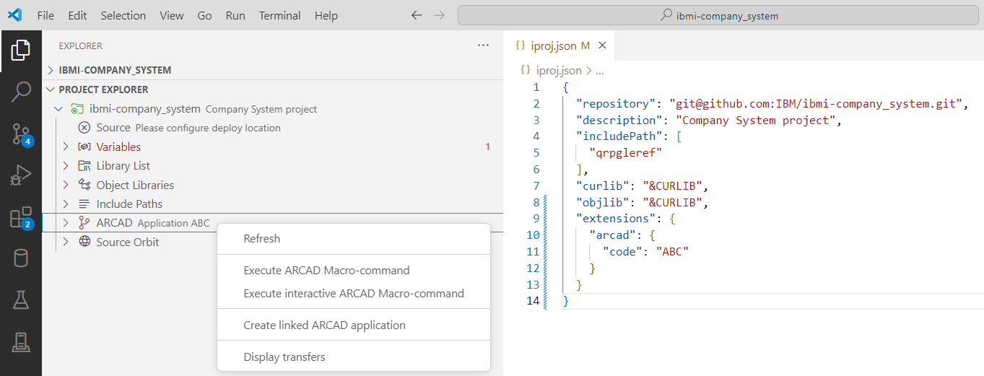
Integration
Source Orbit
ARCAD-Elias
What can you integrate?

Slide 35
Demo

