Slide 1
CARAFE: Content-Aware ReAssembly of FEatures
AI Vision Team
2019.11.27

Slide 2
Contents
Abstract
Framework
Results

Slide 3
Abstract
Aims: replace feature upsampling module
Properties
1, Large field of view;
2, Content-aware handling;
3, Lightweight and fast to compute;

Slide 4
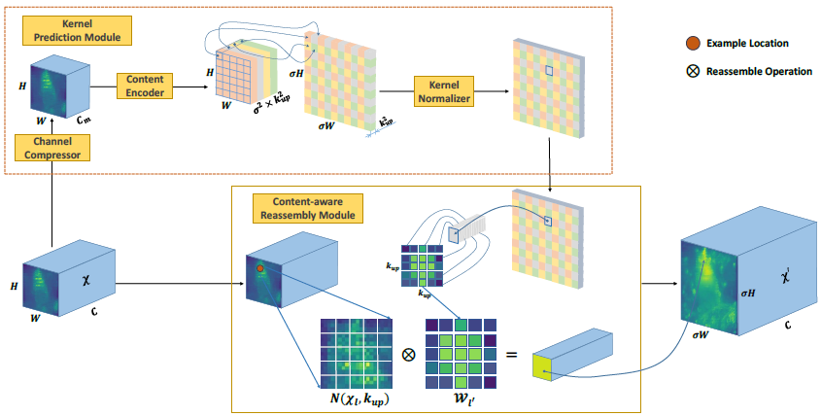

Framework of CARAFE
Kernel Prediction Module
1,Channel Compressor;(1*1 *Cm conv)
2,Content Encoder;(k*k*Cup)
3,Kernel Normalizer; (channels softmax)
Content-aware Reassebly Module
The overall framework of CARAFE

Slide 5
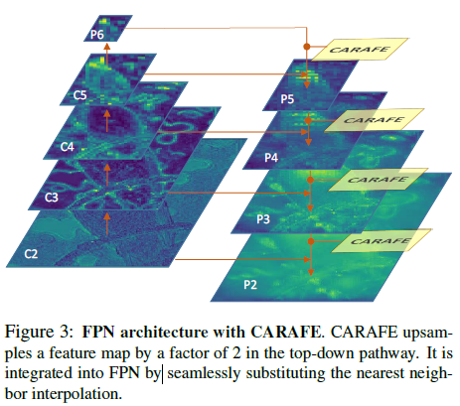
Sample

Slide 6
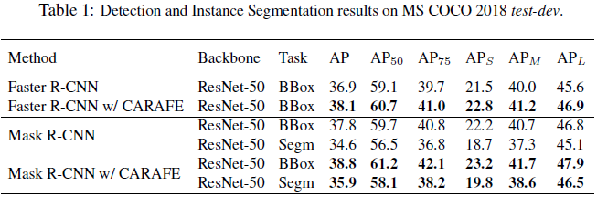
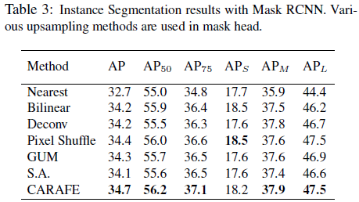
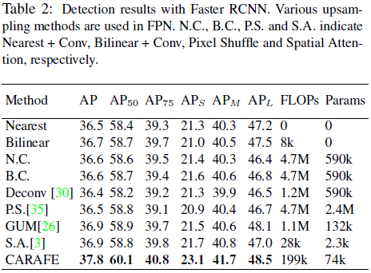
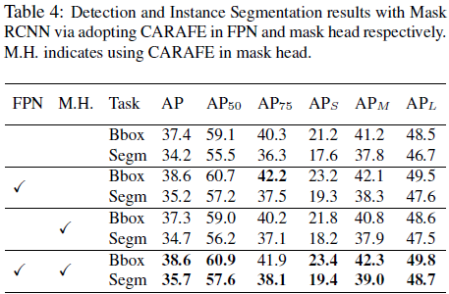
Benchmarking Results

Slide 7
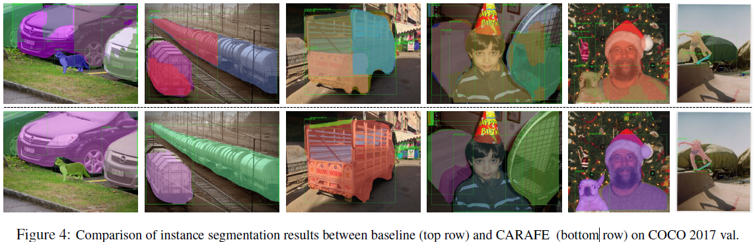
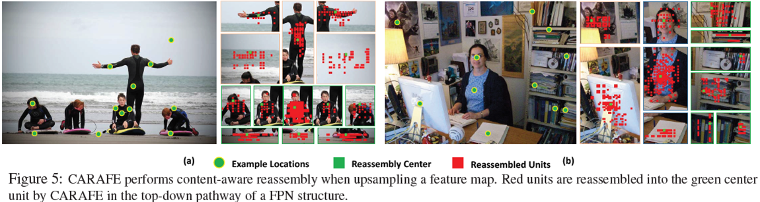

Slide 8
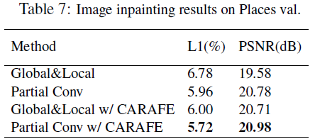
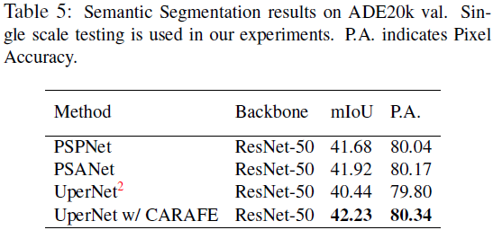
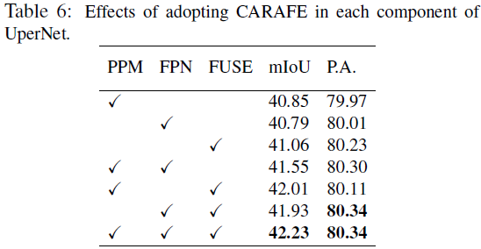
Benchmarking Results

Slide 9
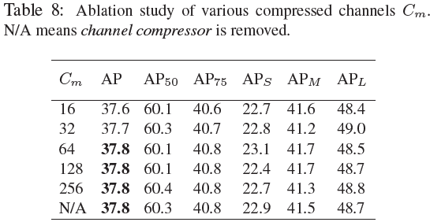
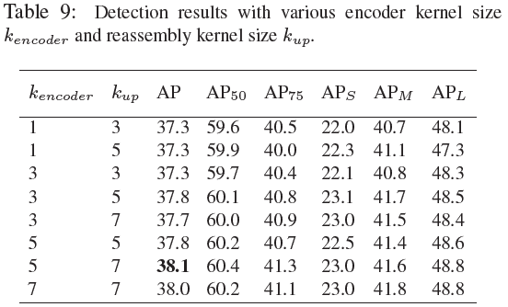
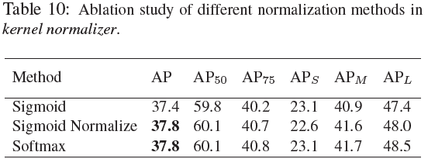
Model Design & Hyper-parameters.

Slide 10
Thank You!

