Slide 1
Seminar

Slide 2
Stock Prediction using Linear Regression
Sanju Abraham Binu

Slide 3
Contents
Stock
Linear Regression
Tools used
JupyterLab
Python
Measurements
Results

Slide 4
Stock
A stock (also known as equity) is a security that represents the ownership of a fraction of a corporation.
This entitles the owner of the stock to a proportion of the corporation's assets and profits equal to how much stock they own.
Units of stock are called "shares."

Slide 5
Linear Regression
Linear regression is used for finding linear relationship between target and one or more predictors.
There are two types of linear regression- Simple and Multiple.
Simple linear regression is useful for finding relationship between two continuous variables.
One is predictor or independent variable and other is response or dependent variable.
It looks for statistical relationship but not deterministic relationship.
Relationship between two variables is said to be deterministic if one variable can be accurately expressed by the other.
For example, using temperature in degree Celsius it is possible to accurately predict Fahrenheit.

Slide 6

Statistical relationship is not accurate in determining relationship between two variables. For example, relationship between height and weight.
The equation has the form Y= a + bX, where Y is the dependent variable (that’s the variable that goes on the Y axis), X is the independent variable (i.e. it is plotted on the X axis), b is the slope of the line and a is the y-intercept.
The core idea is to obtain a line that best fits the data. The best fit line is the one for which total prediction error (all data points) are as small as possible.
Error is the distance between the point to the regression line.

Slide 7
Tools Used - JuptyerLab
JupyterLab is an interactive notebook, code, and data development environment that is accessible via the web.
Using the platform's versatile interface, users can configure and arrange workflows in data science, scientific computing, computational journalism, and machine learning.
A modular architecture allows for extensions that increase and improve functionality.

Slide 8
Tools Used - Python
NumPy is a scientific computing environment based on Python.
Pandas is a Python open-source library that provides efficient and user-friendly data structure and analysis capabilities.
Matplotlib is a Python toolkit that allows you to create graphs, charts, and other data visualization tools.
You'll need the Chart Studio package to use it, which includes utilities for working with Plotly's Chart Studio service (both Chart Studio cloud and Chart Studio On-Prem).

Slide 9
Candlestick Pattern
Candlestick charts are used by traders to forecast price movements based on historical patterns.
Candlesticks are useful in trading because they show four price points (open, close, Adj close, high, and low) over a given time period.
Many algorithms make use of the same price information as candlestick charts.
Emotion is frequently the driving force behind trading, as evidenced by candlestick charts.

Slide 10
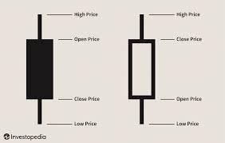

Slide 11
Measurements
The R2 score is a very important metric that is used to evaluate the performance of a regression-based machine learning model.
It is pronounced as R squared and is also known as the coefficient of determination.
It works by measuring the amount of variance in the predictions explained by the dataset.
Simply put, it is the difference between the samples in the dataset and the predictions made by the model.

Slide 12
The r2 score is defined as "(total variance explained by model) / total variance."
If it is 100 percent, the two variables are completely linked and have no variance.
A low number indicates a low level of correlation, implying that the regression model is not always valid.

Slide 13
In statistics, the mean squared error (MSE) of an estimator (of a procedure for estimating an unobserved quantity) measures the average of the squares of the errors — that is, the average squared difference between the estimated values and what is estimated.
MSE is a risk function, corresponding to the expected value of the squared error loss.
The fact that MSE is almost always strictly positive (and not zero) is because of randomness or because the estimator does not account for information that could produce a more accurate estimate.

Slide 14
The mean square error is the average of the squares of the errors (MSE).
The greater the number, the greater the error.
The difference in observed values y1, y2, y3,... as well as the projected values pred(y1), pred(y2), and pred(y3) (y3),...
In this case, the term "error" applies.
To avoid cancelling out negative and positive values, we square each difference (pred(yn) – yn) ** 2.

Slide 15
Results

Slide 16
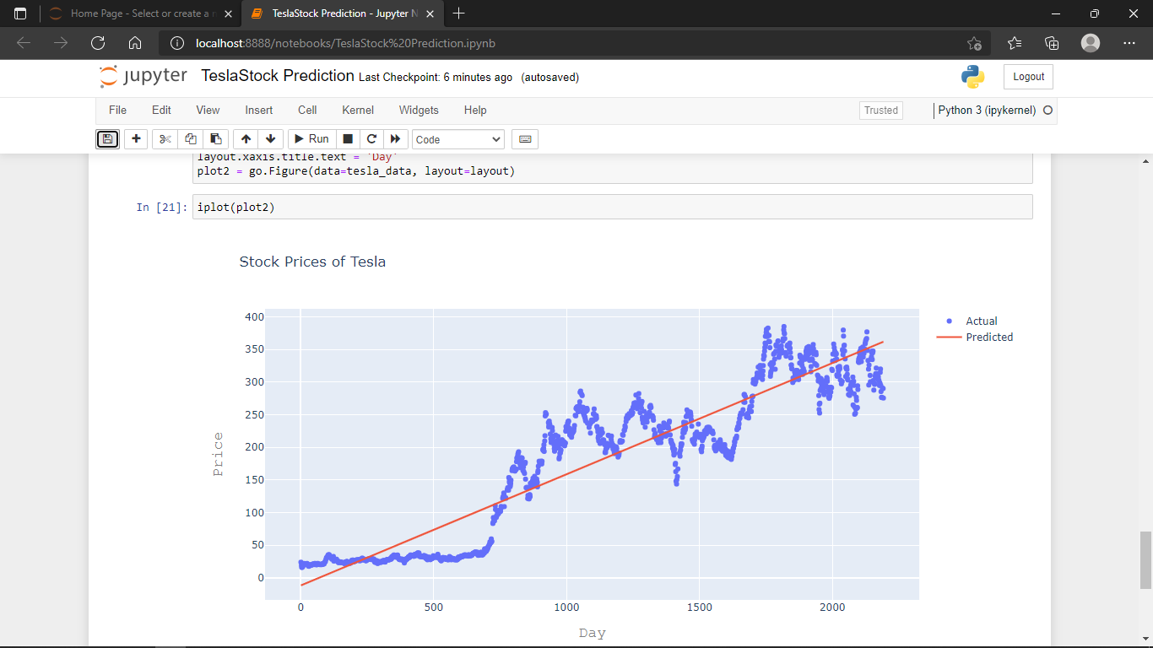

Slide 17
