Slide 1

LECTURE 2
1 Hour
View of Data & Database Languages
Data Abstraction, Independence, DDL and DML
Unit I — Introduction to Database Systems and Data Models
Lecture 2 of 9 • Slide 1 of 8

Slide 2
Our TextBooks:
1
“Database System Concepts”, 6th Edition by Abraham Silberschatz, Henry F. Korth, S. Sudarshan, McGraw-Hill.
2
“Principles of Database and Knowledge – Base Systems”, Vol 1 by J. D. Ullman, Computer Science Press.
3
“Fundamentals of Database Systems”, 5th Edition by R. Elmasri and S. Navathe, Pearson Education.
DBMS for AIML WHALES Dr. Kiran Mayee Adavala, Professor in SoT WOXSEN

Slide 3
LECTURE 2
Learning Objectives
By the end of this session, students will be able to:
1
Describe the three levels of data abstraction
2
Distinguish between a database instance and a schema
3
Explain physical and logical data independence
4
Differentiate between DDL and DML
DBMS for AIML WHALES Dr. Kiran Mayee Adavala, Professor in SoT WOXSEN
Lecture 2 of 9 • Slide 2 of 8

Slide 4
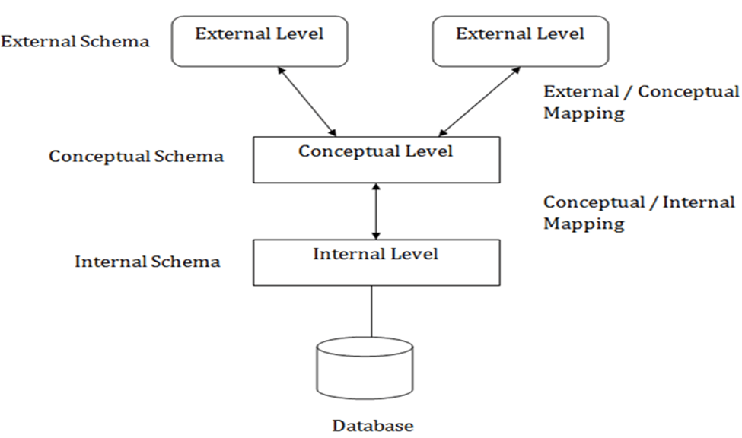
LECTURE 2
View of Data: Levels of Abstraction
How a DBMS hides complexity from users
View level - External Schema: Describes only the part of the database relevant to a specific user
Logical level – Conceptual Schema: Describes what data is stored and the relationships among it
Physical level – Internal Schema: Describes how data is actually stored (files, indexes, blocks)
Purpose: Each higher level hides the complexity of the level below it
DBMS for AIML WHALES Dr. Kiran Mayee Adavala, Professor in SoT WOXSEN
Lecture 2 of 9 • Slide 3 of 8

Slide 6
LECTURE 2
Instances and Schemas
Two related but distinct concepts
Schema: The overall design/structure of the database — changes rarely
Instance: The actual data stored in the database at a given moment — changes constantly
Analogy: Schema is like a blueprint; instance is like the furnished house at one point in time
Schema types: Physical schema, logical schema, and view/subschema, matching the abstraction levels
DBMS for AIML WHALES Dr. Kiran Mayee Adavala, Professor in SoT WOXSEN
Lecture 2 of 9 • Slide 4 of 8

Slide 7
LECTURE 2
Data Independence
Isolating applications from storage/structure changes
Physical Data Independence
Logical Data Independence
Ability to change the physical storage/organization
Ability to change the logical schema
Without altering the logical schema
Without rewriting application programs
E.g., changing file structure or adding indexes
E.g., adding a new attribute to a relation
DBMS for AIML WHALES Dr. Kiran Mayee Adavala, Professor in SoT WOXSEN
Lecture 2 of 9 • Slide 5 of 8

Slide 8
LECTURE 2
Database Languages: Overview
How users and programs communicate with a DBMS
DDL: Data Definition Language — defines and modifies database schema/structure
DML: Data Manipulation Language — retrieves and modifies stored data
DCL: Data Control Language — manages permissions (GRANT, REVOKE)
TCL: Transaction Control Language — manages transactions (COMMIT, ROLLBACK)
DBMS for AIML WHALES Dr. Kiran Mayee Adavala, Professor in SoT WOXSEN
Lecture 2 of 9 • Slide 6 of 8

Slide 9
LECTURE 2
DDL & DML: Commands at a Glance
Common SQL commands by category
Category | Command | Purpose
DDL | CREATE | Create a new table, view, or database object
DDL | ALTER | Modify the structure of an existing object
DDL | DROP | Permanently remove a database object
DML | SELECT | Retrieve data from one or more tables
DML | INSERT | Add new rows of data into a table
DML | UPDATE | Modify existing data in a table
DML | DELETE | Remove existing rows from a table
DBMS for AIML WHALES Dr. Kiran Mayee Adavala, Professor in SoT WOXSEN
Lecture 2 of 9 • Slide 7 of 8

Slide 10
LECTURE 2
Recap & Quick Check
View of Data & Database Languages
Key Takeaways
Quick Check
Three abstraction levels: physical, logical, and view
Q1. What is the difference between a schema and an instance?
Schema = structure (stable); Instance = data (changes often)
Physical independence isolates storage changes; logical independence isolates schema changes
Q2. Give one example each of physical and logical data independence.
DDL defines structure; DML manipulates data
Q3. Which SQL command belongs to DDL: ALTER or UPDATE?
DBMS for AIML WHALES Dr. Kiran Mayee Adavala, Professor in SoT WOXSEN
Lecture 2 of 9 • Slide 8 of 8

