Slide 1
Title
Project Batch ID: 16ECPB046
By:
Sanketh Vijapur (2GI16EC132)
Shivanand Baragali (2GI16EC136)
Sanjeev Vrittikop(2GI16EC130)
Sudarshan Patil (2GI16EC151)
Under the Guidance of:
Prof. Pratijnya Ajawan
(Designation)

Slide 2
Introduction
Lora is a noteworthy technical solution used for the LPWAN design and protocols that is promoted by the LoRa Alliance. Modulation for LoRa is based on spread-spectrum techniques and a variation of a chirp spread spectrum (CSS) scheme. CSS scheme uses wideband linear frequency modulated pulses whose frequency increases or decreases based on the encoded information. This modulation is a proprietary technology by Semtech. The LoRa physical layer consists of many parameters which can be configured into a number of different settings to offer a wide range of choices for ensuring a good quality link or consuming less energy. The most important parameters of the LoRa physical layer are the carrier frequency, spreading factor , bandwidth, transmission power, and coding rate.

Slide 3
Literature Survey
Mookeun Ji, Juyeon Yoony, Jeongwoo Chooz, Minki Jangx, Anthony Smith School of Computer Science and Engineering, Chung-Ang University School of Computing, KAIST have conferred that In the agriculture industry, LoRa-based environmental sensing system enables farmers to remotely monitor the status of a large farm in near real-time. However, there had been only a few explorations to transfer multimedia data such as images or video using LoRa because of its low data rate and restricted bandwidth. To this end, we introduce a novel system to transmit continuous images taken from a camera on a static environment through LoRa.
S.Abrahim,J.beard,and R.Manijacob have conferred that the negative impacts like yield loss due to uncertain weather changes can be treated in a better possible way by implementing LoRaWAN protocol,which gives advantages like scalability, security and robustness in designing IoT applications.

Slide 4
Problem Statement and Objectives
Security and Parameter Monitoring for agriculture using LoRa
Providing visual monitoring to farmers to prevent crops from getting damaged by intruders and monitor the field conditions in real time.
Weather prediction.
Water conservation.
Providing real time status and condition of the farm over a long range.

Slide 5
Methodology
Our prototype consists of three parts: end node, gateway,and back-end server.
End node- a peripheral unit in a network or a primary designated unit in the network.
Gateway-Is a piece of networking hardware used in telecommunication for networks that allow data flow from one discrete network to another.
Back-end server- It is some thing tha communicates between the database and the browser.It consists of three parts a server ,an application and database.
Parameters like Temperature , humidity , soil moisture , rainfall and CO2 are monitored by appropriate sensors.
Utilizing LoRa communication mechanism to send sensor data from transmitter node to receiver node.The receiving node which is Wi-Fi enabled uses MQTT services to monitor the data in cloud or DB server.

Slide 6
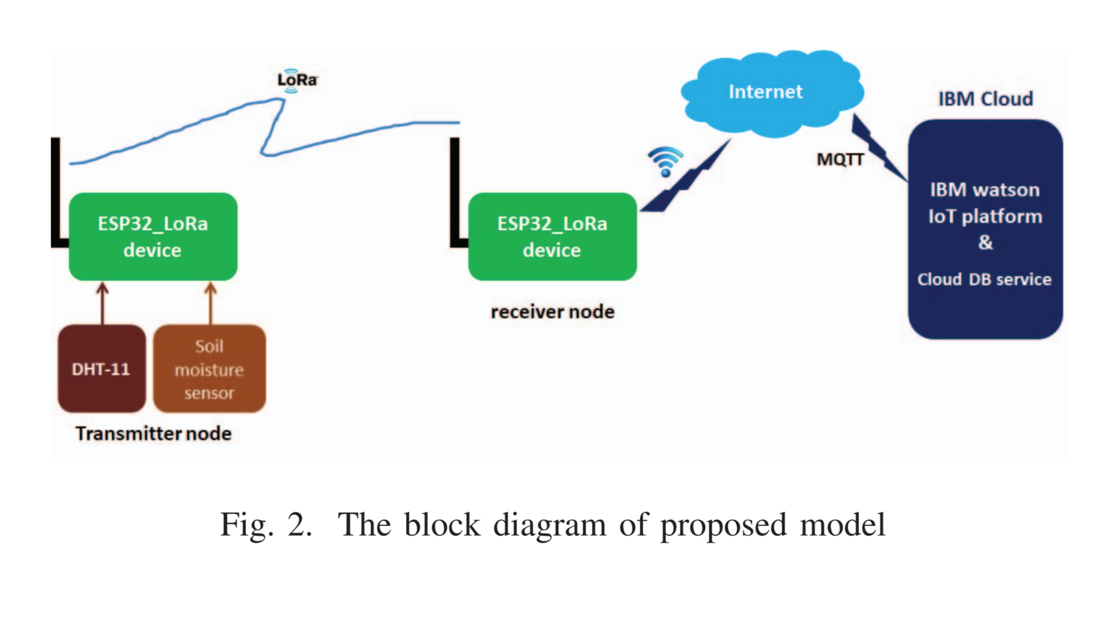
Block Diagram (If Any)

Slide 7
References:
[1] Mookeun Ji, Juyeon Yoony, Jeongwoo Chooz, Minki Jangx, Anthony Smith “LoRa-based Visual Monitoring Scheme for Agriculture IoT”,2019 IEEE Sensors Application Symposium(SAS),13 March 2019
[2]S.Abrahim, J.beard and R.Manijacob, “Remote Environmental monitoring using internet of things(IoT)”in 2017 IEEE Global Humanitarian Technology Conference(GHTC),Oct 2017

Slide 8
Timeline:
SL. No | Process | Time (In Weeks)
1 | Literature Review, Problem Statement and Objectives Finalization
2 | Feasibility Study
3 | Design
4 | Implementation and Coding
5 | Testing, Verification and Validation
6 | Report Submission

