Slide 1


Slide 2


vs.
1900
Amsterdam
Johan Cruijff Arena (54,784)
20-02-2020
27-02-2020
1983
Madrid
Coliseum Alfonso Perez (17,393)

Slide 3
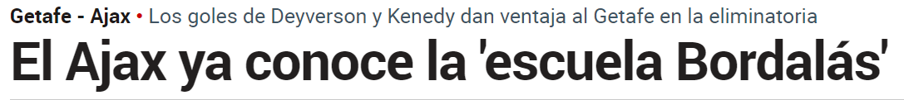

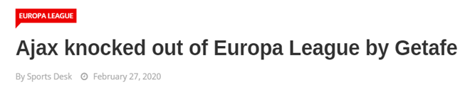
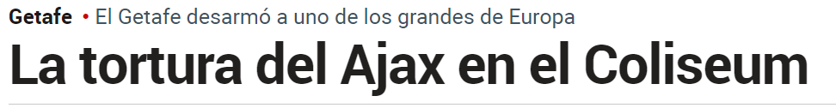

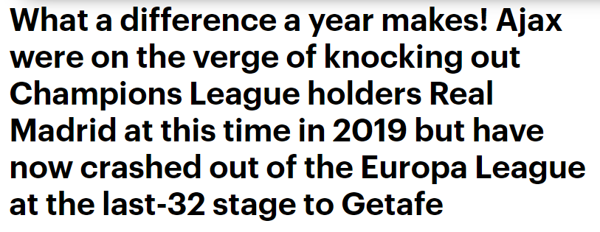

Slide 4
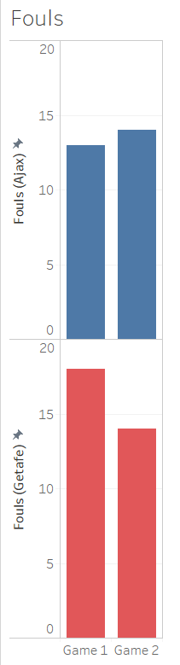
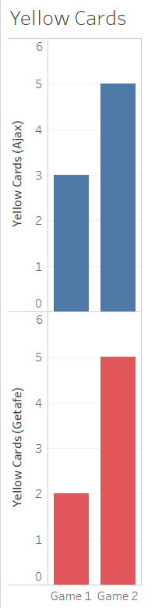
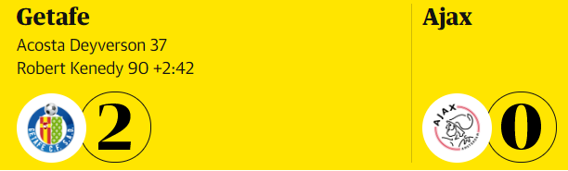
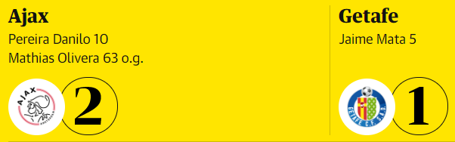
Stats don’t lie
Equally??

Slide 5
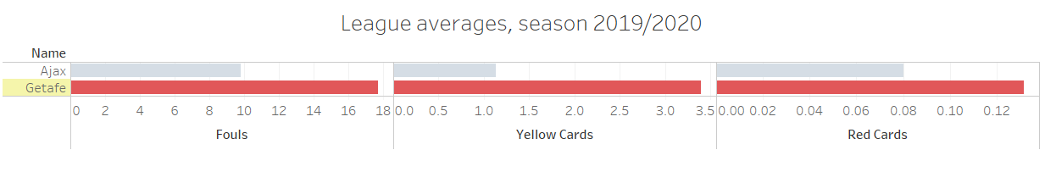



Gladly I am not only being subjective
Getafe | La Liga
18 | 14
2.6 | 1.9
0.08 | 0.088
$$1^{st}$$
>
>
<
$$1^{st}$$
$$5^{th}$$

Slide 6

Science proves me right
1290 Likes
- The chance that you can blame Ajax: 0.00000026 %
- But isn’t the winner always right…
'90+4. Frustrating night…😤\n#UEL #getaja'
3577 Likes
'🎉¡¡FINAAAL en el Coliseum!! 🎉\n@GetafeCF 2-0 @afcajax.
\n\n¡Victoria del equipo que visitará la semana que viene el Johann Cruyff arena
con ventaja de dos goles en la eliminatoria!
💙\n#VamosGeta #GetafeAjaxpic.twitter.com/qYZKkyJkXo'

Slide 7
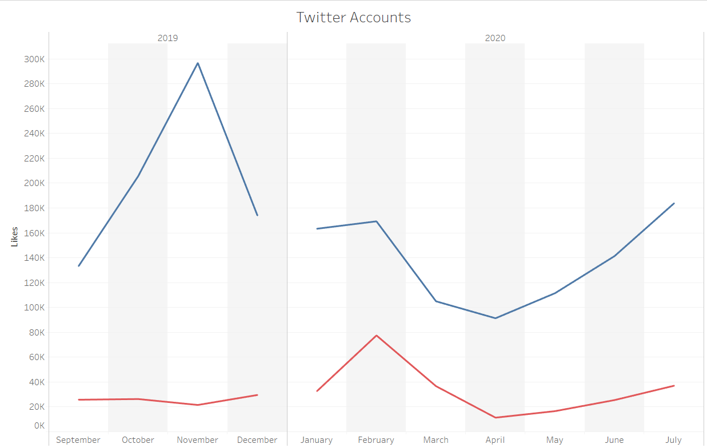
Popularity by Twitter accounts
Champions league defeat
First match: 20-02-2020
Second match: 27-02-2020

Slide 8
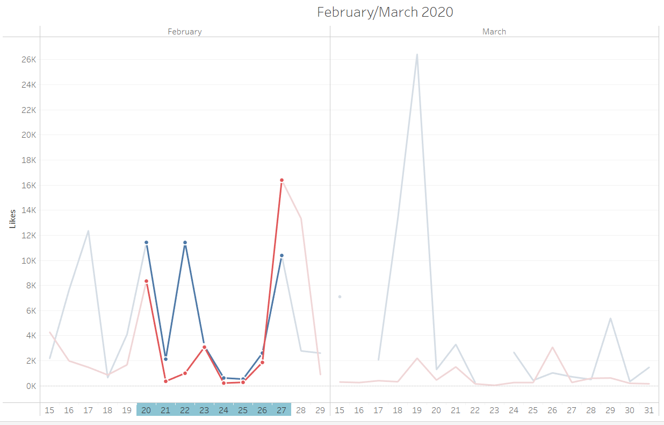
Getafe “scores” better
Getafe
Ajax

Slide 9
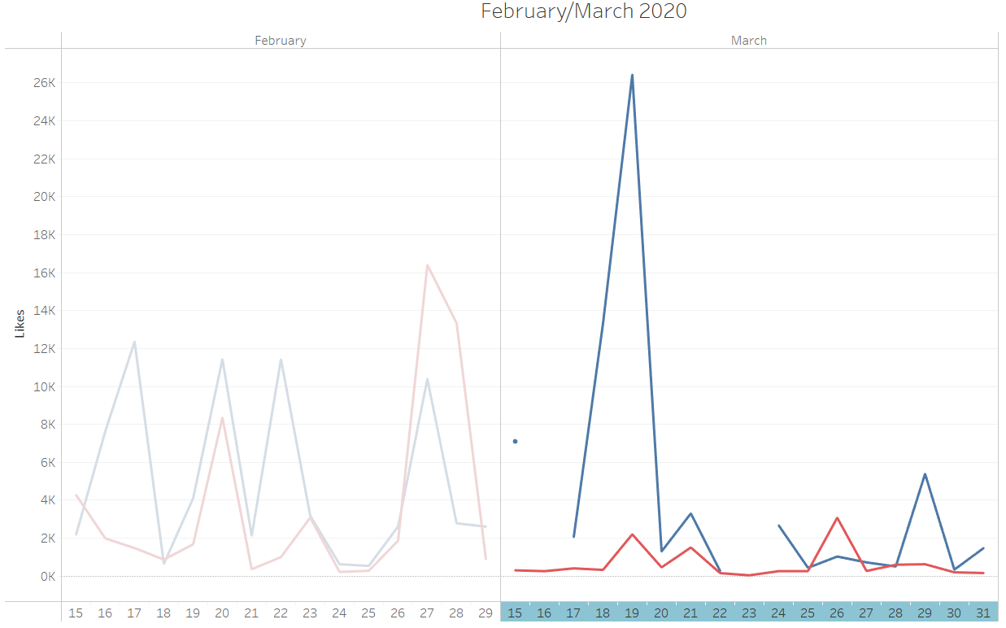
Short-term success
Ajax
Getafe

Slide 10


