Slide 1


Forecasting electricity consumption
Sander Roos
Ironhack
21-08-2020

Slide 2
Topics of today
Context
Goal of the project
Insights data analysis
Time series forecasting
Conclusion
Notes:
Goal: Stimulus for creation of energy community. Develop cheap and efficient methods to predict load consumption, with or without energy generation
Usage: Utilities or DSO are already predicting demand (to match supply)

Slide 3
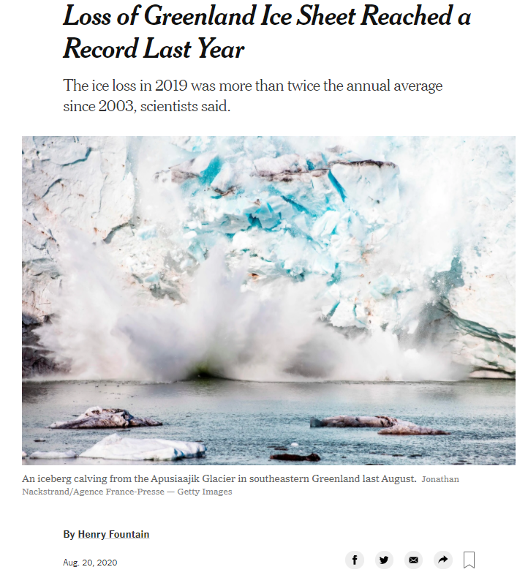
Top priority

Slide 4
Two important concepts
Europe: Traditionally central regulated electricity market
New concept : Energy community
Non-profit organization (consist out of citizens)
Need help
Research on cost-efficient electricity market

Slide 5
Goal of the project
Create method to decrease use of fossil fuels
Understanding energy consumption
Model that predict energy profiles

Slide 6
Insights residential load profiles
Exploration of various datasets (residential loads)
Seasonality/Weekdays/Holidays
Clear pattern
Notes:
Concluded that most people have the same patterns (no corona)

Slide 7
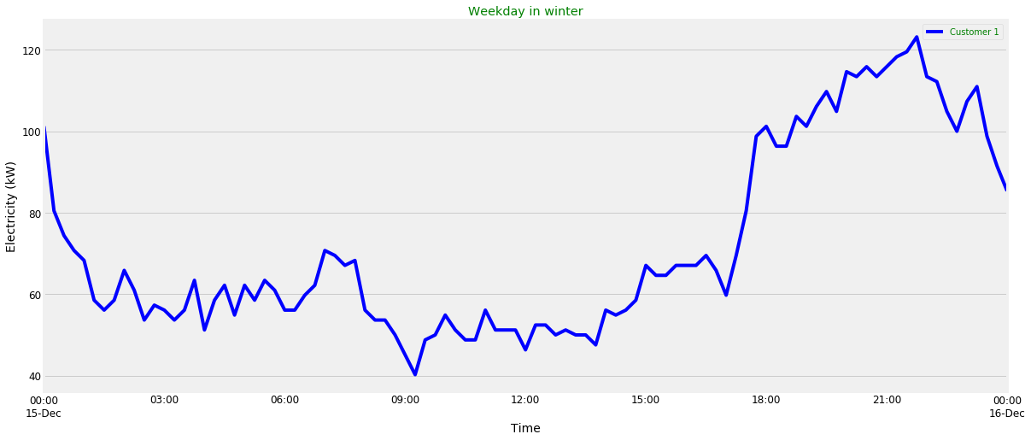
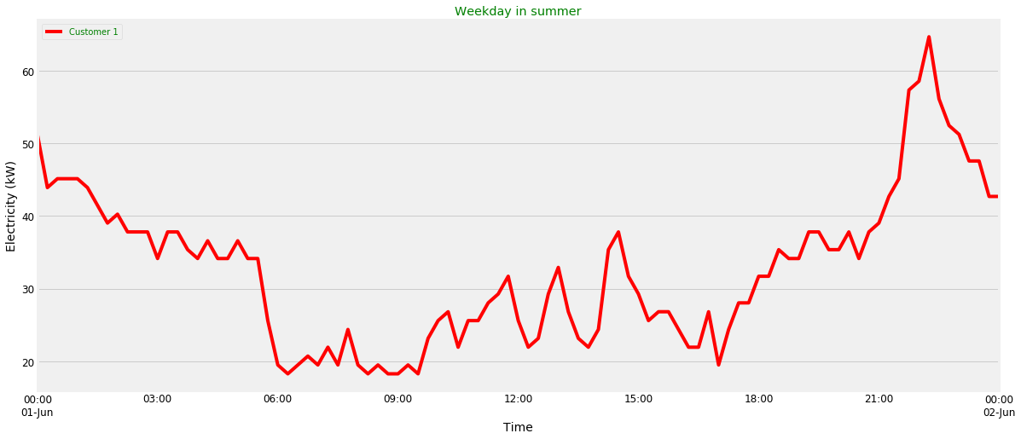
Notes:
In almost all profiles same pattern not unexpected
All countries same , slight diff Netherlands 7

Slide 8
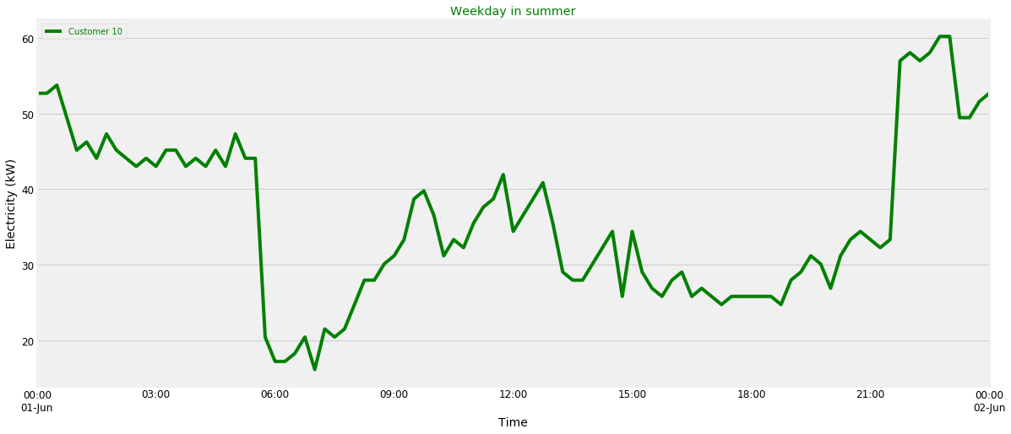
Okay fair enough, just increase the investment in renewables!

Slide 9
Time series forecasting
Predicting the future (with a level of uncertainty)
Multiple models for different types of data
SARIMA
Trends & Seasonality
Notes:
Predicting for new business models/ infrastructure
Can identity trend and seasonality (looked promising )
Yearly measured

Slide 10
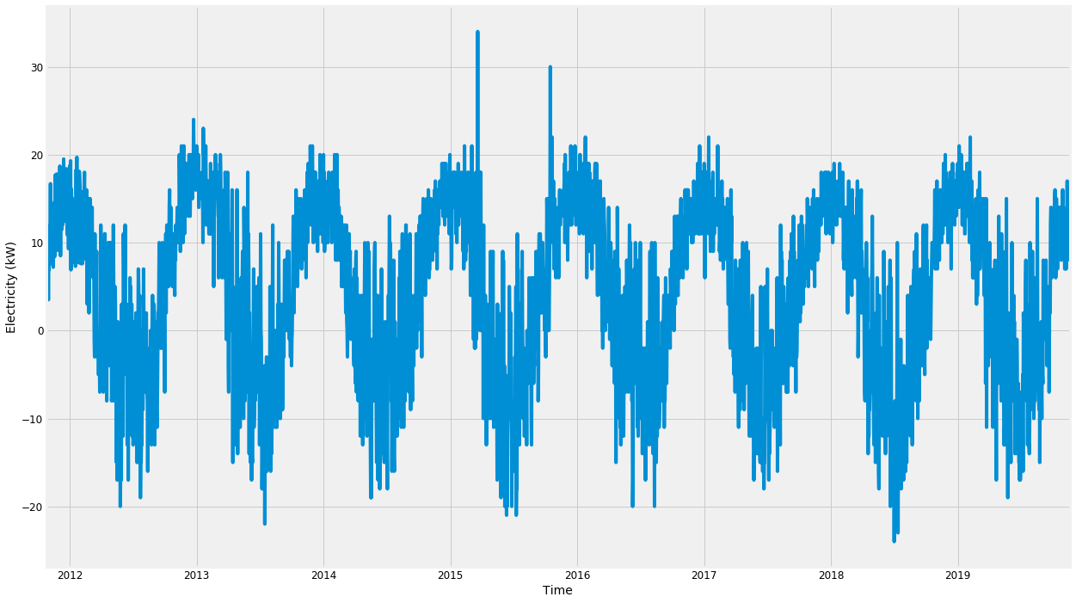
SARIMA for individual household
Notes:
Density
Minus, production in summer months
Don’t want to elaborate on the statistics now, added a factor that will presents an extra multiplier, presenting trends (simplified)
Clear pattern

Slide 11
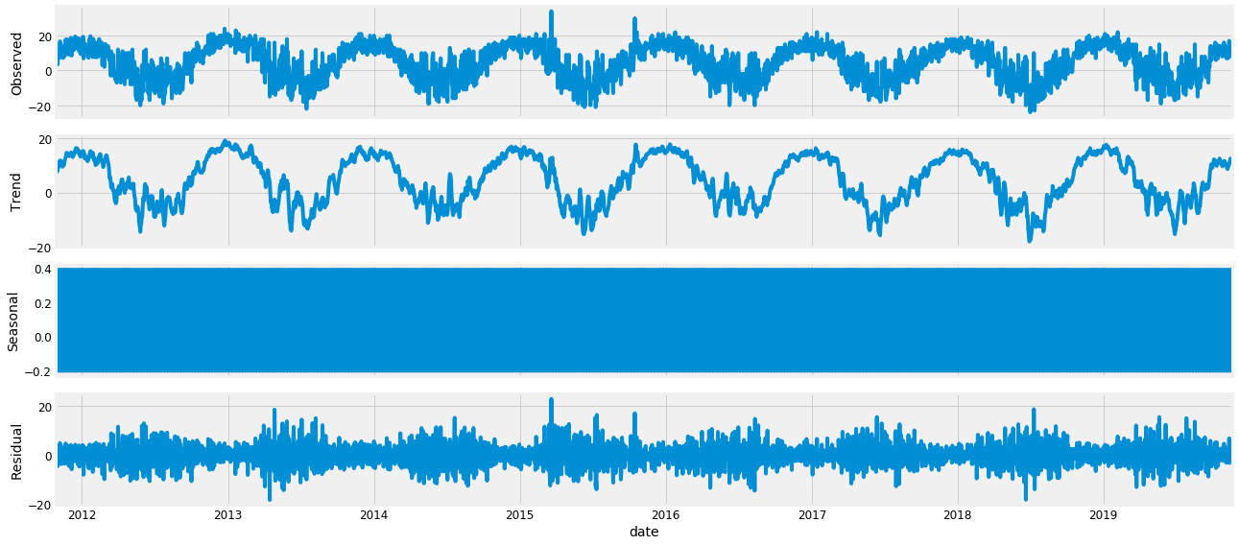
Decomposition of Graph

Slide 12
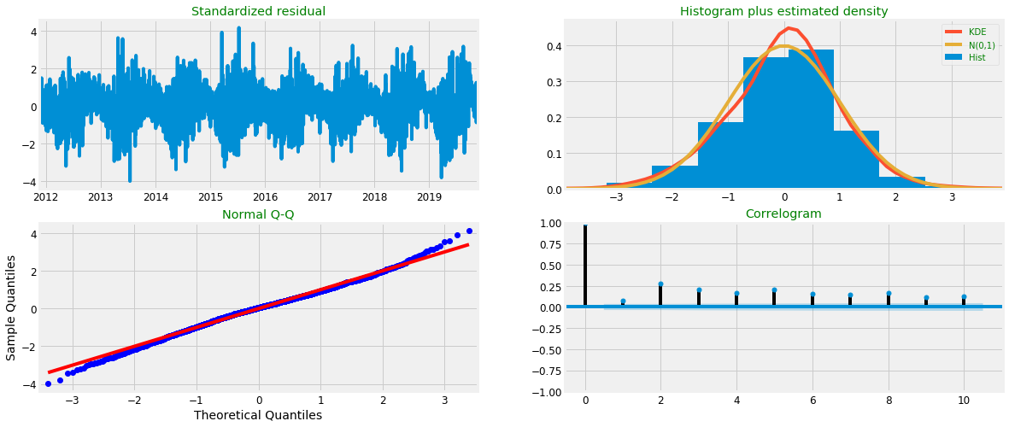
Fit the model

Slide 13
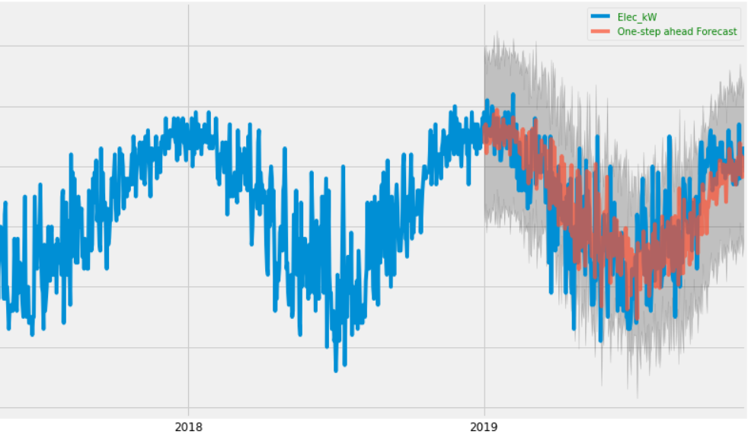
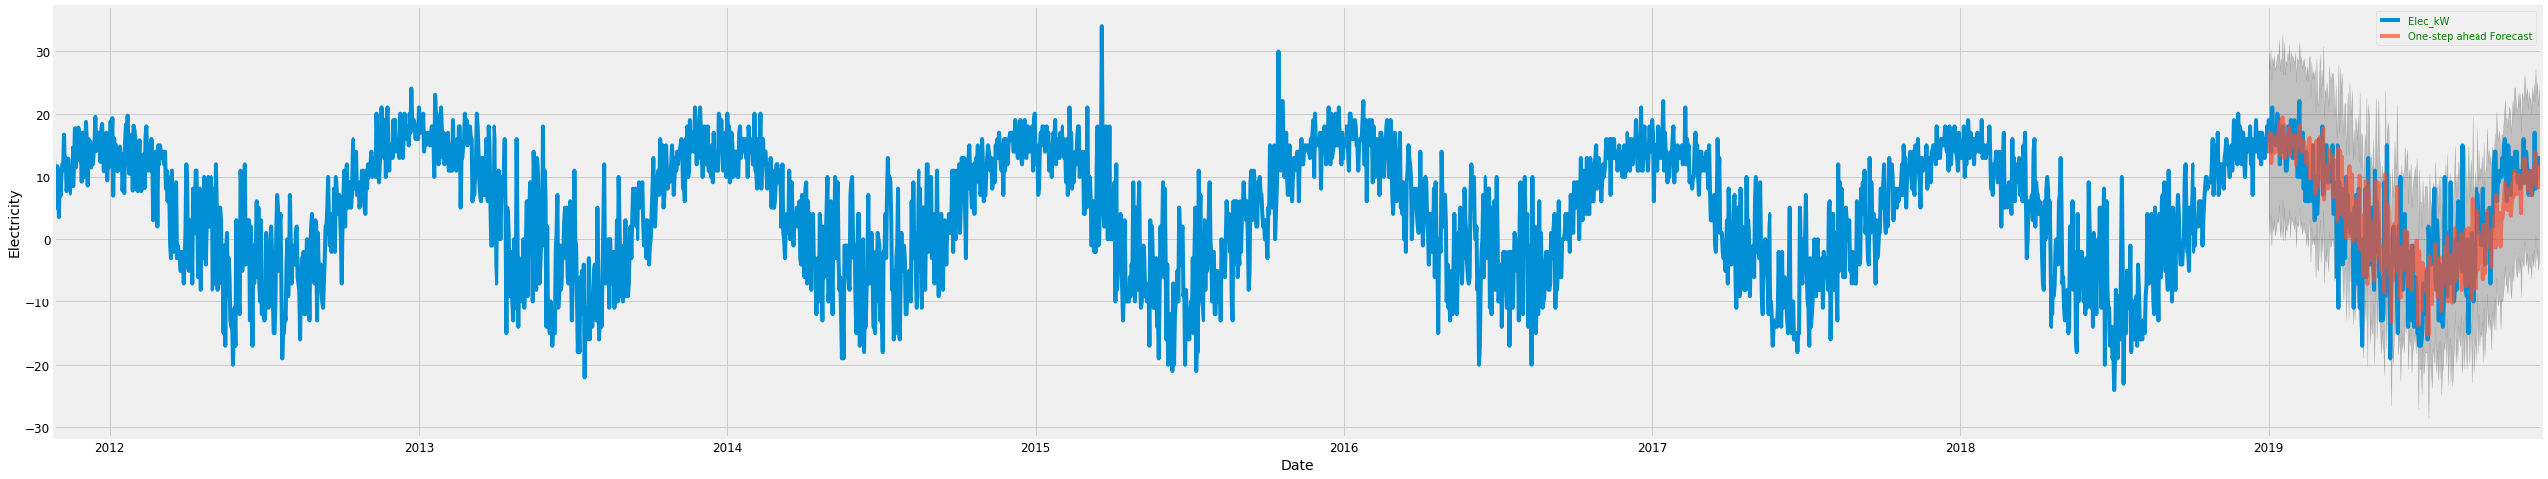
Prediction
Notes:
The Mean Squared Error is Elec_kW 47.12
The Root Mean Squared Error is Elec_kW 6.86
Prediction for energy community

Slide 14
Conclusion
Potential working with time series forecasting
One-step closer
Future research -> need for big dataset with classification possibilities

Slide 15


Glows & Grows
1. Handling big datasets (data cleaning)
1. Insight: More data equals more opportunities
This Photo by Unknown Author is licensed under CC BY-SA

Slide 16
Thank You!

