Slide 1

Project Title- Seasonal Agriculture Performance Analysis
Student Name- Sankalan Roy
College Name- GURU NANAK INSTITUTE OF TECHNOLOGY
AICTE STU ID :STU6745d07e9f53b1732628606

Slide 2

PROBLEM STATEMENT
Agricultural activities are influenced by seasonal variations in environmental conditions, farming practices, resource availability and market conditions. As a result, agricultural performance may differ from one season to another. However, raw agricultural data does not clearly explain how agricultural performance changes across seasons or what patterns can be observed in different seasonal conditions. The problem is to analyze the given agricultural dataset and investigate seasonal differences in agricultural performance by identifying meaningful patterns, trends, relationships and variations within the available data.

Slide 3
Project Description
Seasonal Agriculture Performance Analysis is a data analytics project that investigates how India's three cropping seasons — Kharif, Rabi, and Zaid — shape farm-level agricultural and economic outcomes. It was completed as the Major Project for the VOIS AICTE Virtual Internship, Batch 1 (2026–2027).
Agricultural output in India doesn't stay constant through the year — rainfall, temperature, humidity, soil conditions, and even the resources farmers apply shift dramatically between seasons, and each of these shifts leaves a mark on yield, cost, and profitability. Raw farm records don't make these patterns obvious on their own; the differences have to be extracted through structured analysis. This project takes a dataset of 4,000 farm records across 8 Indian states, 10 districts, 8 crops, and 4 irrigation methods, and works through it end-to-end — from raw, imperfect data to statistically validated, actionable conclusions.
The analysis is organized around one central question: do Kharif, Rabi, and Zaid produce meaningfully different agricultural and economic outcomes, and if so, what's driving the difference? Rather than treating this as a broad, unfocused exploration of the dataset, the project narrows in on season as the primary lens, and every technique used — from cleaning to visualization to hypothesis testing — is chosen to answer that question rigorously.

Slide 4
What the project actually does:
Cleans the data thoughtfully — missing values in rainfall, soil moisture, and yield are imputed using season-specific medians (not a single global average), because these fields are inherently season-dependent and a blanket fix would erase the very differences the project is trying to study. Statistical outliers are flagged rather than blindly deleted, since many turn out to be legitimate agronomic variation (e.g., Sugarcane's naturally much higher yield-per-hectare) rather than data errors.
Engineers fairer comparison metrics — including a crop-normalized yield score, so that seasonal comparisons aren't distorted by which crops happen to be more common in a given season.
Explores systematically — univariate distributions, then season-by-season breakdowns of environmental conditions, resource usage (fertilizer, pesticide, water, irrigation method), and economic performance (cost, revenue, profit, margins).
Tests relationships, not just visuals — correlation analysis between environmental factors and yield, both overall and within each season, to see whether weather alone explains performance.
Validates patterns statistically — using Kruskal-Wallis and Bonferroni-corrected pairwise tests (chosen because yield and profit are heavily skewed, not normally distributed) and Chi-square tests to check whether farming practices actually shift by season.
Hunts for the unexpected — surfacing counter-intuitive or high-risk patterns that a surface-level summary would miss.
Closes with real conclusions — data-grounded findings (e.g., Zaid being the weakest season economically, Kharif being a high-profit but high-disease-risk season) translated into concrete, actionable recommendations rather than generic observations.

Slide 5

WHO ARE THE END USERS?
Agricultural policy makers / government agriculture departments — for evidence-based seasonal planning, subsidy targeting (e.g., support for Zaid-season farmers), and resource allocation decisions.
Agricultural extension officers / advisory services — to guide farmers on season-specific irrigation choices, pest/disease management (especially for Kharif), and crop planning.
Farmers and farmer cooperatives — indirectly, through the recommendations translated into practical advisories about irrigation methods, disease-resistant seed choices, and risk awareness by season.
Agricultural economists and researchers — as a reference analysis or a template methodology for studying seasonal effects in farm-level data.
Financial institutions and crop insurance providers — to inform risk assessment and insurance product design, since the analysis identifies which season carries the highest loss-making risk.

Slide 6

Technology Used
Python 3 — core language for the entire analysis
Pandas — data loading, cleaning, grouping, pivot tables, and feature engineering
NumPy — numerical operations and array computations
Matplotlib — base plotting engine for all charts
Seaborn — statistical visualizations (boxplots, heatmaps, distribution plots) built on top of Matplotlib
SciPy (scipy.stats) — hypothesis testing, including:
Kruskal-Wallis test (non-parametric comparison across seasons)
Mann-Whitney U test (pairwise post-hoc comparisons, Bonferroni-corrected)
Chi-square test of independence (categorical association testing)
Google Colab — cloud-based execution platform (no local setup required)

Slide 7
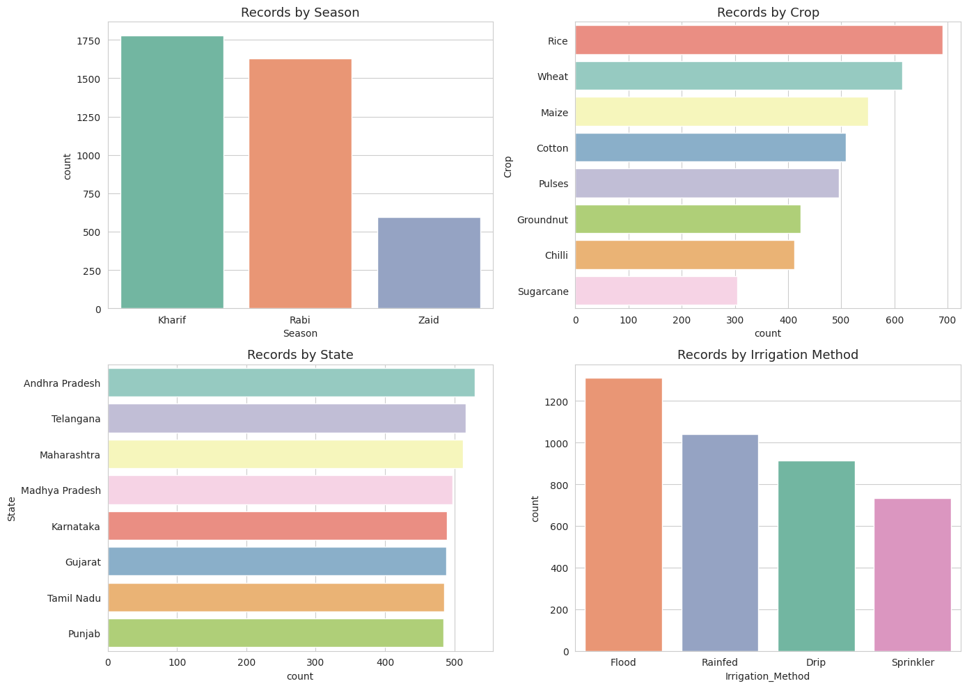
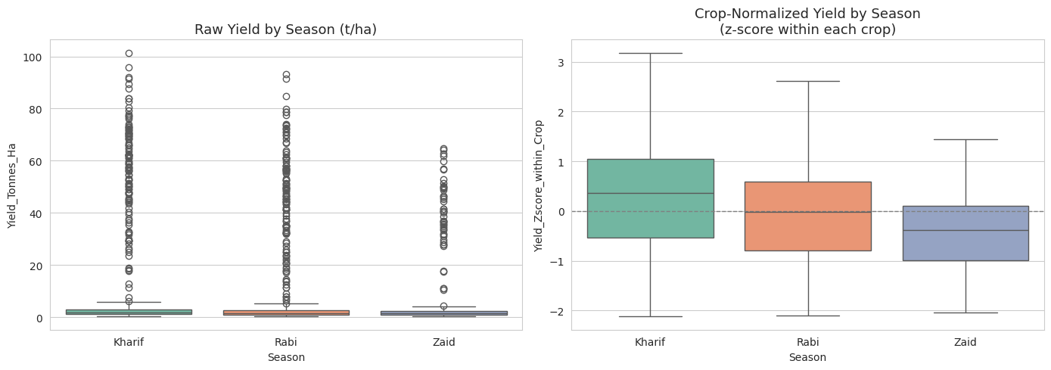
RESULTS
Fig 1: Records w.r.t. different parameters
Fig 2: Raw vs Crop-Norm. Yield

Slide 8
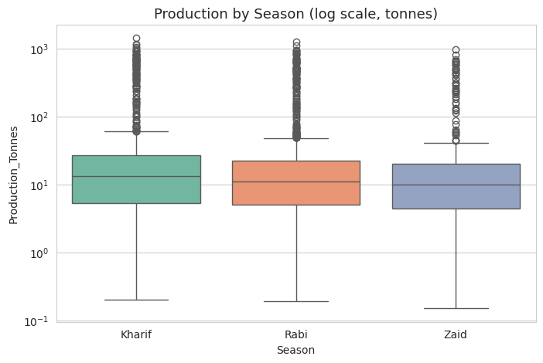
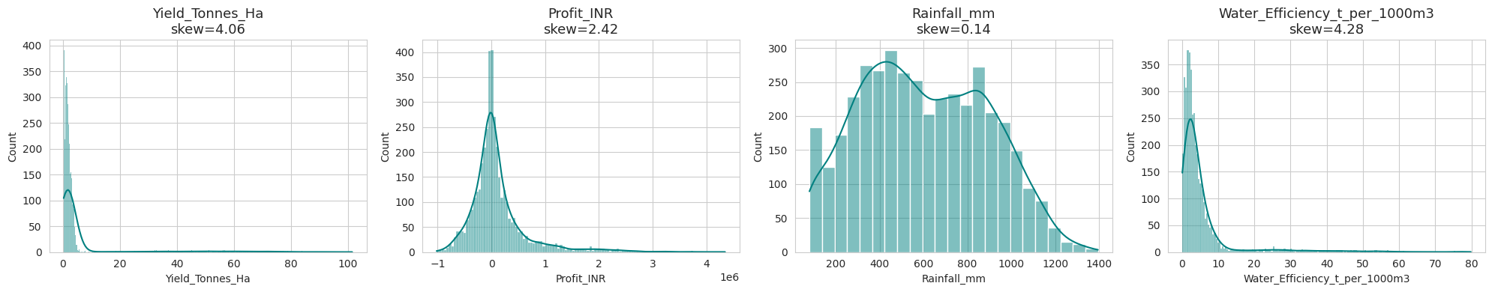
RESULTS
Fig 3: Plots of Records
Fig 4:Production by Season

Slide 9
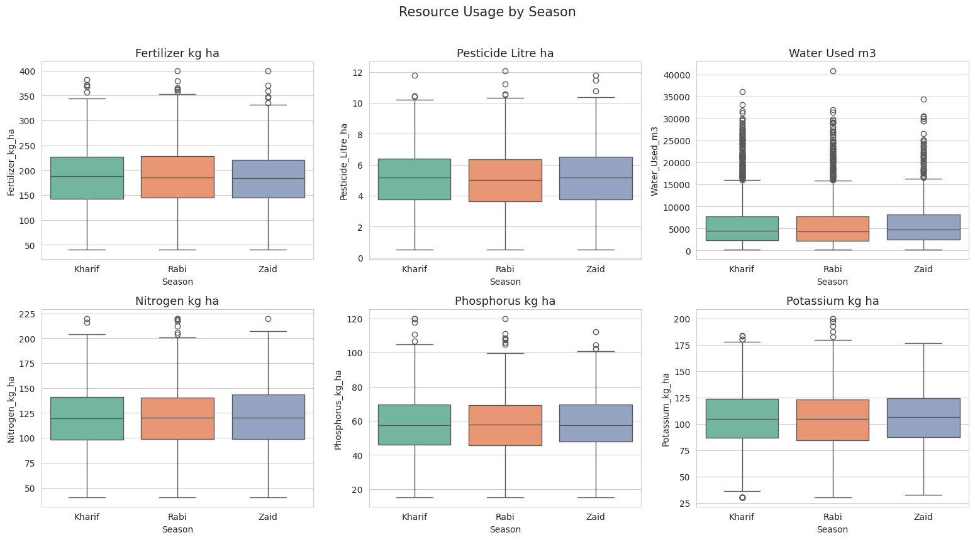
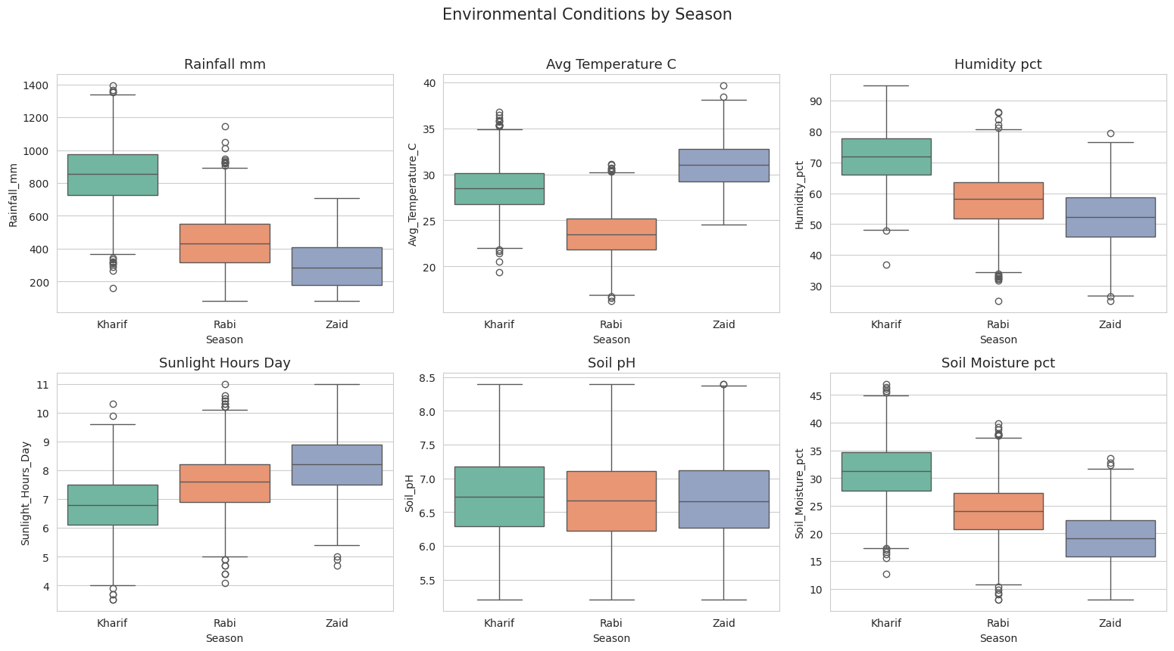
RESULTS
[Add screen shots of your code ]
Fig 5: Env. Conditions
Fig 6: Usages of Resource

Slide 10
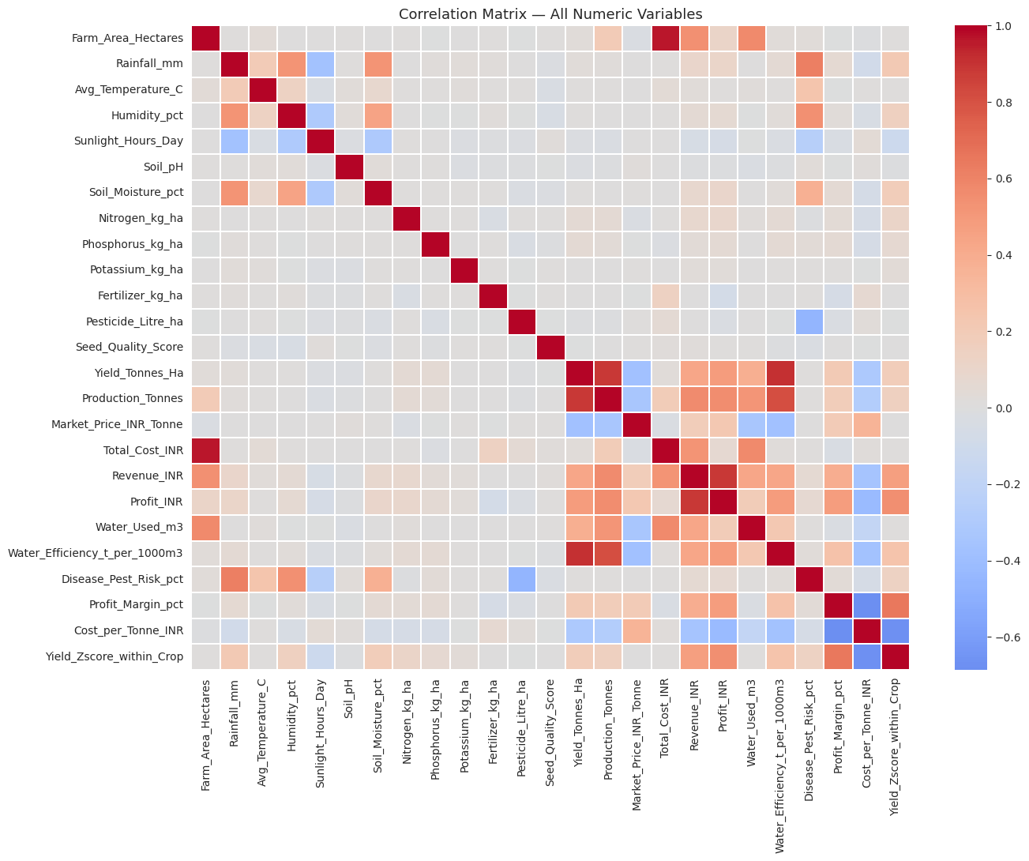
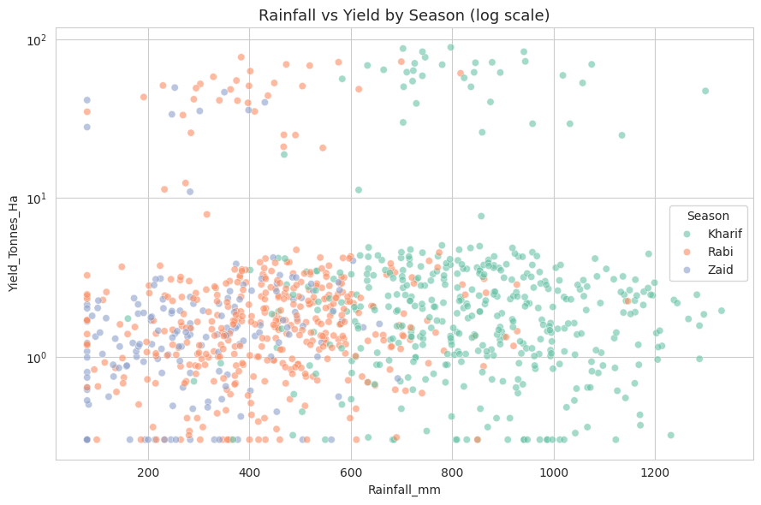
RESULTS
[Add screen shots of your code ]
Fig 7: Conf. Matrix of all Numeric Values
Fig 8: Log Scale

Slide 11
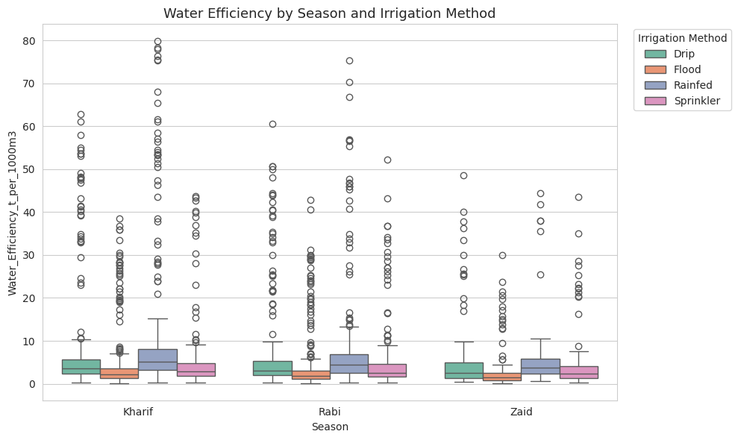
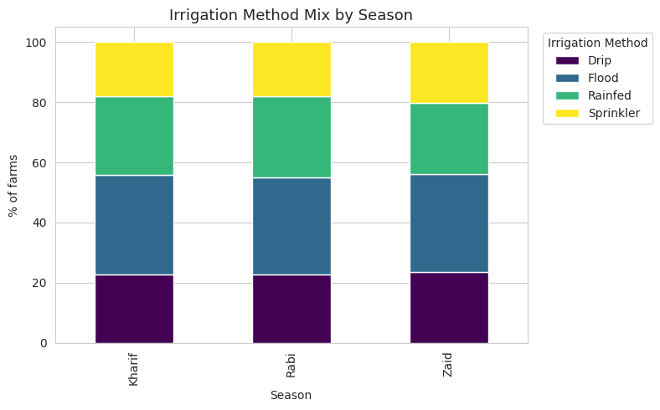
RESULTS
[Add screen shots of your code ]
Fig 9: Water Efficiency
Fig 10: Irrigation by Season

Slide 12
Future scope
Predictive Modelling — Forecast yield/profit using ML (Regression, Random Forest, XGBoost)
Multi-Year Data — Enable trend analysis across years, not just one season snapshot
Climate Integration — Add weather forecasts & satellite (NDVI) data for real-time crop health
Farm Segmentation — Cluster farms into risk/performance profiles using K-Means
Interactive Dashboard — Deploy via Streamlit/Power BI for non-technical users
Recommendation Engine — Suggest optimal irrigation & inputs by crop/season/region
Scale Nationally — Extend beyond current 8 states to validate broader patterns
Field Validation — Pilot-test recommendations with real farmers & extension officers

Slide 13
GitHub Link
GitHub Link

Slide 14

VOIS Course completion certificate - Course name- Data Visualization
CERTIFICATE LINK

Slide 15
Thank you
.
.

