Slide 1

Customer Data Analysis Project
Project ID : PRDA-05
Project Team ID : PTID-CDA-APR-25-431

Slide 2
Team Members
Prateek Vaidya
Sankalp Khanvilkar
Ragini Kondalwade
Member
Member
Member

Slide 3
About Dataset
This dataset contains shopping information from 10 different shopping malls between 2021 and 2023. We have gathered data from various age groups and genders to provide a comprehensive view of shopping habits in Istanbul. The dataset includes essential information such as invoice numbers, customer IDs, age, gender, payment methods, product categories, quantity, price, order dates, and shopping mall locations.

Slide 4
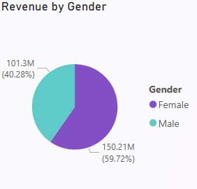
Shopping distribution according to gender
Unique Customers
Female : 59482 Male : 39975
Quantity by Gender
Female : 178659 Male : 120053
Revenue by Gender
Female : 150.21M Male : 101.3M
This indicates that female customers contributed to approximately 59.8% of total product sales, suggesting they were the more active purchasing group.

Slide 5
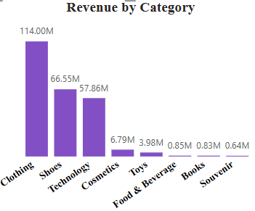
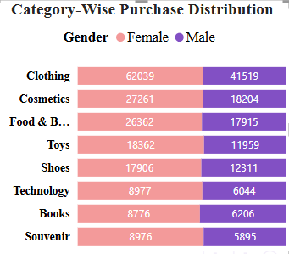
Purchase categories relative to other columns
Top Category
Clothing
The category-wise purchase distribution shows that female customers consistently outperformed male customers across all product categories in terms of quantity purchased.

Slide 6
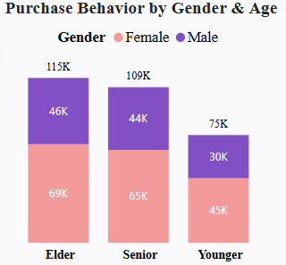
Shopping distribution according to age
Age Categories
Younger (18-30) : 25024
Elder (30-50) : 38332
Senior (>50) : 36101
The Elder age category is the top revenue-generating segment.
Across all age categories, female shoppers lead in purchase volume, and the Elder group (30–50 years) is the most active segment. This makes them a crucial target for promotional strategies and broad category offerings.

Slide 7
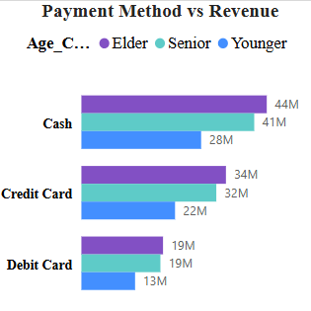
Payment Method According to Age Category
Elder and Senior customers generate the highest revenue across all payment methods, indicating a strong age-based correlation.
Cash remains the most dominant method across age groups, but its preference declines with younger customers, who lean more toward electronic payment methods.
This shows that payment method choice is influenced by age, and potentially by tech-savviness or purchasing power.

Slide 8
Thank you

