Slide 1
FACE MASK
PRESENCE CLASSIFICATION
Deep Learning Based Image Classification using MobileNetV2
Team Leader: SANKALP | Mentor: Yashraj Sir
B.Tech Deep Learning • Semester V, Section A
Group ID: BT_DL_06 | Project ID: DL-006

Slide 2
PROJECT TEAM & MEMBER DETAILS
Group: BT_DL_06 | Project ID: DL-006 | Mentor: Yashraj Sir | Team Leader: SANKALP
NAME STUDENT ID ROLL NO.
NAME STUDENT ID ROLL NO.
SANKALP (TEAM LEADER)
BCS2024462
2410303435
Vaibhav Srivastava
BCS2024464
2410303523
Vansh Rastogi
BCS2024306
2410303527
Shivanshu Mishra
BCS2024465
2410303472
Ravi kumar
BCS2024308
2410303388
Roli Gaurav
BCS2024466
2410303410
Abhishek Kumar
BCS2024455
2410303022
Prashant Kumar
BCS2024467
2410303346
Harshit kumar
BCS2024458
2410303196
Harshit sharma
BCS2024469
2410303198
Abhinav Pratap Singh
BCS2024459
2410303015
Vinayak singh
BCS2024471
2410303552
Rishabh Gangwar
BCS2024460
2410303398
Anushka Gupta
BCS2024474
2410303099
FACE MASK PRESENCE CLASSIFICATION • TEAM DETAILS

Slide 3

Project Overview
WHAT THE SYSTEM DOES
INPUT
PROCESS
OUTPUT
A user selects an image containing a person.
The trained CNN model analyzes the image and predicts a class.
The system displays “With Mask” or “Without Mask” with confidence.
This is a binary image-classification project.
The model is trained using a labeled dataset stored in two folders: mask and no_mask.
The trained model can predict on a new image that was not part of the training set.
FACE MASK RECOGNITION • PROJECT PRESENTATION 02

Slide 4

Problem Statement & Objectives
WHY THIS PROJECT?
PROBLEM STATEMENT
OBJECTIVES
Manually checking every image to identify whether a person is wearing a face mask can be time-consuming. The project explores how deep learning can automate this classification from an image.
• Build a binary image classifier.
• Use transfer learning to reduce training effort.
• Train and validate the model on labeled images.
• Predict a class and confidence score for a new image.
FACE MASK RECOGNITION • PROJECT PRESENTATION 03

Slide 5

Technologies & Tools Used
DEVELOPMENT STACK
Python
TensorFlow / Keras
MobileNetV2
OpenCV
Main programming language
Model building, training and loading
Pre-trained CNN feature extractor
Image reading, color conversion and resizing
NumPy
Matplotlib
VS Code
ImageDataGenerator
Array operations and input preparation
Training accuracy and loss graphs
Code editing and project development
Rescaling, augmentation and data split
FACE MASK RECOGNITION • PROJECT PRESENTATION 04

Slide 6

Dataset & Pre-processing
HOW IMAGES ARE PREPARED
data/
├── mask/ # images with face masks
└── no_mask/ # images without face masks
DATA SPLIT
80% of images are used for training and 20% for validation using validation_split=0.2.
All images are resized to 224 × 224 pixels.
Images are converted to RGB and pixel values are rescaled from 0–255 to 0–1.
Training augmentation: rotation, width/height shift, shear, zoom and horizontal flip.
Augmentation helps the model generalize to small variations in image position and orientation.
FACE MASK RECOGNITION • PROJECT PRESENTATION 05

Slide 7

Model Architecture — MobileNetV2
TRANSFER LEARNING
INPUT IMAGE
MobileNetV2
Global Average
Pooling
Dense Layer
Dropout
Output Layer
224 × 224 × 3
Pre-trained on ImageNet
Base layers frozen
128 neurons • ReLU
0.4 rate • reduce overfitting
1 neuron • Sigmoid
Compress feature maps
MobileNetV2 provides reusable visual features learned from a large image dataset.
The base model is frozen initially; only the new classification head is trained.
Sigmoid returns a value between 0 and 1 for the binary prediction.
FACE MASK RECOGNITION • PROJECT PRESENTATION 06

Slide 8

Model Training
IMPORTANT TRAINING SETTINGS
EPOCHS
BATCH SIZE
OPTIMIZER
20 maximum training epochs
32 images per training batch
Adam • learning rate 0.0001
Loss function: Binary Cross-Entropy, suitable for two-class classification.
Metric: Accuracy, measured on both training and validation data.
EarlyStopping monitors validation loss; training stops after 3 epochs without improvement and restores the best weights.
ModelCheckpoint saves the model with the best validation accuracy as best_mask_model.h5.
The final trained model is also saved as mask_classifier_model.h5.
FACE MASK RECOGNITION • PROJECT PRESENTATION 07

Slide 9

Prediction on a New Image
WHAT PREDICT.PY DOES
1. CHECK FILES
2. LOAD MODEL
3. READ IMAGE
Confirm model and image paths exist.
Load best_mask_model.h5.
Open image with OpenCV; handle unreadable files.
4. PRE-PROCESS
5. PREDICT
6. DISPLAY
BGR → RGB, resize to 224×224, scale to 0–1.
Add batch dimension and call model.predict().
Choose class using 0.5 threshold and print confidence.
FACE MASK RECOGNITION • PROJECT PRESENTATION 08

Slide 10


Prediction Logic & Confidence
HOW THE OUTPUT IS SELECTED
prediction = model.predict(img)[0][0]
if prediction < 0.5:
label = "with_mask"
confidence = 1 - prediction
else:
label = "without_mask"
confidence = prediction
THRESHOLD = 0.5
Below 0.5 → With mask
0.5 or above → Without mask
CONFIDENCE SCORE
The displayed confidence is the model score for the selected class. It is not a guarantee that the prediction is correct.
FACE MASK RECOGNITION • PROJECT PRESENTATION 09

Slide 11
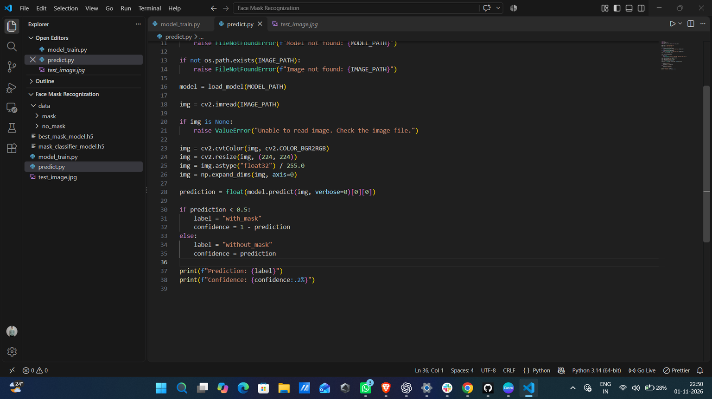

Implementation & Output
PROJECT IN VISUAL STUDIO CODE
PROJECT FILES
model_train.py
predict.py
data/
best_mask_model.h5
OUTPUT
Prediction label and confidence are printed in the terminal.
FACE MASK RECOGNITION • PROJECT PRESENTATION 10

Slide 12

Limitations & Future Improvements
WHAT CAN BE IMPROVED NEXT?
CURRENT LIMITATIONS
FUTURE SCOPE
• Predicts one image at a time.
• Performance depends on dataset quality, size and diversity.
• Image classification does not locate multiple faces separately.
• Confidence score may not equal real-world accuracy.
• Build a web interface to upload an image from a browser.
• Add face detection for images containing multiple people.
• Test on a larger and more diverse dataset.
• Fine-tune selected MobileNetV2 layers and evaluate performance.
• Add webcam/live-video support with appropriate privacy safeguards.
FACE MASK RECOGNITION • PROJECT PRESENTATION 11

Slide 13
CONCLUSION
The project demonstrates how transfer learning with MobileNetV2 can be used to classify face-mask images into two categories.
It combines dataset preparation, model training, evaluation and prediction on a new image.
THANK YOU
Questions?
THANK YOU

