Slide 1
IBM University Engagement Project Submission
“Exploring the Power of Agentic AI with IBM Granite and IBM Bob”

Slide 2

Project Tile – Interview Trainer Agent
Domain of Project – Educational Technology
Student Name | Recent Passport Photo | Email ID | Mobile number [WhatsApp]
Sankalp Tiwari |  | sankalptiwari1706@gmailicom | 9968201172

Slide 3
Problem Statement - Interview Trainer Agent
The Challenge – An Interview Trainer Agent, powered by RAG (Retrieval-Augmented Generation), prepares users for job interviews by generating tailored question sets and preparation strategies based on their profile name, experience level, and job role. It retrieves role-specific interview questions, industry expectations, behavioral scenarios, and HR guidelines from recruitment portals, professional networks, and company interview databases. Users can input their resume or job title, and the agent provides targeted questions, model answers, and improvement tips. It supports both technical and soft skill assessment, ensuring a comprehensive interview prep experience. This AI-driven assistant builds user confidence, sharpens responses, and increases success rates in competitive hiring environments.
Technology – Use of IBM Cloud Lite services / IBM Granite is mandatory.

Slide 4
Proposed Solution -
Our proposed solution is an AI-powered Interview Trainer Agent that provides personalized interview preparation using Retrieval-Augmented Generation (RAG) and IBM Granite foundation models on IBM Cloud.
The system analyzes a candidate's resume, experience level, skills, and target job role to understand their profile. It retrieves relevant interview content—including technical questions, HR and behavioral scenarios, industry expectations, and company-specific interview patterns—from a curated knowledge base containing recruitment portals, interview experiences, and professional resources.
Using IBM Granite, the agent generates:
Personalized technical and behavioral interview questions
Context-aware model answers and explanations
Resume-specific follow-up questions
HR interview guidance and situational scenarios
Communication, confidence, and response improvement tips
The platform also evaluates user responses, identifies strengths and weaknesses, and provides actionable feedback with personalized learning recommendations. As users continue practicing, the agent adapts the difficulty level and question selection based on their performance, creating a customized interview preparation experience.
By combining semantic retrieval (RAG) with IBM Granite's generative capabilities, the solution delivers accurate, relevant, and up-to-date interview preparation while minimizing AI hallucinations and improving the quality of generated responses.
Key Benefits
Personalized interview preparation based on resume and job role
Covers technical, HR, behavioral, and aptitude interviews
AI-generated model answers with detailed feedback
Adaptive learning based on user performance
Company and role-specific interview practice
Powered by IBM Granite and IBM Cloud Lite services
Scalable, accurate, and cost-effective interview coaching platform

Slide 5
Technology Used
IBM Granite 4.0 — Primary LLM that generates prep plans, answer guidance, and scored evaluations via watsonx.ai.
ibm-watsonx-ai SDK — Official Python SDK that wraps the IBM Granite and Slate APIs for inference and embedding calls.
FAISS (faiss-cpu) — Facebook's vector similarity library used to build and query the local document index.
Streamlit — Python web framework that powers the entire chat-first UI including tabs, sidebar, and session state.
Bob — AI coding assistant embedded in VS Code that reads, explains, and edits the codebase using tools like FindSymbol, grep, and read_file.

Slide 6
IBM Bob -
Bob is the AI coding assistant integrated into this VS Code workspace via the Bob extension. It operates within the same repository and:
Stores its own memory in the Git object store under refs/notes/bob (visible in .git/refs/notes/bob and .git/logs/refs/notes/bob)
Runs in Ask, Plan, and Agent modes — each with a different set of tools (read-only exploration vs. full file editing + command execution)
Supports Skills (loaded on-demand instruction sets, like create-skill, build-mcp-server, xlsx-insights) and Workflows (multi-step processes like creating PRs)
Understands the full project codebase via tools like FindSymbol, grep, read_file, and GetSymbolsOverview
Respects the project's engineering discipline: minimal changes, grounded answers only after reading actual files

Slide 7
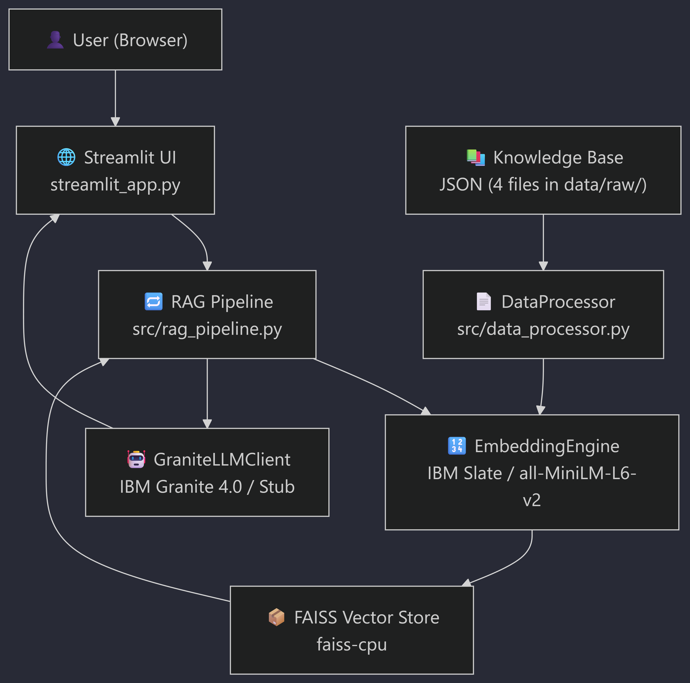
Architecture blueprint

Slide 8
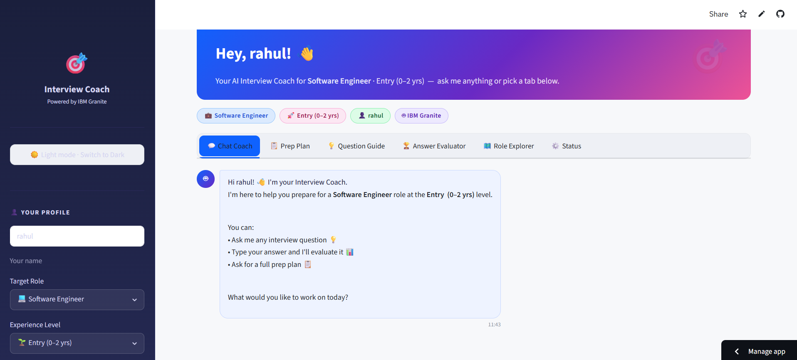
Working -

Slide 9
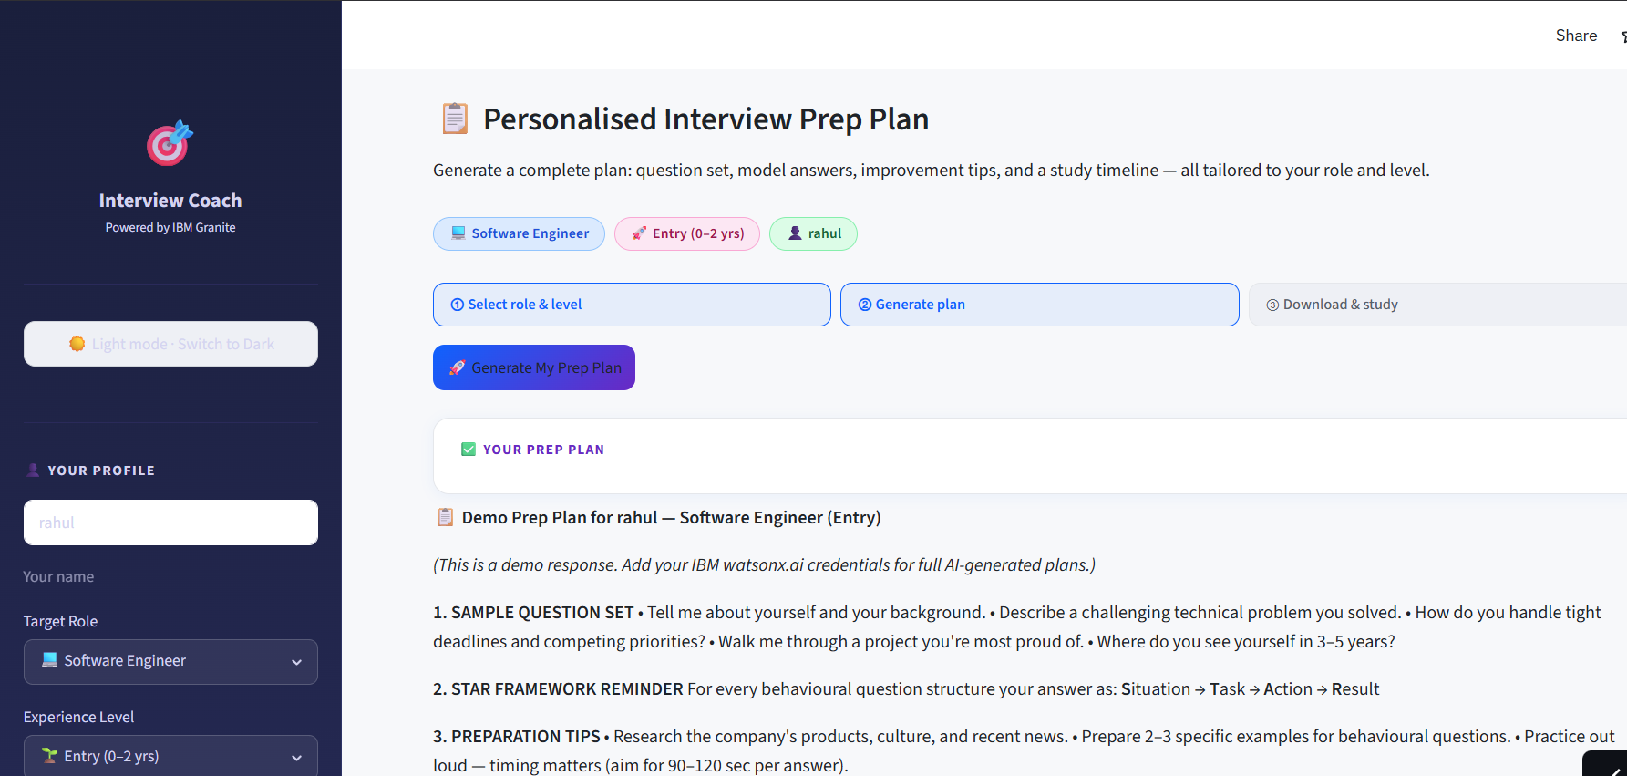

Slide 10
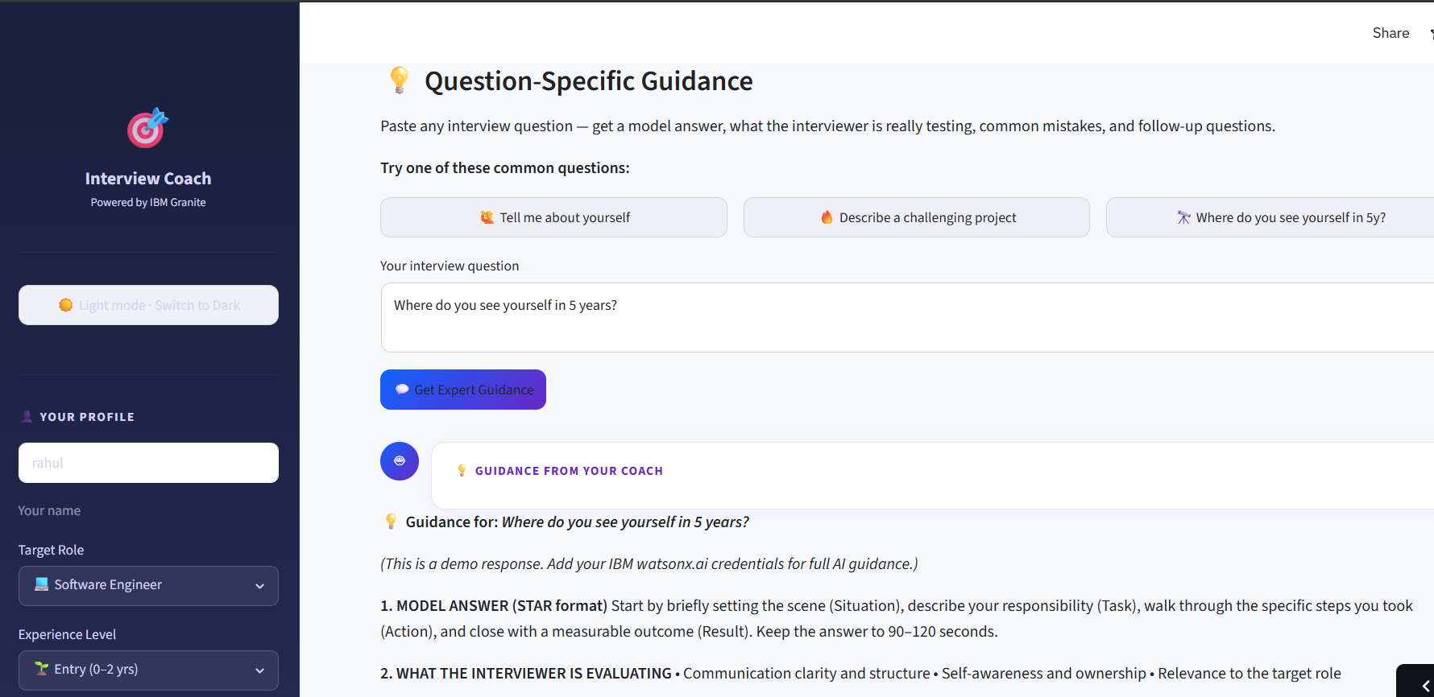

Slide 11
Role of Agentic AI in the solution
Agentic AI enables the Interview Trainer Agent to function as an intelligent, autonomous interview coach rather than a simple question-answering chatbot. Using IBM watsonx.ai and IBM Granite models, it coordinates multiple specialized agents to deliver personalized and effective interview preparation.
Each agent performs a specific role—such as analyzing resumes, retrieving role-specific interview questions, generating technical and HR questions, evaluating candidate responses, and providing improvement suggestions—while working collaboratively. This multi-agent approach ensures efficient task execution and highly relevant interview guidance.
Agentic AI also brings context awareness by understanding the user's experience level, technical skills, target job role, and career goals to generate personalized interview scenarios and preparation strategies. It supports real-time adaptation, continuously adjusting question difficulty and focus areas based on the candidate's performance during mock interviews.
Additionally, the agents communicate with each other, enabling better decision-making by combining retrieved knowledge with AI-generated insights to provide accurate model answers, constructive feedback, and targeted learning recommendations.
Overall, Agentic AI makes the Interview Trainer Agent proactive, personalized, and goal-driven, acting as a smart virtual interview mentor that helps candidates build confidence, improve communication skills, and maximize their chances of success in job interviews.

Slide 12
Novelty and Uniqueness
The proposed Interview Trainer Agent stands out by combining Agentic AI, RAG, and personalized interview coaching into a single intelligent system.
Multi-Agent Intelligence – Instead of a single chatbot, multiple specialized agents collaborate to analyze resumes, retrieve interview knowledge, generate questions, and evaluate candidate responses.
RAG-Based Accuracy – Integrates real-time knowledge retrieval with AI generation, reducing hallucinations and ensuring role-specific, accurate interview preparation.
Hyper-Personalization – Tailors interview questions, mock sessions, and preparation strategies based on the candidate's resume, experience level, skills, and target job role.
Adaptive Learning – Continuously adjusts question difficulty and learning recommendations based on user performance and identified skill gaps.
Comprehensive Interview Coverage – Supports technical, HR, behavioral, situational, and company-specific interview preparation within a single platform.
Constructive AI Feedback – Evaluates responses and provides model answers, communication tips, confidence-building suggestions, and improvement recommendations.
Scalable & Enterprise-Ready – Built on IBM watsonx.ai with IBM Granite models, ensuring reliability, scalability, security, and responsible AI governance.

Slide 13
Git Hub Link
Repository Link: https://github.com/Sankalp-Dev06/Interview-Trainer-AI
Live Link: https://interview-trainer-ai-ysbnd46yiusuyceq4uaxvv.streamlit.app/

Slide 14
Future Scope
The Interview Trainer Agent can be further enhanced with advanced AI capabilities to provide a more comprehensive and realistic interview preparation experience.
Voice-Based Mock Interviews – Enable real-time voice conversations with AI to simulate actual interview environments.
Video Interview Analysis – Analyze facial expressions, eye contact, body language, and confidence to provide non-verbal communication feedback.
Company-Specific Interview Preparation – Integrate company interview patterns, hiring trends, and role-specific question banks for personalized practice.
Coding Assessment Integration – Support live coding interviews with automated code evaluation and performance analysis for technical roles.
Multilingual Interview Support – Conduct interviews and provide feedback in multiple languages to improve accessibility.
AI Career Guidance – Recommend learning paths, certifications, and skill development based on interview performance and career goals.
Enterprise & University Integration – Enable organizations and educational institutions to conduct AI-powered mock interviews and candidate assessments at scale using IBM watsonx.ai and IBM Granite.

Slide 15
Certificates Earned:

Slide 16
Certificates Earned:

Slide 17
Certificates Earned:

Slide 18
Certificates Earned:​

Slide 19
Certificates Earned:​

Slide 20
Certificates Earned:​

Slide 21


