Slide 1
PRIMALITY TESTING
- A beautiful application of randomized algorithms
Project by:
Debraj Karmakar (220329)
Naman Kumar Jaiswal (220687)
Sankalp Mittal (220963)

Slide 2


Problem Definition
What are the uses?
Given a $n$-bit number N, develop an efficient algorithm to identify whether N is a prime or a composite number.
Finite Field Arithmetic
Cryptography
Encryption
$$n=O(\log_{2}{N)}$$
Provide Efficiency and Correctness bounds for the algorithm with proof

Slide 3

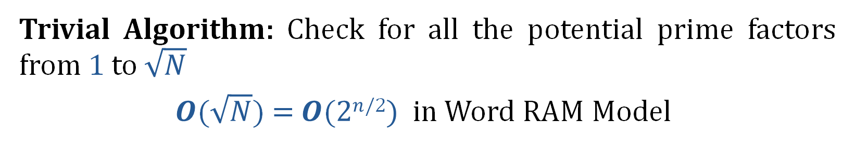
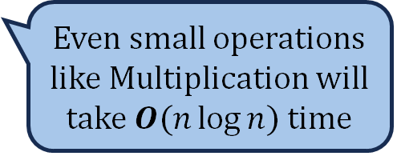
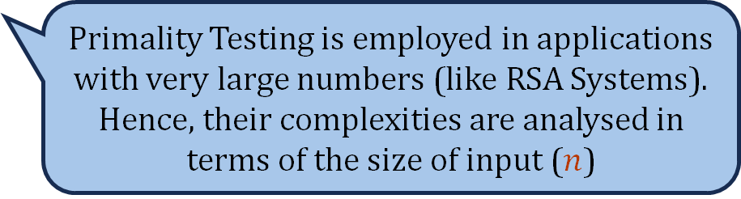

Deterministic Results
Trivial Algorithm: Check for all the potential prime factors from 1 to $\sqrt{N}$
$O$($\sqrt{N}$) = $O$($2n$^{/2}$)$ in Word RAM Model
Exponential time, impractical to work when $N>1020$
For these applications, we must analyse beyond Word RAM model
Primality Testing is employed in applications with very large numbers (like RSA Systems). Hence, their complexities are analysed in terms of the size of input ($n$)
Even small operations like Multiplication will take $O(n\log{n})$time

Slide 4

Deterministic Results
Best Deterministic Algorithm: [Agrawal, Kayal and Saxena, 2002]
Employs the polynomial congruence for prime powers
$$O(n^{6})$$
Polynomial in input but still not practical
Even though it has good theoretical bounds, its actual implementation is complicated due to handling large polynomials.
For numbers where primality testing is employed, Randomized Algorithms outperform AKS.

Slide 5

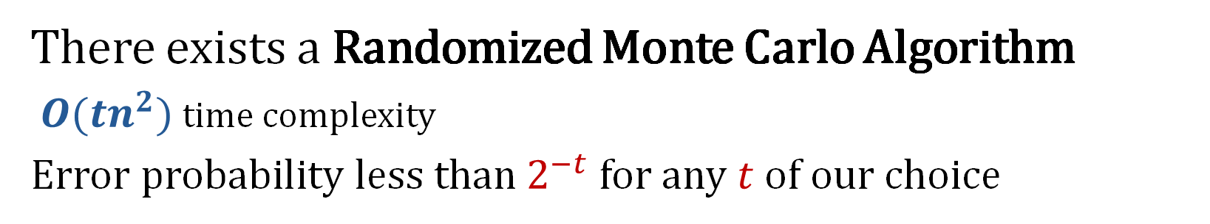

Randomized Results
There exists a Randomized Monte Carlo Algorithm
$O({tn}^{2})$ time complexity
Error probability less than$2^{−t}$ for any $t$ of our choice
Simple and elegant
Easy to implement
Good for practical purposes
For $t$= $50$, error probability is ${10}^{−15}$

Slide 6


Toolkit
Randomization
Modulo Arithmetic
Number Theory
Fermat’s Little Theorem
Elementary Probability

Slide 7
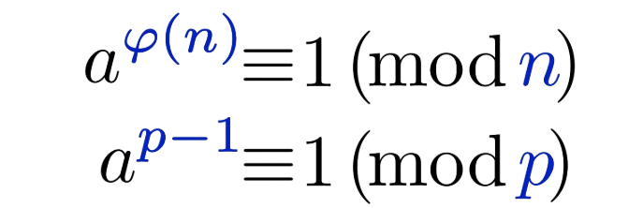
Fermat's Little Theorem

Slide 8
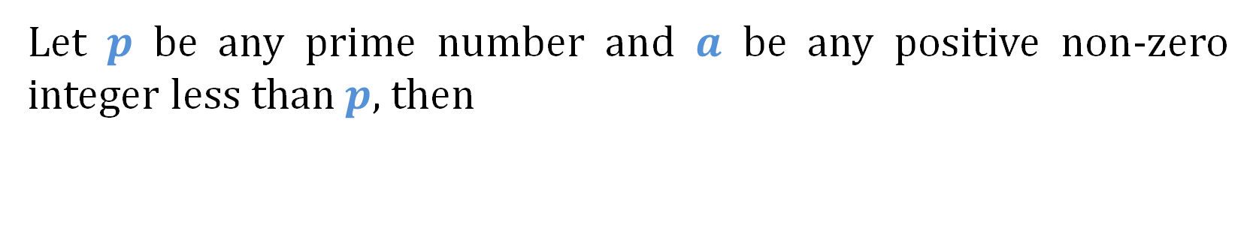

Fermat's Little Theorem
Let $p$ be any prime number and $a$ be any positive non-zero integer less than $p$, then
$$a^{p−1}≡1 \left(mod p\right)$$
Fermat, 1640
This gives a condition that holds for all primes, but for primality testing, we require the inverse relation that segregates primes from composites.

Slide 9



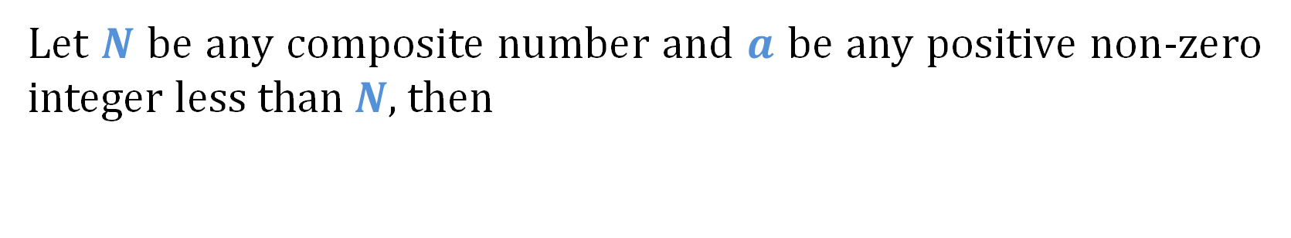
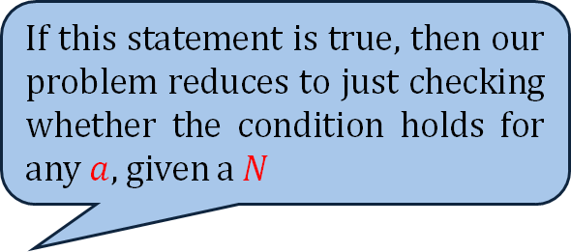


Inverse Statement
Let $N$ be any composite number and $a$ be any positive non-zero integer less than $N$, then
$$a^{N−1}≢1 \left(mod N\right)$$
If this statement is true, then our problem reduces to just checking whether the condition holds for any $a$, given a $N$
The Inverse of Fermat’s Little Theorem is not correct
Take a = 14 for n = 15
Verifying the condition takes $O(log⁡N)$time, in Word RAM model
$${14}^{14}=1 mod 15$$

Slide 10


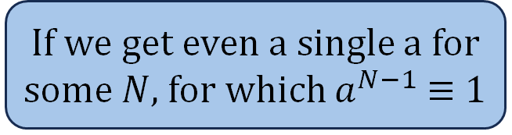

Attempt 1
Primality Testing ($N$) {
if ($N=2)$
return Prime;
if ($N\%2=0)$
return Composite;
Repeat $t$times {
$a$ $←$ pick an integer randomly uniformly from $1$ to $N−1$
if ( $a^{N−1}≢1 mod N)$
return Composite;
}
return Prime;
}
If we get even a single a for some $N$, for which $a^{N−1}$≡ 1
Time Complexity: $O({tn}^{2})$
Sufficient to prove that $N$ is composite
Notes:
Mention the time complexity and also say that we are ignoring logarithmic factors

Slide 11
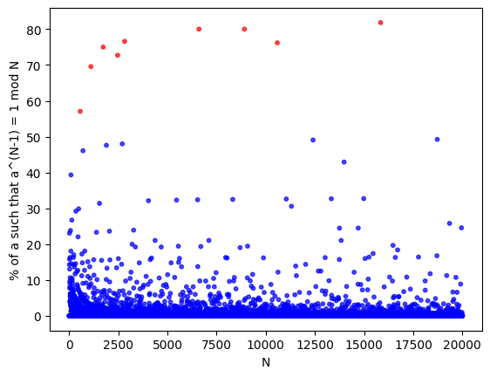

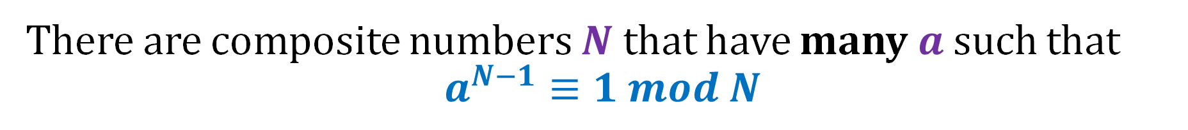
Problem with Attempt 1
There are composite numbers $N$ that have many $a$ such that
$$a^{N−1}≡1 mod N$$

Slide 12
Another Attempt

Slide 13






Attempt 2
$$N$$
If ($N\%2=0$) {
If ($N=2)$ Return Prime;
Else return Composite;
}
Don’t discard Fermat’s theorem
It is still useful
Handle even $N$ separately
$N$ is even
$N$ is odd
$P($error$)=0$

Slide 14
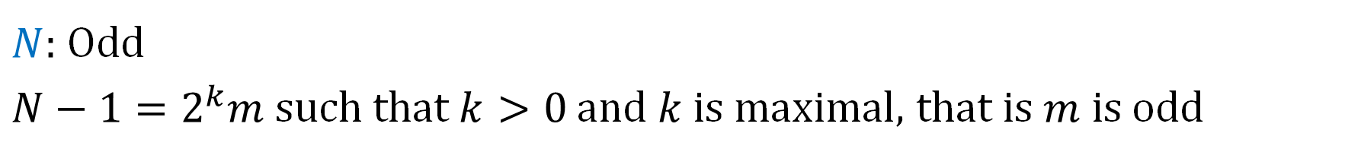


Attempt 2
$N:$ Odd
$N−1=2^{k}m$ such that $k>0$ and $k$ is maximal, that is $m$ is odd
$$a^{N−1}−1=a^{2^{k}m}−1$$
$$={(a}^{2^{k−1}m}+1){(a}^{2^{k−1}m}−1)$$
$={(a}^{2^{k−1}m}+1){(a}^{2^{k−2}m}+1)$ ⋯${ (a}^{2^{2}m}+1){(a}^{2^{1}m}+1){(a}^{m}+1){(a}^{m}−1)$
Notes:
Mention that this factorization is the key insight

Slide 15


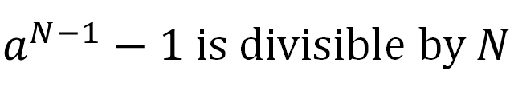
Attempt 2
$N:$ Odd prime
$a^{N−1}−1$ is divisible by $N$
At least one of ${(a}^{2^{k−1}m}+1),$⋯${ (a}^{2^{1}m}+1), {(a}^{m}+1), {(a}^{m}−1)$ is divisible by $N$
$a^{2^{k−1}m}≡−1\left(mod N\right)$
$$or a^{2^{k−2}m}≡−1\left(mod N\right)$$
⋮
$or$ $a^{2^{1}m}≡−1\left(mod N\right)$
${or a}^{m} ≡−1\left(mod N\right)$
$$or a^{m}≡1(mod N)$$

Slide 16



Some more insights
Is there any relation between $a^{2^{k−1}m}$, $a^{2^{k−2}m}$, ⋯, $a^{2^{2}m}$, $a^{2^{1}m} and{ a}^{m}$ ?
Yes!
$$a^{2^{k−1}m}={ (a}^{2^{k−2}m})^{2}$$
$$a^{2^{k−2}m}={ (a}^{2^{k−3}m})^{2}$$
⋮
$$a^{2^{1}m}={ (a}^{m})^{2}$$

Slide 17

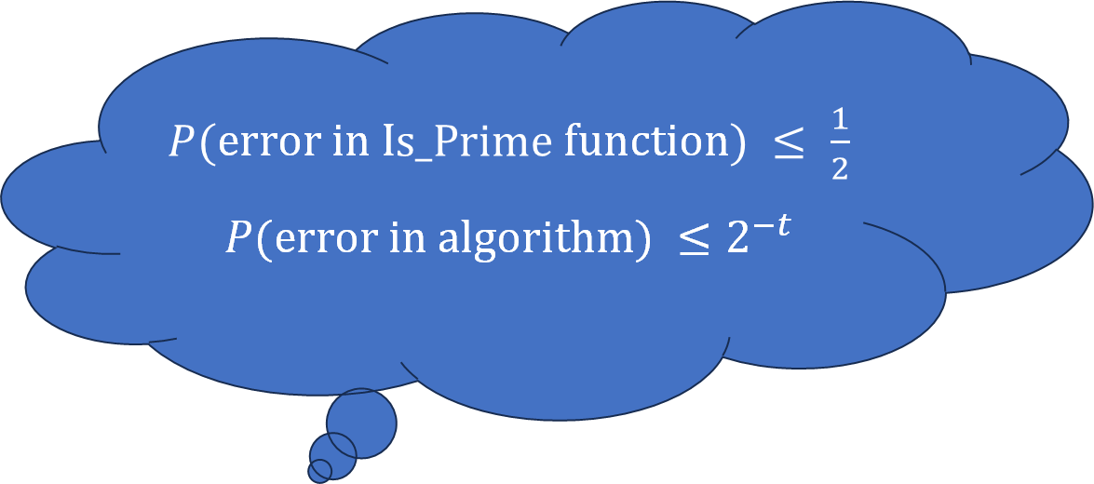
Algorithm
$N:$ Odd
Is_Prime $(N, a) \{$
$x$ $←$ $a^{m} \left(mod N\right)$
If $(x = 1)$return Prime;
Repeat $(k$ times$)$ {
If $(x=N−1)$ return Prime;
${x←x}^{2} \left(mod N\right)$
}
return Composite;
}
Primality_Test $\left(N\right) \{$
Repeat $(t$ times$)$ {
$a←$ pick an integer randomly uniformly from $1$ to $N−1;$
If $($Is_Prime$\left(N, a\right)=$ Composite$)$ return Composite;
}
return Prime;
}
$P($error in I$s_Prime$function$) ≤ \frac{1}{2}$
$P($error in algorithm$) ≤2^{−t}$

Slide 18







Error Analysis
$N:$ Odd Prime
Is_Prime always returns Prime
Primality_Test returns Prime
$P($Error $| N$ is Odd Prime$)=0$
$$N$$
$N$ is even
$N$ is odd
$P($error$)=0$
$N$ is Prime
$N$ is Composite
$P($error$)=0$

Slide 19

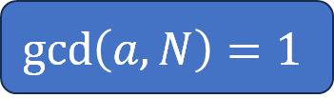






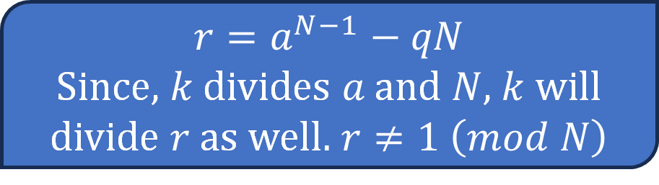

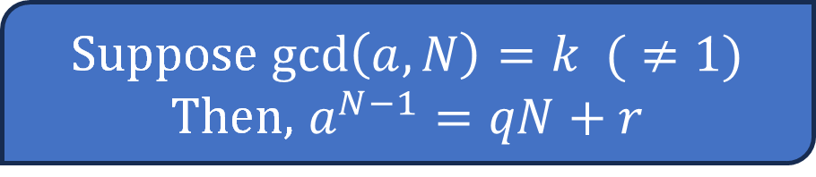


Error Analysis
Suppose $\gcd\left(a, N\right)=k (≠1)$
Then, $a^{N−1}=qN+r$
$N:$ Odd Composite
$$a:\gcd\left(a, N\right)≠1$$
Is_Prime returns Composite
Primality_Test returns Composite
$P($Error $| N$ is Odd C$omposite and\gcd\left(a, N\right)≠1)=0$
$$N$$
$${r=a}^{N−1}−qN$$
Since, $k$ divides $a$ and $N$, $k$ will divide $r$ as well. $r≠1 \left(mod N\right)$
$N$ is even
$N$ is odd
$P($error$)=0$
$N$ is Prime
$N$ is Composite
$P($error$)=0$
$$gcd⁡(a, N)≠1$$
$$\gcd\left(a, N\right)=1$$
$P($error$)=0$

Slide 20




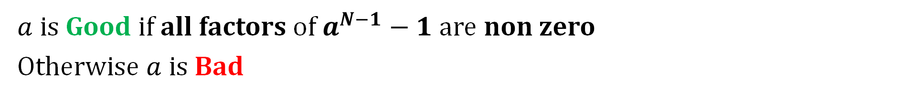
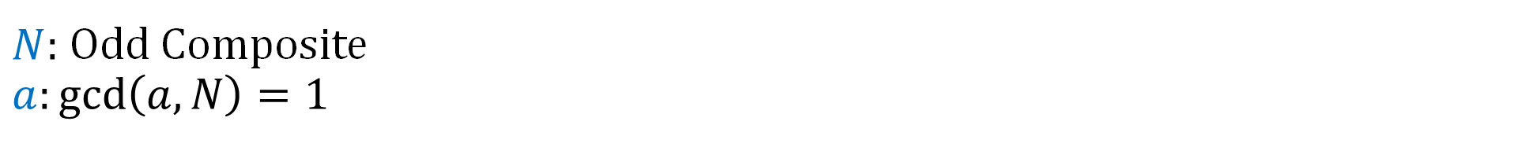
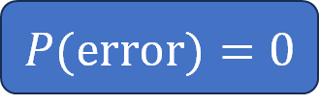
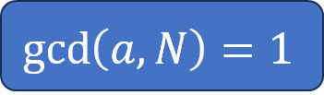

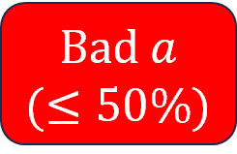


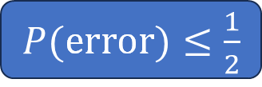
Error Analysis
$$N$$
$N:$ Odd Composite
$$a:\gcd\left(a, N\right)=1$$
$N$ is even
$N$ is odd
$a$is Good if all factors of $a^{N−1}−1$ are non zero
Otherwise $a$ is Bad
$P($error$)=0$
$N$ is Prime
$N$ is Composite
$P($error$)=0$
$$gcd⁡(a, N)≠1$$
$$\gcd\left(a, N\right)=1$$
$P($error$)=0$
Good $a$
$(≥50\%)$
Bad $a$
$(≤50\%)$
$P($error$)≤\frac{1}{2}$

Slide 21



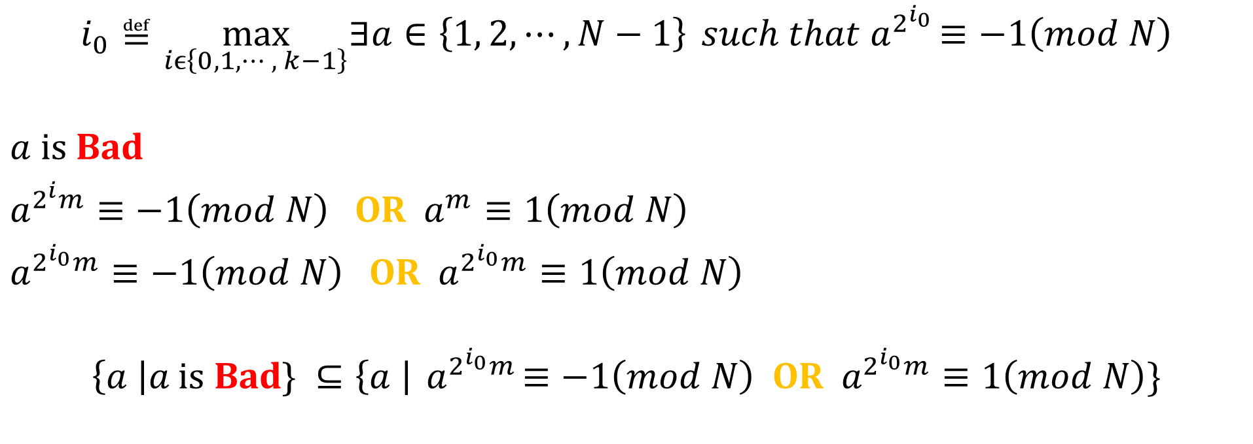
Error Analysis
$N:$ Odd Composite
$$a:\gcd\left(a, N\right)=1$$
$$i_{0}≝\max_{iϵ\left\{0, 1, ⋯, k−1\right\}}∃a∈\left\{1, 2, ⋯, N−1\right\}{ such that a}^{2^{i_{0}}}≡−1\left(mod N\right)$$
$a$ is Bad
$a^{2^{i}m}≡−1\left(mod N\right)$ OR $a^{m}≡1\left(mod N\right)$
$a^{2^{i_{0}}m}≡−1\left(mod N\right)$ OR $a^{2^{i_{0}}m}≡1\left(mod N\right)$
$$\left\{a \right|a \text{is} \text{Bad}\text{\} }⊆\left\{a \right|{ a}^{2^{i_{0}}m}≡−1\left(mod N\right) \text{OR} a^{2^{i_{0}}m}≡1\left(mod N\right)\}$$
$$C$$
$$B$$

Slide 22

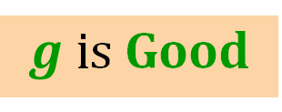

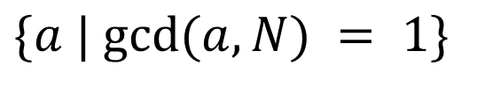
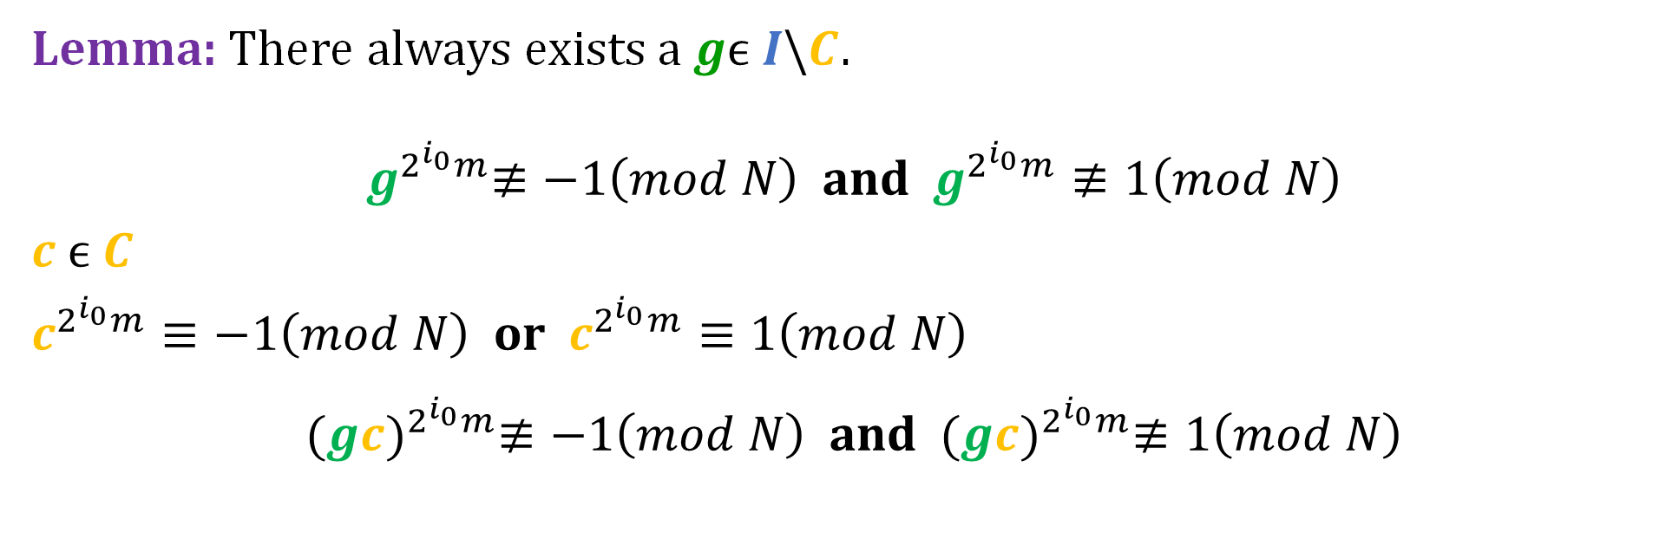
Error Analysis
Good News
$$\{a | gcd⁡⁡(a, N) = 1\}$$
$N:$ Odd Composite
$$a:\gcd\left(a, N\right)=1$$
$$I$$
Lemma: There always exists a$gϵ I\backslash C$.
$${ g}^{2^{i_{0}}m}≢−1\left(mod N\right) \text{and} g^{2^{i_{0}}m}≢1\left(mod N\right)$$
$c ϵ C$
$c^{2^{i_{0}}m}≡−1\left(mod N\right) \text{or} c^{2^{i_{0}}m}≡1\left(mod N\right)$
$${ (gc)}^{2^{i_{0}}m}≢−1\left(mod N\right) \text{and} {(gc)}^{2^{i_{0}}m}≢1\left(mod N\right)$$
$g$is Good
$$gc\left(mod N\right)ϵ I\backslash C$$

Slide 23


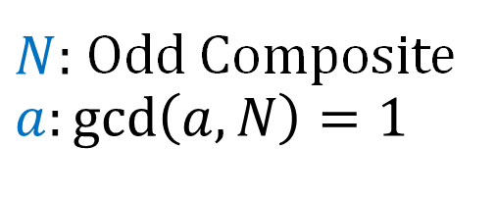

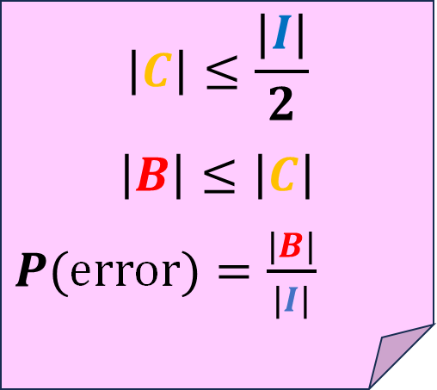


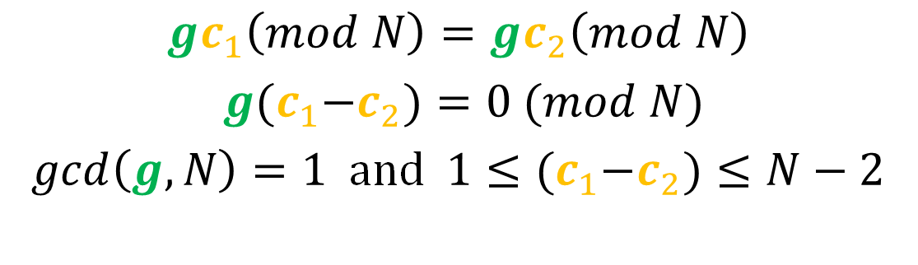

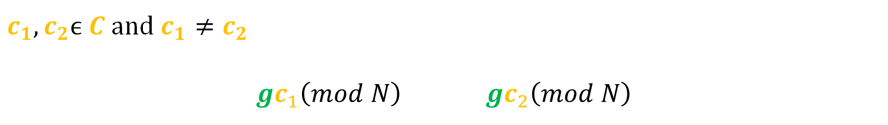

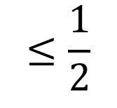
Error Analysis
$$c$$
$$gc(mod N)$$
$$B$$
$$g$$
$N:$ Odd Composite
$$a:\gcd\left(a, N\right)=1$$
$$b$$
$$C$$
$c_{1},c_{2}ϵ C$ and $c_{1}≠c_{2}$
$$gc_{1}\left(mod N\right) gc_{2}\left(mod N\right)$$
$$I\backslash C$$
$$\left|C\right|≤\frac{|I|}{2}$$
$$\left|B\right|≤\left|C\right|$$
$P($error$)=\frac{|B|}{|I|}$
$$gc_{1}\left(mod N\right)=gc_{2}\left(mod N\right)$$
$g{(c}_{1}−c_{2})=0 (mod N)$
$gcd\left(g,N\right)=1$ and $1≤{(c}_{1}−c_{2})≤N−2$
$$≤\frac{1}{2}$$

Slide 24
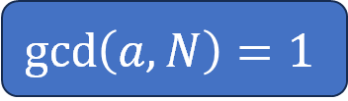



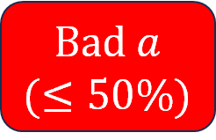
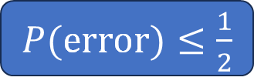





Error Analysis
$$N$$
$P($error in I$s_Prime$function$) ≤ \frac{1}{2}$
$P($error in algorithm$)≤ 2^{−t}$
$N$ is even
$N$ is odd
$P($error$)=0$
$N$ is Prime
$N$ is Composite
$P($error$)=0$
$$gcd⁡(a, N)≠1$$
$$\gcd\left(a, N\right)=1$$
$P($error$)=0$
Good $a$
$(≥50\%)$
Bad $a$
$(≤50\%)$
$P($error$)≤\frac{1}{2}$

Slide 25


What was wrong with Attempt 1
$a^{N−1}−1={(a}^{2^{k−1}m}+1){(a}^{2^{k−2}m}+1)$ ⋯${(a}^{2^{1}m}+1){(a}^{m}+1){(a}^{m}−1)$
$$N$$
Composite

Slide 26



Experimental Results
Running Time $($ for $t=log⁡n)$
$$O(n^{2}log⁡n)$$
Digits | Runtime (in ms)
100 | 0.2137
200 | 0.3788
300 | 1.1221
400 | 1.7571
500 | 2.6959
600 | 4.4511
700 | 6.9591
800 | 10.2553
900 | 13.7075
1000 | 18.5088

Slide 27



Experimental Results
Comparison with $O(2^{n/2})$ time algorithm
Digits | Randomized Algo (ms) | Deterministic Algo (ms)
10 | 0.209326 | 0.083652
11 | 0.160492 | 0.162398
12 | 0.17181 | 0.516129
13 | 0.161881 | 3.93635
14 | 0.131291 | 2.33564
15 | 0.139025 | 12.8007
16 | 0.155669 | 37.5555
17 | 0.145033 | 70.2461
18 | 0.150207 | 252.387
19 | 0.161797 | 928.462
20 | 0.187234 | 5126.59

Slide 28


Experimental Results
Usage of Randomization
Composite $N$ chosen randomly uniformly
Number of Digits | Random Bases (ms) | Sequential Bases (ms)
100 | 0.207868 | 0.049424
200 | 0.372822 | 0.225997
300 | 1.03214 | 0.8577
400 | 1.68758 | 1.52874
500 | 2.77264 | 2.60728
600 | 4.81948 | 4.6583
700 | 8.11095 | 7.93717
800 | 9.70584 | 9.52614
28871482380507712126714295971303939919776094592797227009265160241974323037991527 33116328983144639225941977803110929349655578418949441740933805615113979999421542 41693397290542371100275104208013496673175515285922696291677532547504444585610194 94042000399044321167766199496295392504526987193290703735640322737012784538991261 20309244841494728976885406024976768122077071687938121709811322297802059565867
Randomized algorithm: 0.0057s
Deterministic algorithm: 0.3063s
Notes:
397 digit number

Slide 29



Experimental Results
Expected Number of iterations
Error is associated only with composite numbers
$X≝\#$of times algo repeats
$$P\left(X=c\right)={\left(1−p\right)}^{c−1}p$$
$$E\left[X\right]= \frac{1}{p}≤2$$
Digits | Average no. of Iterations
100 | 1.00
200 | 1.00
300 | 1.00
400 | 1.00
500 | 1.00
600 | 1.00
700 | 1.00
800 | 1.00
900 | 1.00
1000 | 1.00
$p:$ Probability of choosing Good $a$
$$p≥\frac{1}{2}$$

Slide 30

Experimental Results
Deviation from Average
Notes:
Std Dev = 1 by root 2 times mean ( for a composite ) ( For primes, time = (n^2 log n), for composite = (n^2))

Slide 31


Experimental Results
$x: \%$of deviation from mean
$$x$$ | 100 | 200 | 300 | 400 | 500 | 600 | 700 | 800 | 900 | 1000
0 | 53.1 | 49.2 | 50 | 53.1 | 50.7 | 50.8 | 50.3 | 47.5 | 50.7 | 50.4
10 | 53.1 | 49.2 | 50 | 53.1 | 50.7 | 50.8 | 50.3 | 47.5 | 50.7 | 50.4
20 | 53.1 | 49.2 | 50 | 53.1 | 50.7 | 42.9 | 50.3 | 47.5 | 50.1 | 50.4
30 | 53.1 | 49.2 | 50 | 53.1 | 50.7 | 41.4 | 50.3 | 41.4 | 42.1 | 50.4
40 | 53.1 | 49.2 | 50 | 38.8 | 43.9 | 40.8 | 40.5 | 36.7 | 37.1 | 40.6
50 | 53.1 | 49.2 | 33.7 | 29.5 | 30.9 | 40.6 | 29.2 | 35.3 | 36.7 | 30.5
60 | 53 | 49.2 | 29.7 | 28.2 | 30.1 | 27.7 | 27.1 | 34.8 | 36.3 | 26.2
70 | 38.5 | 35.9 | 28.3 | 27.2 | 29.6 | 24.2 | 26.9 | 30.4 | 25.5 | 26
80 | 24.2 | 28 | 26.2 | 21.6 | 29.2 | 22.9 | 26.9 | 24.5 | 22.6 | 24.8
90 | 15.2 | 26.3 | 18.9 | 14.8 | 17.6 | 21.2 | 17.6 | 21.2 | 20.9 | 20.4
100 | 10.6 | 18.6 | 17.2 | 13.5 | 16.1 | 19.8 | 15.4 | 20.3 | 19.2 | 16.2
110 | 6.9 | 14.3 | 16.4 | 13.1 | 15.7 | 14.8 | 14.8 | 19.2 | 16.9 | 14.5
120 | 5.1 | 13.5 | 14.4 | 10.9 | 15.5 | 12.5 | 14.8 | 18 | 12.6 | 14.2
130 | 4.2 | 9.3 | 10.8 | 7.7 | 10.2 | 11.2 | 11.8 | 14.1 | 10.8 | 12
140 | 3.1 | 8.1 | 9.5 | 6.9 | 8.2 | 10.9 | 8.8 | 12.4 | 10.2 | 11.5
150 | 2.6 | 7.3 | 8.7 | 6.8 | 7.9 | 10.2 | 8.3 | 11.3 | 9.4 | 8.9
160 | 2.3 | 5.1 | 7.1 | 5.7 | 7.8 | 7.7 | 7.8 | 9.9 | 9.4 | 8.2
170 | 1.7 | 4 | 6.2 | 4 | 6.9 | 6.5 | 7.7 | 9.4 | 8.8 | 7.2
180 | 1.2 | 3.3 | 5.5 | 3.7 | 5.6 | 5.7 | 5.7 | 8.5 | 6.2 | 5.8
190 | 0.9 | 2.3 | 4.9 | 3.6 | 5.2 | 5.4 | 4.8 | 6.7 | 5.3 | 5.6
200 | 0.8 | 1.7 | 4.3 | 3 | 5.1 | 4.5 | 4.6 | 5.3 | 4.8 | 4.4

Slide 32










Experimental Results
Deviation from Average
100 digits
200 digits
300 digits
400 digits
500 digits
600 digits
700 digits
800 digits
900 digits
1000 digits

Slide 33
Thank You

