Slide 1

Customer Segmentation using K-Means Clustering
This presentation explores customer segmentation using unsupervised machine learning, specifically the K-Means Clustering algorithm. We aim to group customers based on demographic and behavioural attributes to identify valuable customer groups, tailor marketing efforts, optimise resource allocation, and improve customer satisfaction and profitability.

Slide 2

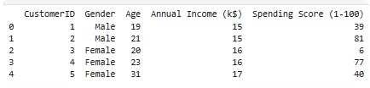
Dataset Overview: Mall Customer Segmentation
CustomerID
Unique ID assigned to each customer
Gender
Gender of the customer (Male/Female)
Age
Age of the customer in years
Annual Income
Annual income of the customer in thousands of dollars
Spending Score
Score assigned by the mall based on customer behavior
The dataset, sourced from Kaggle, contains basic information about mall customers who signed up for a membership card. It is ideal for unsupervised learning, allowing us to group customers based on similarities in their attributes.
df.head() # in given image

Slide 3
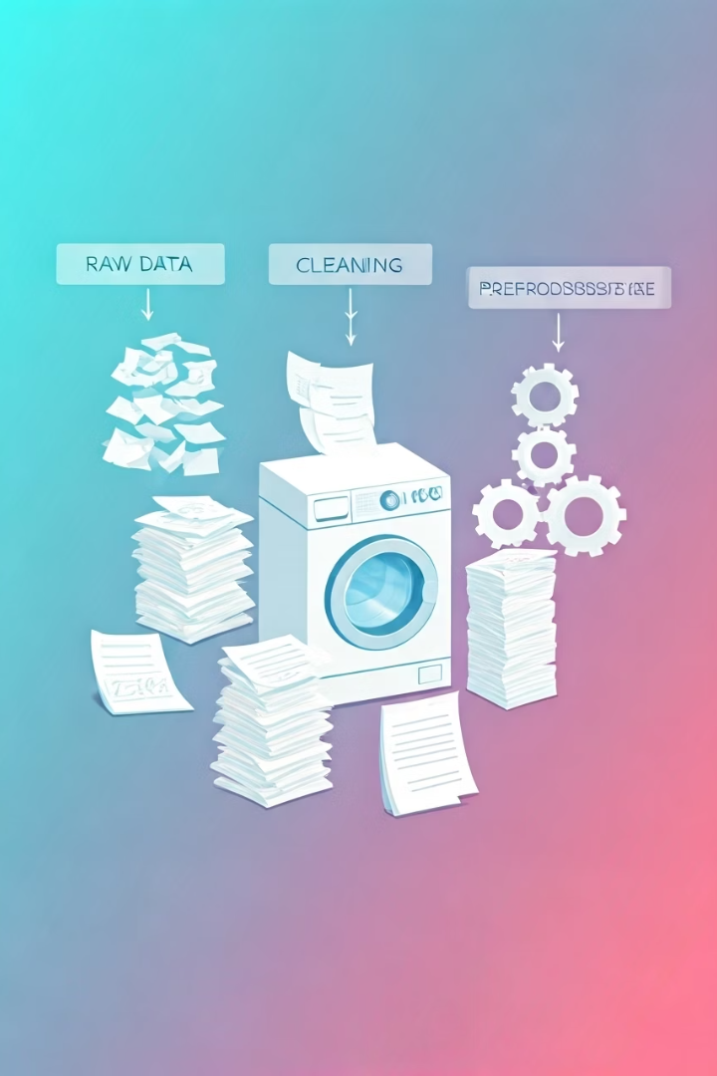
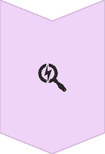

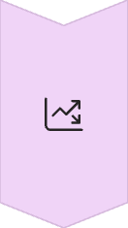
Data Cleaning and Preprocessing Steps Using pandas
Missing Values Check
No missing values were found using df.isnull().sum(), eliminating the need for imputation.
Encoding Categorical Data
The 'Gender' column was converted to numerical form (Male=1, Female=0) using LabelEncoder for algorithm compatibility.
Scaling Numerical Features
Features like Age, Annual Income, and Spending Score were scaled using StandardScaler to ensure they are within the same range, crucial for K-Means clustering.
Before applying any machine learning algorithm, data cleaning and preparation are essential for accurate and meaningful results.

Slide 4
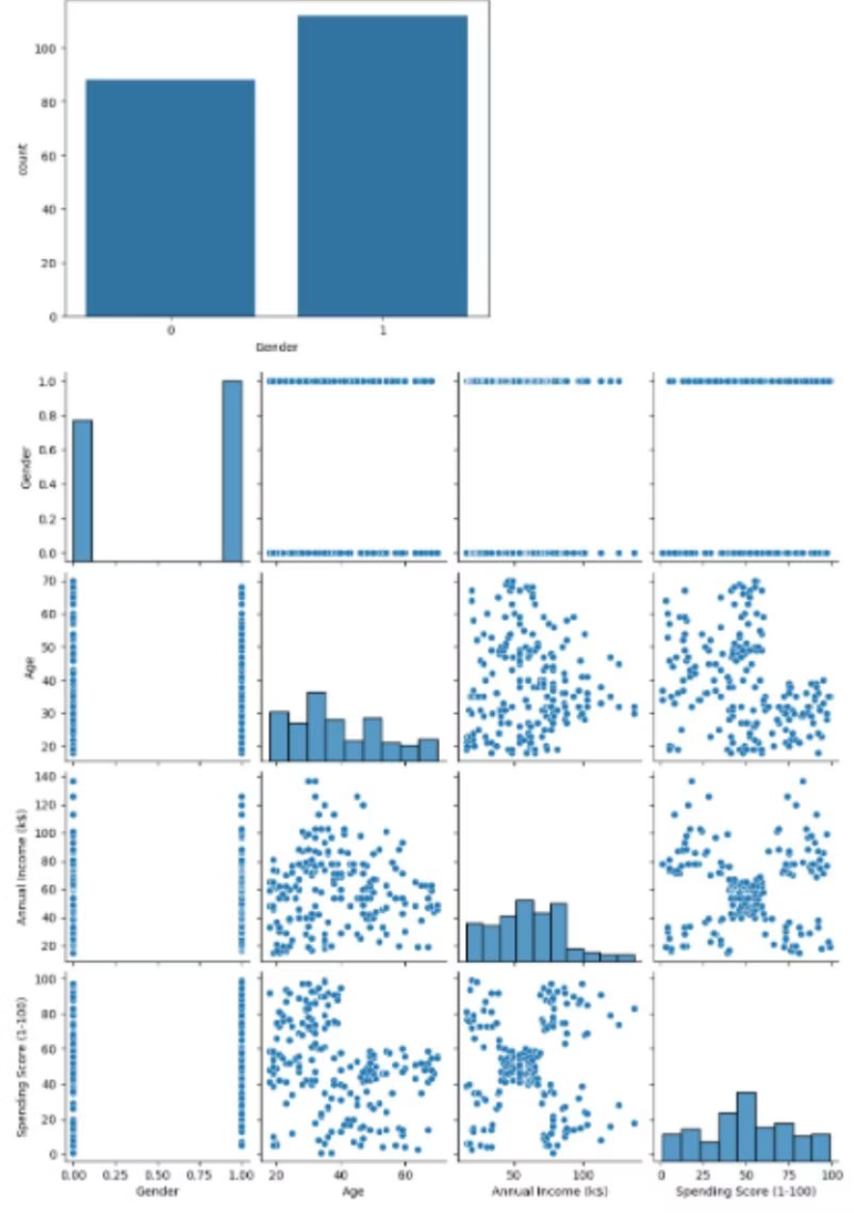
Exploratory Data Analysis (EDA) Insights
Distribution Plots
Histograms and density plots revealed that Age has a normal-like distribution (most customers between 20-40), while Income and Spending Score show varied spreads, ideal for segmentation.
Gender Distribution
A countplot showed a fairly balanced gender distribution within the dataset.
EDA helps in understanding data distribution, trends, and relationships before applying machine learning algorithms. A correlation heatmap indicated a moderate correlation between Annual Income and Spending Score, with other features showing low or no strong linear correlation.

Slide 5
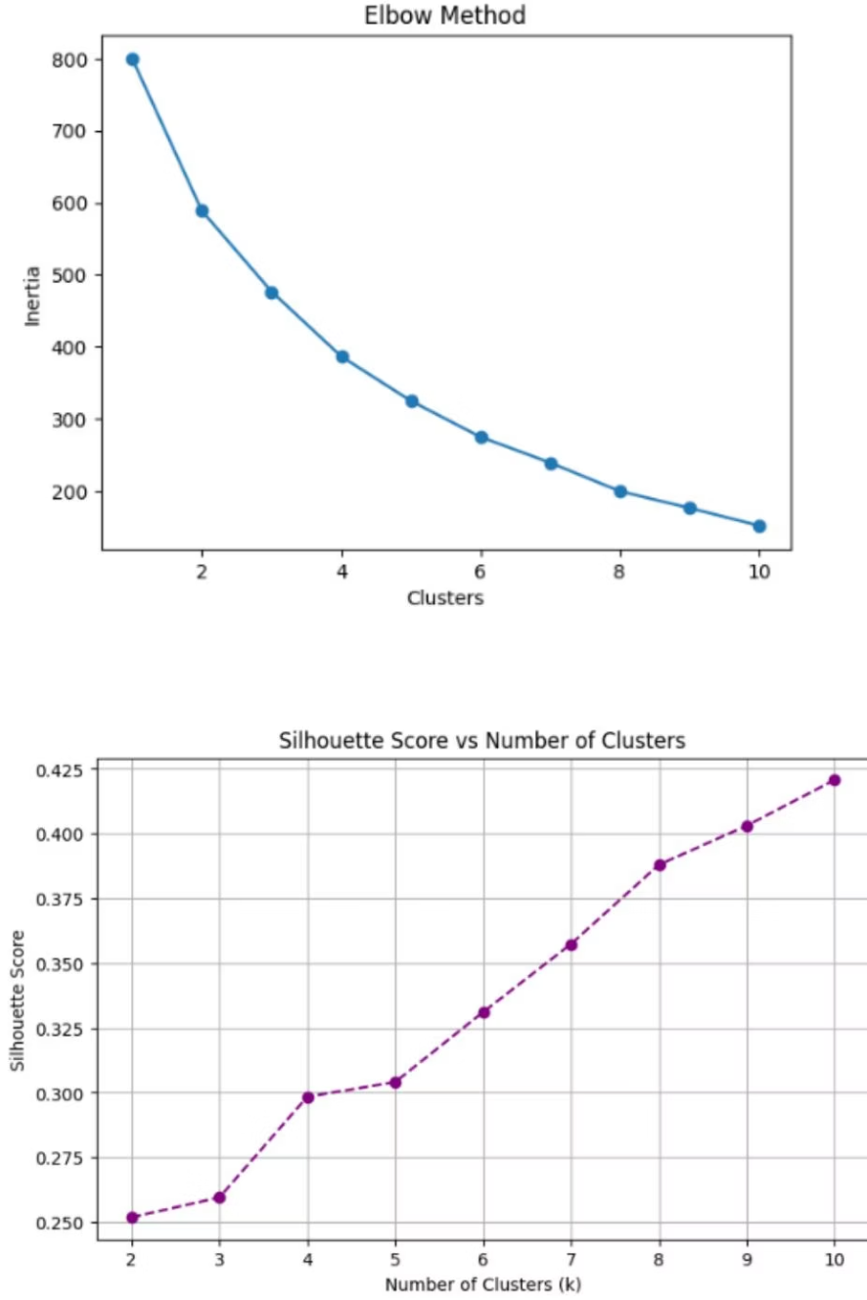
Optimal Number of Clusters (K)
Elbow Method
By plotting the Within-Cluster-Sum-of-Squares (WCSS) against the number of clusters, an "elbow point" was observed around K=5, indicating diminishing returns beyond this point.
Silhouette Score
The Silhouette Score, which measures cluster similarity, also showed its highest value around K=5, confirming the optimal number of clusters.
Selecting the right number of clusters (K) is crucial for K-Means. Both methods consistently pointed to K=5 as the optimal choice for final segmentation.

Slide 6
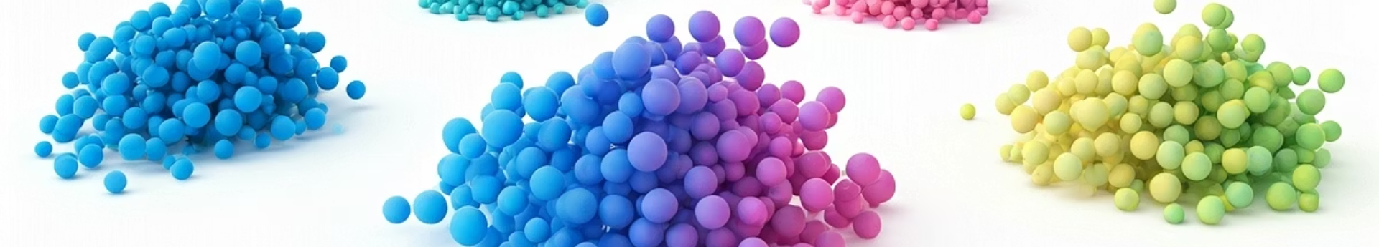
Applying K-Means Clustering
Resulting Data
Adding Cluster Labels
The DataFrame now includes the assigned cluster for each customer, facilitating further analysis and profiling.
Building the Model
A new 'Cluster' column was added to the original DataFrame, indicating the group each customer belongs to.
The K-Means algorithm was applied to the scaled dataset with the optimal K=5, assigning a cluster label (0 to 4) to each customer.
With the optimal number of clusters determined, the K-Means algorithm was applied to segment customers, providing a foundational grouping for targeted strategies.

Slide 7

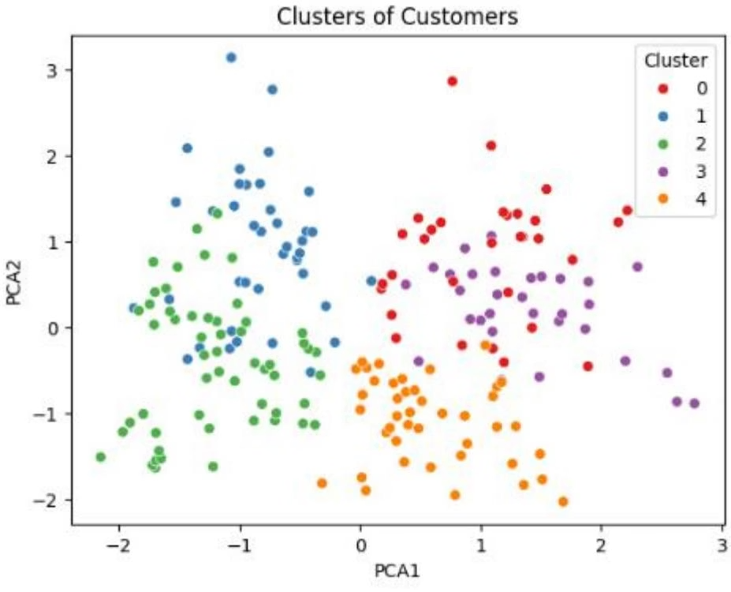
Cluster Visualization
1
2D Scatter Plot (Annual Income vs. Spending Score)
This plot clearly showed distinct customer groups based on their income and spending habits, revealing patterns like high income-low spending and low income-high spending.
2
PCA (Principal Component Analysis)
PCA reduced dimensionality to 2 components, allowing for a clear visualisation of separated customer groups, confirming the effectiveness of the clusters in capturing different behaviours.
Visualising clusters is key to understanding customer groupings. Both methods confirmed that the clusters effectively capture distinct customer behaviours, providing valuable insights for targeted strategies.

Slide 8
Cluster Profiling and Insights
Cluster 0: High Income, High Spending
Cluster 1: Low Income, High Spending
Cluster 2: High Income, Low Spending
Ideal for premium products and exclusive offers.
Price-sensitive but active shoppers; respond well to discounts and loyalty programs.
Cautious or brand-loyal customers; need personalised engagement and trust-building campaigns.
Cluster 3: Low Income, Low Spending
Cluster 4: Young Customers, Average Income & Spending
Budget-conscious; best targeted with essentials and discounts, avoid aggressive campaigns.
Trend-driven segment; potential for long-term loyalty, ideal for trendy or digital-first products.
Profiling each cluster helps interpret customer behaviour. By analysing average age, annual income, spending score, and gender distribution per cluster, we can tailor marketing strategies effectively.

Slide 9
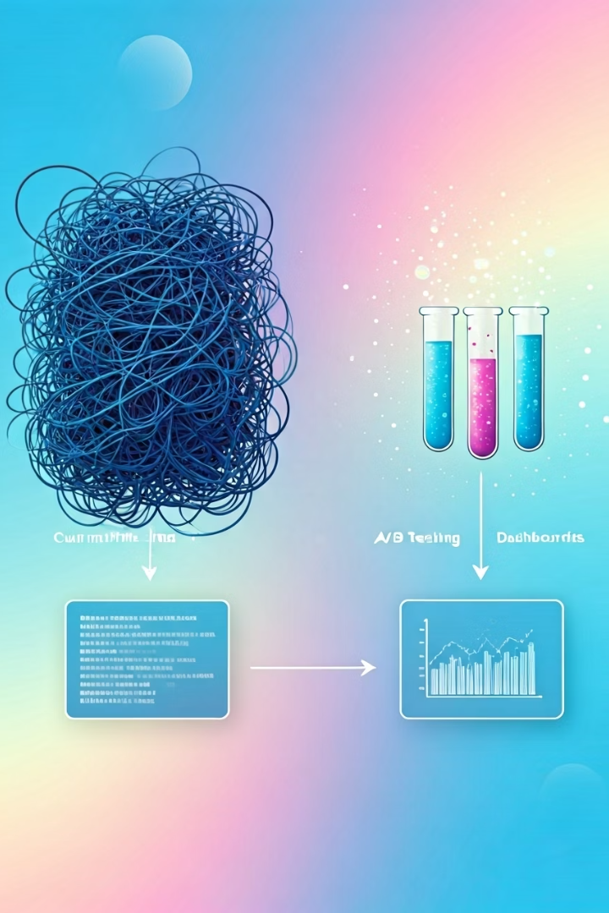
Conclusion and Future Work
1
Conclusion
Successfully applied K-Means Clustering to segment customers, cleaning data, conducting EDA, determining optimal clusters, and visualising segments. This provides a foundation for targeted marketing, improving ROI and customer experience.
2
Future Work
Future enhancements include dynamic segmentation with real-time behaviour, incorporating more features, A/B testing campaigns, exploring advanced models like DBSCAN, and integrating with dashboards for live monitoring.
This customer segmentation model forms the basis for data-driven decisions in customer relationship management, marketing, and sales strategy, ensuring more precise targeting and increased customer satisfaction.

