Slide 1

Project-4 Analysis of Super Car Dataset
ALY 6000
Sankalp Susil Kumar Biswal
College of Professional Studies, Northeastern University Boston
ALY6000- Introduction to Analytics
Prof. Kayal Chandrasekaran
October 15, 2023

Slide 2
Table of Content
Introduction
Data Cleaning
Question 1
Question 2
Question3
Question4
References

Slide 3
Introduction
The dataset that I’ve chosen to work on is called “Super car dataset”. I am very passionate about cars and this project would help unravel some interesting aspects about this dataset. This dataset has 8 columns or features and has 1007 observations.
Dataset Features
Car make
Car Model
Year
Engine Size
5.Horsepower (Bhp)
6. Torque (lb-ft)
7. 0-60Mph Time
8. Price (In USD)

Slide 4
Data Cleaning
I’ve used the following functions and some more which are mentioned in my code-
Clean names() - Standardizing column names for consistency
rename() - To rename columns for better readability
str() - To determine data type of each column
trimws() - To trim leading white spaces
gsub() - To replace special characters from a column
as.numeric() - To convert few columns to correct data type since price, torque, horsepower and 0-60mph time were in ‘car’ datatype
na.omit()- To remove NA values from columns
mutate()-To add new columns
filter() - To subset based on conditions
arrange()- To arrange data in desc or asc order
slice()- To show required amount of data

Slide 5
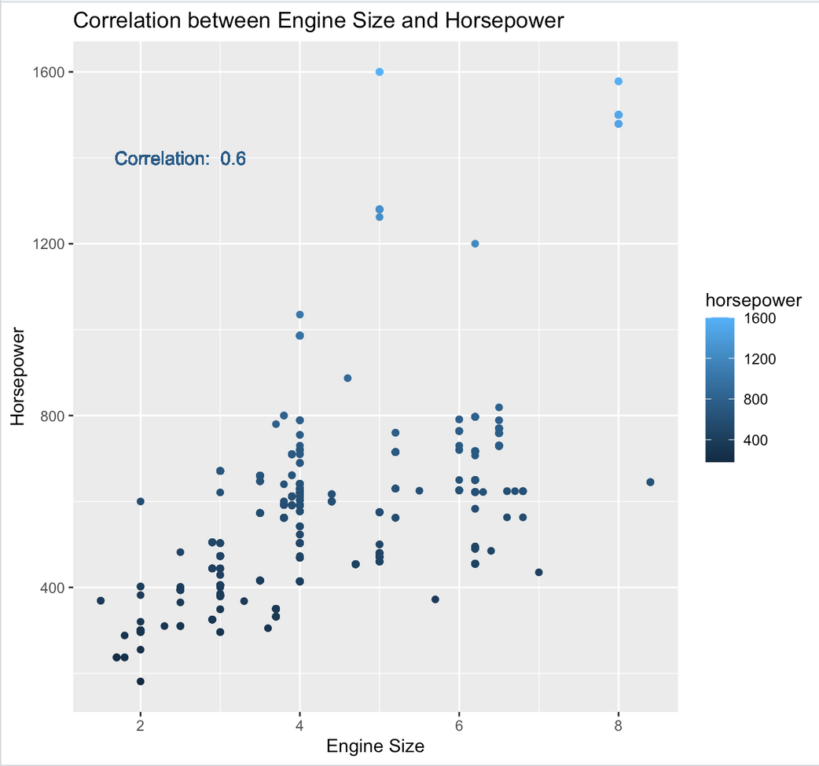
Ques1
What is the correlation between engine size and power?
The scatter plot shows the correlation between Engine size and Horsepower. As we can observe that with increasing size of engine the corresponding value of Horsepower also increases. There are some exceptions like the one’s marked with red circles which despite having smaller engine size produce power equivalent to bigger engine sizes.
Correlation coefficient of 0.6 means moderate positive relation between the two features
Notes:
1.Conversion of datatype was crucial as horsepower, engine size, torque were in "chr' datatype
2. Used trimws() and gsub()
to remove characters from the above mentioned cols because otherwise converting them returned N/A for whole column
3. The col, engine size had entries like "electric", "Hybrid" which had to be removed before plotting the scatter plot. I used as.numeric and it converted these rows to N/A and then I used na.omit() to get non_electric_cars dataset

Slide 6
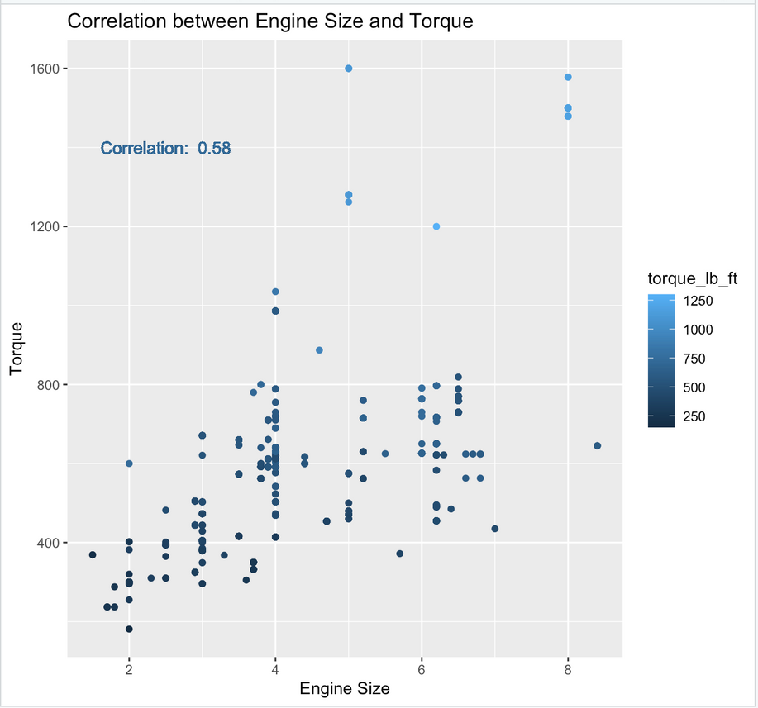
The scatter plot shows the correlation between Engine size and Torque. As we can observe that with increasing size of engine the corresponding value of Torque also increases. There are some exceptions like the one’s marked with red circles which despite having smaller engine size produce power equivalent to bigger engine sizes.
Correlation coefficient of 0.58 means moderate positive relation between the two features
Notes:
1. Calculated correlation coefficient for relation between X-axis variable and y-axis variable.

Slide 7
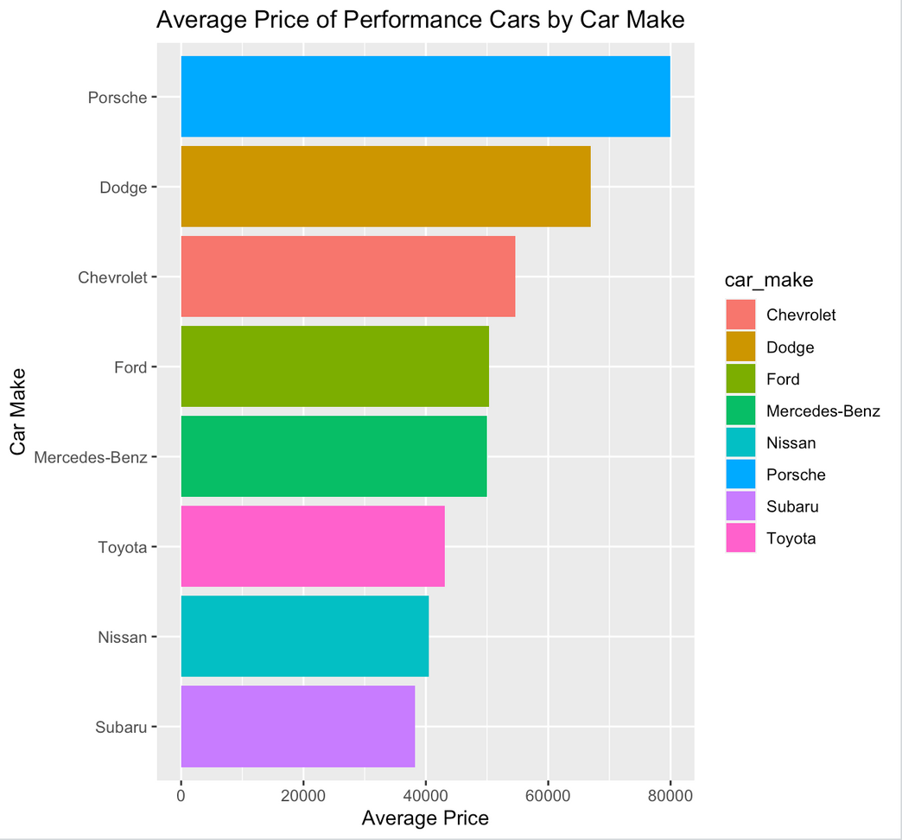
Ques2
What is the average price of a budget performance car (<$100,000) for each car make?Which car offers the best price/performance ratio?
The Bar Graph shows the different car makes that have been arranged by their price and offer the best price to performance ratio under $100,000.
Camaro 2021 offers best price to performance ratio under $100,000.
Notes:
1. Added a col for "Price Category"(Budget[<$100,000], Medium, High-end[>$500,000]) to dataset for easy segregation.
2. Added a col "Price_to_performance" to calculate power(Horsepower) offered per dollar spent and arranged the dataset for budget cars with the best Price/Performance ratio
3. Grouped the best budget cars (<$100,000) and with the best Price/Performance ratio and plotted a bar chart to represent the same. Used summarise() and Mean().
4.The car with the best Price/Performance was displayed using arrange(), desc() and slice()

Slide 8
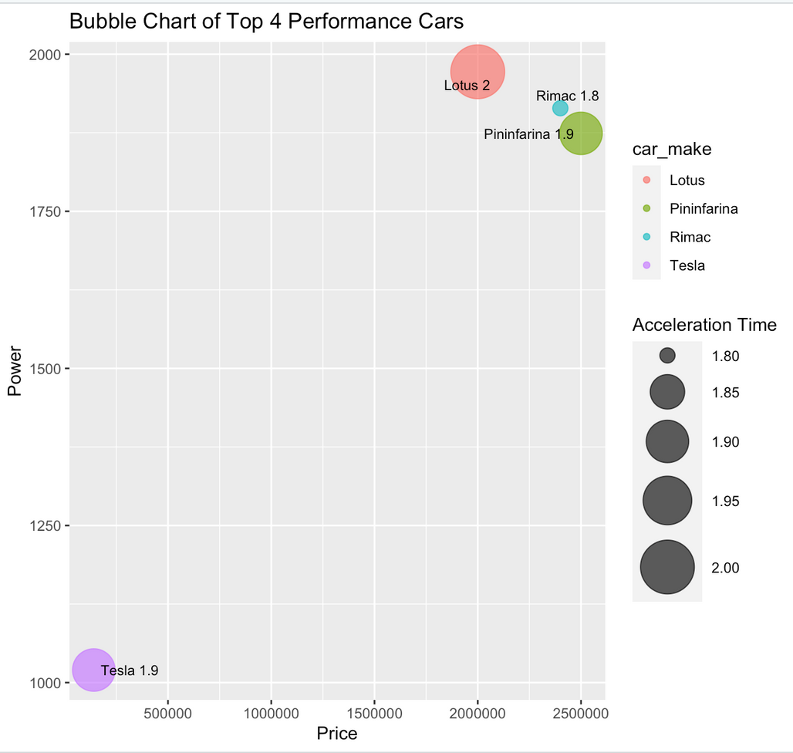
Ques3
How do top 4 performance cars stack up against each other in terms of price, power, acceleration? Which is has the fastest acceleration(0-60MPH)?
The Bubble chart compares the top 4 performance cars in terms of acceleration time in seconds, Price and Power. The bubble size indicates the acceleration time i.e the bigger the bubble, the higher the value in seconds.
It’s safe to conclude that Rimac produces the fastest car with acceleration time of 1.8 seconds for doing 0-60MPH.
Notes:
1. Filtered cars with acceleration time under 2.5seconds
2.Grouped these cars by lowest acceleration time, avg. price and and maximum horsepower.
Used min(),max() and mean() functions
3.Further used arrange() to get the top 4 cars with the best performance and lowest acceleration time
4. Displayed these results in a bubble chart.

Slide 9
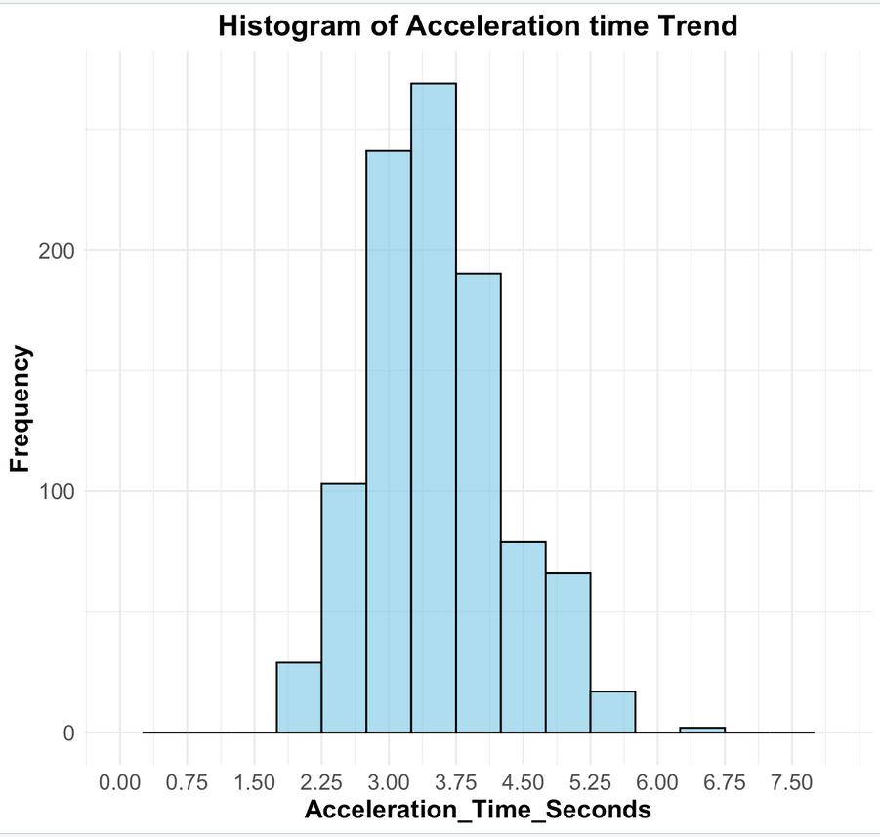
Ques4
What is the industry standard acceleration time?Earlier cars doing 0-60MPH between 2.5-3secs were considered as the fastest and only few cars were able to achieve this figure. Has this trend changed? What is the new industry standard?
The histogram shows the trend of acceleration times that has been derived from the whole dataset. Here we can see that the fastest cars are now doing 0-60MPH in under 2 seconds. Definitely the trend has changed. The new industry standard is around 3-4 seconds.
Notes:
1. Plotted a histogram for the acceleration times of the whole dataset to see the distribution of the data. Found that the industry standard and also range of the fastest acceleration times.

Slide 10
References
Stack overflow. (2008). Retrieved from https://stackoverflow.com/
R Core Team. (2021). R: A language and environment for statistical computing (Version 4.1.0) [Computer software]. R Foundation for Statistical Computing. https://www.R-project.org/
Wickham, H. (2019). ggplot2: Elegant graphics for data analysis. R package version 3.3.5. https://ggplot2.tidyverse.org
DataCamp. (n.d.). Introduction to R. Retrieved from https://www.datacamp.com/courses/free-introduction-to-r

