Slide 1

ITC 6000 Database Management Systems Final Project Presentation FALL 2023 Term A HIRE MUSICIANS
SANKALP SUSIL KUMAR BISWAL
Biswal.s@northeastern.edu

Slide 2
Table of Contents
Project Overview
User Persona’s
Business Rules
ER Diagram
Major SQL Examples
Metrics and Analytics
Future Considerations

Slide 3
Project Overview
Project Name : HIRE MUSICIAN
Description: Hire Musician is a platform in which musicians, employers and music companies can hire/book other musicians either for a full-time contract or part-time gigs depending upon their requirements.
Business Implication: Increased opportunities for musicians to earn money and increase their online and offline presence. More business for music companies since they can hire musicians part-time.

Slide 4
Personas
Employers/Musicians/Music Companies-
Millions of users
Users will create Employer_Profile and can-
Create multiple Job Listings.
View Musician Profiles to shortlist based on requirements.
Interact with Musicians.
Musicians-
Millions of users
Users will create Musician_Profile and can-
Apply to multiple Job Listings via Job applications.
View all Job Listings around a region.
Interact with Musicians & Music companies.

Slide 5
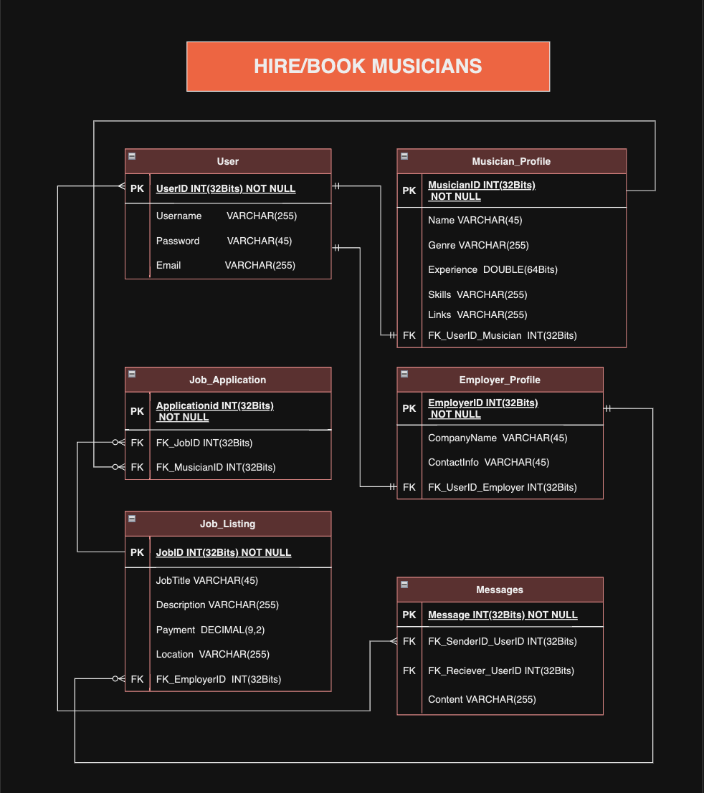
ER Diagram

Slide 6
Other Business Rules & Facts
Business Rules-
A User can make Musician or Employer Profile.
A Musician Profile or Employer Profile will be associated to one User.
A User with Musician Profile can apply to Multiple Job Listings via Job Application.
A User with Employer Profile can create multiple Job Listings.
Out of Scope-
Users can post and see reviews for musicians and Employers.
Users can upload their profile picture and also upload videos of sample work.

Slide 7
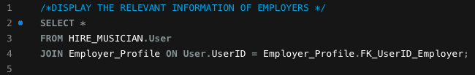
SQL Examples
Q)Display Information of Employers
RAW SQL-
Explanation – Joined two tables ‘User’ & ‘Employer_Profile’ using the column ‘UserID’ and ‘FK_UserID_Employer’ and Displayed the result using SELECT query.
Output-
Used SHA1() to encrypt passwords

Slide 8

SQL Examples
Q)Display Information of Musicians
RAW SQL-
Explanation – Joined two tables ‘User’ & ‘Musician_Profile’ using the column ‘UserID’ and ‘FK_UserID_Musician’ and Displayed the result using SELECT query.
Output-
Used SHA1() to encrypt passwords

Slide 9
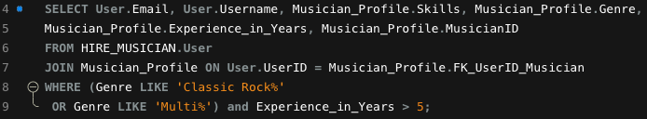
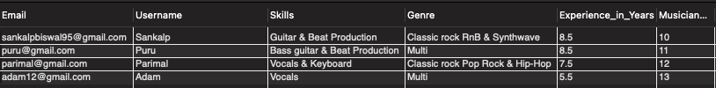
SQL Examples
Q) Find the email id of musicians who play multiple genres or play classic rock and have more than 5 years of experience.
RAW SQL-
Explanation – Joined two tables ‘User’ & ‘Musician_Profile’ using the column ‘UserID’ and ‘FK_UserID_Musician’ and Displayed the result using SELECT query and entering condition into WHERE query followed by LIKE query for Pattern matching.
Output-

Slide 10
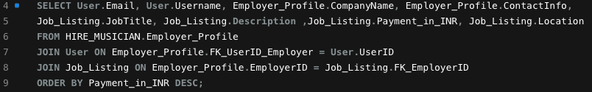
SQL Examples
Q) Display the Job listings and details of person who has listed it.
RAW SQL-
Explanation – Joined three tables ‘Employer_Profile’ , ‘User’ & ‘Job_Listing’ using the common columns and Displayed the result using SELECT query and ORDER BY for Descending Order.
Output-

Slide 11
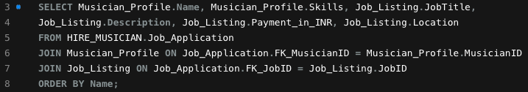
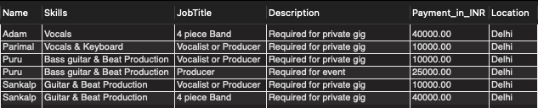
SQL Examples
Q) What are the details of the Jobs that a Musician has applied to?
RAW SQL-
Explanation – Joined three tables ‘Job_Application’ , ‘Musician_Profile’ & ‘Job_Listing’ using the common columns and Displayed the result using SELECT query and ORDER BY for Descending Order.
Output-

Slide 12
Metrics and Analytics
Musician
Number of gigs performed within a month.
Average pay for certain types of gigs.
Employer/Music Companies
No. of Musicians playing a certain type of genre.
Average demand of musicians in terms money.
Type of music listened to in a geographic area.
Application Administrator
Total Number of users and ratio of musicians to employers.
Most popular musician.
Most rewarding company.

Slide 13
Future Consideration
A review column can be added to both the Employer Profile and Musician Profile for credibility.
User will be able to upload their videos as sample work.
Make a fully-functioning website, an android app and IOS app for maximum reach.
Option for video-conferencing within application for features like Live video which can help users monetize their content. (Similar to Superchat)

Slide 14
THANK YOU!

