Slide 1
Project Title
Healthcare Management System
Sr no | Member | Role | Contribution
1 | Sankalp Kokare | Back-end development, front-end development, Testing | REST-API, Git handling, React component, react-redux
2 | Rushikesh Waikar | Back-end, Documentation, Database handling | REST-API, Workflow diagram, Database management
3 | Uday Dudhe | Back-end, Front-end development, Database handling | REST-API, Git handling, React component, react-redux, Database management
4 | Purshottam Sulay | Documentation, Database handling | REST-API, Git handling, Documentation, user case diagrams

Slide 2
ABSTRACT:
This initiative aims to bridge the gap between healthcare providers in remote or underserved areas by equipping them with essential digital resources. This comprehensive system encompasses various functionalities, including patient registration, appointment scheduling, electronic health records (EHR) management, and prescription handling.

Slide 3
Objectives
Simplifying Doctor Registration
Simplifying Patient Registration
Login Patients, Doctors and Admin
Appointments
Doctor approval By Admin
Doctor dis-approval By Admin
Doctor delete By Admin

Slide 4
Admin Module
In the admin module admin has the right to approve and disapprove the doctor registration request as well as he can delete the patient.
Doctor module
In the doctor module doctor has the right to register and login feature. A doctor can even see his appointments.
Patient Module
In the patient module patient has the right to register and login feature.
Appointment
In the patient module patient has the right to register and login feature, see doctors Book appointments, and edit profile

Slide 5

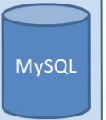
3 Tier Architecture
Client Side
Middle tier with Microservices architecture
DB Tier
Web server running on localhost:3000
Springboot Rest API Server for Business APis
on localhost:8080
•
•
•
Using HTML, CSS Bootstrap
React Js components
Running on 3306
JPA
Hiberante
JDBC

Slide 6
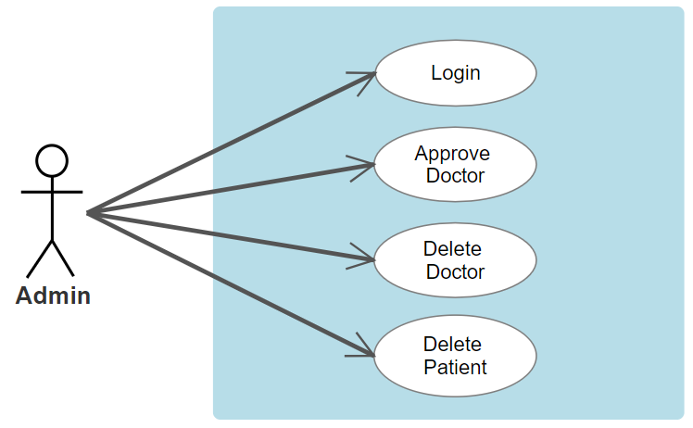
Use case diagram for Admin

Slide 7
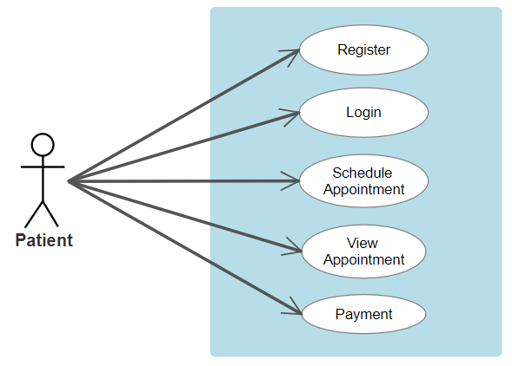
Use case diagram for Patient

Slide 8
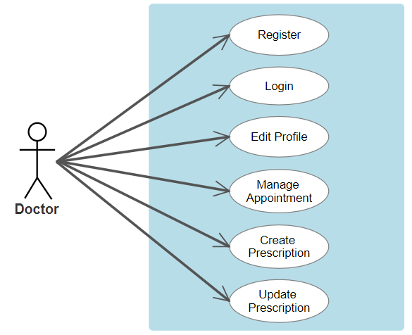
Use case diagram for Doctor

Slide 9
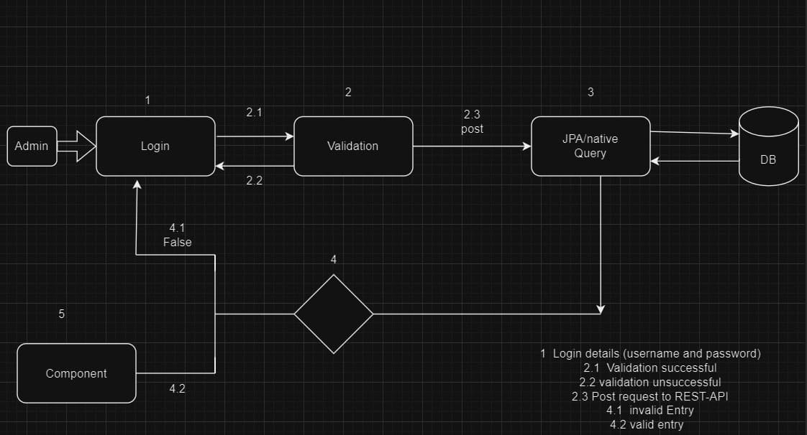
Work Flow Diagram For Admin

Slide 10
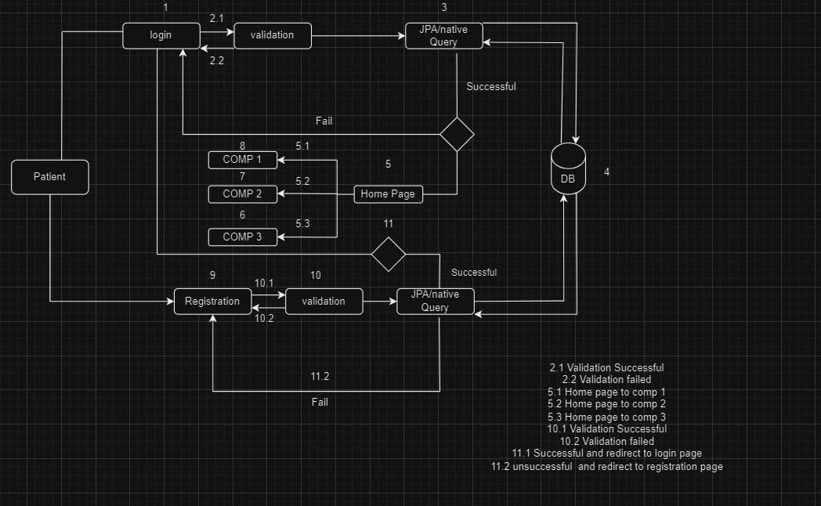
Work Flow Diagram For Patient

Slide 11
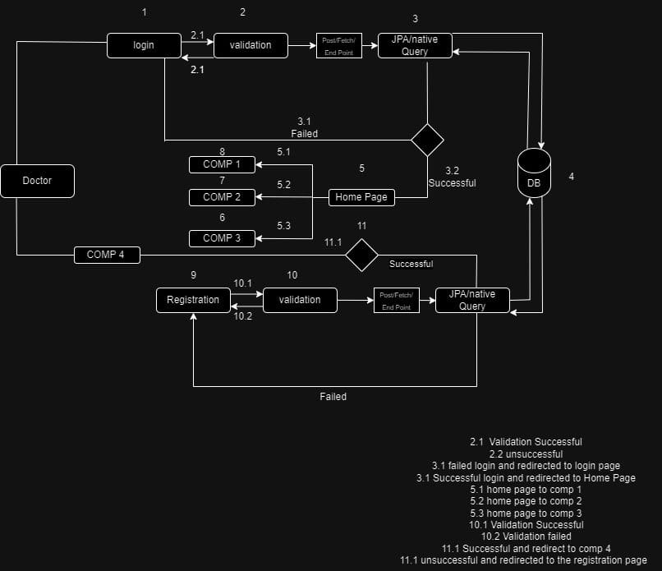
Work Flow Diagram For Doctor

Slide 12
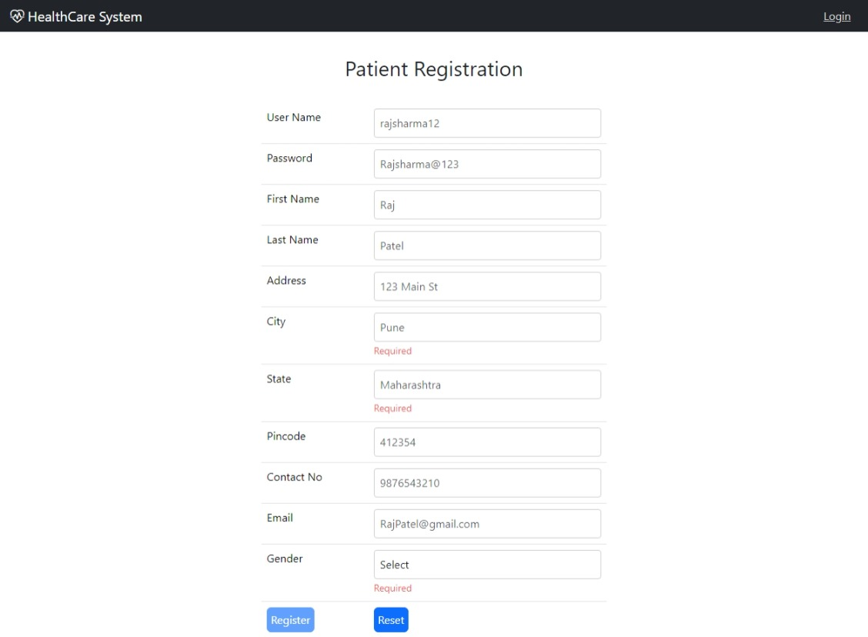
Patient Registration
In patient registration patients can register with minimum routine parameters but to make the identity of each patient different we have added a username, Email Address, and phone number these parameters will be unique to each patient

Slide 13
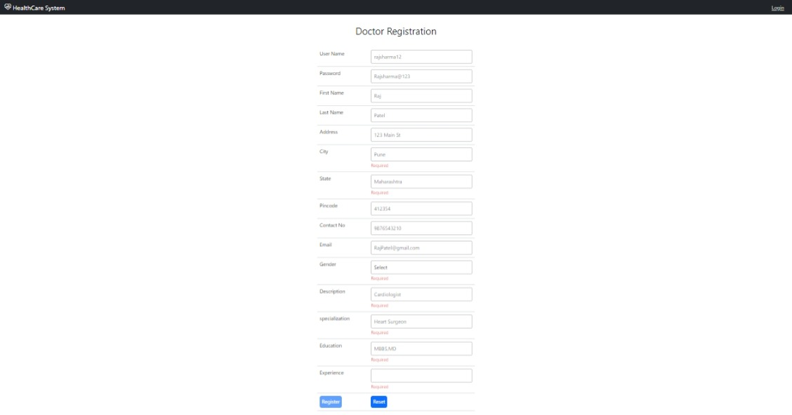
Doctor Registration
In patient registration patients can register with minimum routine parameters but to make the identity of each patient different we have added a username, specialization, education, and phone number these parameters will be unique to each doctor

Slide 14
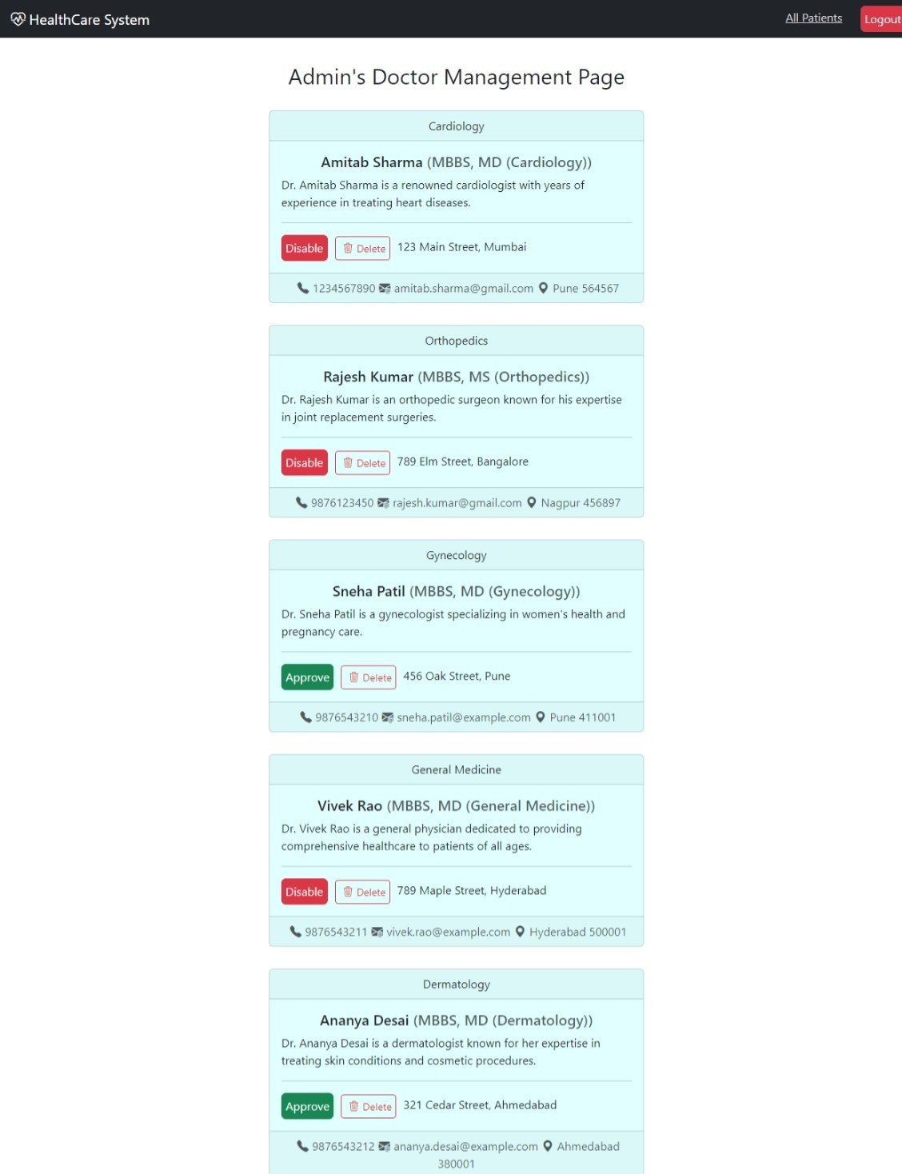
Admin Login
Admin has the right to approve and disapprove doctor registration as well as delete the doctor.

Slide 15
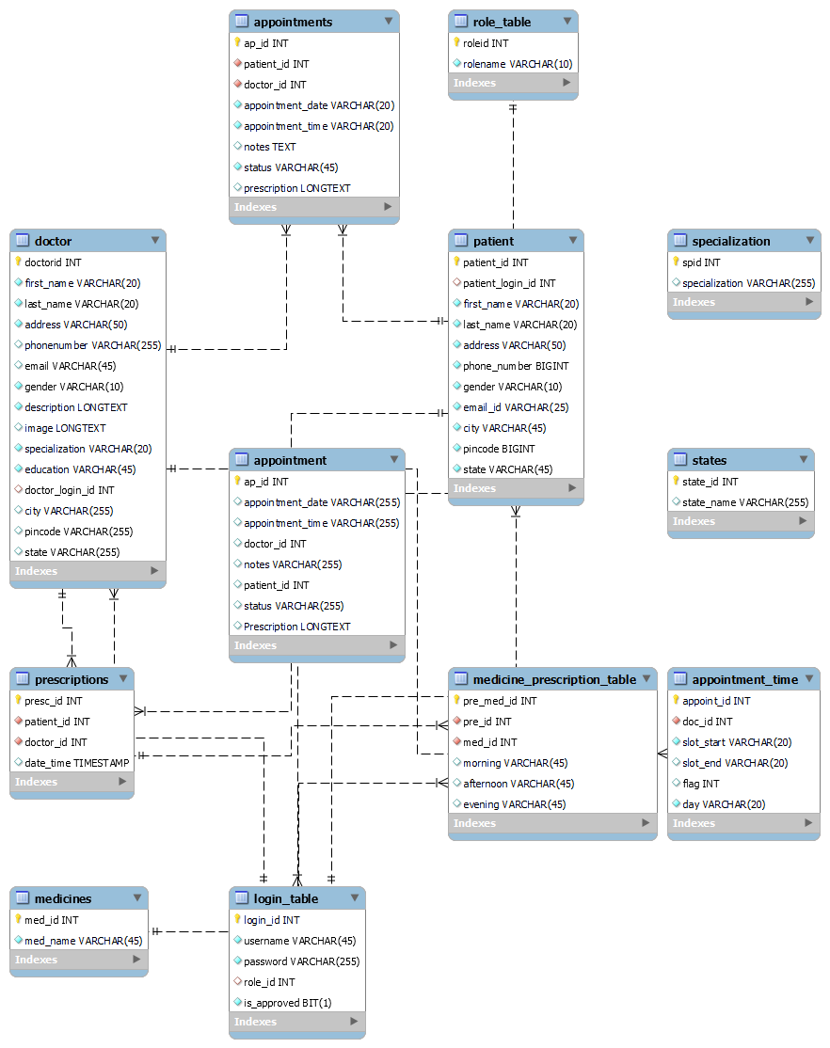
Entity Relationship diagram

Slide 16
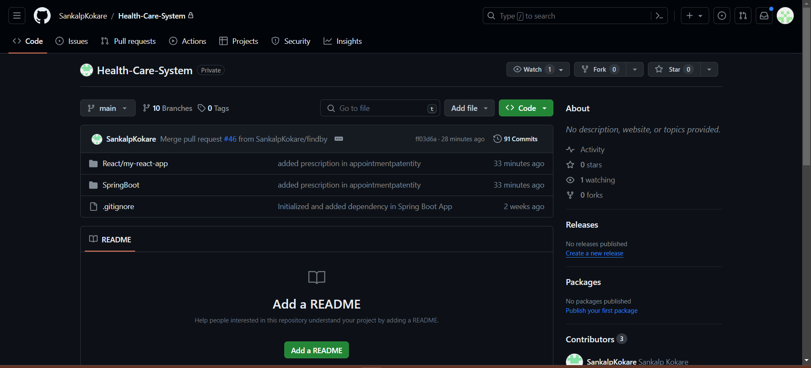
Use Of GIThub

Slide 17
Future Scope
We will be trying to make the User Interface more and more interactive
Prescription will be sent as a pdf by email to the patient
Patient can make online payment.

