Slide 1

SMART INDIA HACKATHON 2026
TITLE PAGE
Problem Statement ID –
Problem Statement Title-
Theme-
PS Category- Software/Hardware
Team ID-
Team Name (Registered on portal)

Slide 2
NIYAMDRISHTI
dotcom
Proposed solution
NiyamDrishti helps an officer read package labels, verify findings and follow the same product across inspections.
Round two prototype
Local OCR and twelve screening checks
Live DNA comparisons between saved scans
Correction Lab tests proposed label text
Photographs and officer decisions persist
X-FACTOR: COMPLIANCE DNA
PHYSICAL
PACKAGE
ONE PRODUCT IDENTITY
Declaration drift
Repeated flags
CAPTURED
LISTING
PREVIOUS
LABEL
Saved scans feed live comparisons. Sample marketplace sightings remain labelled.
Notes:
Demonstrated in local source on 10 September 2026: src/lib/complianceDna.ts builds comparisons from saved inspections as well as explicitly marked sample sightings. src/RoundTwo.tsx provides Correction Lab. Captured listing means user-entered/uploaded evidence, not automatic marketplace crawling. Sources: supplied SIH problem statement 26034 and the existing deck legal references.

Slide 3
TECHNICAL APPROACH
dotcom
CAPTURE
ALL SURFACES
LOCAL OCR
EXTRACT TEXT
RULE ENGINE
CHECK 12
REPORT
OFFICER REVIEW
PRODUCT DNA
SAVED HISTORY
Implementation
React and TypeScript with Tesseract.js in the browser. IndexedDB retains photographs, extracted text and officer decisions.
Verification logic
Rules inspect text patterns and calculations. Low-confidence OCR needs review. DNA compares saved records, and Correction Lab reruns the rules on a draft.
20 automated tests pass. The current POC has no central backend or user authentication.
Notes:
Implementation source: package.json, src/lib/ocr.ts, src/lib/compliance.ts, src/lib/repository.ts. Tesseract.js documentation: https://github.com/naptha/tesseract.js (checked 10 September 2026). Its v6 blocks output is opt-in. Local automated regression run: 20/20 passing on 10 September 2026. A heuristic match score is not a calibrated probability. Current storage is per browser origin and device.

Slide 4
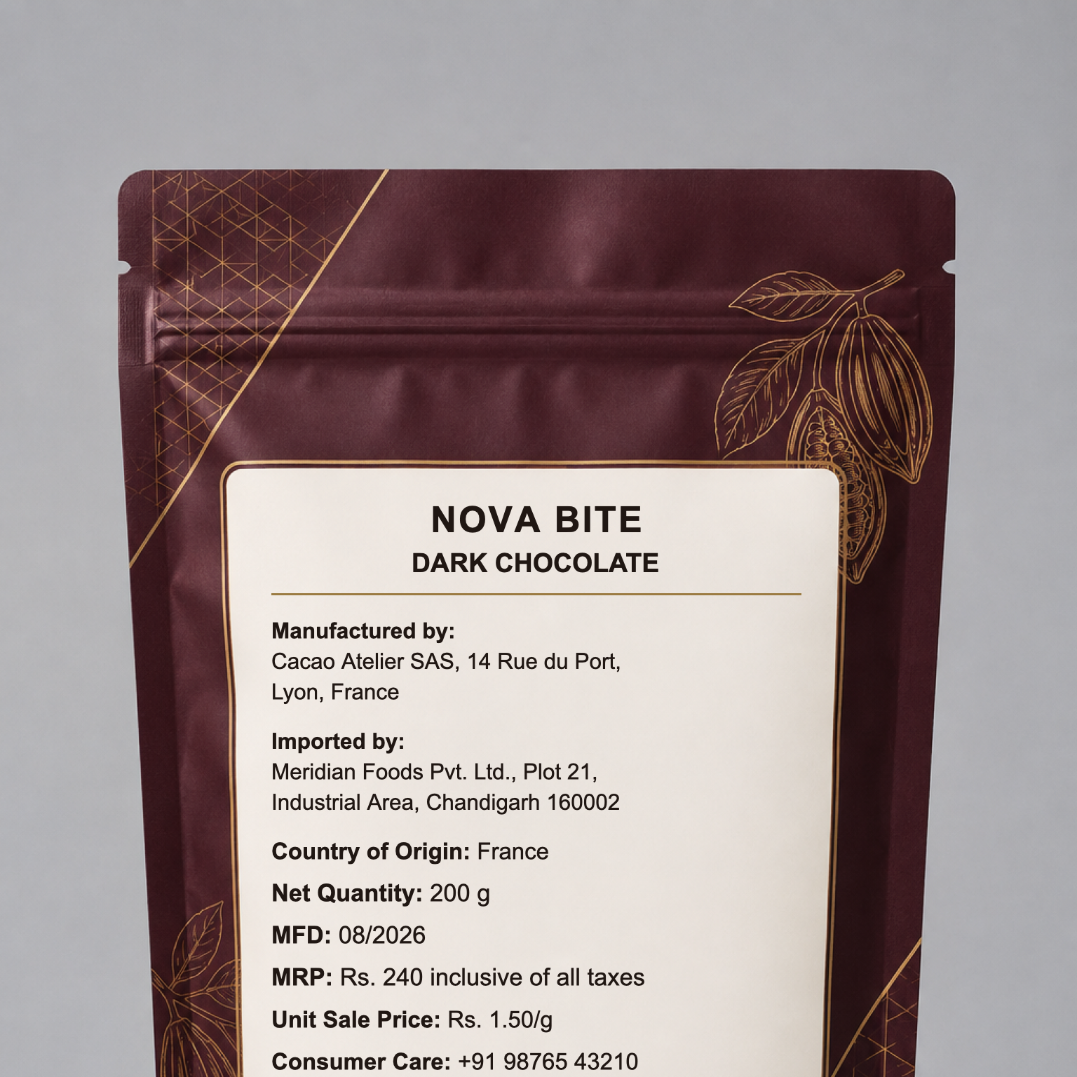
FEASIBILITY AND VIABILITY
dotcom
Working improvements
The prototype retains photo evidence after refresh, checks imported-product mismatches and records officer decisions.
HydraGlow correction simulation
Adding the missing email and correcting unit price changes two findings. The sample score rises from 79 to 93 while the original record stays unchanged.
Validation before 30 September
Test unseen real packages, measure field extraction and false flags, and obtain expert feedback on applicability.
GENERATED TEST PACKAGE FOR LIVE OCR
Notes:
Browser verification on 10 September 2026: the HydraGlow Correction Lab changed consumer_email and unit_sale_price from violation to pass after adding care@example.com and changing 0.70/ml to 0.60/ml. Simulation score 79 to 93, with the original inspection score unchanged. Nova Bite image is generated test artwork from the previous prototype, not a field-validation dataset. The real-package study is planned, not completed.

Slide 5
IMPACT AND BENEFITS
dotcom
Intended value
Inspectors can revisit original evidence and focus on scans that need attention.
Compliance DNA reveals declaration changes and repeated flags across saved product records.
Manufacturers can test proposed corrections before printing another label version.
A real-package benchmark will quantify accuracy and time saved.
Next implementation stage
Priorities: multilingual OCR evaluation, a shared backend with authentication, and marketplace evidence intake.
International expansion would require expert-validated rule packs for each jurisdiction.
Product history and correction testing extend the value of each inspection.
Notes:
Impact statements describe intended benefits, not measured outcomes. Proposed priorities for the 30 September round require implementation and validation. Country-specific rule libraries require appropriate legal review before deployment. No government system integration exists in this POC.

Slide 6
RESEARCH AND REFERENCES
dotcom
Official legal basis
Department of Consumer Affairs: Legal Metrology Act, 2009
Legal Metrology (Packaged Commodities) Rules, 2011 with consolidated amendments
Official Legal Metrology FAQ
Technical basis
Tesseract.js OCR documentation
github.com/SankalpSamarth/NiyamDrishti
POC validation
20 automated tests passing
Correction simulation
2 findings change
Original evidence stays intact
Current scope
12-check POC subset
English OCR, local storage
Officer verification required
No production accuracy claim
Notes:
References retained from existing SIH deck: Department of Consumer Affairs Legal Metrology Act portal https://consumeraffairs.gov.in/pages/legal-metrology-act and consolidated LMPC Rules link in the source deck. POC only covers selected checks. Technical reference https://github.com/naptha/tesseract.js . Automated tests and browser demo results are local engineering checks, not production accuracy evidence.

