Slide 1
Excel Final Assessment Sheet
Sankalp Panthi

Slide 2
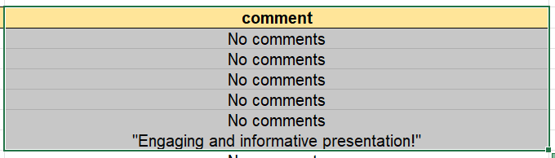
q1
Steps involved:
1. removed duplicates (no duplicates removed as each row was different
2. Added “No comments” to blank cells in comments col (snapshot can be seen).

Slide 3
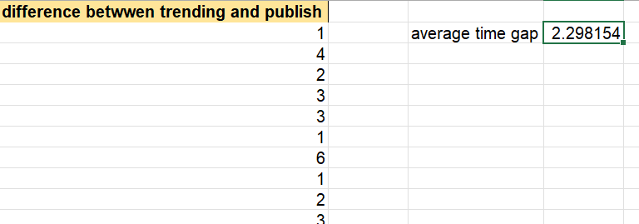
Q2
Steps involved:
1. removed duplicates (no duplicates removed as each row was different
2. Added “No comments” to blank cells in comments col (snapshot can be seen).

Slide 4
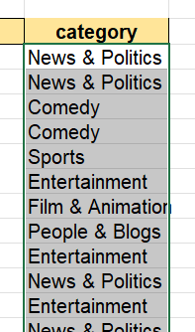
Q3
Category formula: VLOOKUP('q3'!F3,Category!$A$1:$B$33,2,FALSE)
Row Labels | Average of views | Average of likes | Average of comment_count
Movies | 3862190 | 40013 | 2308.5
Gaming | 3436401.95 | 99422.9 | 8929
Pets & Animals | 2490776 | 186307 | 21384
Music | 2017880.624 | 44600.25721 | 2844.686727
Film & Animation | 1800523.971 | 27359.00191 | 2286.978967
Sports | 1379353.406 | 27059.69452 | 2266.072046
Howto & Style | 826816.9331 | 9043.506276 | 861.5543933
Comedy | 717054.7935 | 34833.39138 | 2798.449731
Science & Technology | 664622.3467 | 31888.78667 | 11273.27333
Shows | 649225.5372 | 3531.793388 | 529.8016529
Entertainment | 574766.2767 | 11108.54578 | 1188.503114
People & Blogs | 450423.3628 | 7176.24513 | 838.0381494
Autos & Vehicles | 333265.3824 | 5563.617647 | 792.5
News & Politics | 297358.62 | 2300.562475 | 421.7285429
Travel & Events | 192907.75 | 3262 | 559
Education | 92618.26474 | 4428.069009 | 572.1016311
Religious | 56945.04348 | 1850.057971 | 101.6521739

Slide 5
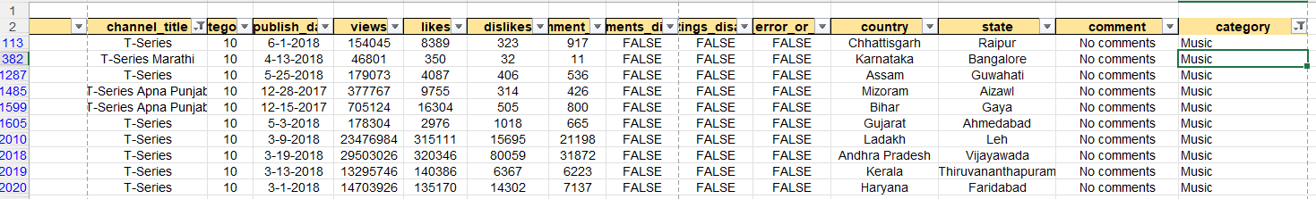
Q4

Slide 6
Q5
Concatenate formula: CONCAT(D2," - ",E2)
Text join formula:TEXTJOIN(",",TRUE,Q3:Q16309)

Slide 7
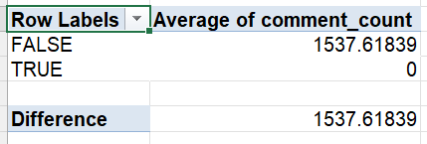
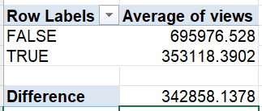
Q6

Slide 8
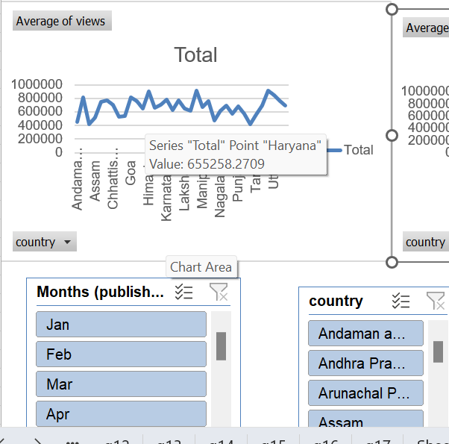
Q7

Slide 9
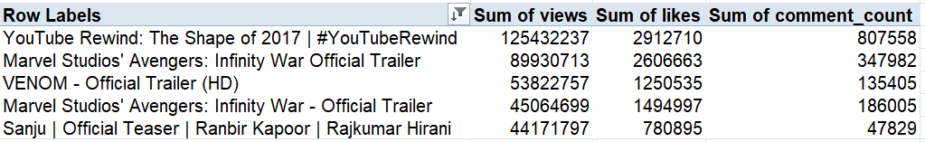
Q8
Using pivot

Slide 10
Q9
Insight: average of views and comment count is steadily increasing with time

Slide 11
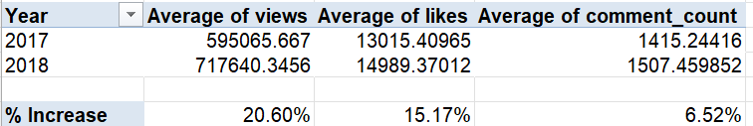
Q10
Formula: for avg views increase %: (B5-B4)/B4 in cell B7

Slide 12
Q11
Insights : As the graph for all three averages (views, likes and comment count) is steadily
growing so the retention rate for youtube for period May 2017 to Jun 2018 is pretty good.

Slide 13
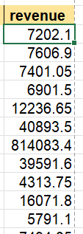
Q12
Revenue per view taken: 0.05
Total revenue:

Slide 14
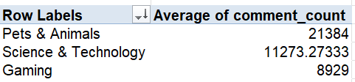
Q13

Slide 15
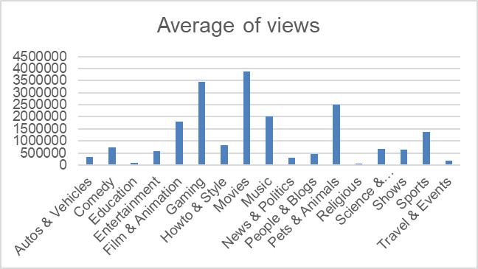
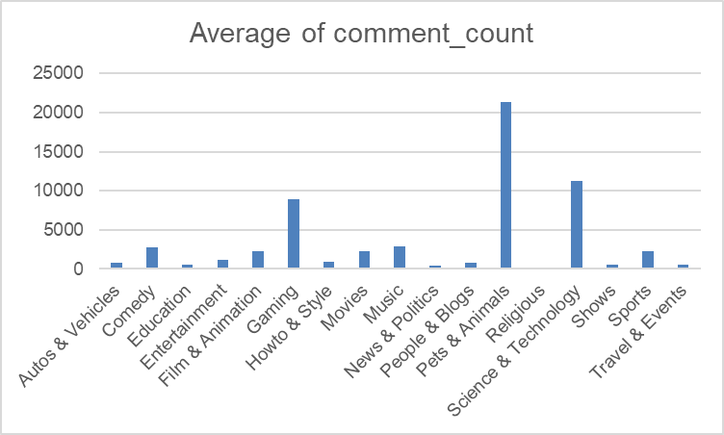
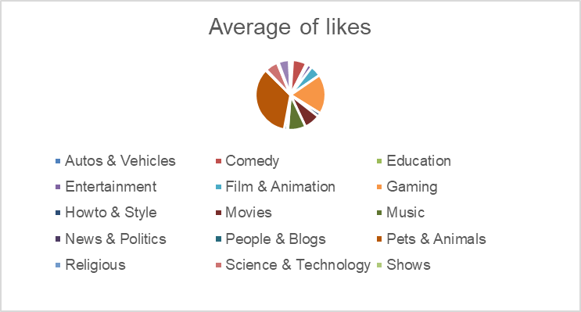
Q14
In views top 3: Movies, Gaming, Pets and animals
In comment top 3: Pets and animals, Science and technology, Gaming
In likes top 3: Pets and animals, Gaming, Music

Slide 16
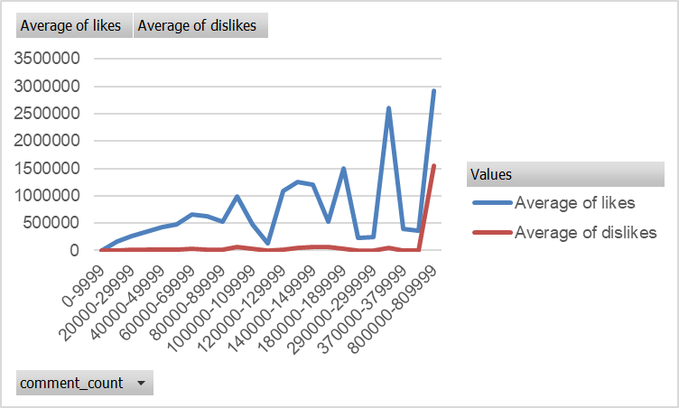
Q15
Dislikes and likes are mostly directly proportional to comment count

Slide 17
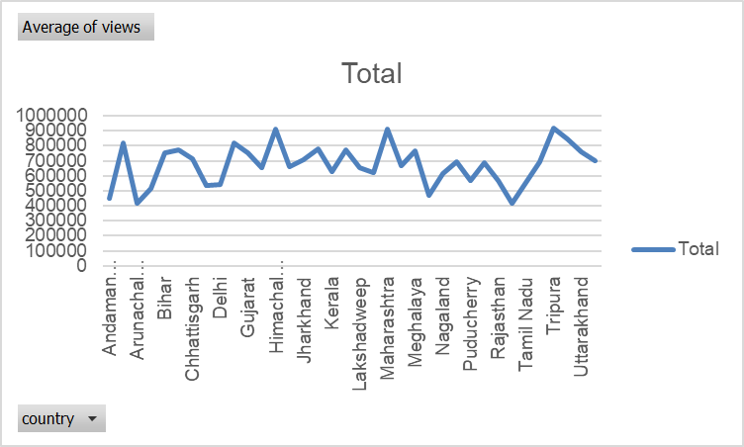
Q16

Slide 18
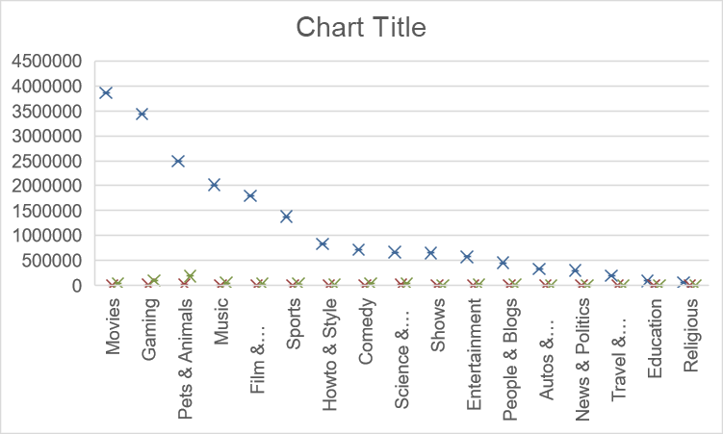
Q17

Slide 19
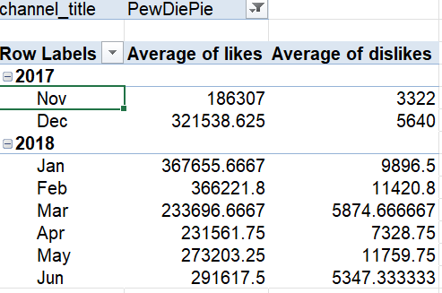
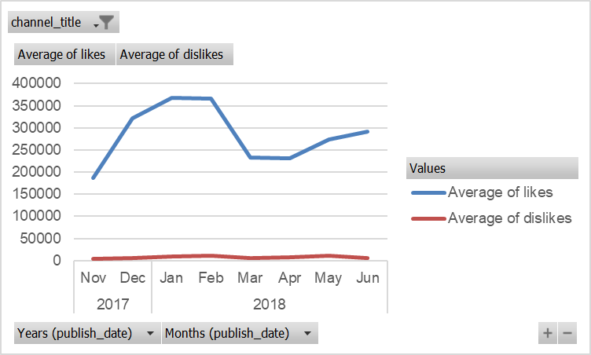
q18

Slide 20
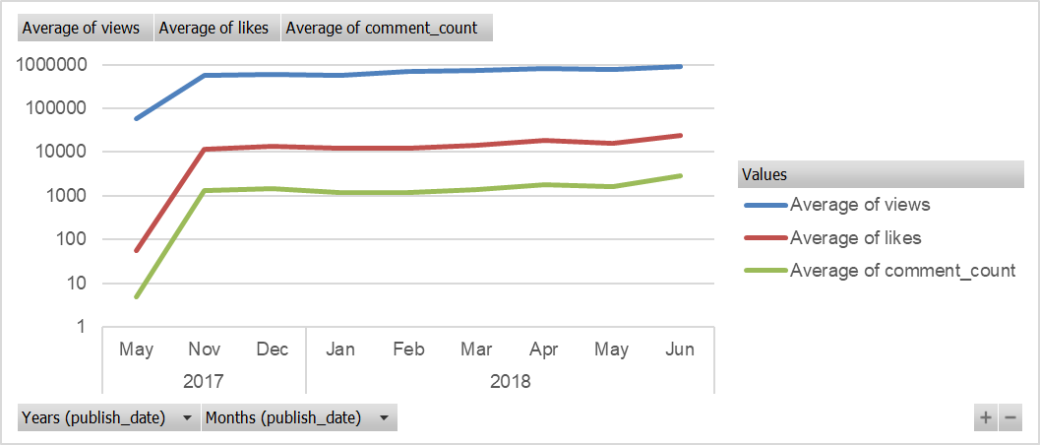
q19
Q11 in excel file does this

Slide 21
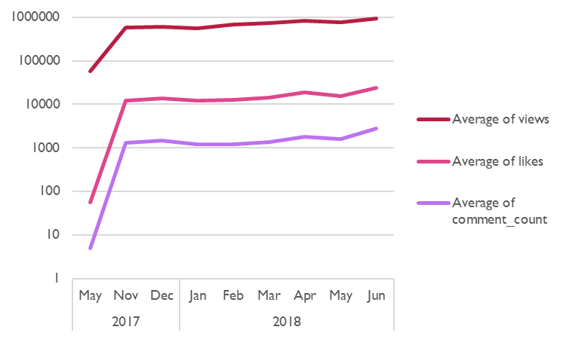
q20

