Slide 1
Excel Reassessment
Sankalp Panthi
Employee id: 4304

Slide 2
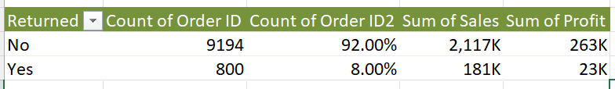
Q1
As we can see from the above table a total of 8% of orders were returned
which costed sales of 181k to go to waste and a profit of 23k got returned
FORMULA: first we used =XLOOKUP(B2,Returns!$B$2:$B$297,Returns!$A$2:$A$297,"No",0)
To connect the orders table with the returns table (we will be using this combined table from now on).
After that, we used a pivot table to get the above table.
The total loss will be the sum of profit that got returned i.e. 23k

Slide 3
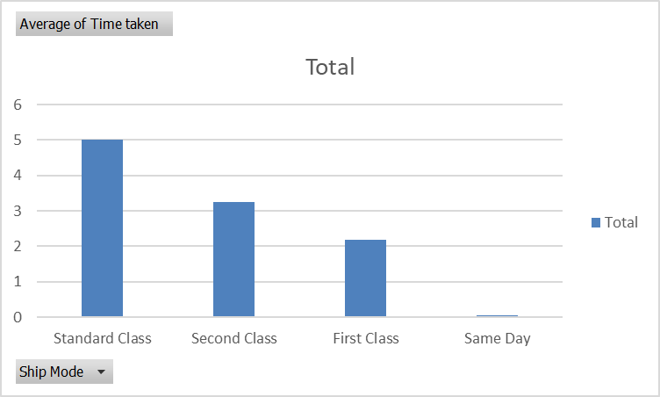
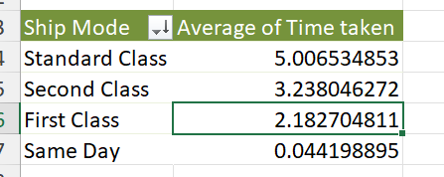
Q2
FORMULA: First we calculated the shipping time by simply subtracting Order date and Ship Date
and then we used pivot table
Same day has the fastest delivery time and
Standard class has the slowest shipping time

Slide 4
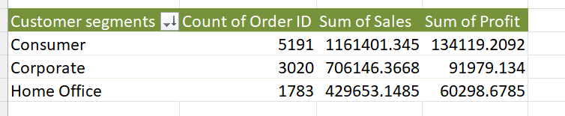
Q3
FORMULA: we used pivot table for above result
The table shows the various segments of customers and their
order count and sum of profit which we can get from these customers.
We can see that the consumer segment gets much more profit than
Any other segment of customers so we should be focussing more on that
Segment to increase profit.

Slide 5
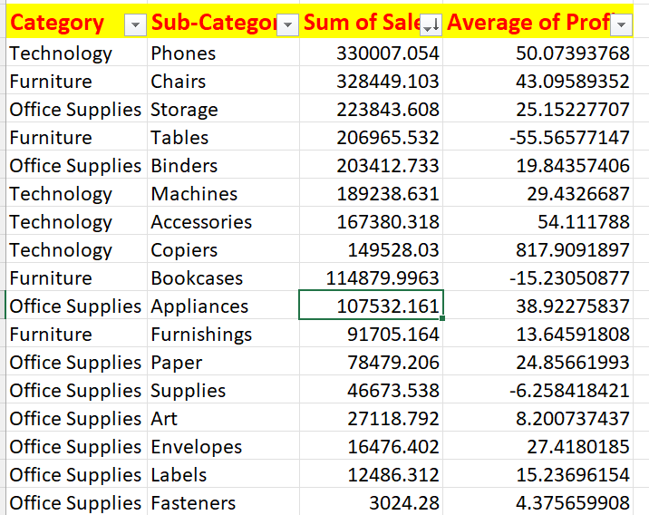
Q4
FORMULA: Used a pivot table
to get this table
Here the top selling category and sub-category based on sum of sales
are technology and phones respectively

Slide 6
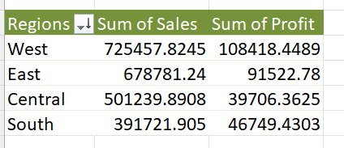
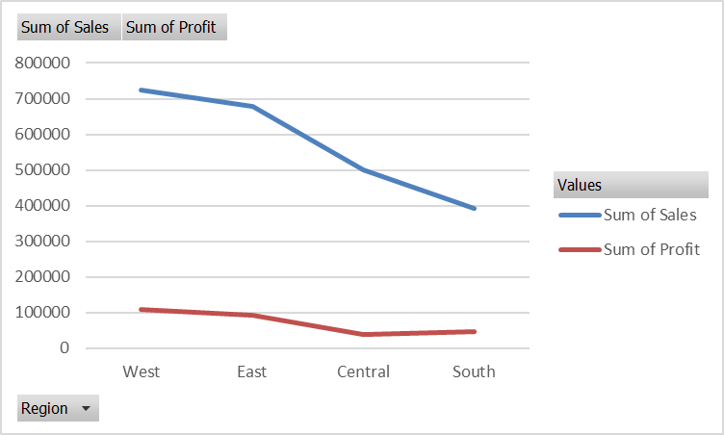
Q5
FORMULA: Used a pivot table
to get this table
West region has the most sales whereas South has the least sales
We can see from graph that sum of profit also mostly decreases as the sum of sales
Decrease so they are positively correlated

Slide 7
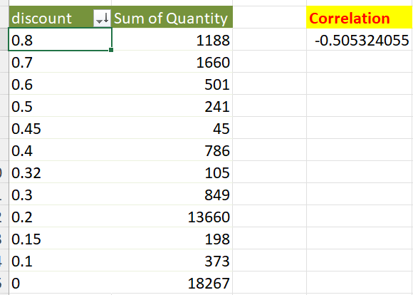
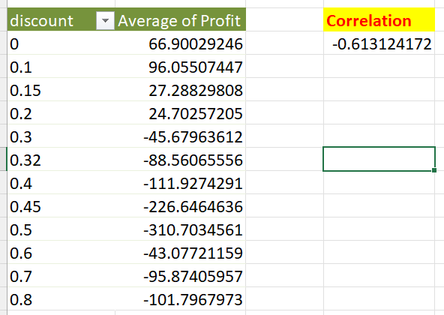
Q6
Comparison between discount rate and quantity
Comparison between discount rate and profit
Formula used: =CORREL(A4:A15,B4:B15)
We can see from the correlation of both tables that both
are inclined towards negative correlation -0.5 and -0.6

Slide 8
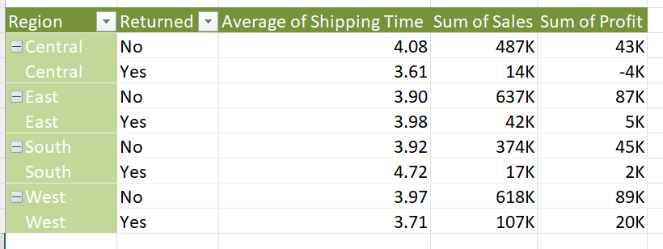
Q7
FORMULA: Used a pivot table
to get this table
So, we can see from the above table that the average shipping time is more in
the central region and we are making a loss for the returned products in the central region.
So we should focus on the central region to increase the sales and profit.

Slide 9
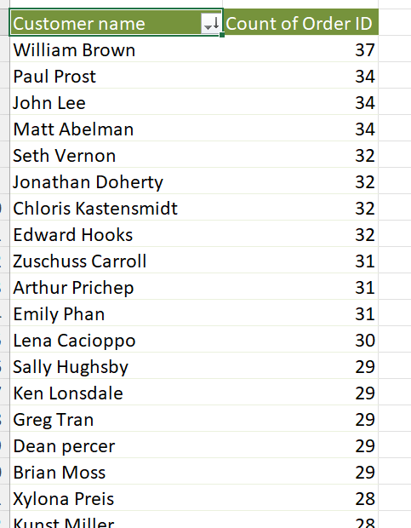
Q8
FORMULA: The table is made using a pivot table and sorted based on
Count of order id descending.
We can see that William Brown is the customer who ordered the
most frequently the count of orders keeps on decreasing as we
move down the table. So we should be focussing more on these
Customers rather than the customers who order in the lower
end of this table

Slide 10
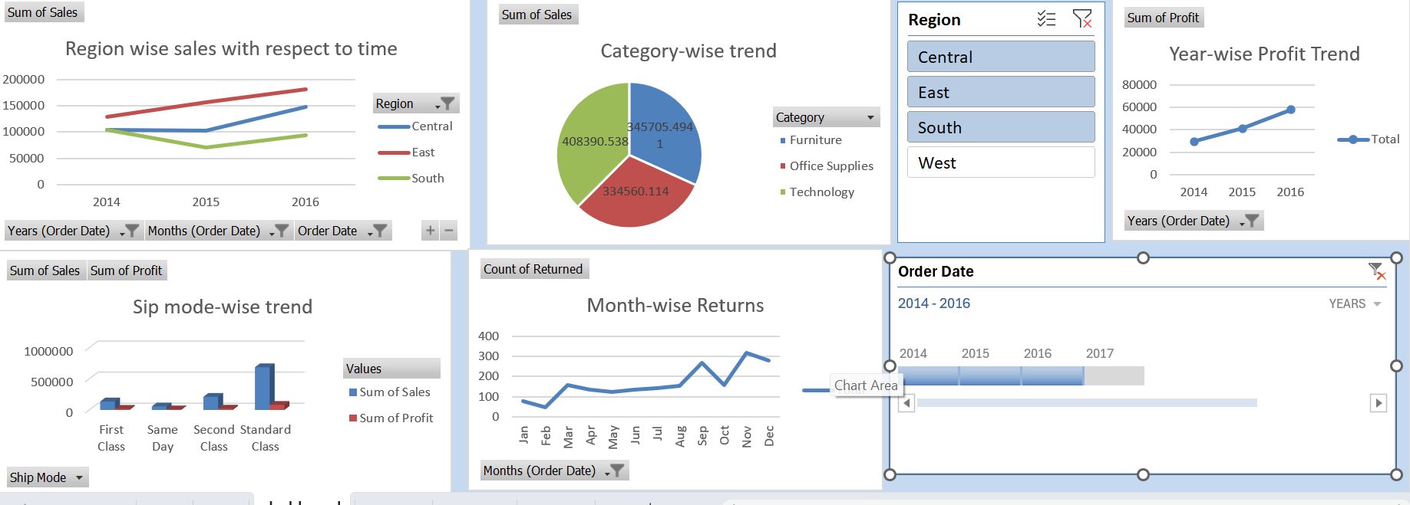
DASHBOARD

Slide 11
DASHBOARD (explanation)
A dashboard has been created using 5 different graphs showing various kinds of insights.
Two slicers (one time and one normal) have been added to make changes in the graphs according to our need.
We are using different types of visualization charts like bar chart, line chart, pie chart and 3d column
Getting various insights like profit, sales, returns, etc.

