Slide 1

HTML,XML
Santhosh bj
For any queries please drop a mail to santhoshkumarbj@gmail.com

Slide 2
History of Markup languages
XML is derivative of SGML (Standard Generalized Markup Language -1986) but with lesser complexity.
SGML – Derived from GML – 1970
SGML inspired the invention of Web.
Tim Berners-Lee, a British scientist, invented the World Wide Web (WWW) in 1989, while working at CERN.(Conseil Européen pour la Recherche Nucléaire – Europen Laboratory for Particle Physics)
He used HTML as publishing language.
XML (Extensible Markup Language)

Slide 3
Markup Language vs Programing language
Declarative language only talks about how the data should be presented.
Programing language talks about algorithm and logical steps.
HTML, XML are markup language.
C# , Java , C++ are programing languages.

Slide 4
Agenda
HTML
XHTML
HTML5
XML

Slide 5
HTML history
First version came in 1993. Though it was started in 1989
Till 2000 HTML 4.01 was widely used.
In 2000 another version of HTML was released known as XHTML which is rewrite of HTML as an XML Language.
After XHTML another version of HTML became popular which is HTML 5.
Drafted in 2007 and recommended in 2014.
Current proposed version of HTML is HTML 6.
WHATWG is taking care of HTML standards. (Web Hypertext Application Technology Working Group).
Earlier W3C – Worldwide web consortium used to take care of HTML standards.

Slide 6
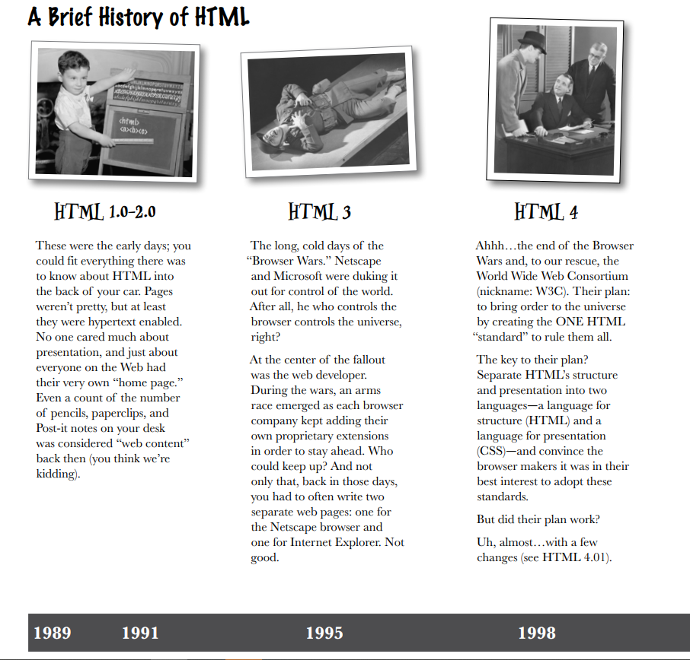

Slide 7
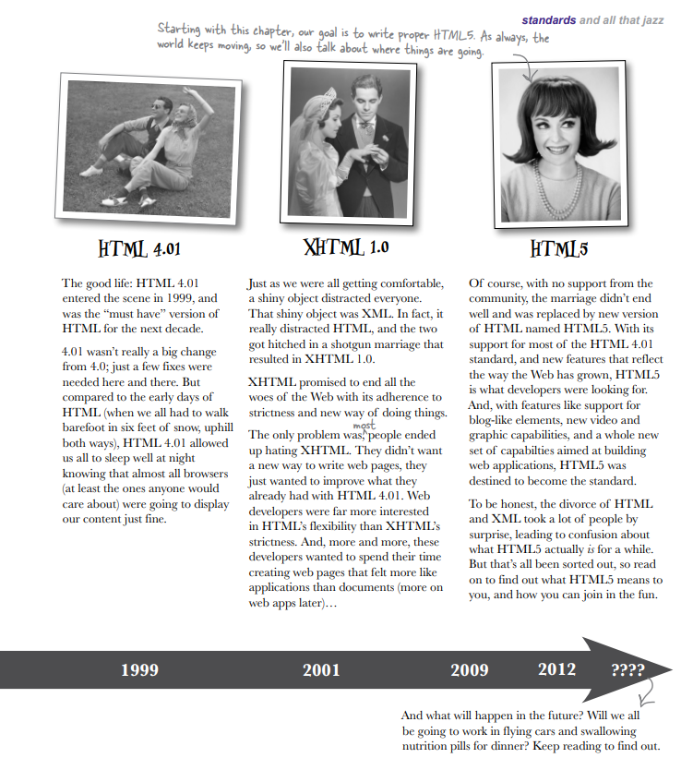

Slide 8
HTML (Hyper Text Markup Languages)
Markup language
Platform Independent
Provides tags to embed graphics, animation, links.
Create , Save and View a document or information in the browser.
Format a web page
Web browser understands HTML
Runs on presentation layer.

Slide 9
Web browSer
A web browser is an application which takes you anywhere on the internet, letting you see text, images and video from anywhere in the world.
Client
Server
Browser

Slide 10
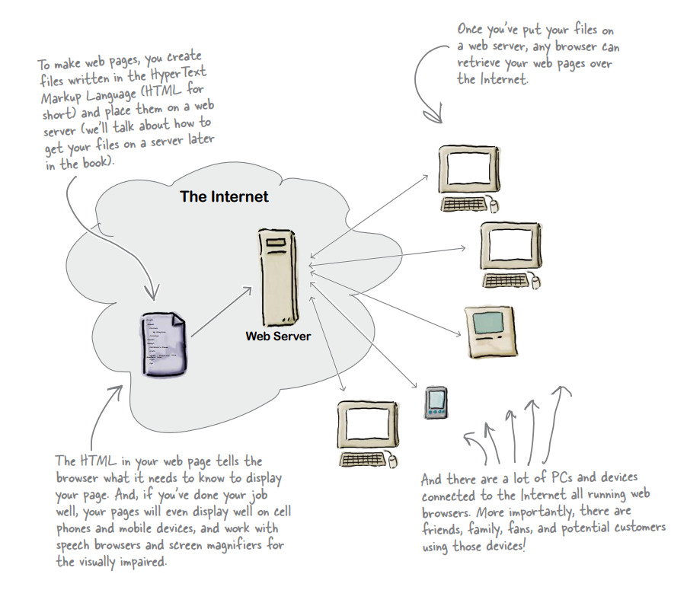

Slide 11
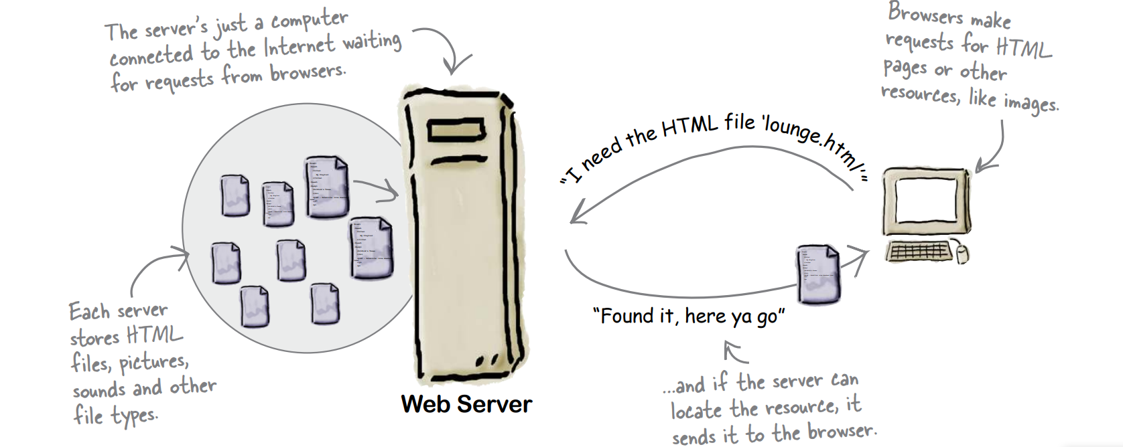
What does a web browser do ?

Slide 12
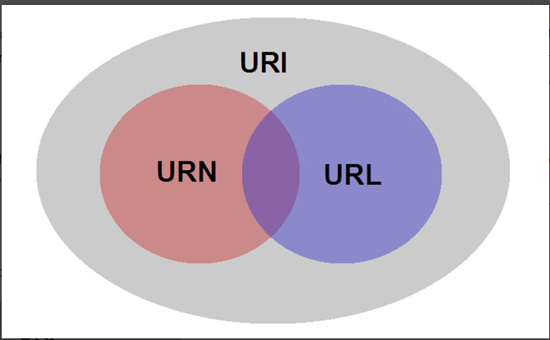
URL, URI and URN
Uniform Resource Name, Uniform Resource Identifier, Uniform Resource Locator
URL is subset of URI. URI identifies the resource and URL identifies location.
+
=
URI
URN
URL

Slide 13
Html structure
<!DOCTYPE html> <html> <head> <title>Page Title</title> </head> <body> <h1>My First Heading</h1> <p>My first paragraph.</p> </body> </html>

Slide 14
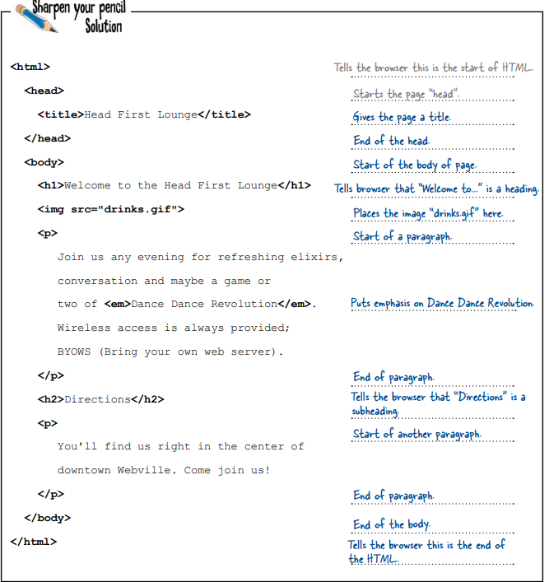

Slide 15
Elements , attributes
The HTML element is everything from the start tag to the end tag:
<h1>My First Heading</h1>
All HTML elements can have attributes
Attributes provide additional information about elements
Attributes are always specified in the start tag
Attributes usually come in name/value pairs like: name="value“
The <a> tag defines a hyperlink. The href attribute specifies the URL of the page the link goes to:
<a href="https://www.w3schools.com">Visit W3Schools</a>

Slide 16
Introduction to Tags
The <!DOCTYPE html> declaration defines that this document is an HTML5 document
The <html> element is the root element of an HTML page
The <head> element contains meta information about the HTML page
The <title> element specifies a title for the HTML page (which is shown in the browser's title bar or in the page's tab)
The <body> element defines the document's body, and is a container for all the visible contents, such as headings, paragraphs, images, hyperlinks, tables, lists, etc.
The <h1> element defines a large heading
The <p> element defines a paragraph

Slide 17
HTML Styles
<tagname style="property:value;">
<body style="background-color:powderblue;"> <h1 style="color:blue;">This is a heading</h1> <h1 style="font-family:verdana;">This is a heading</h1> <h1 style="font-size:300%;">This is a heading</h1> <h1 style="text-align:center;">Centered Heading</h1>

Slide 18
Formatting
<b> - Bold text
<strong> - Important text
<i> - Italic text
<em> - Emphasized text
<mark> - Marked text
<small> - Smaller text
<del> - Deleted text
<ins> - Inserted text
<sub> - Subscript text
<sup> - Superscript text

Slide 19
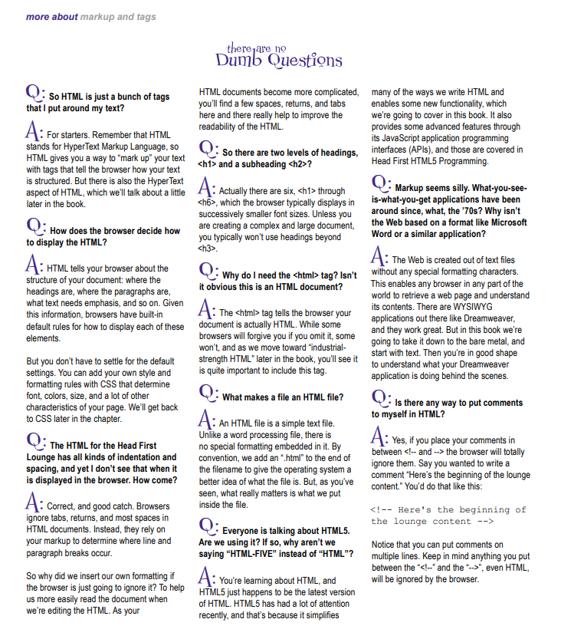

Slide 20
XML introduction
XML was designed to store and transport data
XML was designed to be self-descriptive
XML is a W3C Recommendation
<Student>
<USN>2BLCS001<USN>
<Name>Santhosh</Name> </Student>
In many HTML applications, XML is used to store or transport data, while HTML is used to format and display the same data.
<?xml version="1.0" encoding="UTF-8"?> is prolog and optional

Slide 21
Namespace and DOM
Namespace : <h:table xmlns:h="http://www.w3.org/TR/html4/">
All HTML elements can be accessed through the HTML DOM.
<h1 id="demo">This is a Heading</h1> <button type="button" onclick="document.getElementById('demo').innerHTML = 'Hello World!'">Click Me! </button>

Slide 22
XPath
XPath is a syntax for defining parts of an XML document
XPath uses path expressions to navigate in XML documents
XPath contains a library of standard functions
XPath is a major element in XSLT and in XQuery
XPath is a W3C recommendation

Slide 23
XPath
/bookstore/book[1] | Selects the first book element that is the child of the bookstore element
/bookstore/book[last()] | Selects the last book element that is the child of the bookstore element
/bookstore/book[last()-1] | Selects the last but one book element that is the child of the bookstore element
/bookstore/book[position()<3] | Selects the first two book elements that are children of the bookstore element
//title[@lang] | Selects all the title elements that have an attribute named lang
//title[@lang='en'] | Selects all the title elements that have a "lang" attribute with a value of "en"
/bookstore/book[price>35.00] | Selects all the book elements of the bookstore element that have a price element with a value greater than 35.00
/bookstore/book[price>35.00]/title | Selects all the title elements of the book elements of the bookstore element that have a price element with a value greater than 35.00

Slide 24
XSLT
XSLT (eXtensible Stylesheet Language Transformations) is the recommended style sheet language for XML.
XSLT is far more sophisticated than CSS. With XSLT you can add/remove elements and attributes to or from the output file. You can also rearrange and sort elements, perform tests and make decisions about which elements to hide and display, and a lot more.
XSLT uses XPath to find information in an XML document.
Can use XSLT to transform XML into HTML, before it is displayed in a browser.

Slide 25
XML Schema
An XML Schema describes the structure of an XML document, just like a DTD.
An XML document with correct syntax is called "Well Formed".
An XML document validated against an XML Schema is both "Well Formed" and "Valid".

