Slide 1
CS772: DL4NLP Assignment Evaluation
Group 11
Sankalp Mule, 17D110007
Siddhant Benake, 17D110011
Kumar Miskin, 17D110026
Abeen Bhattacharya 170110013
Date: 12/04/21

Slide 2
Problem Statement
We have a sentiment analysis problem at hand and we need to classify the given sentence into a class based on the sentiment of the sentence
What we need to incorporate:
RNN
LSTM
Bi-LSTM
GRU
Bi-GRU
With and Without Pre-Trained Word Embeddings

Slide 3
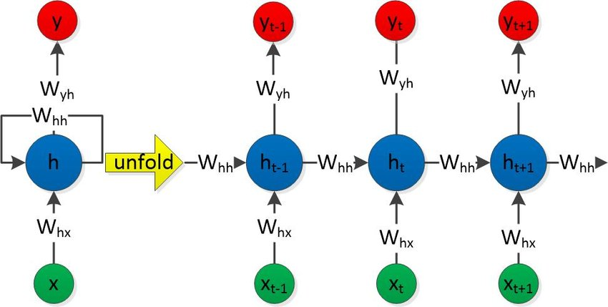
Architecture: RNN
Input Layer: 300d Embedding Vector Number of Hidden Layers: 2 Number of Hidden Neurons in each Hidden Layer: 256

Slide 4
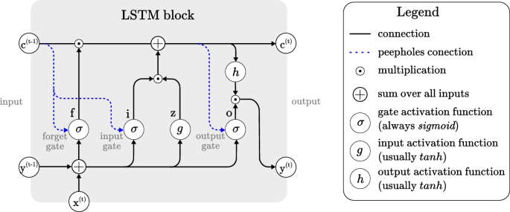
Architecture: LSTM
Input Layer: 300d Embedding Vector Number of Hidden Layers: 2 Number of Hidden Neurons in each Hidden Layer: 256

Slide 5
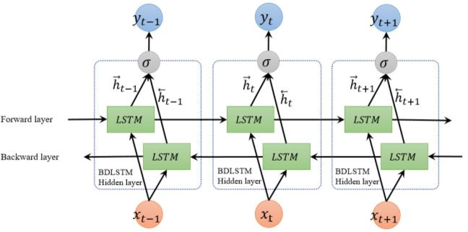
Architecture: Bi-LSTM
Input Layer: 300d Embedding Vector Number of Hidden Layers: 1 Forward Layer, 1 Backward Layer Number of Hidden Neurons in each Hidden Layer: 256

Slide 6
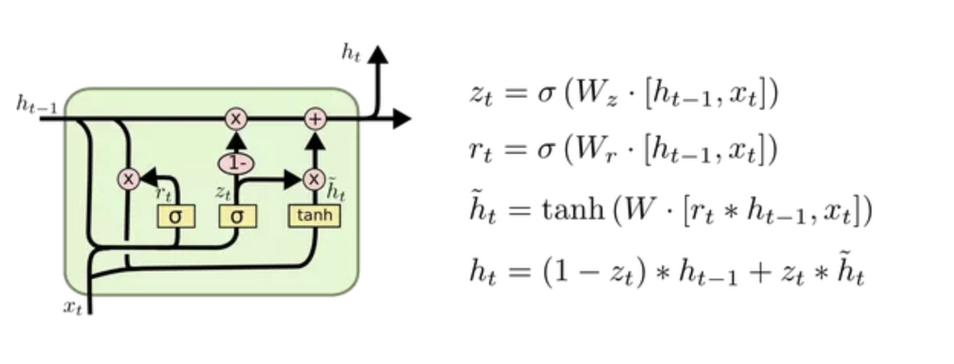
Architecture: GRU
Input Layer: 300d Embedding Vector Number of Hidden Layers: 2 Number of Hidden Neurons in each Hidden Layer: 256

Slide 7
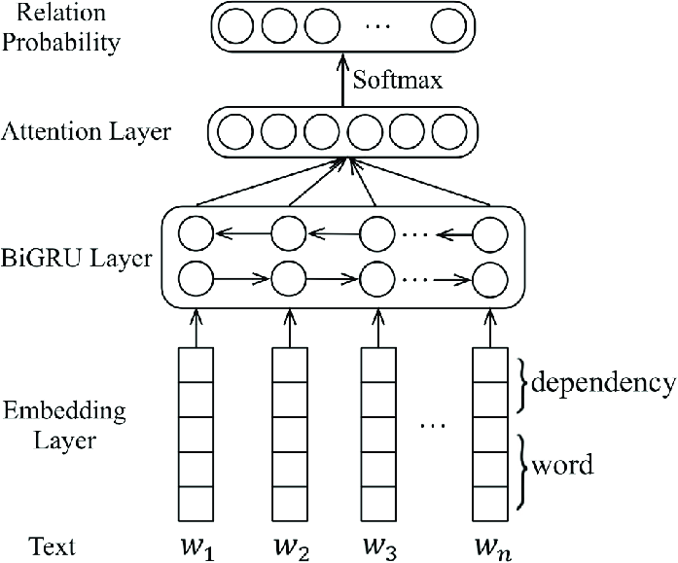
Architecture: Bi-GRU
Input Layer: 300d Embedding Vector Number of Hidden Layers: 1 Forward Layer, 1 Backward Layer Number of Hidden Neurons in each Hidden Layer: 256

Slide 8
Library functions used
os
string
pandas
nltk
nltk.corpus import stopwords
nltk.tokenize import word_tokenize
sklearn.model_selection import train_test_split
torch
torch.nn
torch.utils.data
numpy
gensim.models import Word2Vec,FastText
torch.nn.functional
imblearn.over_sampling import SMOTE, RandomOverSampler, SMOTENC, ADASYN
imblearn.under_sampling import RandomUnderSampler

Slide 9
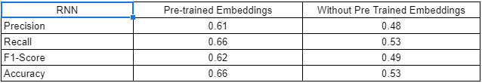
Evaluation Table: RNN

Slide 10
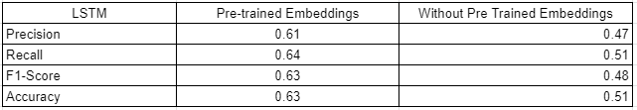
Evaluation Table: LSTM

Slide 11
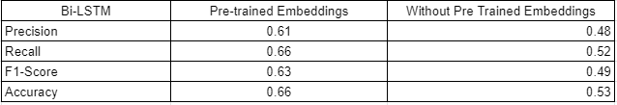
Evaluation Table: Bi-LSTM

Slide 12
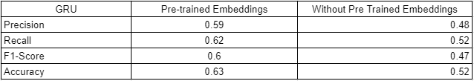
Evaluation Table: GRU

Slide 13

Evaluation Table: Bi-GRU

Slide 14
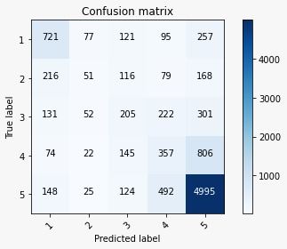
Confusion Matrix for the best model:

Slide 15
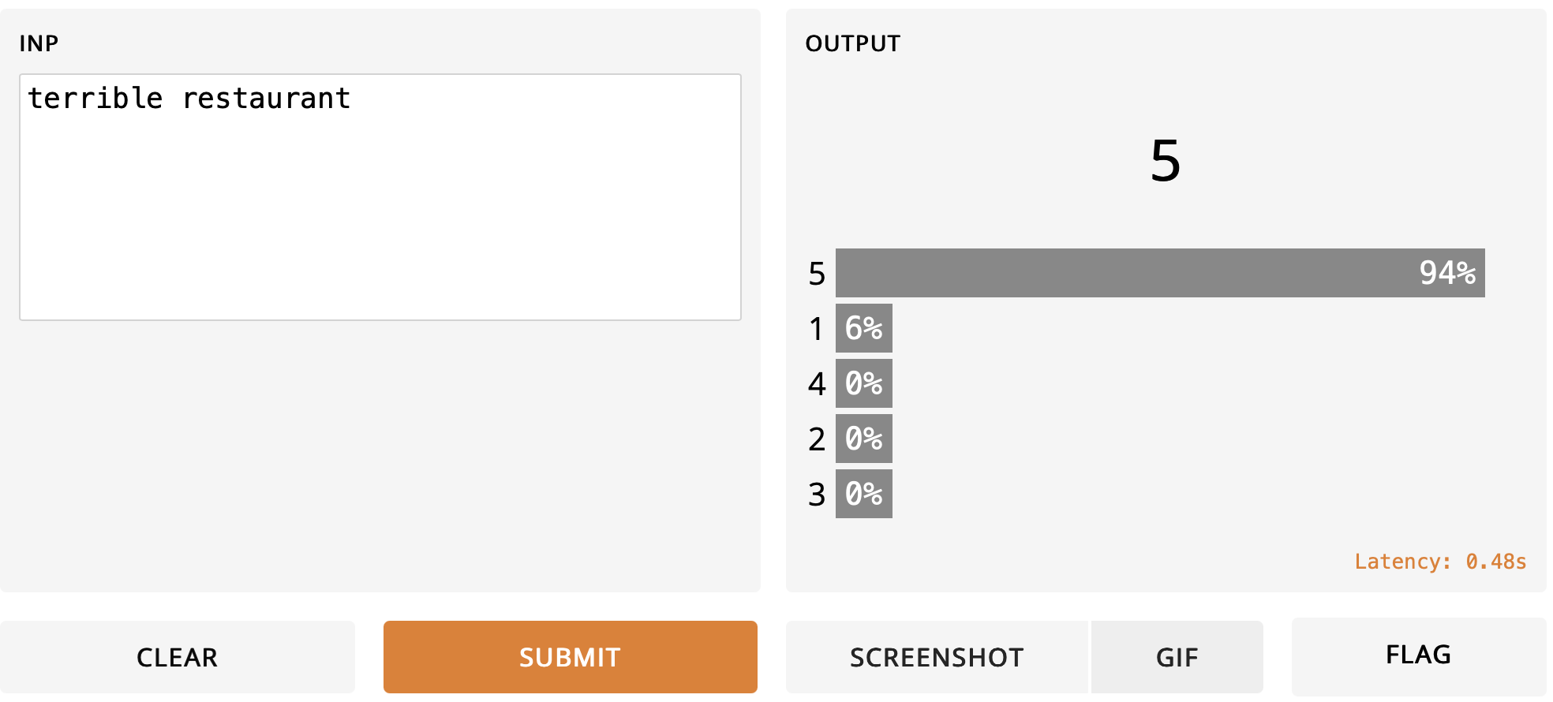
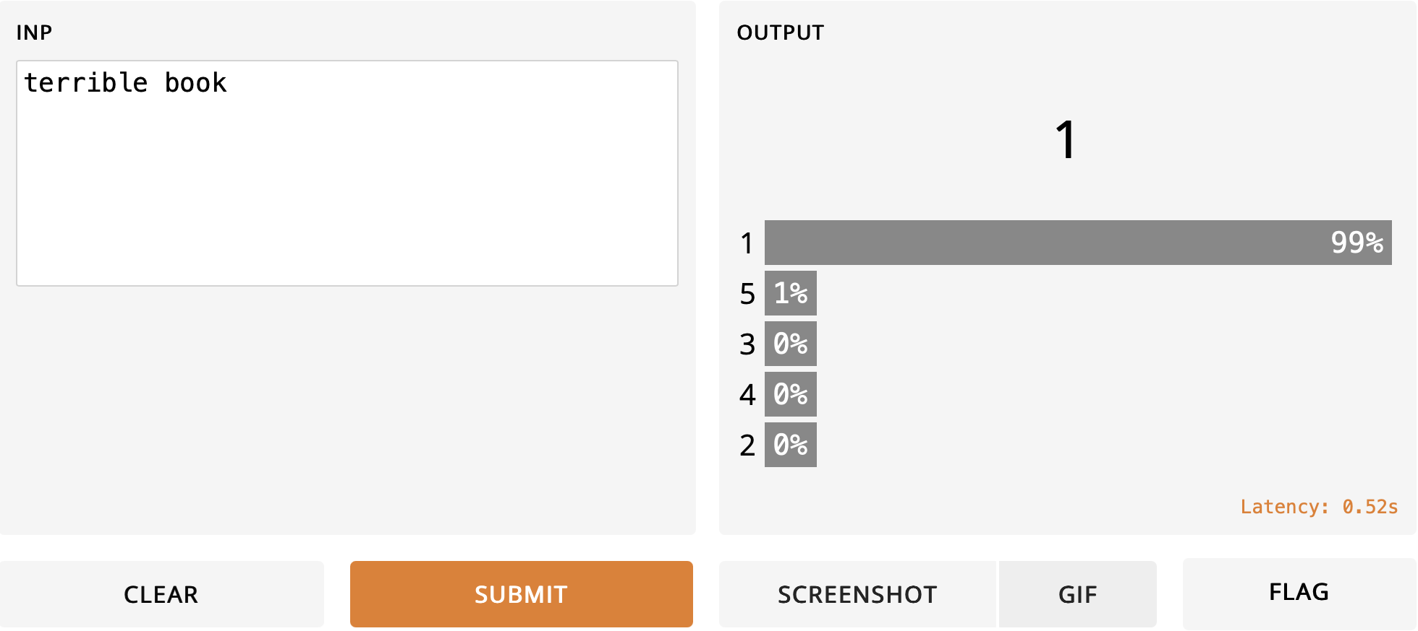
Qualitative Analysis
Some words like “book” are always giving 5. This I speculate is probably due to only positive reviews on “book” in Data.

Slide 16
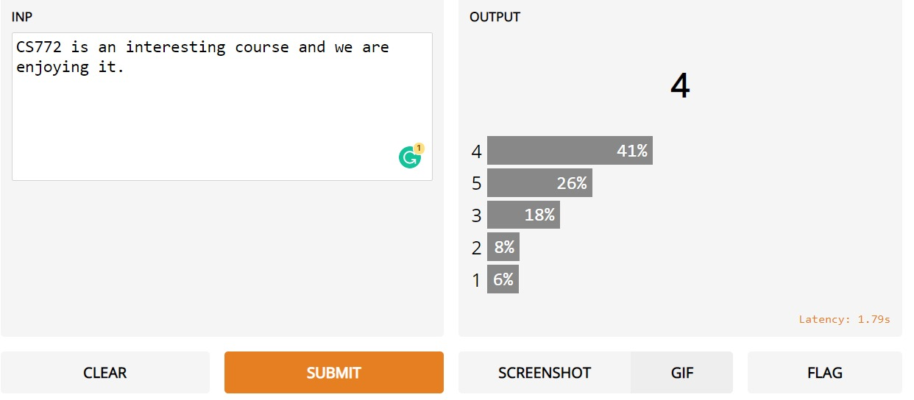
GUI:

