Slide 1
CS772: DL4NLP Assignment Evaluation
Group 11
Sankalp Mule, 17D110007
Siddhant Benake, 17D110011
Kumar Miskin, 17D110026
Abeen Bhattacharya 170110013
Date: 13/05/21

Slide 2
Problem statement
Identifying the rating of a review using sentiment analysis
Input dataset contains reviews and their rating score between 1 to 5 - low to high
Given a review, we predict the rating score.

Slide 3
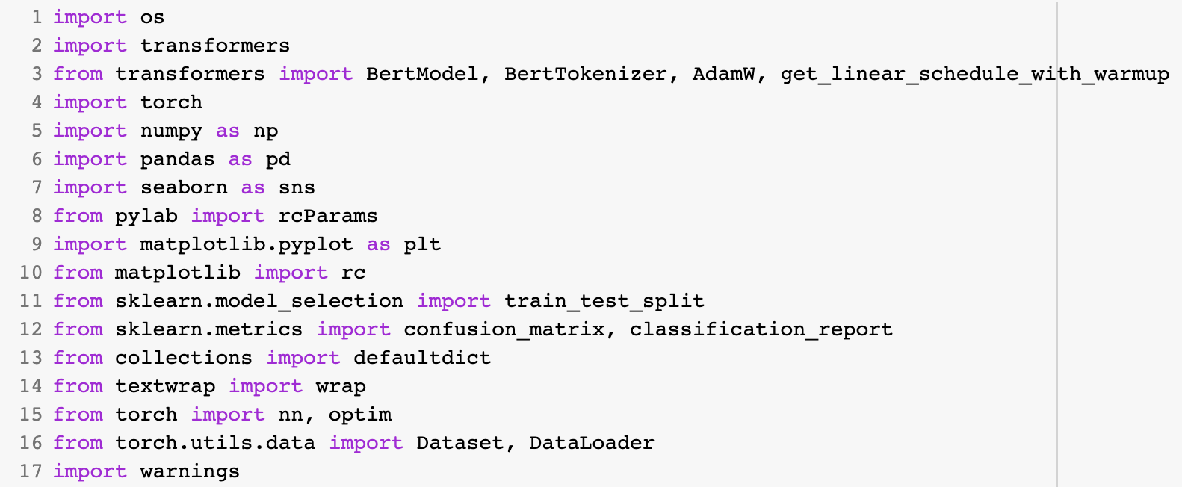
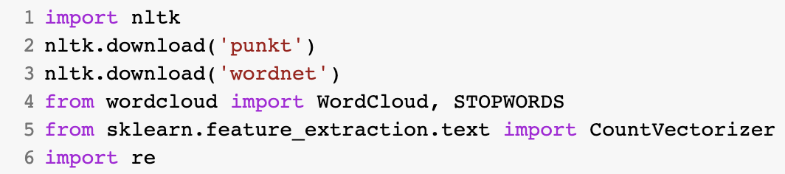
Libraries
Lime
Gradio

Slide 4
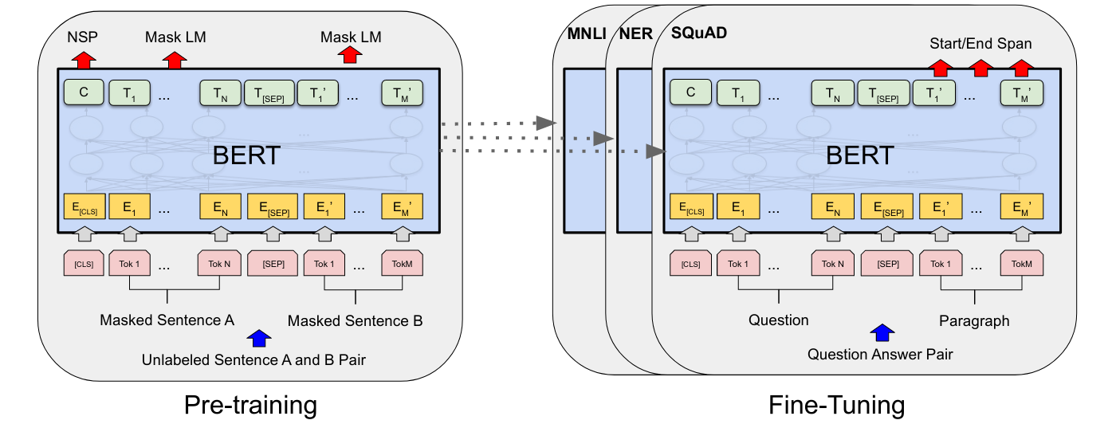

Architecture

Slide 5
Results
 | Accuracy | Precision | Recall | F1-Score
RNN | 0.68 | 0.62 | 0.68 | 0.63
LSTM | 0.63 | 0.61 | 0.64 | 0.63
Bi-LSTM | 0.68 | 0.62 | 0.68 | 0.63
GRU | 0.63 | 0.59 | 0.62 | 0.6
Bi-GRU | 0.64 | 0.61 | 0.63 | 0.62
Transformers | 0.74 | 0.70 | 0.74 | 0.71

Slide 6
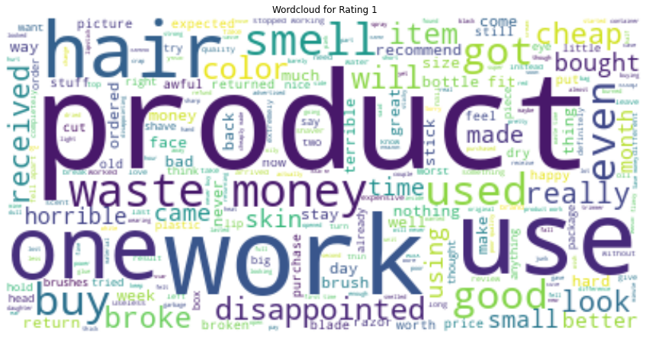
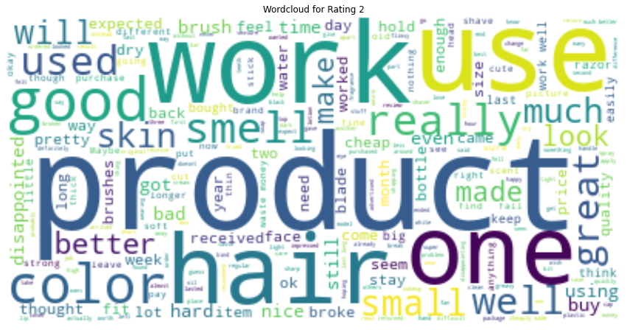
Qualitative unigram analysis of Class 1 & 2

Slide 7
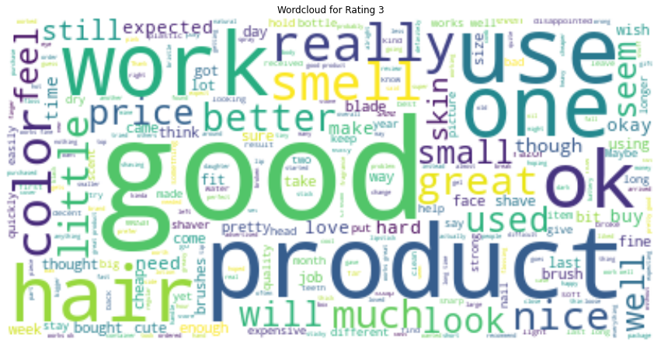
Qualitative unigram analysis of Class 2 & 3

Slide 8
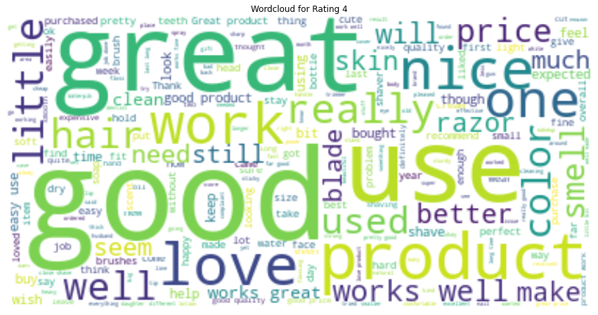
Qualitative unigram analysis of Class 3 & 4

Slide 9
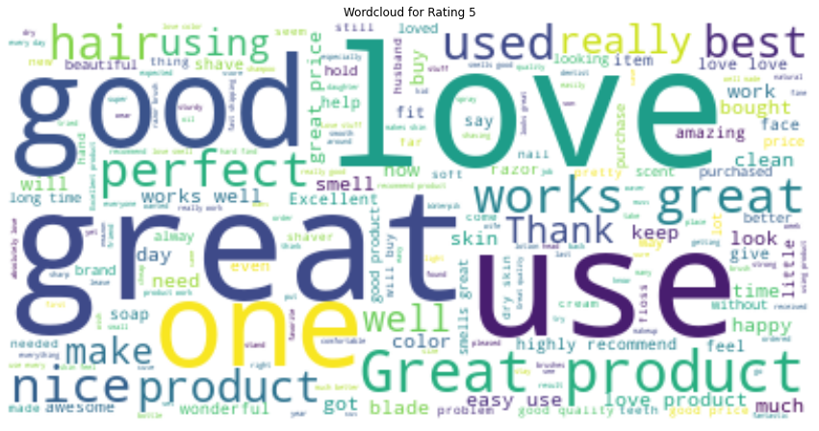
Qualitative unigram analysis of Class 4 & 5

Slide 10
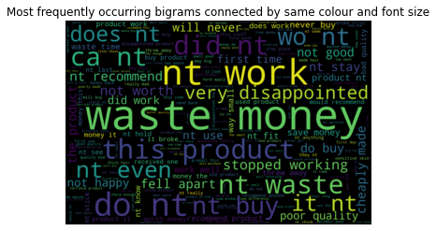
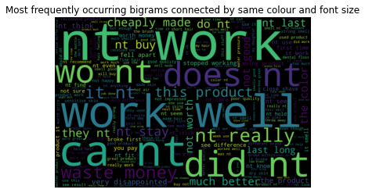
Qualitative bigram analysis of Class 1 & 2

Slide 11
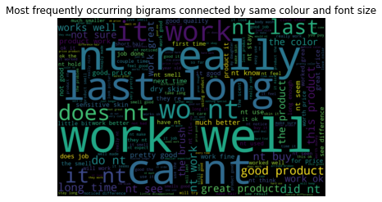
Qualitative bigram analysis of Class 2 & 3

Slide 12
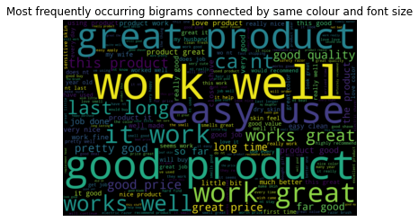
Qualitative bigram analysis of Class 3 & 4

Slide 13
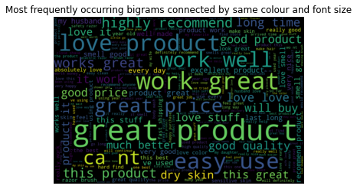
Qualitative bigram analysis of Class 4 & 5

Slide 14
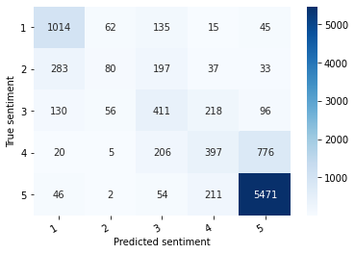
Confusion matrix
Confusion matrix
+ Explaining confusion matrix using the unigram overlap (previous slide)

Slide 15
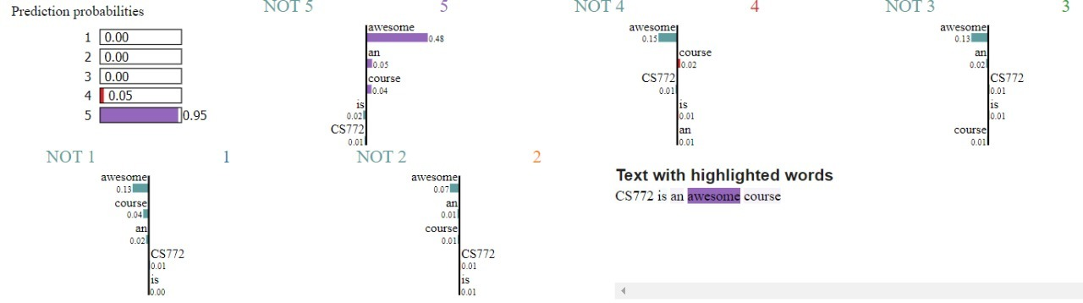
Demo:
Transformer-based model
Showing sensitivity of input words towards the sentiment decisions, using explanability tools

