Slide 1
Light Weight Virtualization: Docker
B. RAMAMURTHY

Slide 2
References
http://docs.docker.com
https://prakhar.me/docker-curriculum/
https://codecon.bloomberg.com/tutorial
https://docs.docker.com/engine/docker-overview/#what-can-i-use-docker-for

Slide 3
Overview
From Wikipedia: Docker is open-source project that automates the deployment of software applications inside containers by providing an additional layer of abstraction and automation of OS-level virtualization on Linux.
Docker offers a light weight virtualization
Docker is light weight container
Docker image is a self-contained executable unit containing all that is needed for execution.
Docker allows an application to execute within its own sandbox; it is a standardized package with all the dependencies that can be easily deployed.
It is the core concept behind the emerging “containerization” movement.
CSE 541, B. Ramamurthy

Slide 4
Container (https://docs.docker.com)
An image is a lightweight, stand-alone, executable package that includes everything needed to run a piece of software, including the code, a runtime, libraries, environment variables, and config files.
A container is a runtime instance of an image—what the image becomes in memory when actually executed. It runs completely isolated from the host environment by default, only accessing host files and ports if configured to do so.
Containers run apps natively on the host machine’s kernel. They have better performance characteristics than virtual machines that only get virtual access to host resources through a hypervisor. Containers can get native access, each one running in a discrete process, taking no more memory than any other executable.
CSE 541, B. Ramamurthy

Slide 5
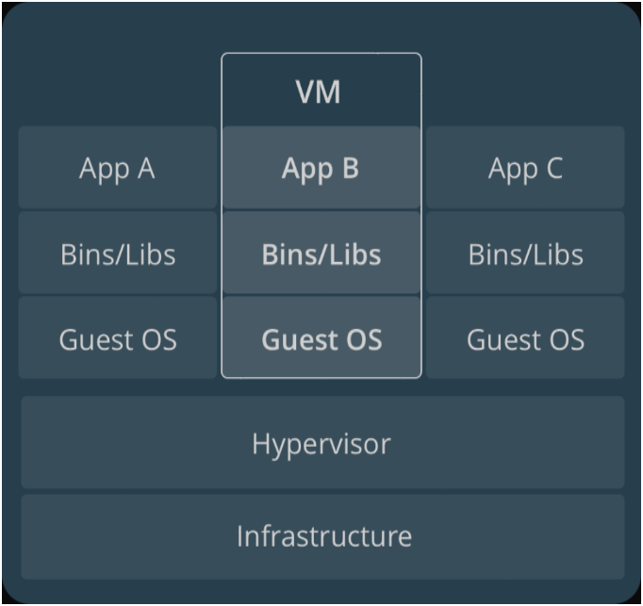
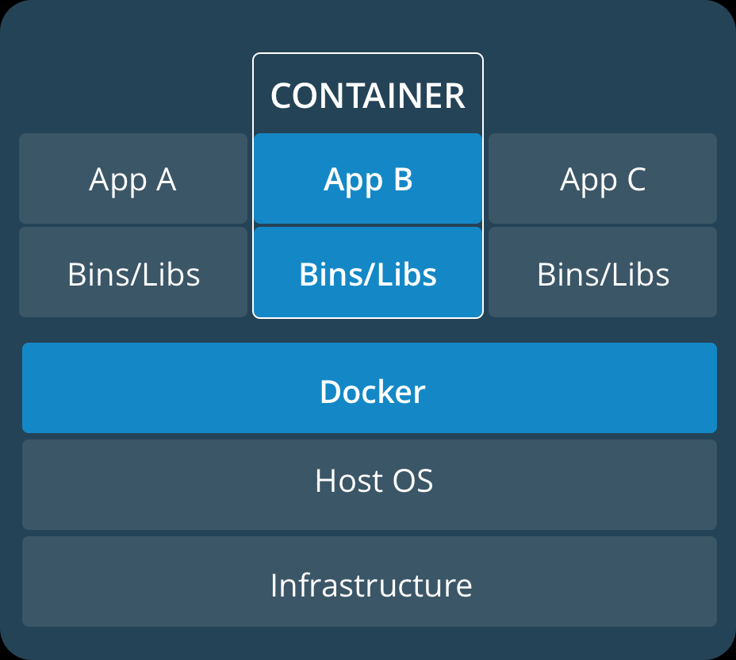
VM vs Docker (our “stack”)
CSE 541, B. Ramamurthy

Slide 6
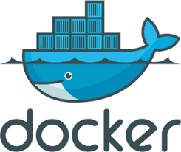
Lets Understand Docker
All the following slides are based on http://docs.docker.com
Install the latest version of the docker software: I guess the :container” idea comes from shipping containers!!??
After installation click on the icon for cdocker
A shell shows up; note the dynamic IP that appears and the prompt
Now you can give some simple docker commands and check it out.
CSE 541, B. Ramamurthy

Slide 7
Simple Docker Commands
All docker commands are prefixed with “docker”
All regular unix shell commands like ls, mkdir, etc. can be directly typed in as such
Try “ls” the entire directory listing will print out
The try
docker run hello-world
Since you dis not create any image for a docker app hello-world, it will go fetch one from docker repositories ad run it!
docker –version
It will display the version of docker you installed and are running.
CSE 541, B. Ramamurthy

Slide 8
Understanding Docker through Examples
Define a file Dockerfile will define what will go on inside your container. (somewhat similar to manifest file)
CSE 541, B. Ramamurthy

Slide 9
How to create a Docker Image
A simple starter image
Create three files in an new folder
  Dockerfile: this is like the manifest file
  requirements.txt: what are the software needed for the execution of the application: in case its contents are REDIS (data storage) and Flask (python web framework)
  The application itself: in this case a python application: app.py
The install the requirements:
pip install –r requirements.txt
ls
CSE 541, B. Ramamurthy

Slide 10
Docker image steps
docker build –t friendlyhello
docker images
docker run –p 4000:80 friendlyhello
Check it on the web ip of your server and port #4000
Many such containers of the same image (in this case friendlyhello) can be run and used.
CSE 541, B. Ramamurthy

Slide 11
What else can we do?
Create a swarm of containers using docker images>
We can deploy an application onto a cluster, running it on multiple machines. Multi-container, multi-machine applications are made possible by joining multiple machines into a “Dockerized” cluster called a swarm.
Hmm.. In that case can run MPI on this swarm cluster?
http://ieeexplore.ieee.org/document/7868429/?reload=true
CSE 541, B. Ramamurthy

Slide 12
Summary
Many systems are being built using docker container technology.
It provides light weight virtualization and resultant portability and performance.
It makes deployment of applications very easy to manage.
CSE 541, B. Ramamurthy

