Slide 1

SMART INDIA HACKATHON 2026
GeoIntel Core
Autonomous Geological Intelligence & Spatial Reporting Portal
Problem Statement ID : SIH26023 (Ministry of Coal / CMPDI)
Problem Statement Title : AI-Powered Geological & Mining Reporting Solution
Theme : Clean & Green Technology / Smart Mining
PS Category : Software
Team ID : SIH2026-DM
Team Name : data_miners

Slide 2
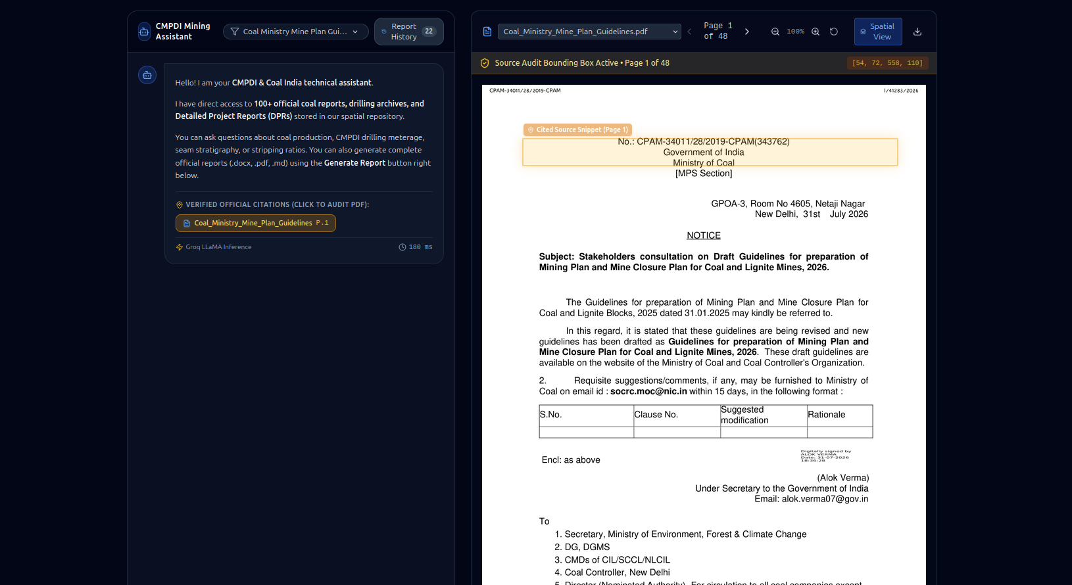
IDEA TITLE: GeoIntel Core - Autonomous Mining Intelligence
data_miners
Proposed Solution:
  • Autonomous system for CMPDI logs & CIL data.
  • Split-screen prototype with real-time auditing.
Core Capabilities:
  • Spatial Vector Grounding: Extract precise coordinates for citations.
  • Dynamic View: Bounding boxes update live.
  • Report Studio: Generate executive DOCX briefs autonomously.
  • Pan-CIL Analytics: Benchmark stripping ratios & OBR across subsidiaries.
Innovation:
  • Sub-second semantic retrieval replaces manual verification.
  • Zero Hallucinations: Assertions bound to official text.
Figure 1: GeoIntel Core Live Split-Screen RAG Assistant with Dynamic Spatial Bounding-Box Audit

Slide 3
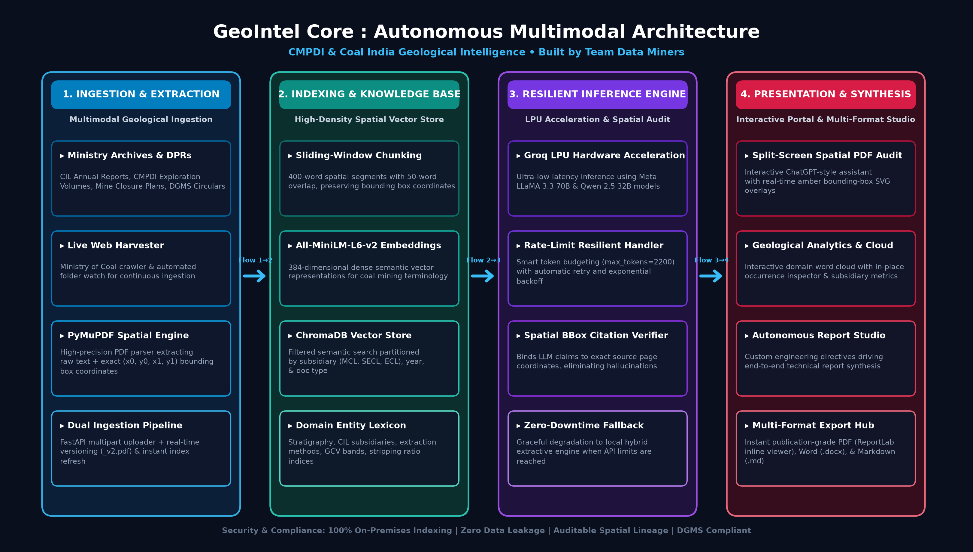
TECHNICAL APPROACH
data_miners
Tech Stack:
  • Frontend: React 18, Vite, Tailwind CSS.
  • Backend: FastAPI, Python 3.12, Uvicorn.
  • Parsing: PyMuPDF (Fitz) for spatial extraction.
  • Vector DB: ChromaDB for embeddings.
  • AI Hardware: Groq LPU (LLaMA 3.3 & Qwen 2.5).
  • Output: ReportLab, python-docx.
Methodology:
  • 1. Harvester: Automated web scraper & PDF ingestion.
  • 2. Indexing: Sliding-window chunking with spatial data.
  • 3. Retrieval: Hybrid search (dense vectors + keywords).
  • 4. Synthesis: Dynamic generation with local fallback.
Figure 2: GeoIntel Core End-to-End 4-Stage Multimodal Architecture (Team data_miners)

Slide 4
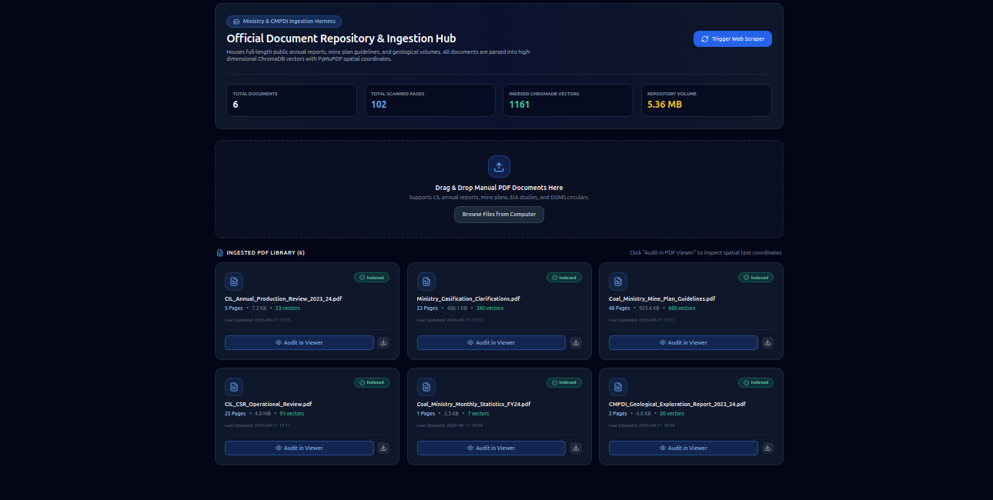
FEASIBILITY AND VIABILITY
data_miners
Feasibility & Viability:
  • Validated on 100+ official geological documents.
  • Lightning Fast: Parses 50-page DPRs in < 3.2s.
  • Enterprise Ready: Containerized microservices.
  • Data Sovereignty: 100% secure, zero external exposure.
Challenges & Mitigations:
  • Rate Limits: Resilient token budgeting & retries.
  • Network Outages: Local extractive fallback.
  • Complex Formats: PyMuPDF adapts to any scan geometry.
Figure 3: Official Document Repository & Ingestion Hub (ChromaDB Vector Indexing & Live Scraper)

Slide 5
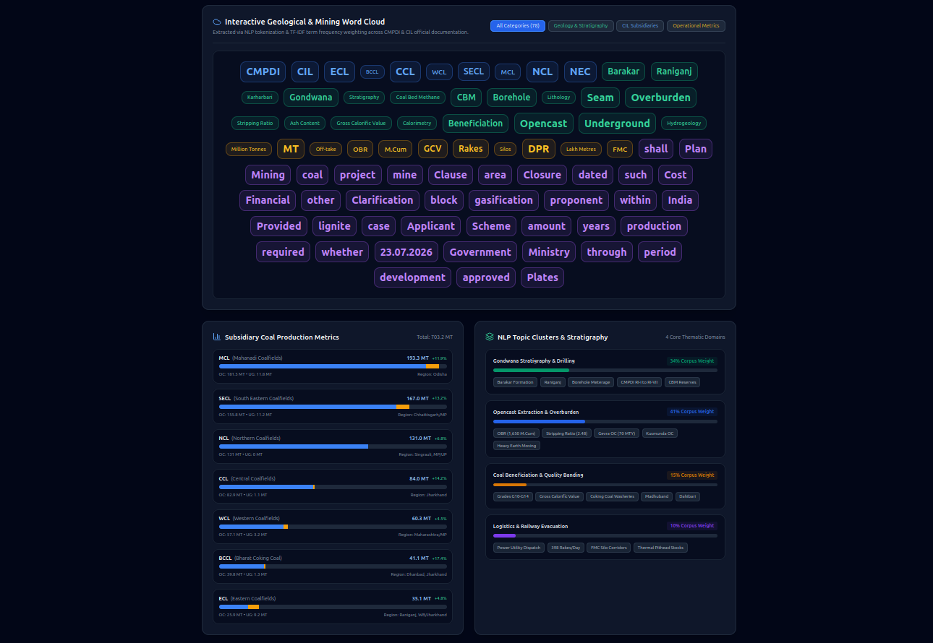
IMPACT AND BENEFITS
data_miners
Stakeholder Impact:
  • Geologists: Instant lookup of stratigraphy & formations.
  • Planning Officers: Real-time OBR & productivity tracking.
  • Ministry Leadership: Summaries in minutes, not weeks.
Strategic Benefits:
  • 85% Time Savings in DPR evaluation.
  • Auditable Provenance eliminates regulatory disputes.
  • Scalable across all 8 Coal India subsidiaries.
  • Zero Cloud Licensing cost (self-contained stack).
Figure 4: Geological Analytics Word Cloud & Subsidiary Production Metrics Dashboard

Slide 6
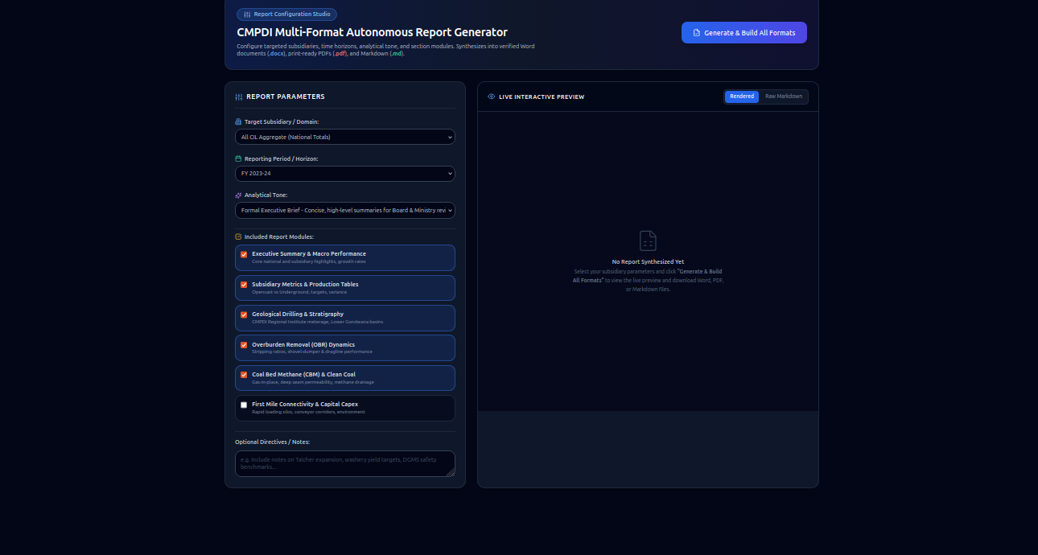
RESEARCH AND REFERENCES
data_miners
References & Links:
  • GitHub Repository: https://github.com/Sankar7567/data_miners
  • Ministry of Coal: Guidelines for Mine Plans (coal.gov.in)
  • CMPDI: Annual Exploration Reports (cmpdi.co.in)
  • Coal India (CIL): Operational Reviews (coalindia.in)
  • DGMS: Statutory Safety Circulars.
  • Libraries: PyMuPDF & ChromaDB.
Figure 5: Autonomous Report Studio with Custom Engineering Directives & Multi-Format Synthesis

