Slide 1

Data Engineering
Wikipedia Data Set
Sankar Chinna Shanmugam

Slide 2
Wikipedia
Understanding of Domain Knowledge
Online Encyclopedia
Interesting to Parse the APIs
One Source (Past, Current and Feature)
Multilingual Support
Business Case Queries

Slide 3
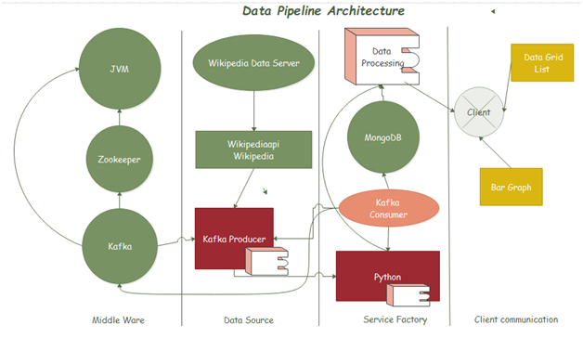
Data Pipeline Architecture

Slide 4
Resources & Tools Used in Pipeline
Servers
JVM
Zookeeper
Kafka
Mongo
IDE
Pycharm
Operating Systems
Windows 7(64bit)
Hardware
4GB RAM
Inter Core i5 processor
APIs
Wikipedia
Wikipediaapi
Pymongo
Kafka
MongoClient
PrettyTable
Numpy
Matplotlib
Networkx
Packages
Python

Slide 5
Bibliography
Wikipedia Data Source
https://meta.wikimedia.org/wiki/Research:Data
https://wikitech.wikimedia.org/wiki/EventStreams
https://www.mediawiki.org/wiki/API:Recent_changes_stream
https://stream.wikimedia.org/v2/stream/recentchange
http://rcmap.hatnote.com/#en
http://listen.hatnote.com/
GitHub
https://github.com/jasonmar/topk
Python
https://pypi.org/project/Wikipedia-API/
https://stackabuse.com/getting-started-with-pythons-wikipedia-api/
Kafka
http://kafka.apache.org/
https://towardsdatascience.com/kafka-python-explained-in-10-lines-of-code-800e3e07dad1
https://medium.com/@shaaslam/installing-apache-kafka-on-windows-495f6f2fd3c8
https://dzone.com/articles/running-apache-kafka-on-windows-os
https://stackoverflow.com/questions/35560767/pyspark-streaming-with-kafka-in-pycharm
Mongo
https://realpython.com/introduction-to-mongodb-and-python/
https://www.w3schools.com/python/python_conditions.asp
Visualization
https://pythonspot.com/matplotlib-bar-chart/
https://codepunk.io/building-relationship-graphs-in-python-with-networkx/

Slide 6
Demo

Slide 7
Challenges
Interest to Configuring Server
Exception Handling
Null Records
Pushing the Records into the DB
Consuming the multiple APIs
Identify the Business Case
Interface Implementations
Timeout

Slide 8
Q & A

Slide 9


