Slide 1

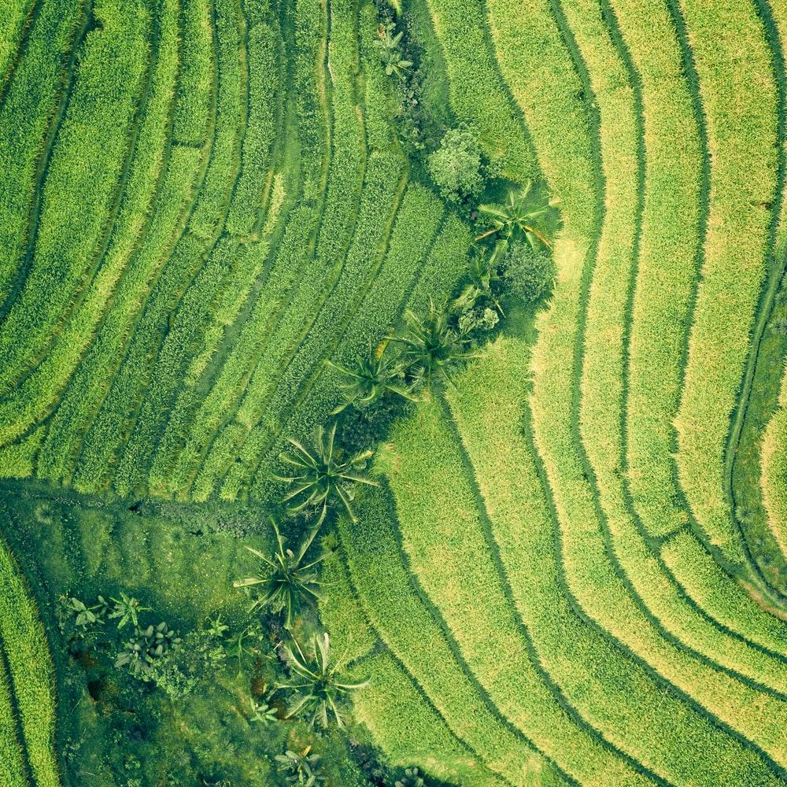
AI PHALANX

Slide 2

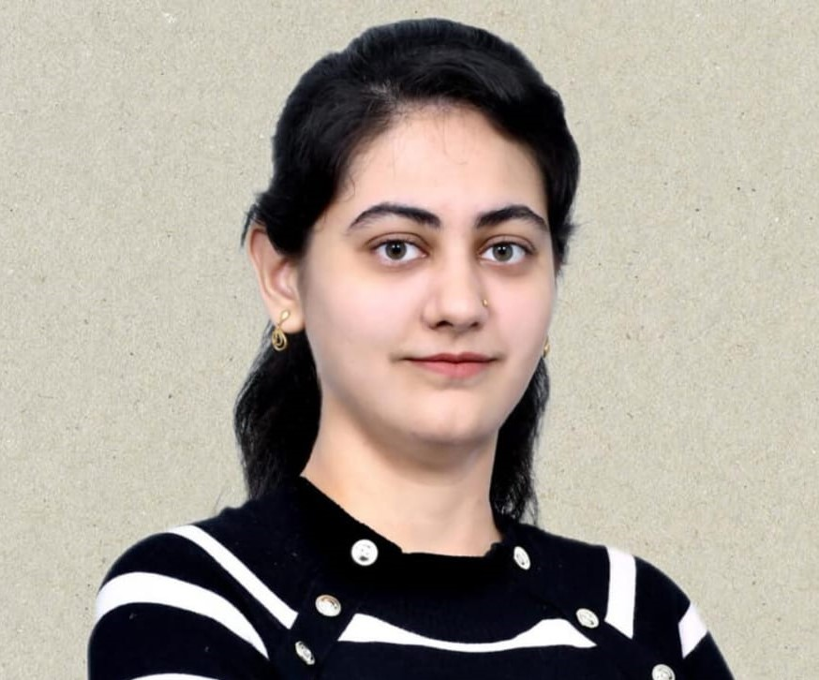

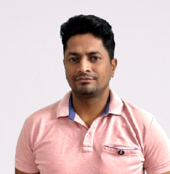

Meet Our Team
MANISH
SALONI
PRIYANKA
SANKAR
SACHIN
AI Phalanx: Empowering Decisions for a Sustainable Future

Slide 3
API INNOVATION
Importance of APIs in the Current AI World
Seamless Integration
Scalability
Real-Time Decision-Making
Interoperability
Innovations to Bring to the Table
Autonomous API Adaptation
Sustainability-Focused APIs
Customizable AI Pipelines
Enhanced Explainability in APIs

Slide 4
Climate Finance Data
Why it is important :
Funds efforts to address climate challenges.
Reduces emissions and aids climate adaptation.
Promotes sustainable development.
How Financial Industry will benefit:
Helps manage risks and identify opportunities.
Aids in meeting regulations.
Supports sustainable growth.
In recent years, the IMF has increasingly focused on how climate change affects global economic stability.
IMF promotes global economic cooperation and stability.
Ensures the stability of the international monetary system.
Provides financial assistance to countries in need.
The IMF, in collaboration with other international organizations, has developed a set of indicators that help track and measure how economic activities are affecting climate change. These indicators are grouped into six key categories to provide a comprehensive understanding of the connection between the economy and climate. Here's an easy-to-understand breakdown of these categories:
Greenhouse Gas (GHG) Emissions | Mitigation | Adaptation
Transition to a Low-Carbon Economy | . Climate Finance | Climate and Weather

Slide 5

Our Goal is to develop and website and API schema which will allow us to achieve below key metrics. 1. Tracking Progress Key Indicators: Develop metrics that measure emissions reductions, renewable energy adoption, and climate adaptation investments. 2. Data Integration: Combine IMF Climate Finance Data from website and create a proper data model for a holistic view. 3. Define the API Schema as per Open AI standard. Visualization Tools: Build dashboards to showcase progress in real-time, tailored for policymakers and the public. Risk : There is no correct and structure data. Data preparation will take significant time.
Hackathon Goal

Slide 6
Lean Canvas
Problem Statement
By utilize the IMF’s Climate Finance Data to build APIs that integrate financial metrics related to climate mitigation and adaptation efforts. The indicators provide a foundation for creating tools that assess climate related risks, model financial flows for green projects, and guide sustainable decision-making in banking and investment
Key Delivarables
Data Simplification
API Schema definition
Website to show key metrics
Risks and Vulnerabilities Analysis
Insight Analytics using AI
Value Propositions
It will be an unique website with peroformant API which allow user to get the insight about current financial data and its indicator.
Tech Stack
Python
Open AI
Jupyter Lab
Data Gym
AI
Customer Segments
Financial institute
Govermenmt Organisation
IMF Body
Key Resources
IMF: https://climatedata.imf.org/pages/climate-finance
Cost Structure
Insert your content
Revenue Streams
Open to all

Slide 7
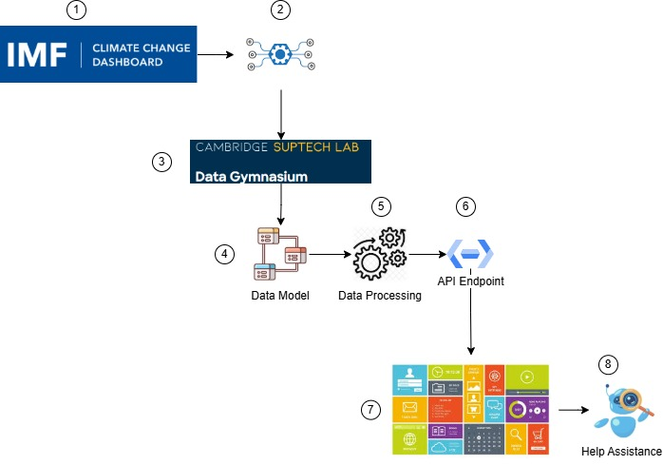
Architecture Diagram

Slide 8
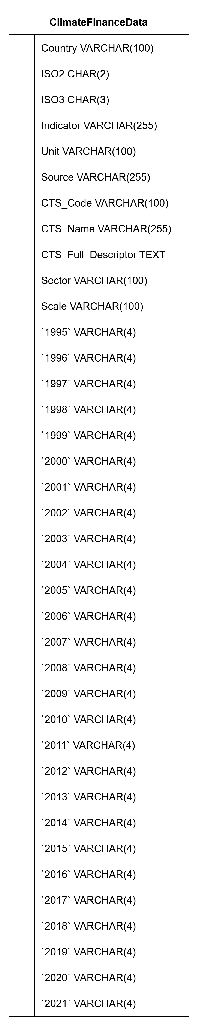
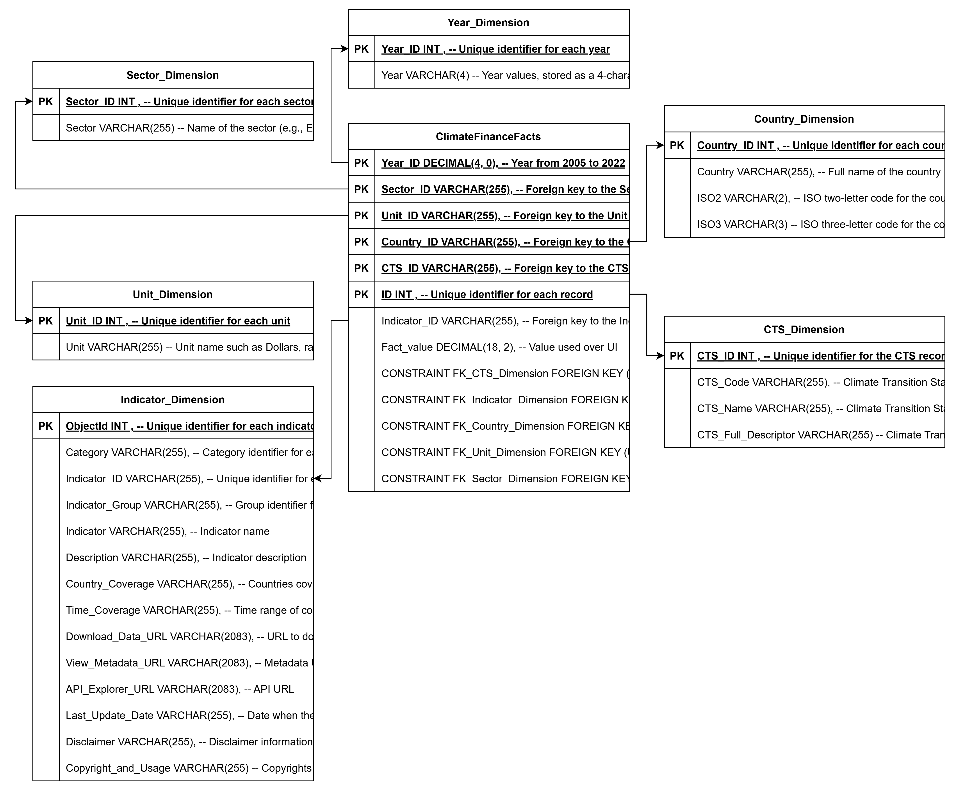
Data Model

Slide 9
Demo

Slide 10
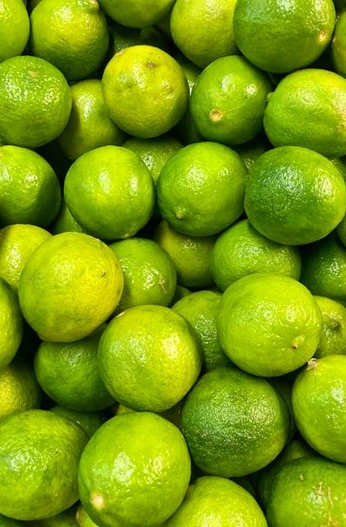
Milestone
Data Model
New Data Model from IMF Data
Data Transformation
Data Clean up using Python ETL
API Schema
API Schema Design as per Open AI standard
Web Tool
A wesite to presnt these metrics
AI Analytics
Analytics to showcase the insight
Final Demo
Presentation on 13th Dec

Slide 11
Future Scope
1. Real-time data access: Provides current climate data to support immediate decision-making.
2. Climate-finance integration: Combines climate data with financial and economic models to assess risk.
3. Scalability: Enhances infrastructure to handle increasing volumes of climate-related data.
4. AI/ML analytics: Uses advanced methods to predict climate impacts and risks.
5. Automation tools: Streamlines data-driven decision-making.
6. Sustainability policies: Supports data-backed, climate-focused policy development.
7. Visualization: Tools to display complex data for easy analysis.

