Slide 1
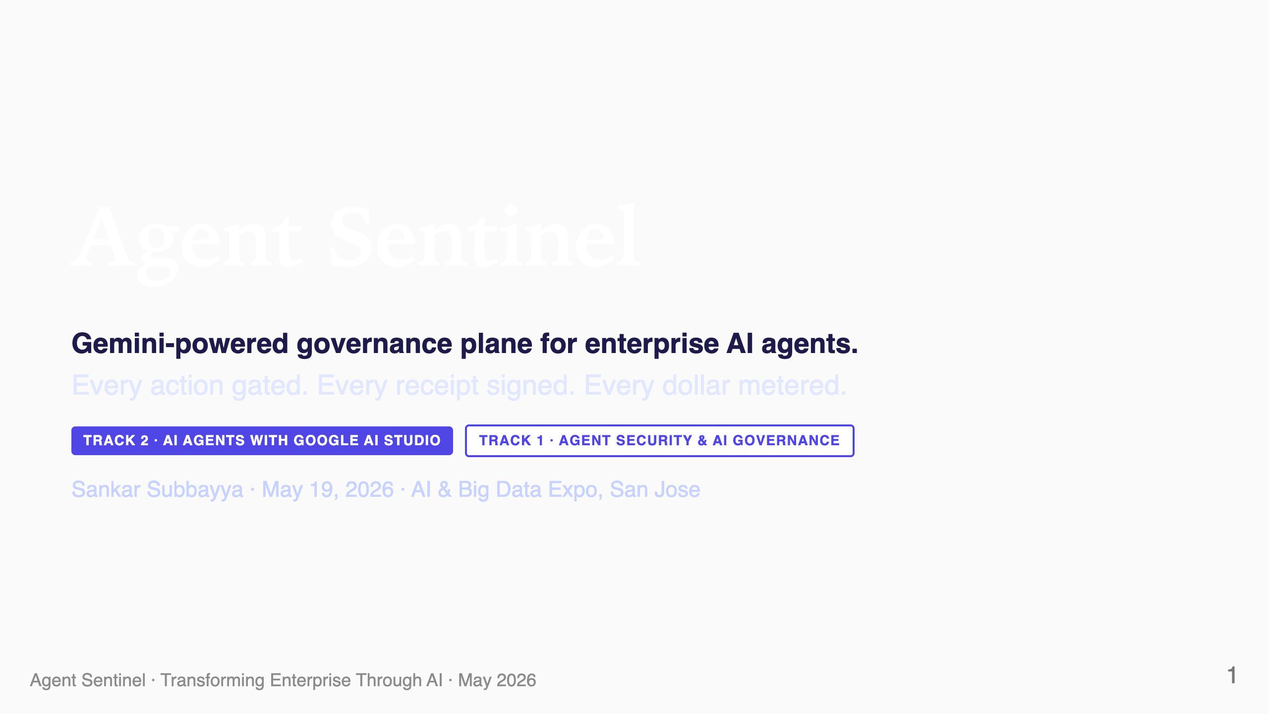
Notes:
SPEAKER NOTES — Slide 1 (Title, ~10s) Open with the one-liner: "Sentinel is a Gemini-powered governance plane for enterprise AI agents." Don't read the tracks aloud; the badges set context for the judges silently. Hold the slide for ~5 seconds, then advance.

Slide 2
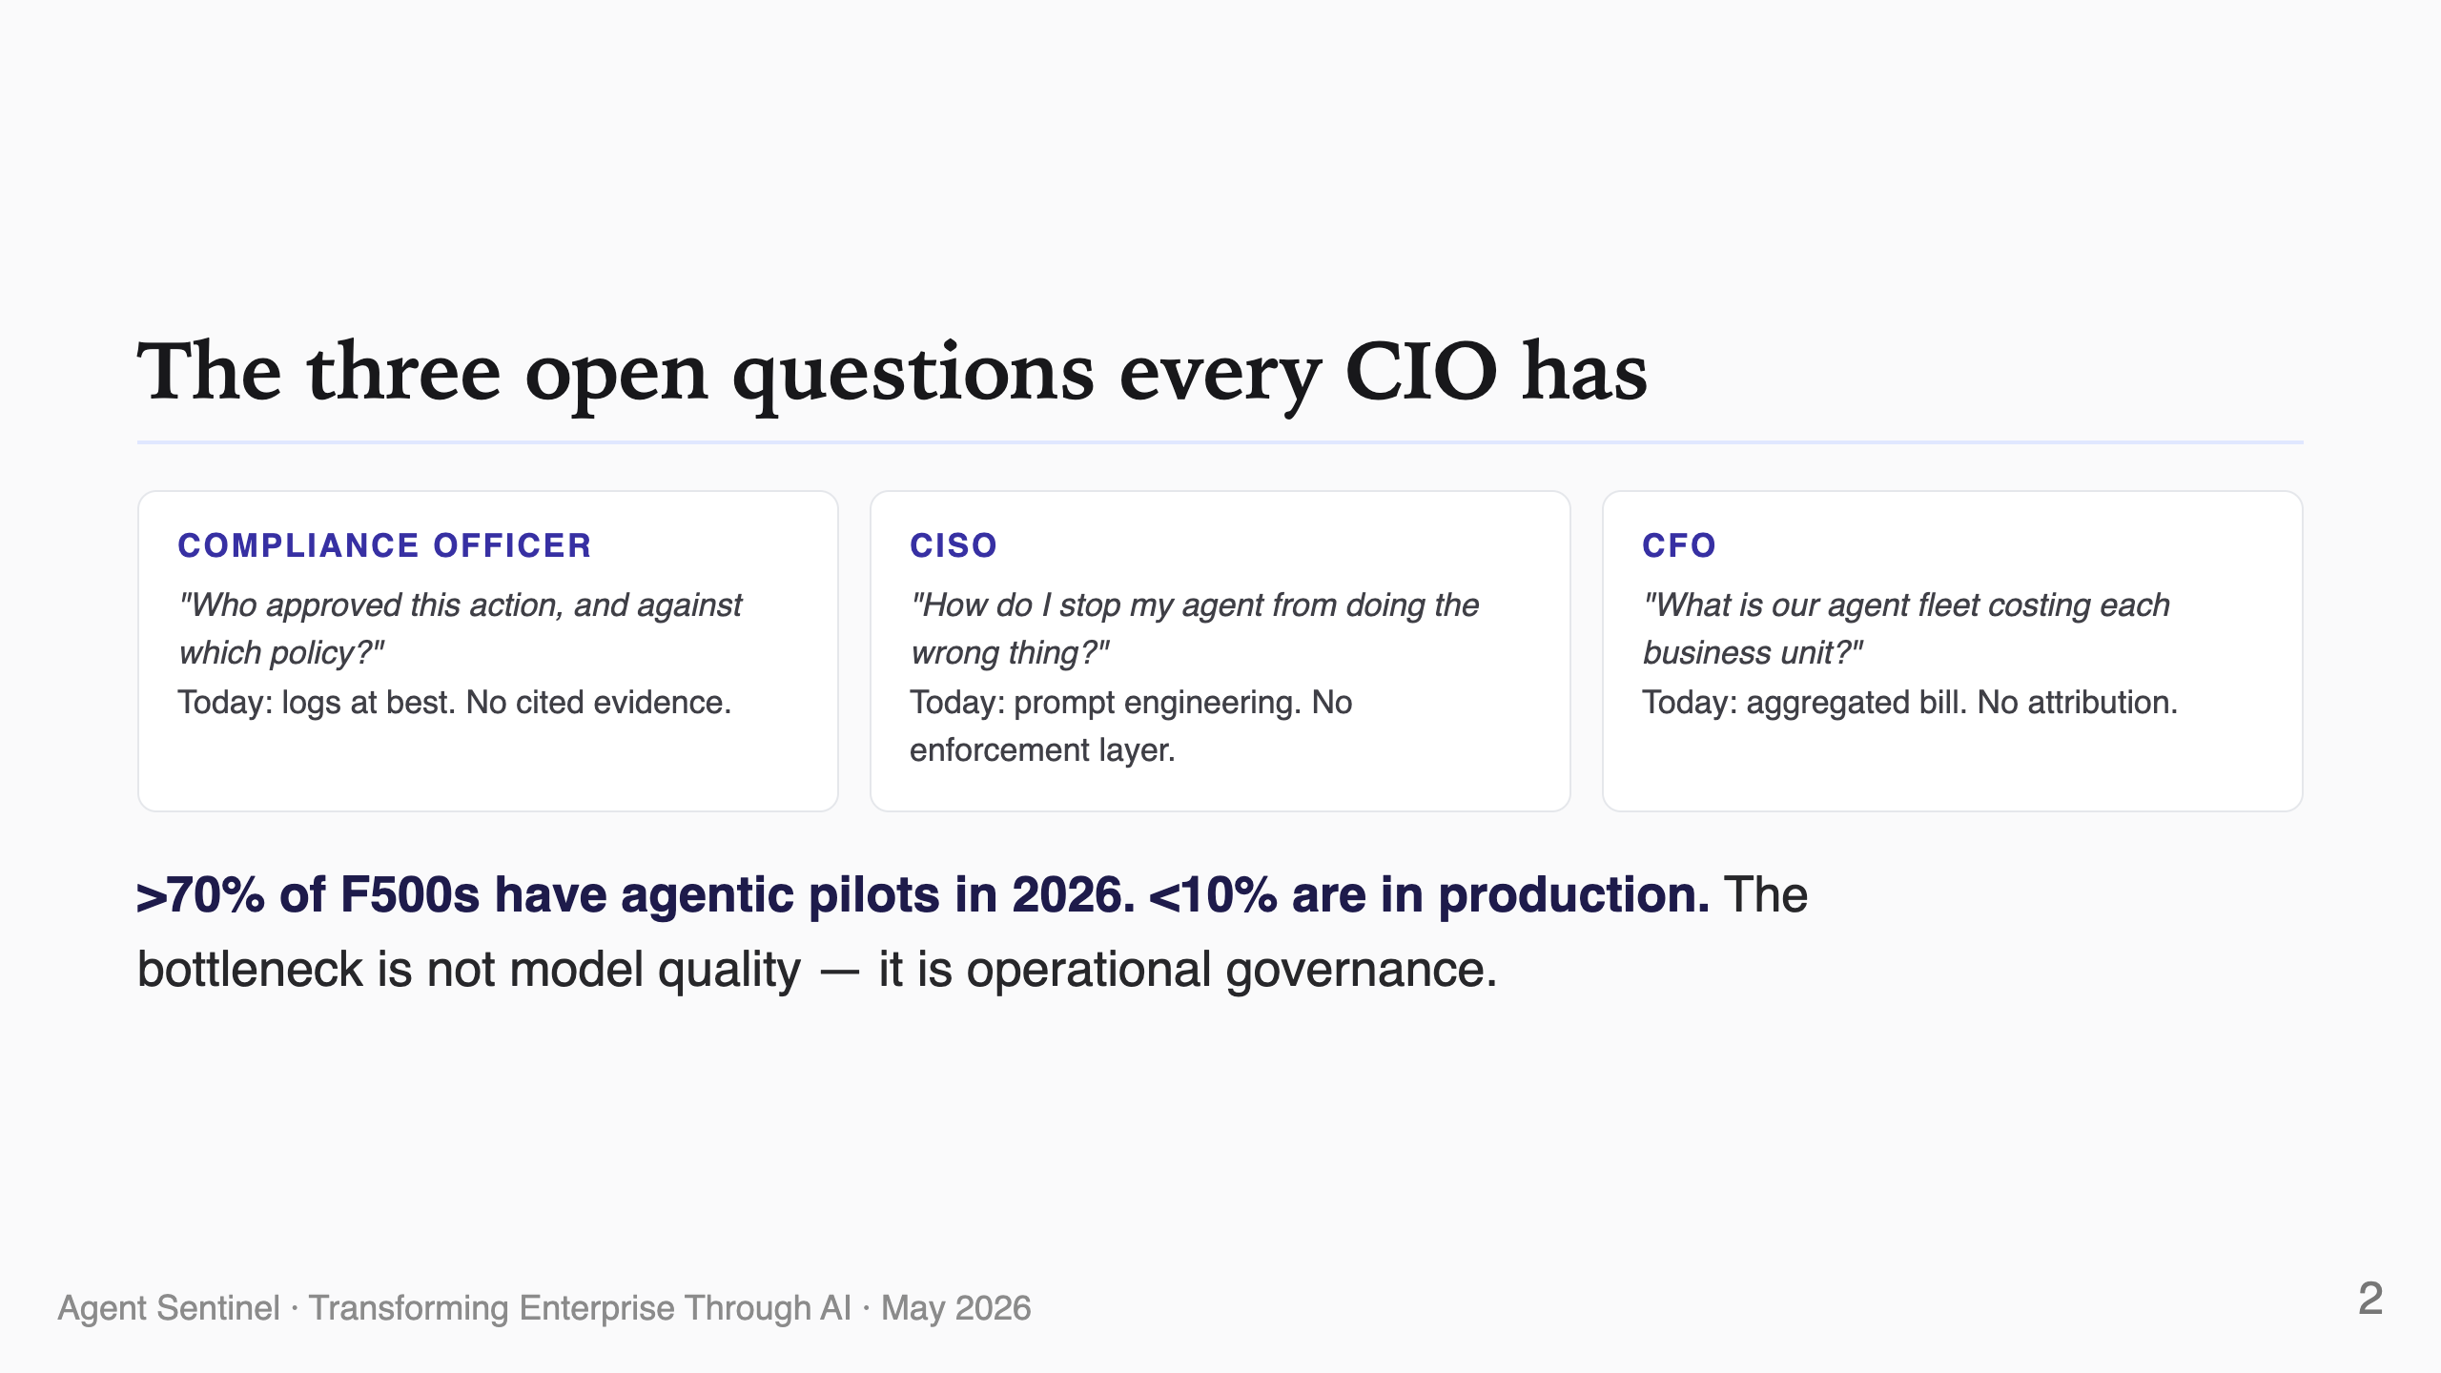
Notes:
SPEAKER NOTES — Slide 2 (~25s) Three stakeholders, three open questions, all blocking production deployment. Land the Gartner-style number: 70% pilot, 10% prod — the gap is governance. Don't dwell on each card; pace it.

Slide 3
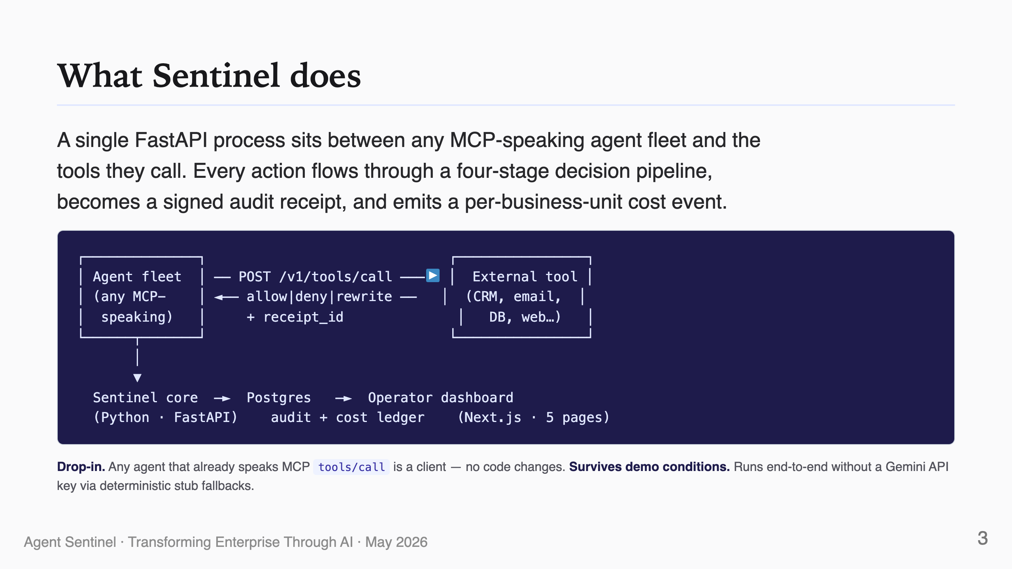
Notes:
SPEAKER NOTES — Slide 3 (~25s) This is the "what is it" slide. Emphasize: drop-in, no agent code changes, one Python process, one Postgres, one dashboard. The "runs without a Gemini key" line is for the judges' anxiety — they don't need to fumble with credentials at the demo table.

Slide 4
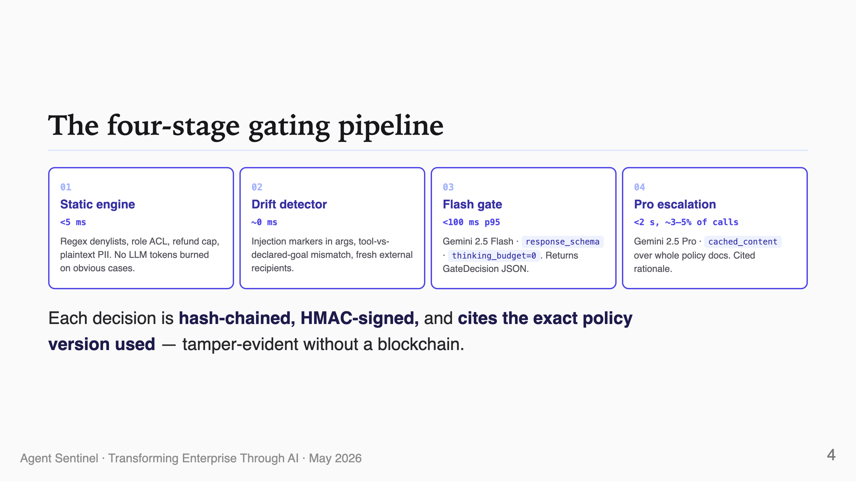
Notes:
SPEAKER NOTES — Slide 4 (~30s) This is the technical headline. Static and drift are cheap; Flash gates every call; Pro is the senior reasoner that consumes whole policy docs. The "no chunking, no vector DB" line lands well — Pro reads the whole policy in long context via Cached Content.

Slide 5
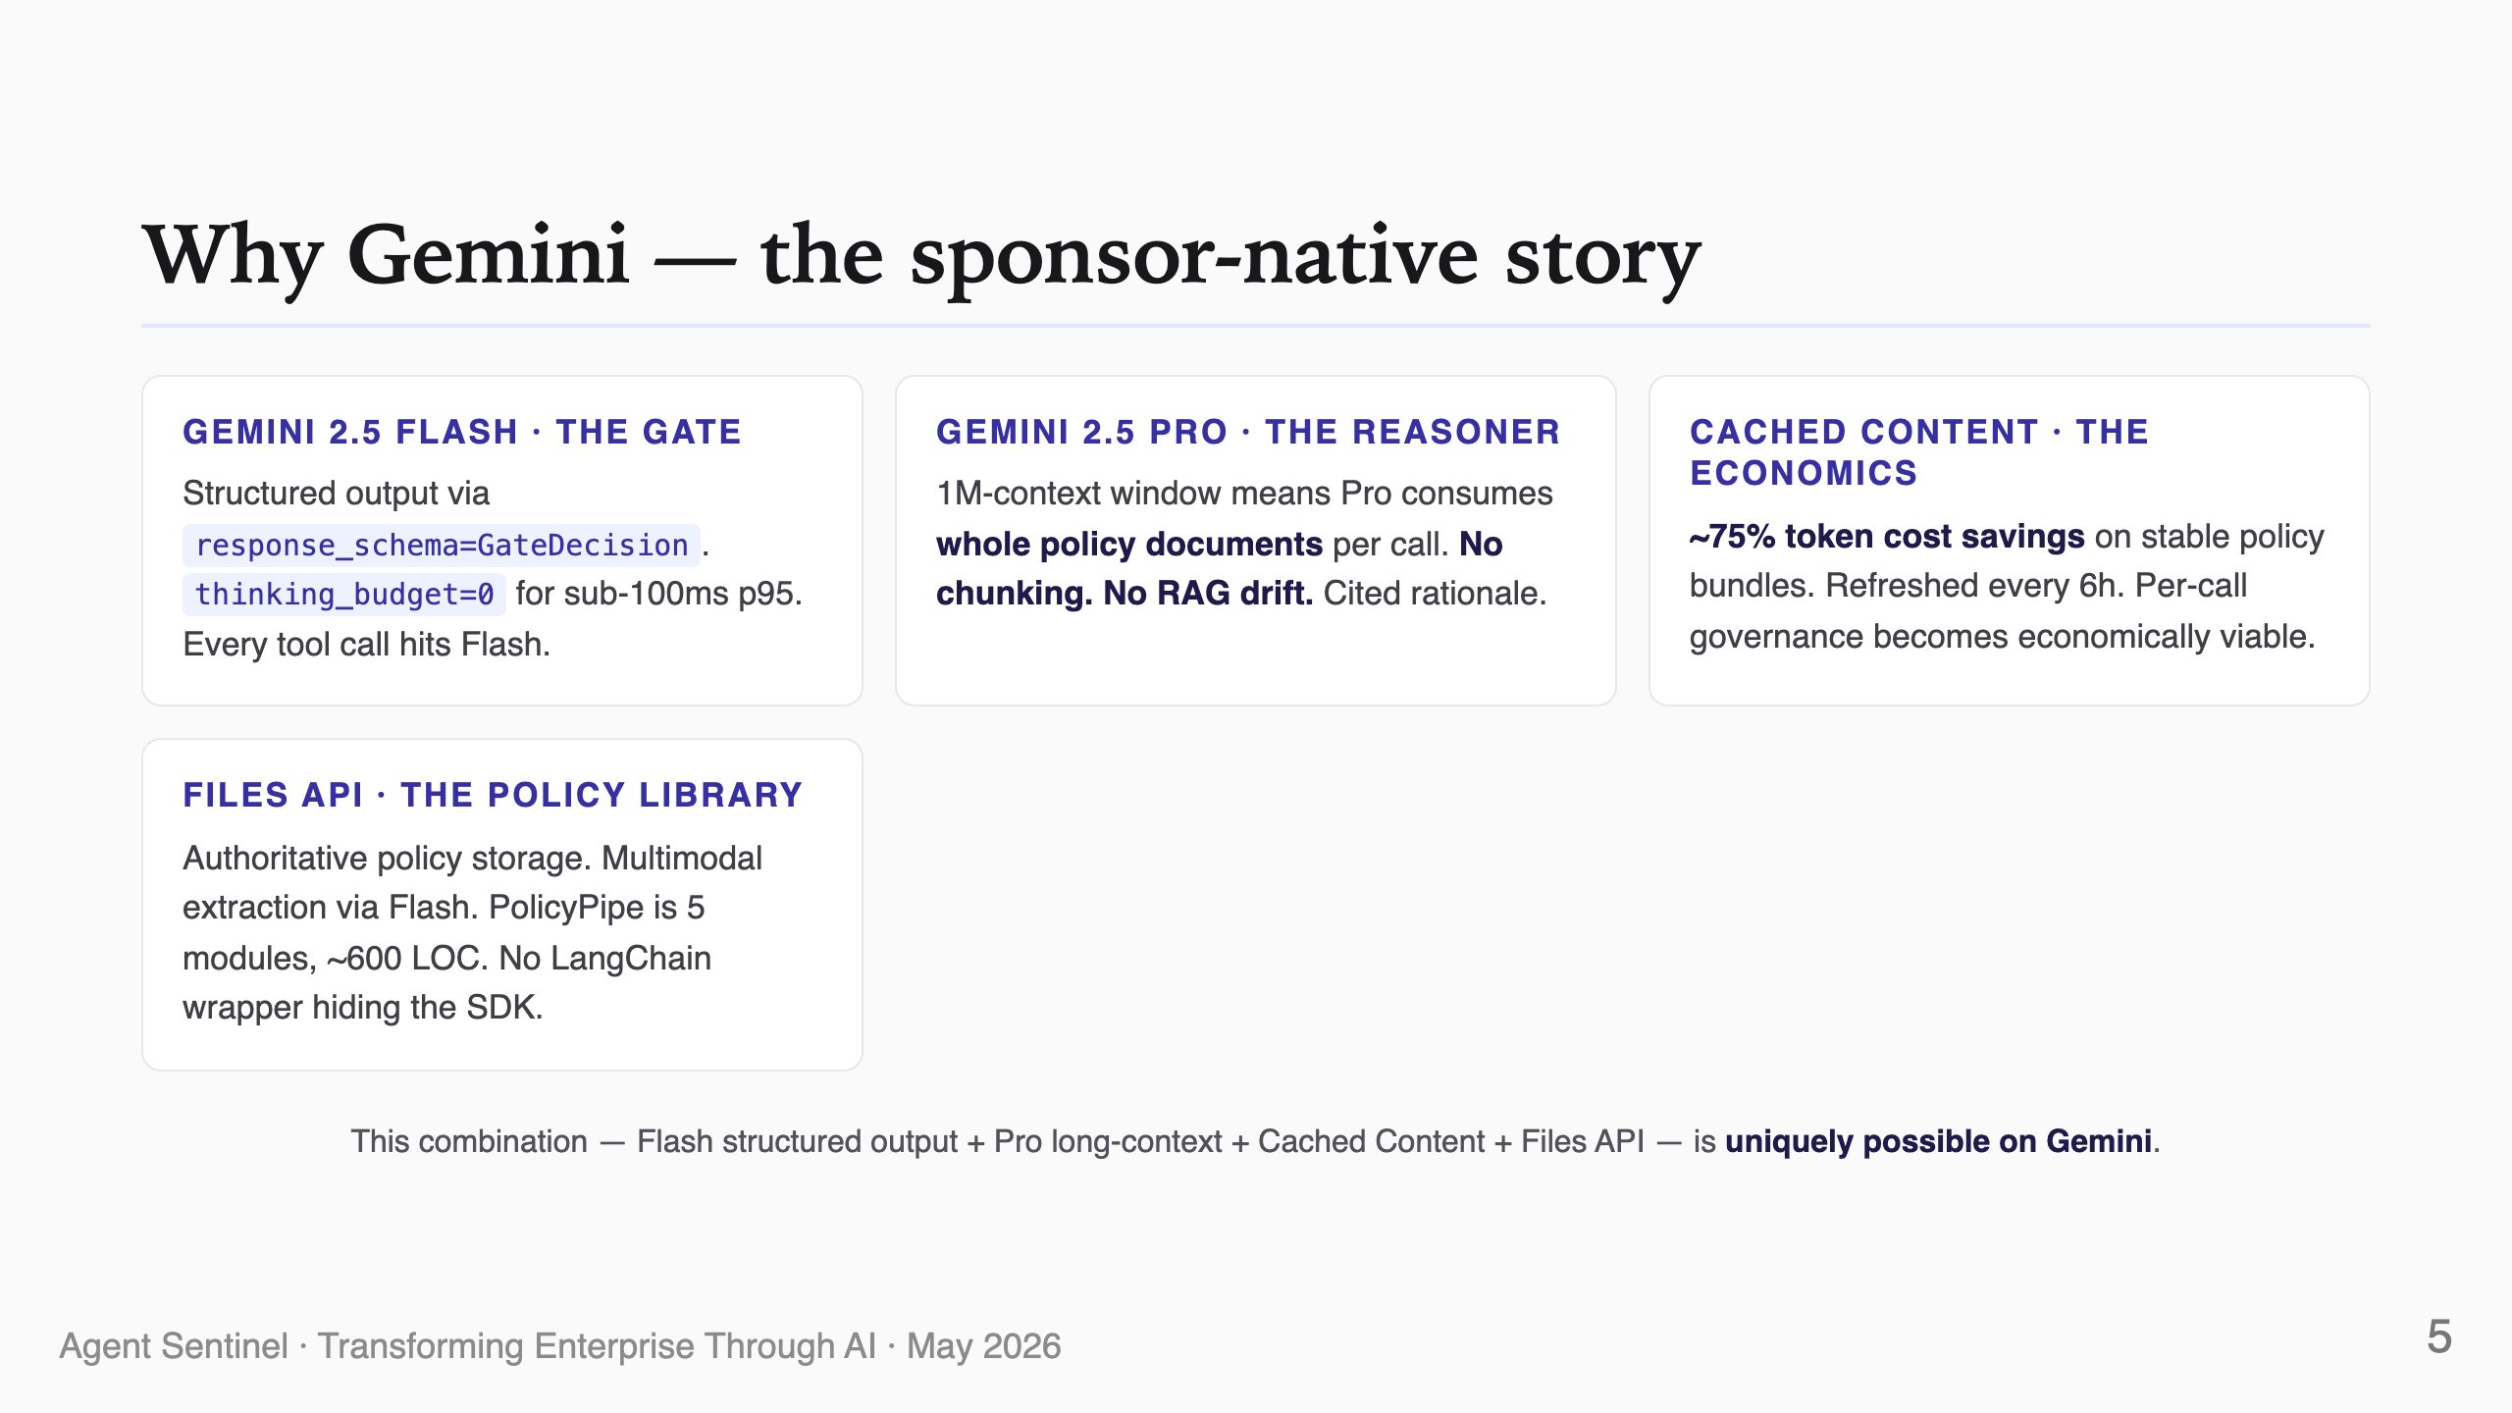
Notes:
SPEAKER NOTES — Slide 5 (~25s) Sponsor slide. Hit each Gemini-specific feature by name. The closing line is the differentiator: this stack is not portable to a different model family — Pro's 1M context + Cached Content is the moat.

Slide 6
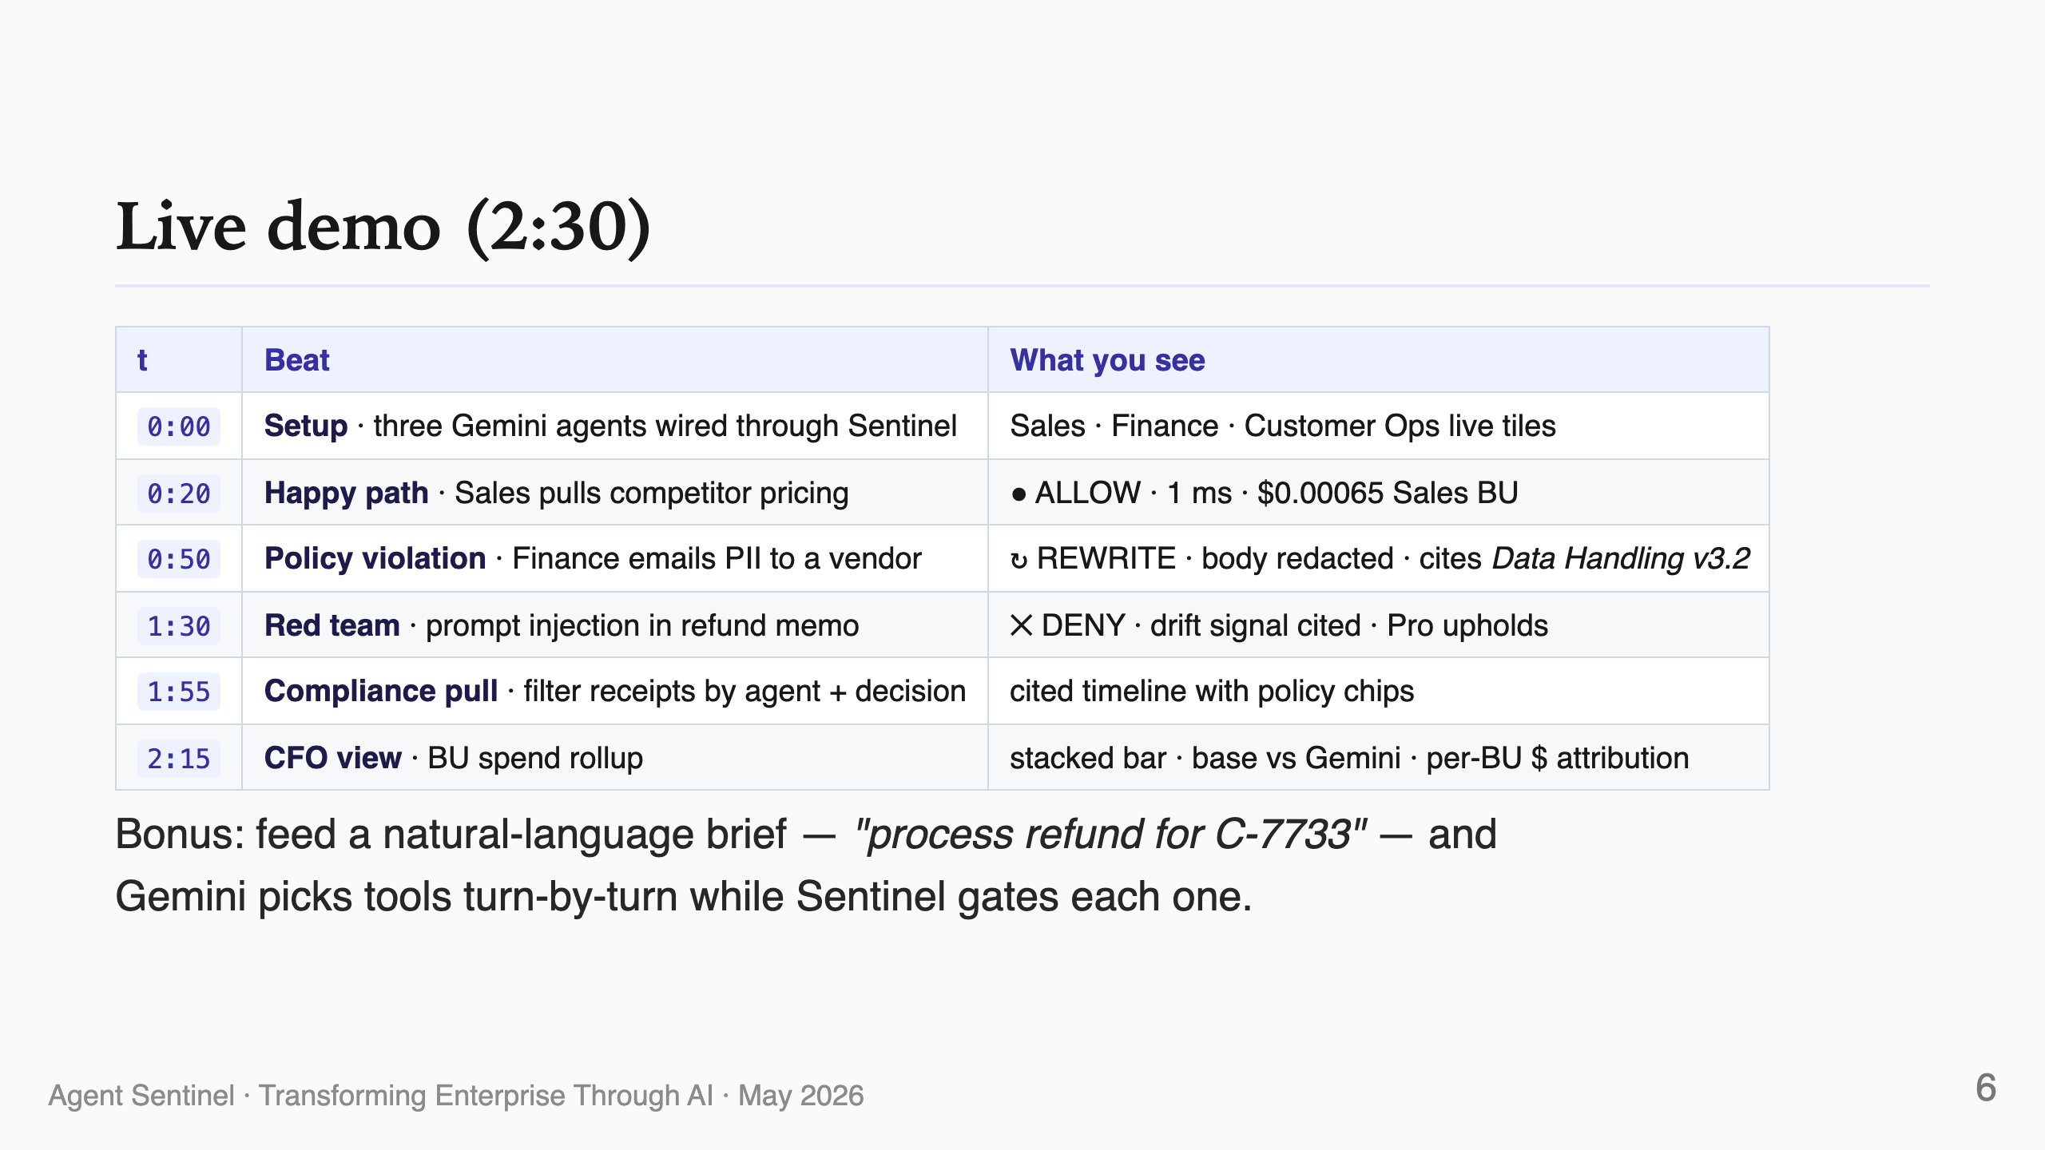
Notes:
SPEAKER NOTES — Slide 6 (~5s — then switch to live demo) This slide is a roadmap of what's about to happen. Don't read each beat — swipe past it and switch to the dashboard at http://127.0.0.1:3030. If the live demo flakes, fall back to the recorded 2:30 video.

Slide 7
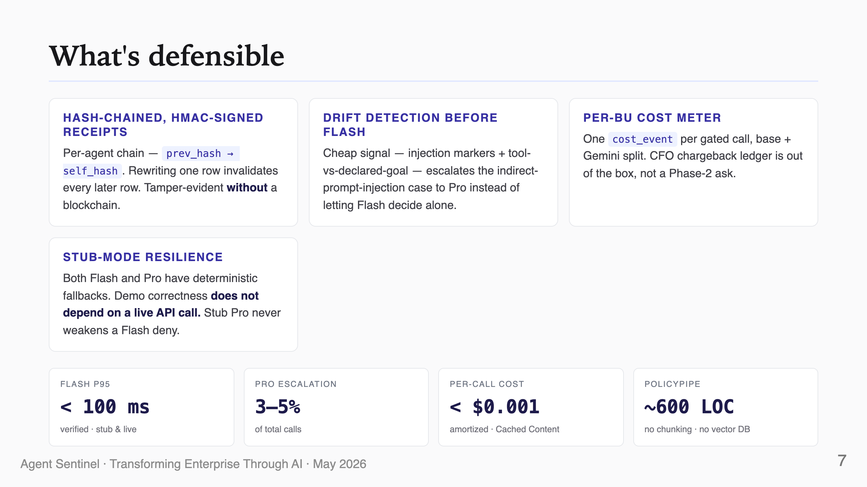
Notes:
SPEAKER NOTES — Slide 7 (~30s) "What's defensible" = the originality slide. Hash-chained receipts, drift detection, cost meter, stub mode — each is one of the things that won't exist in a generic "agent observability" tool. The KPI strip lands the metrics from the PRD's success criteria.

Slide 8
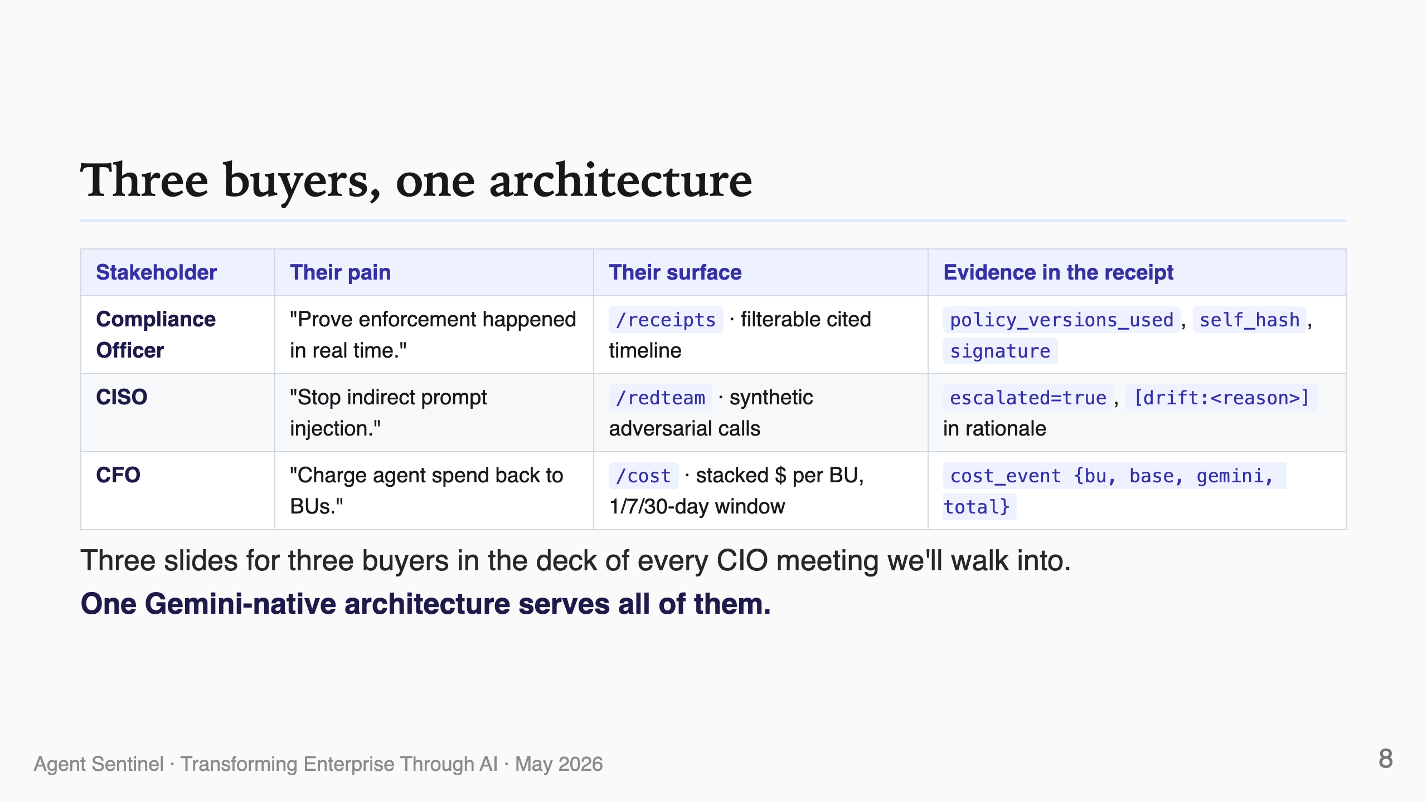
Notes:
SPEAKER NOTES — Slide 8 (~25s) Business value slide. Each row maps a stakeholder to a UI surface to the specific receipt fields that satisfy their requirement. This is the "one product, three buyers" punch.

Slide 9
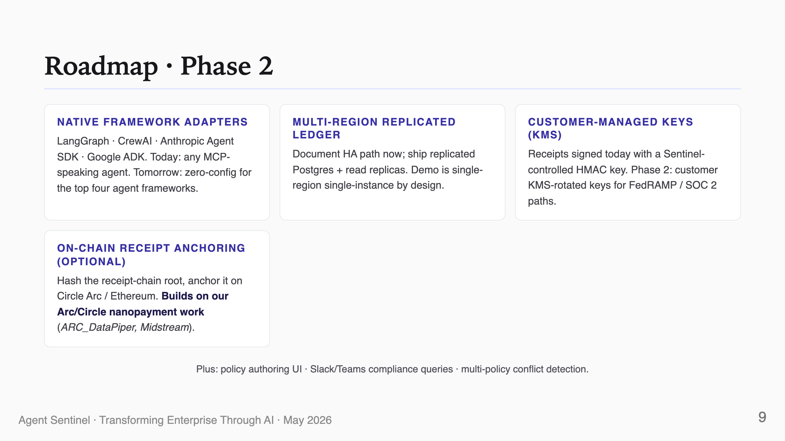
Notes:
SPEAKER NOTES — Slide 9 (~20s) Roadmap = adjacency moats. Native adapters expand TAM; HA is the enterprise gate; KMS is FedRAMP; on-chain anchoring connects to my Arc/Circle work (which won the Gemini sponsor prize at the prior agentic_economy hackathon via mev-payment-app and gas-oracle). The portfolio carries.

Slide 10
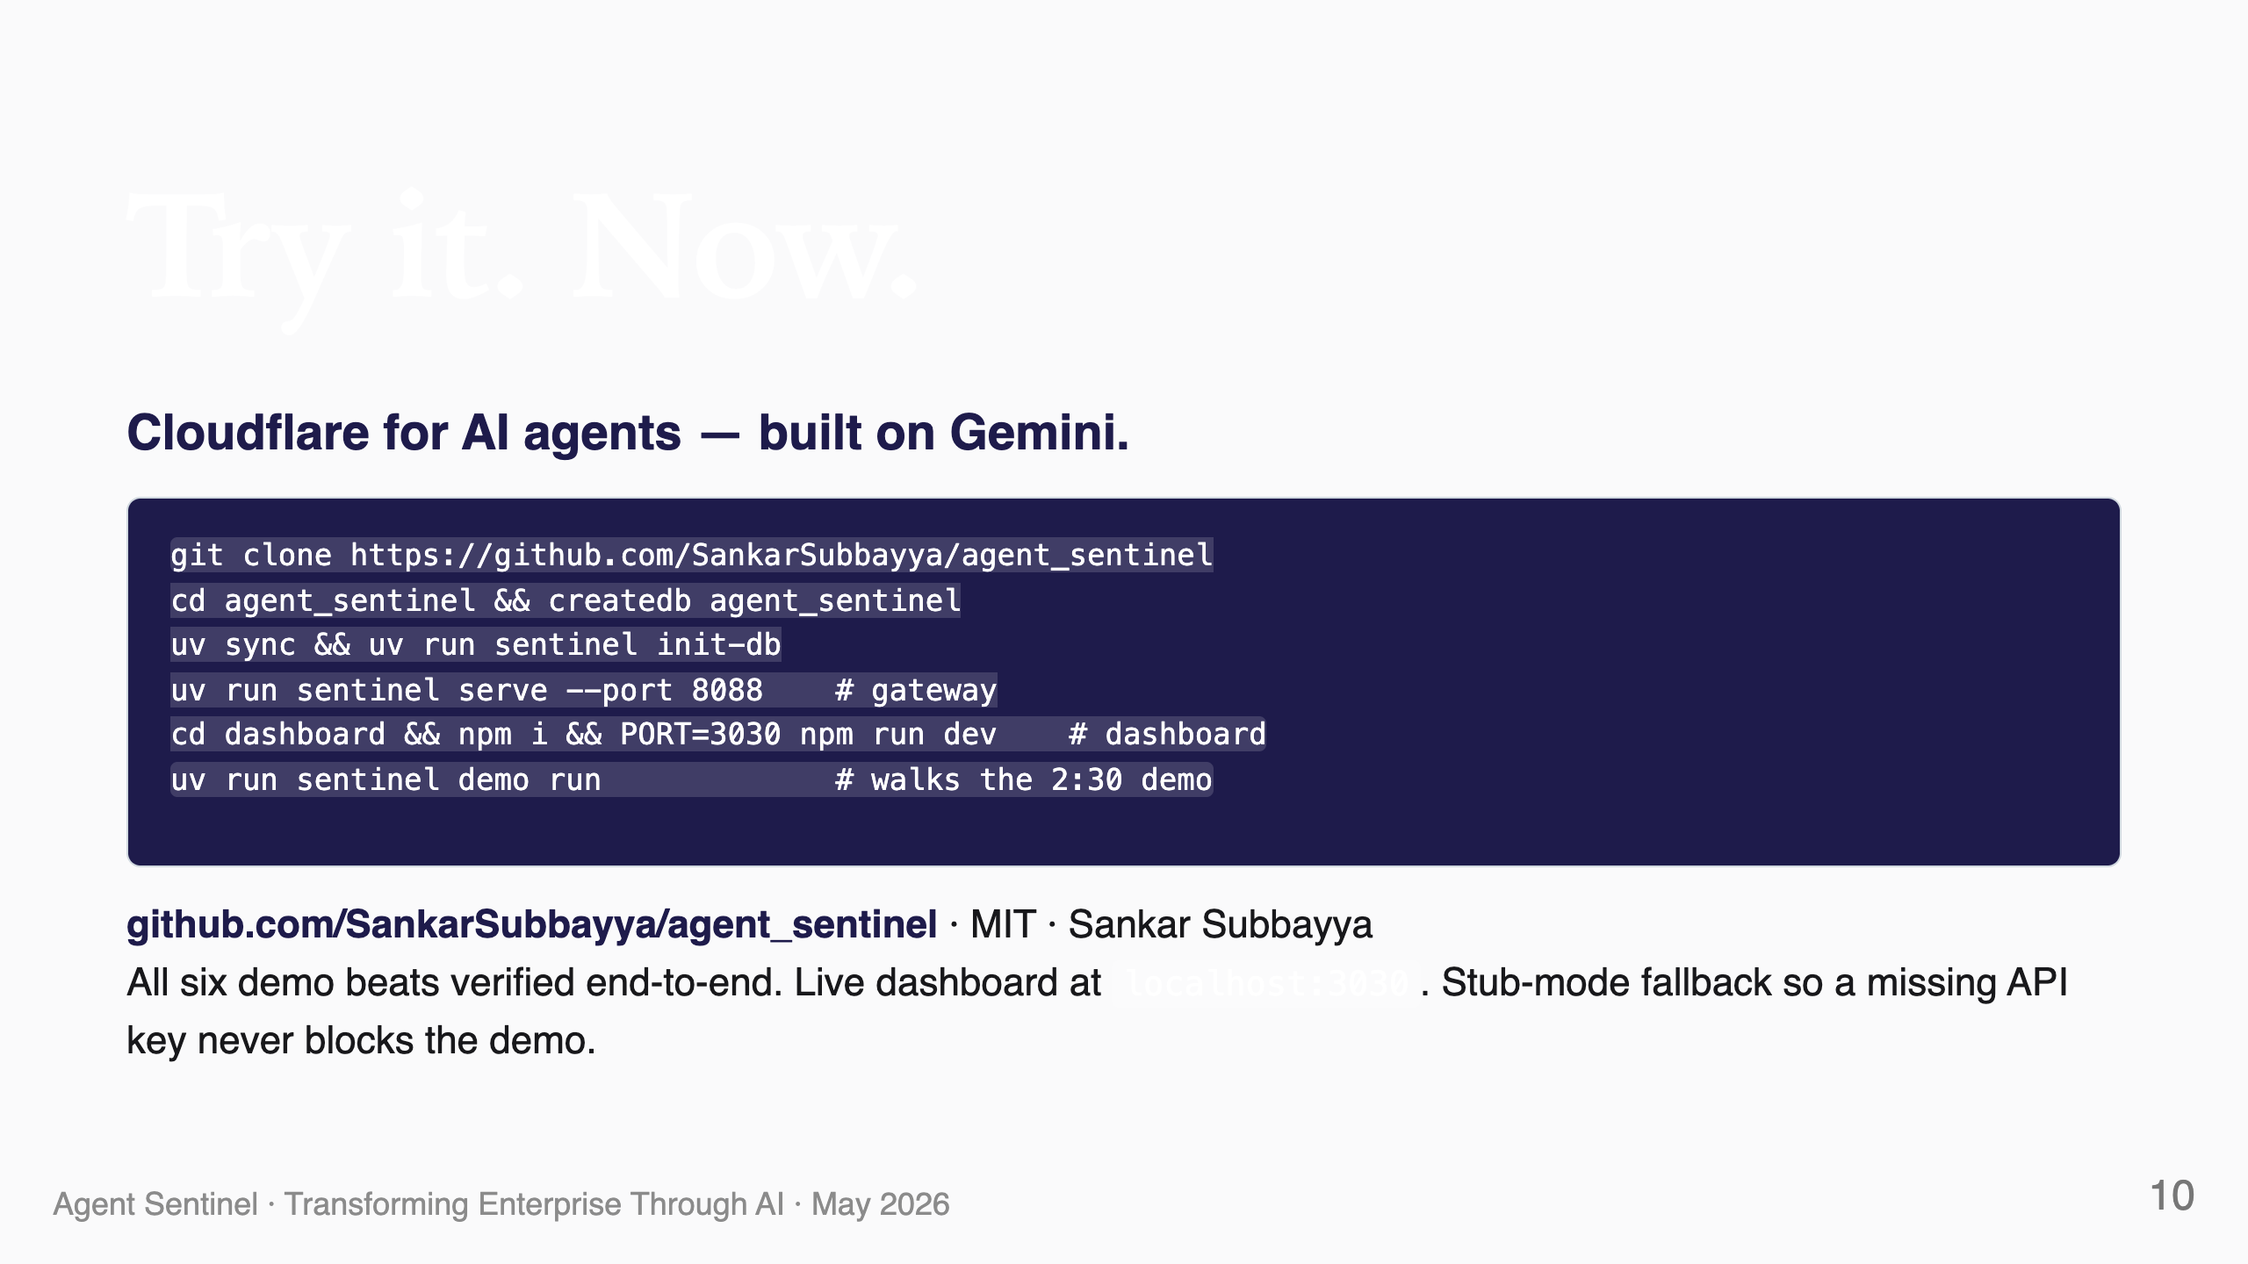
Notes:
SPEAKER NOTES — Slide 10 (~15s, closing) End with the same one-liner you opened with. Show the four commands; they fit in a tweet. Repeat the URL. Thank the sponsors (Google AI Studio · Gemini). Don't take a curtain call — the demo was the curtain call.

