Slide 1
Design and Implementation of Online Shopping System
By
Nivas Kanmanthareddy
Sri Gayatri Mudimbi
Keerthana Sankaramaddi
Asha Jyothi Mannem

Slide 2
Introduction
In today’s fast-changing business environment, it’s extremely important to be able to respond to client needs in the most effective and timely manner.
E-commerce is rapidly gaining traction as an accepted and used business model. More and more traders are setting up websites that provide the functionality of conducting business transactions over the web.
It is reasonable to say that the process of purchasing on the Web is becoming more common.
If your customers wish to see your business online and have instant access to your products or services.
Online Shopping is a lifestyle e-commerce website, which retails various fashion and lifestyle products. This project allows viewing various products available enables registered users to purchase desired products instantly using Credit cards and can place order by using Cash on Delivery option.

Slide 3
The goal of this project is to develop a general-purpose e-commerce store where products such as clothing and electronics can be purchased from the comfort of home via the internet.
This project provides an easy access to Administrators and Managers to view orders placed using Instant Pay options.
An online store is a virtual store on the Internet where customers can browse the catalog and select the products that interest them.
The selected items may be collected in a shopping cart. At checkout time, the items in the shopping cart will be presented as an order. At that time, more information will be needed to complete the transaction.
Usually, the customer will be asked to fill or select a billing address, a shipping address, a shipping option, and payment information such as a credit card number.
An email notification is sent to the customer as soon as the order is placed

Slide 4
To develop an e-commerce website, several Technologies must be studied and understood.
These include multi-tiered architecture, server and client-side scripting techniques, implementation technologies such as HTML, CSS, JAVASCRIPT, programming language C#, Java, and relational databases.
This is a project with the objective to develop a basic website where a consumer is provided with a shopping cart site and to know about the technologies used to develop such an application.

Slide 5
Overview
Any member can register and view available products.
Only registered member can purchase multiple products regardless of quantity.
Contact Us page is available to contact Admin for queries.
There are three roles available: Visitor, User and Admin.
Visitor can view available products.
User can view and purchase products.
An Admin has some extra privilege including all privilege of visitor and user.
Admin can add products, edit product information and add/remove product.
Admin can add user, edit user information, and can remove user.
Admin can ship order to user based on order placed by sending confirmation mail.

Slide 6
Web Pages details:
Home Page
Electronics Page
Contact Us Page
Admin Page
Login Page
Register Page

Slide 7
TECHNICAL TOOLS:
The various system tools that have been used in developing both the front end and the back end of the project are:
FRONT END: JSP, HTML, CSS, JAVA SCRIPT
Java Server Pages (JSP): The various pages of the application are designed using JSP. The Java Server Pages component is a type of Java Servlet intended to act as a user interface for Java web applications.
Web developers write JSPs as text files that combine HTML or XHTML code, XML elements, and embedded JSP actions and commands.
JSPs are used to collect user input about webpage.
HTML (Hyper Text Markup Language) HTML is a syntax used to format a text document on the web.

Slide 8
CSS (Cascading Style Sheets) CSS is a style sheet language used for describing the look and formatting of a document written in a markup language.
Java Script JS is a dynamic computer programming language. It is most used as part of web browsers, whose implementations allow client-side scripts to interact with the user, control the browser, communicate asynchronously, and alter the document content that is displayed.
Java Script is used to create popup windows displaying different alerts in the system like “User registered successfully”,” Product added to cart” etc.
BACK END: The back end is implemented using MySQL which is used to design the databases.
MySQL is the world's second most widely used open-source relational database management system (RDBMS).
The SQL phrase stands for Structured Query Language.

Slide 9
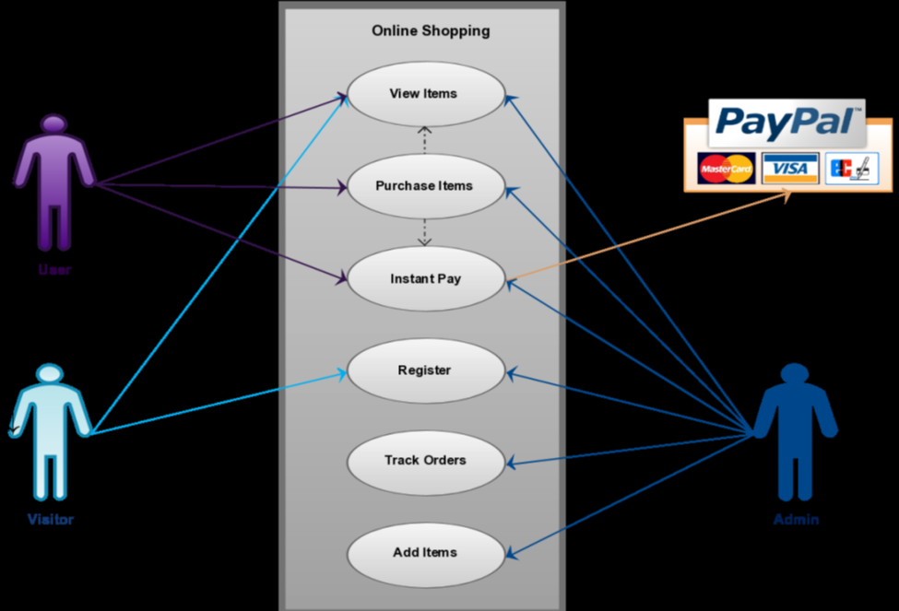
SYSTEM REQUREMENTS:
USE-CASE DIAGRAM:

Slide 10
ONLINE SHOPPING PORTAL:
Anyone can view Online Shopping portal and available products, but every user must login by his/her Username and password to purchase or order products.
Unregistered members can register by navigating to registration page. Only Admin will have access to modify roles, by default developer can only be an ‘Admin’.
Once user register site, his default role will be ‘User’.

Slide 11
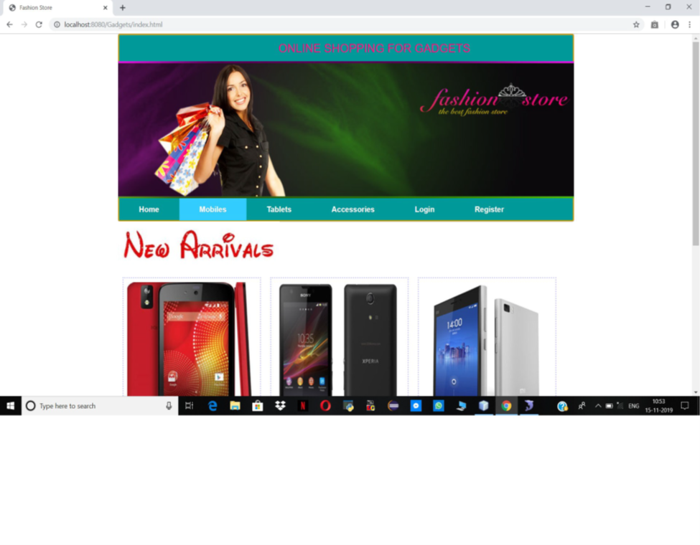
Home Page
The Home Screen will consist of screen were one can browse through the products which we have on our website.

Slide 12
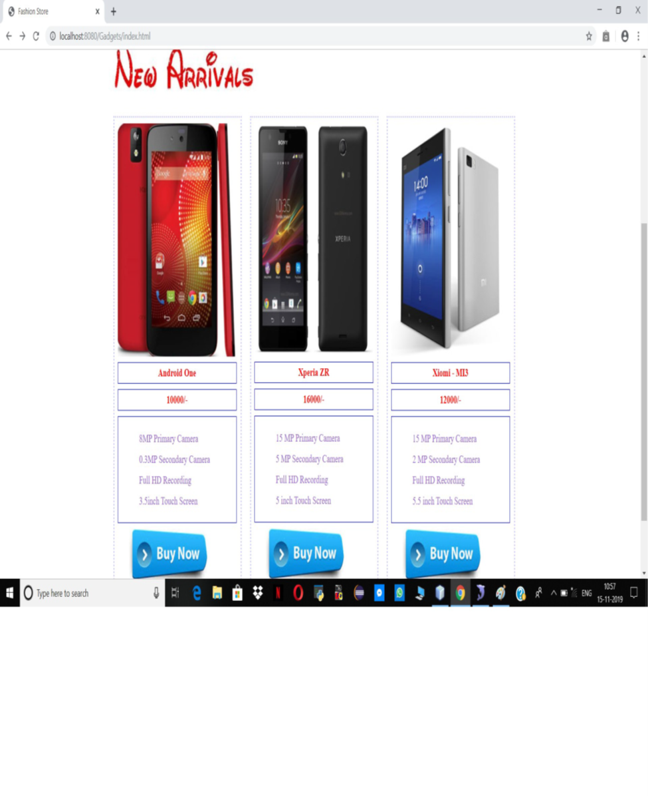
ELECTRONICS PAGE (PRODUCTS)
This page consists of product details. This page appears same for both visitors and users

Slide 13
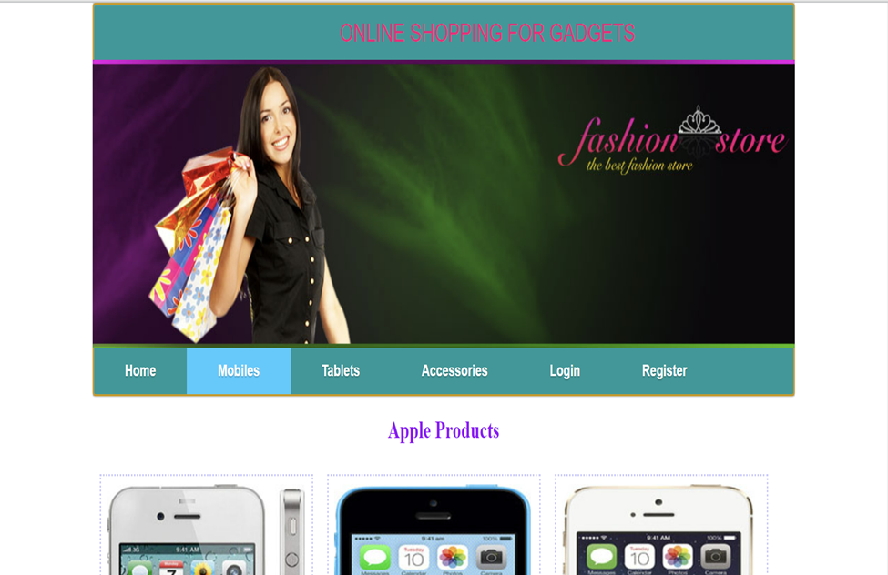
ORDER US PAGE:
Registered users can order desired products from here.

Slide 14
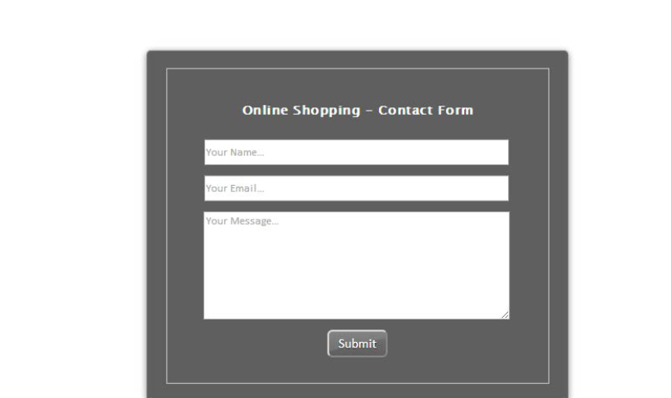
Contact Us Page:
Visitors and Registered users can contact website owners or administrators from here.

Slide 15
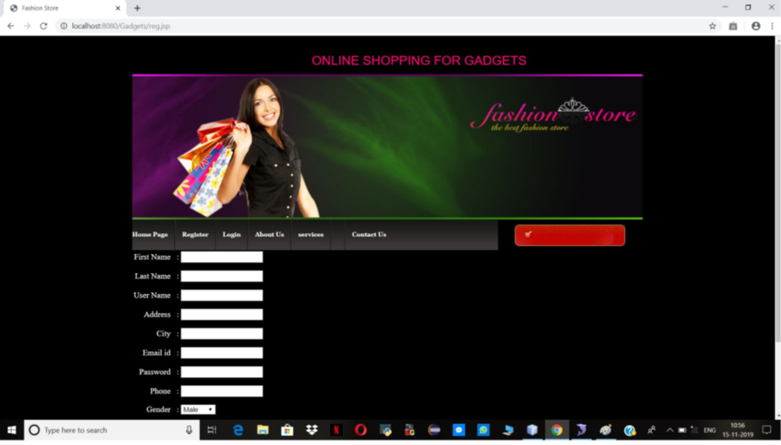
REGISTER PAGE:
New users can register here

Slide 16
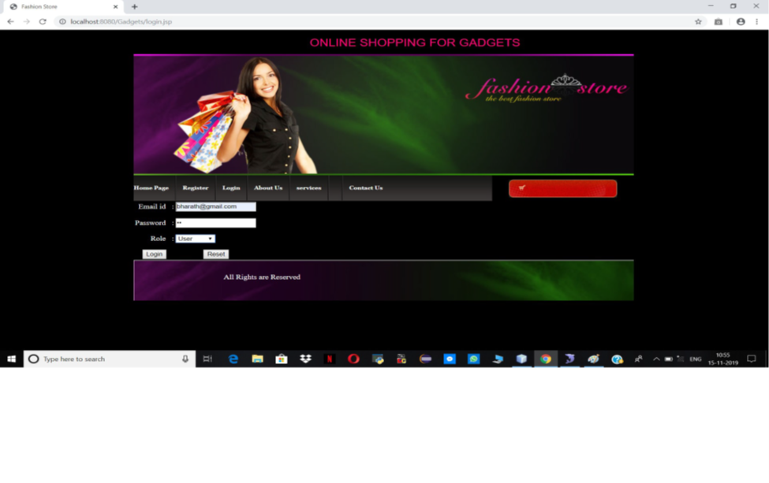
LOGIN PAGE:
Login page for both users and administrators.

Slide 17
Admin Page:
Only difference you see in this page is Role: Admin. User and Admin role will be checked once the page was login and Session [“role”] will be either Admin or User. If credentials belong to Admin, then role will be Admin and if credentials belong to User, then role will be User.

Slide 18
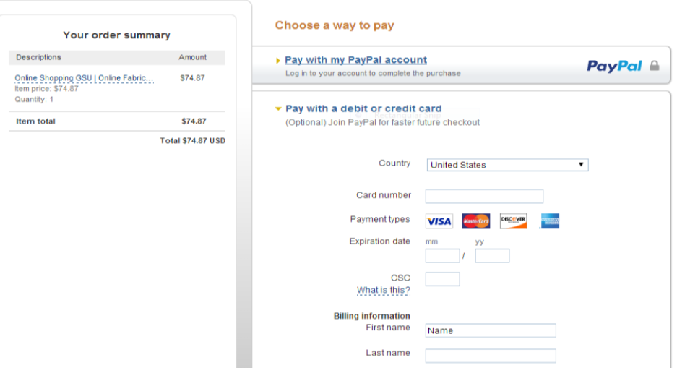
PAYPAL FOR PAYMENT:
Once users order products, they are redirected to a payment page.

Slide 19
E-Commerce Testing Checklist:
Below, we have listed important segments and test cases for eCommerce website testing.
1. Homepage
2. Search
3. Product Details
4. Shopping Cart
5. Payments
6. After-Order Tests
7. Other Tests

Slide 20
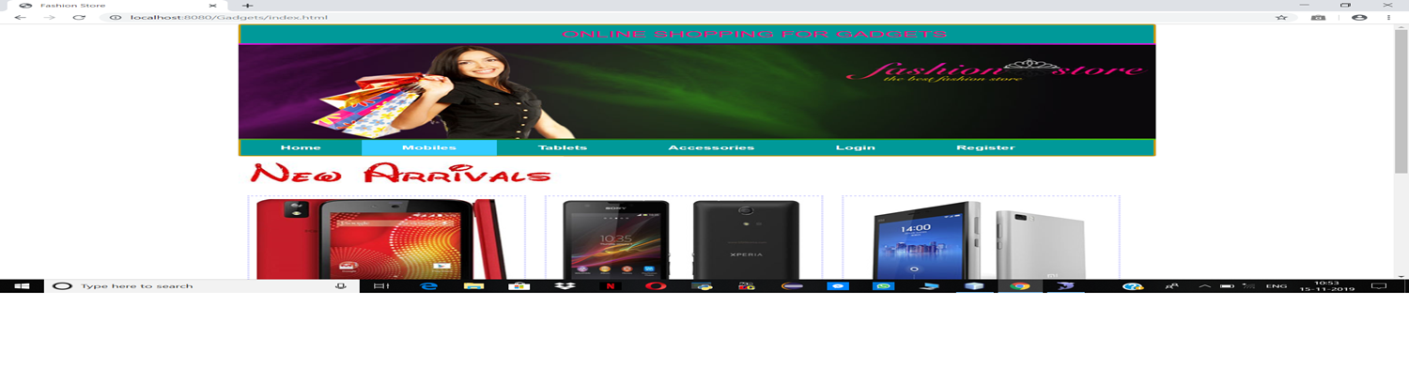
Homepage:
Homepages of retail sites are busy. They have a lot going on.
This is the kind of the clickable image (a slideshow of sorts) that occupies the majority of the page.

Slide 21
The following are a few things to test:
Is it going to auto scroll?
If yes, at what interval will the image be refreshed?
When the user hovers over it, is it still going to scroll to the next one?
Can it be hovered on?
Can it be clicked on?
If yes, is it taking you to the right page and right deal?
Is it loading along with the rest of the page or loads last in comparison to the other elements on the page?
Can the rest of the content be viewed?
Does it render the same way in different browsers and different screen resolutions?

Slide 22
Product Details Page:
Once a user finds a product either through search or by browsing or by clicking on it from the homepage, the user will be taken to the product information page.
Check:
Image or images of the product
Price of the product
Product specifications
Reviews
Check out options
Delivery options
Shipping information
In-stock/Out of stock
Multiple color or variations options
Breadcrumb navigation for the categories (highlighted in Red below). If navigation such as that is displayed, make sure every element of it is functional.

Slide 23
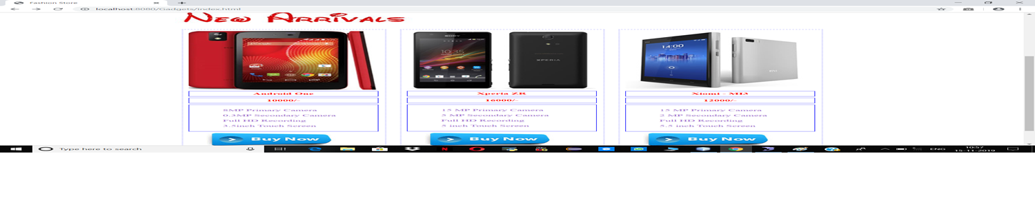
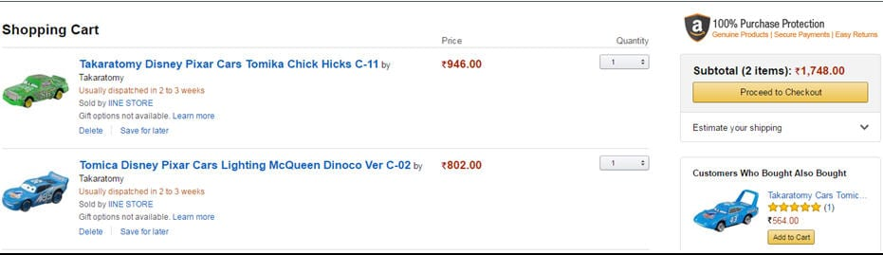
Shopping Cart:
This is the penultimate stage before the user commits to the purchase.

Slide 24
Test the following:
Add items to the cart and continue shopping
If the user adds the same item to the cart while continuing to shop, the item count in the shopping cart should get incremented
All items and their totals should be displayed in the cart
Taxes as per location should be applied
A user can add more items to the cart- total should reflect the same
Update the contents added to the cart- total should reflect that too
Remove items from the cart
Proceed to checkout
Calculate Shipping costs with different shipping options
Apply coupons
Don’t check out, close the site, and come back later. The site should retain the items in the cart

Slide 25
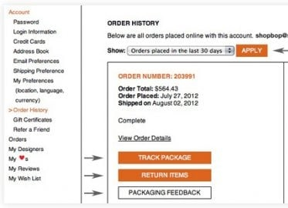
After-Order Tests
Check:
Change the Order
Cancel the Order
Track the Order
Returns

Slide 26
Other Tests
Login
FAQs
Contact Us page
Customer Service page etc.

Slide 27
Data Management:
Data Description :
This database consists of
Users: User and Admin information is added to database with Unique ID based on their roles.
Shopping: Complete products information is stored in this table.
Orders: Customer ordered products, status and delivery information is stored in this table.

Slide 28
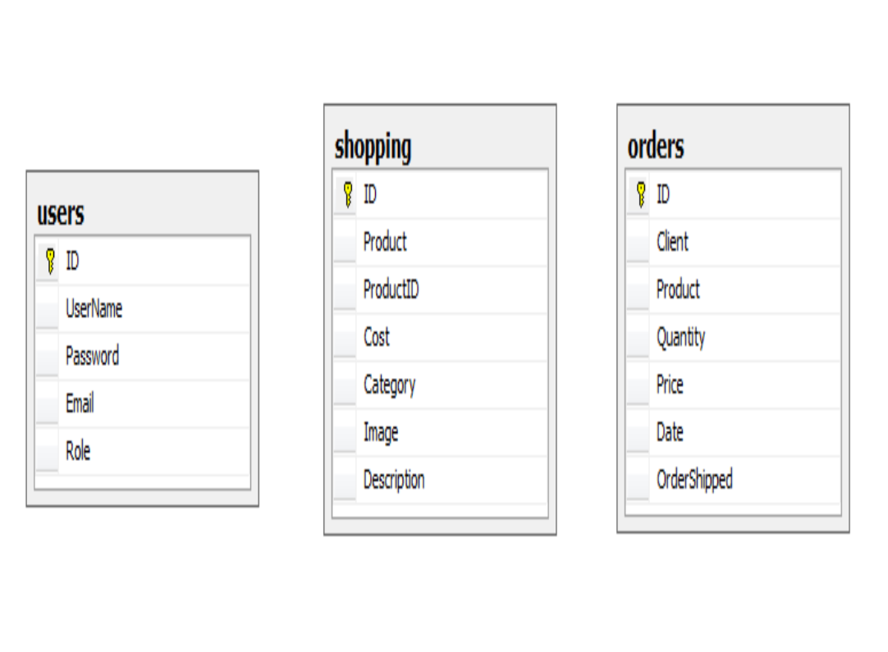
Data Objects:
User: ID, Username, Password, Email, Role
Shopping: ID, Product, Product ID, Cost, Category, Image, Description
Orders: ID, Client, Product, Quantity, Price, Date, Order Shipped
Database Table Diagram:

Slide 29
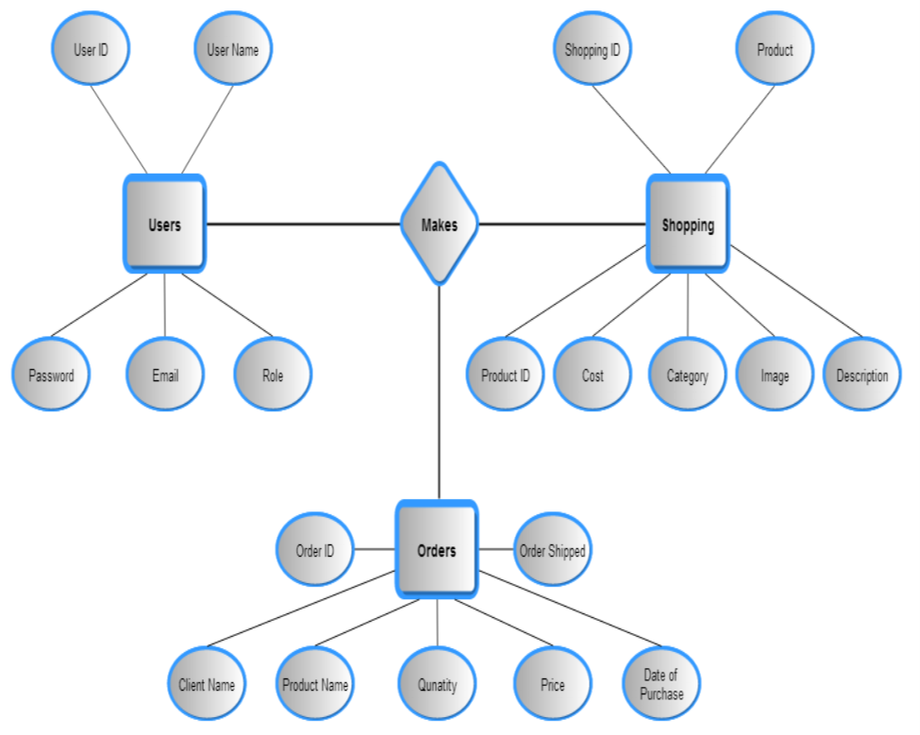
Relationships:

Slide 30
Non-Functional / Operational Requirements:
Security :
Pages of the website must be access in the way they were intended to be accessed. Included files shall not be accessed outside of their parent file.
Administrator can only perform administrative task on pages they are privileged to access. Customers will not be allowed to access the administrator pages.

Slide 31
Efficiency and Maintainability:
Page loads should be returned and formatted in a timely fashion depending on the request being made.
Administrators will have the ability to edit the aspects of the order forms, product descriptions, prices, and website directly.
Conclusion:
As per a survey, most consumers of online stores are impulsive and usually decide to stay on a site within the first few seconds. “Website design is like a shop interior. If the shop looks poor or like hundreds of other shops the customer is most likely to skip to the other site. Hence, we have designed the project to provide the user with easy navigation, retrieval of data and necessary feedback as much as possible. In this project, the user is provided with an ecommerce web site that can be used to buy electronics online.

