Slide 1
TITLE PAGE
Problem Statement ID – [Insert PS ID from SIH portal]
Problem Statement Title- Eco-Loop Building Agents: Autonomous Closed-Loop Building Energy & Comfort Optimization
Theme- [Insert theme from SIH portal, e.g. Clean & Green Technology]
PS Category- Software
Student Name- S Sankarsha
Student ID-

Slide 2
IDEA TITLE
Proposed Solution (Describe your Idea/Solution/Prototype)
Closed loop, every 5 min: EnergyPlus-style simulator → live telemetry → open-source LLM agent (via MCP) → setpoint control → back into the simulator.
No hard-coded schedules — the agent reasons over temperature, PMV comfort, and grid-carbon intensity, then calls an MCP tool to push new HVAC setpoints in real time.
Addresses rigid rule-based BMS that can't adapt to weather/occupancy/grid swings — verified 37.78% energy + 44.54% carbon savings (standard weather, 0 comfort violations) and 30.02% savings with 85→0 violations in a heatwave stress-test.
Unique: LLM tool-calling over standardized MCP protocol, not fixed rules, with a deterministic rule-based fallback so the loop never crashes if the LLM goes offline.

Slide 3
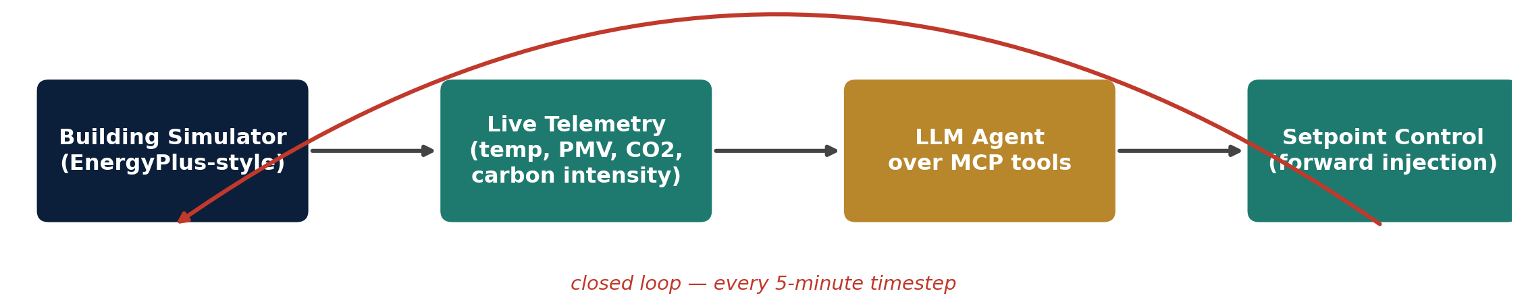
TECHNICAL APPROACH
Technologies: Python; EnergyPlus simulation bridged via eppy / pyenergyplus; open-source LLM (Llama 3 / Mistral / Qwen) served locally through Ollama; Model Context Protocol (FastMCP) for tool-calling; Streamlit dashboard; pandas/NumPy for telemetry & comfort (PMV) analysis.
Methodology: at every 5-min timestep the simulator writes telemetry to a JSON state file; MCP exposes get_zone_telemetry, set_zone_setpoint and read_simulation_log; the LLM reasons against comfort/carbon rules and calls the tool; a deterministic rule-based controller is the tested fallback whenever the LLM is unreachable.

Slide 4
FEASIBILITY AND VIABILITY
Feasible today: the closed loop already runs end-to-end in simulation with a working PoC — LLM reasoning, MCP tool-calls, and telemetry-driven control are all functional, not conceptual.
Risks: real EnergyPlus/eppy integration is heavier than the current simplified thermodynamic model; local LLM tool-calling can be unreliable or slow; multi-zone buildings add control complexity; wrong setpoints could threaten equipment or comfort.
Mitigations: hard safety bounds (16–28°C) on every setpoint the LLM can request; a tested deterministic rule-based fallback whenever the LLM is unreachable; comfort constraints enforced before any energy/carbon optimization; phased rollout starting single-zone before multi-zone.

Slide 5
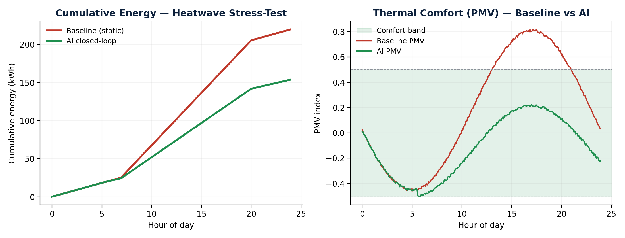
ARTIFACTS
Relevant artifacts:
Full source code — energyplus_wrapper.py, llm_agent.py, mcp_server.py, main.py, plus test suite (repo link on References slide)
Streamlit dashboard comparing baseline vs. AI-driven runs, backed by real logged CSVs (simulation_results.csv, simulation_results_heatwave.csv)
baseline.idf building model, with runtime-modified versions saved per run
Chart on the right is generated directly from our actual heatwave stress-test run
Heatwave stress-test: AI closed-loop cuts energy use ~30% and holds PMV inside the comfort band the entire day, while the static baseline drifts outside it for 85 occupied timesteps.

Slide 6
RESEARCH AND REFERENCES
EnergyPlus — U.S. DOE building energy simulation engine: energyplus.net
eppy — Python scripting API for EnergyPlus IDF files: github.com/santoshphilip/eppy
Model Context Protocol (MCP) specification — Anthropic: modelcontextprotocol.io
Ollama — local runtime for open-source LLMs (Llama 3, Mistral, Qwen): ollama.com
ASHRAE 55 — Thermal Environmental Conditions for Human Occupancy (PMV comfort index basis): ashrae.org
Project repository (source code, data, dashboard): [Insert your GitHub repo link]

