Slide 1
DevSecOps CI/CD : Deploying a Secure Hotstar Clone
Prerequisites
AWS account setup
Basic knowledge of AWS services
Understanding of DevSecOps principles
Familiarity with Docker, Jenkins, Java, SonarQube, AWS CLI, Kubectl, and Terraform,Docker Scout
Step-by-Step Deployment Process
Step 1: Setting up AWS EC2 Instance
Creating an EC2 instance with Ubuntu AMI, t2.large, and 30 GB storage
Assigning an IAM role with Admin access for learning purposes
Step 2: Installation of Required Tools on the Instance
Writing a script to automate the installation of:
Docker
Jenkins
Java
SonarQube container
AWS CLI
Kubectl
Terraform
Step 3: Jenkins Job Configuration
Creating Jenkins jobs for:
Creating an EKS cluster
Deploying the Hotstar clone application
Configuring the Jenkins job stages:
Sending files to SonarQube for static code analysis
Running npm install
Implementing OWASP for security checks
Installing and running Docker Scout for container security
Scanning files and Docker images with Docker Scout
Building and pushing Docker images
Deploying the application to the EKS cluster
Step 4: Clean-Up Process
Removing the EKS cluster
Deleting the IAM role
Terminating the Ubuntu instance

Slide 2
STEP 1A: Setting up AWS EC2 Instance and IAM Role
Sign in to the AWS Management Console: Access the AWS Management Console using your credentials
Navigate to the EC2 Dashboard: Click on the “Services” menu at the top of the page and select “EC2” under the “Compute” section. This will take you to the EC2 Dashboard.
Launch Instance: Click on the “Instances” link on the left sidebar and then click the “Launch Instance” button.
Choose an Amazon Machine Image (AMI): In the “Step 1: Choose an Amazon Machine Image (AMI)” section:
Select “AWS Marketplace” from the left-hand sidebar.
Search for “Ubuntu” in the search bar and choose the desired Ubuntu AMI (e.g., Ubuntu Server 24.04 LTS).
Click on “Select” to proceed.
Choose an Instance Type: In the “Step 2: Choose an Instance Type” section:
Scroll through the instance types and select “t2.large” from the list.
Click on “Next: Configure Instance Details” at the bottom.
Configure Instance Details: In the “Step 3: Configure Instance Details” section, you can leave most settings as default for now. However, you can configure settings like the network, subnet, IAM role, etc., according to your requirements.
Once done, click on “Next: Add Storage.”
Add Storage: In the “Step 4: Add Storage” section:
You can set the size of the root volume (usually /dev/sda1) to 30 GB by specifying the desired size in the “Size (GiB)” field.
Customize other storage settings if needed.
Click on “Next: Add Tags” when finished.
Add Tags (Optional): In the “Step 5: Add Tags” section, you can add tags to your instance for better identification and management. This step is optional but recommended for organizational purposes.
Click on “Next: Configure Security Group” when done.
Configure Security Group: In the “Step 6: Configure Security Group” section:
Create a new security group or select an existing one.
Ensure that at least SSH (port 22) is open for inbound traffic to allow remote access.
You might also want to open other ports as needed for your application’s requirements.
Click on “Review and Launch” when finished.
Review and Launch: Review the configuration details of your instance. If everything looks good:
Click on “Launch” to proceed.
A pop-up will prompt you to select or create a key pair. Choose an existing key pair or create a new one.
Finally, click on “Launch Instances.”
Accessing the Instance: Once the instance is launched, you can connect to it using SSH. Use the private key associated with the selected key pair to connect to the instance’s public IP or DNS address.
STEP 1B: IAM ROLE
Search for IAM in the search bar of AWS and Click on Create Role
Select entity type as AWS service
Use case as EC2 and click on Next.
For permission policy select Administrator Access (Just for learning purpose), click Next.
Provide a Name for Role and click on Create role.

Slide 3
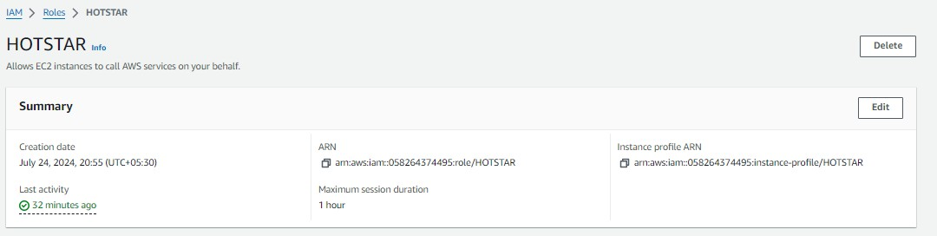
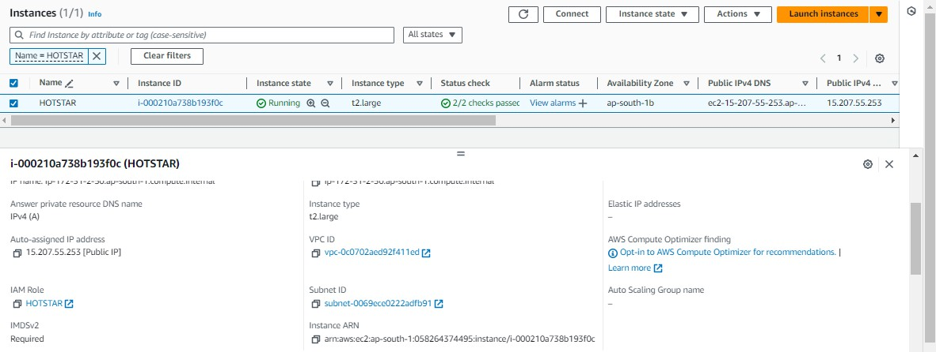
Now Attach this role to EC2 Instance that we created earlier, so we can provision cluster from that instance.
Click on Actions –> Security –> Modify IAM role.
Step 2: Installation of Required Tools on the Instance
vi script1.sh
#!/bin/bash
sudo apt update -y
sudo apt install openjdk-17-jre -y
sudo wget -O /usr/share/keyrings/jenkins-keyring.asc \
https://pkg.jenkins.io/debian-stable/jenkins.io-2023.key
echo "deb [signed-by=/usr/share/keyrings/jenkins-keyring.asc]" \
https://pkg.jenkins.io/debian-stable binary/ | sudo tee \
/etc/apt/sources.list.d/jenkins.list > /dev/null
sudo apt-get update
sudo apt-get install jenkins
Now make the script1.sh executable;
sudo chmod +x script1.sh
Now apply by using below command;
./script1.sh

Slide 4
vi script2.sh
#!/bin/bash
# Update system packages
sudo apt update -y
sudo apt-get update -y
# Install Docker
sudo apt install -y docker.io
sudo chmod 666 /var/run/docker.sock
# Add Kubernetes repository dependencies
sudo apt-get install -y apt-transport-https ca-certificates curl gpg
# Create the keyrings directory if it doesn't already exist
sudo mkdir -p -m 755 /etc/apt/keyrings
# Add Kubernetes signing key
curl -fsSL https://pkgs.k8s.io/core:/stable:/v1.28/deb/Release.key | sudo gpg --dearmor -o /etc/apt/keyrings/kubernetes-apt-keyring.gpg
# Add Kubernetes repository to the sources list
echo "deb [signed-by=/etc/apt/keyrings/kubernetes-apt-keyring.gpg] https://pkgs.k8s.io/core:/stable:/v1.28/deb/ /" | sudo tee /etc/apt/sources.list.d/kubernetes.list
# Update package lists to include Kubernetes packages
sudo apt-get update -y
# Install Kubernetes tools
sudo apt-get install -y kubelet kubeadm kubectl
# Enable and start the kubelet service
sudo systemctl enable --now kubelet
-- Terraform installation script3.sh
#!/bin/bash
sudo apt-get update && sudo apt-get install -y gnupg software-properties-common
wget -O- https://apt.releases.hashicorp.com/gpg | \
gpg --dearmor | \
sudo tee /usr/share/keyrings/hashicorp-archive-keyring.gpg > /dev/null
gpg --no-default-keyring \
--keyring /usr/share/keyrings/hashicorp-archive-keyring.gpg \
--fingerprint
echo "deb [signed-by=/usr/share/keyrings/hashicorp-archive-keyring.gpg] \
https://apt.releases.hashicorp.com $(lsb_release -cs) main" | \
sudo tee /etc/apt/sources.list.d/hashicorp.list
sudo apt update
sudo apt-get install terraform
#install Aws cli
curl "https://awscli.amazonaws.com/awscli-exe-linux-x86_64.zip" -o "awscliv2.zip" sudo apt install unzip unzip awscliv2.zip sudo ./aws/install
Now make the script2.sh executable;
sudo chmod +x script2.sh
Now apply by using below command;
./script2.sh
Now time to SonarQube installation;
docker run -d --name sonar -p 9000:9000 sonarqube:lts-community

Slide 5
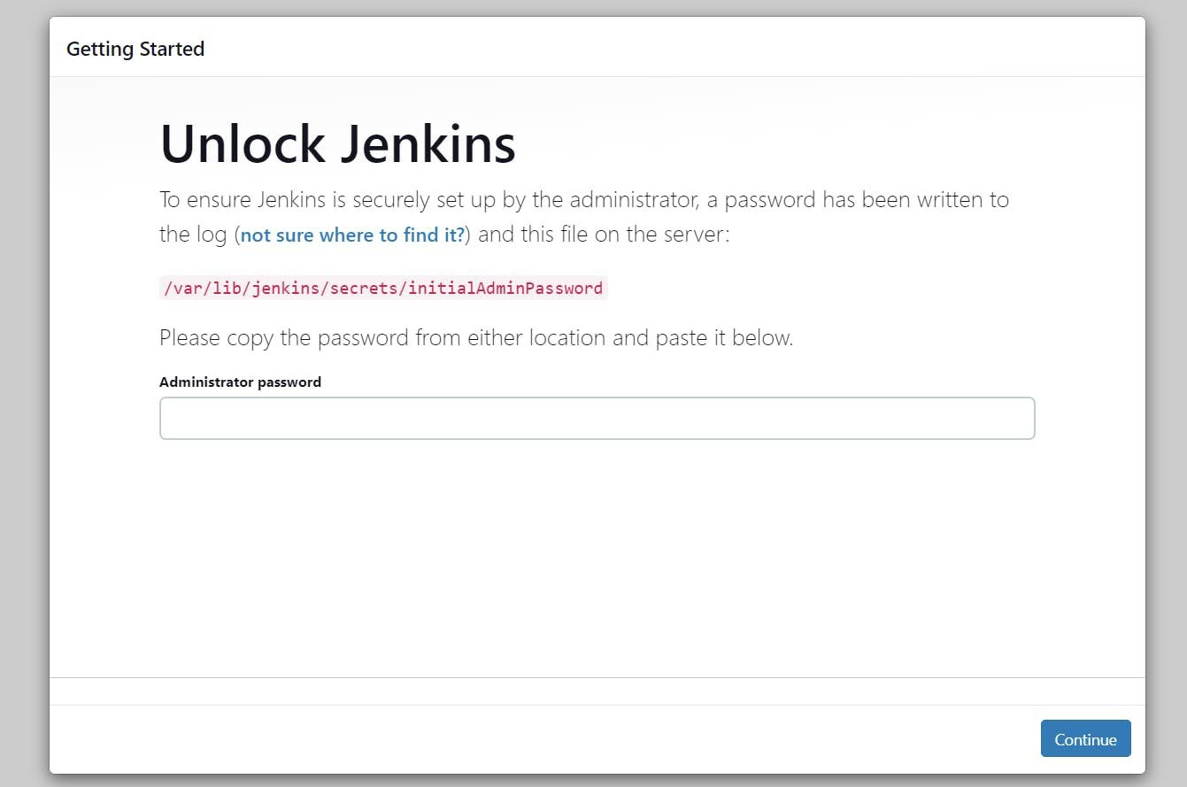

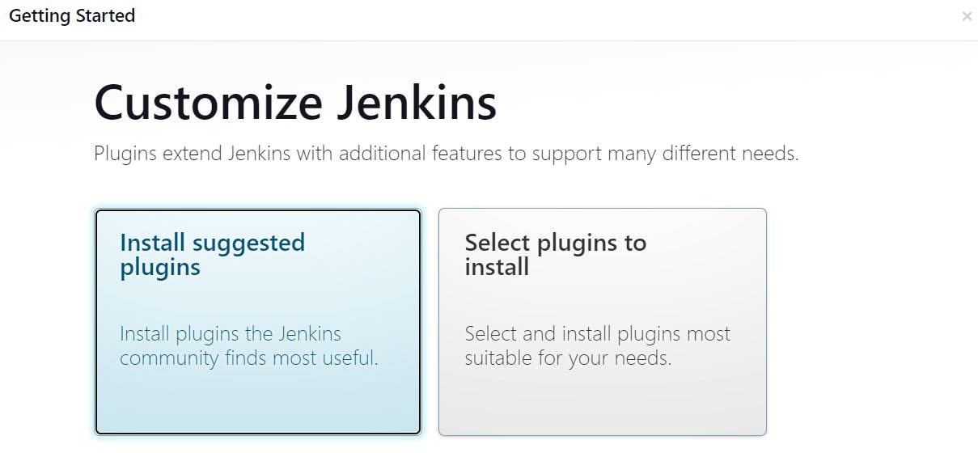
Now copy the public IP address of ec2 and paste it into the browser with :8080 for jenkins
Now, install the suggested plugins.

Slide 6
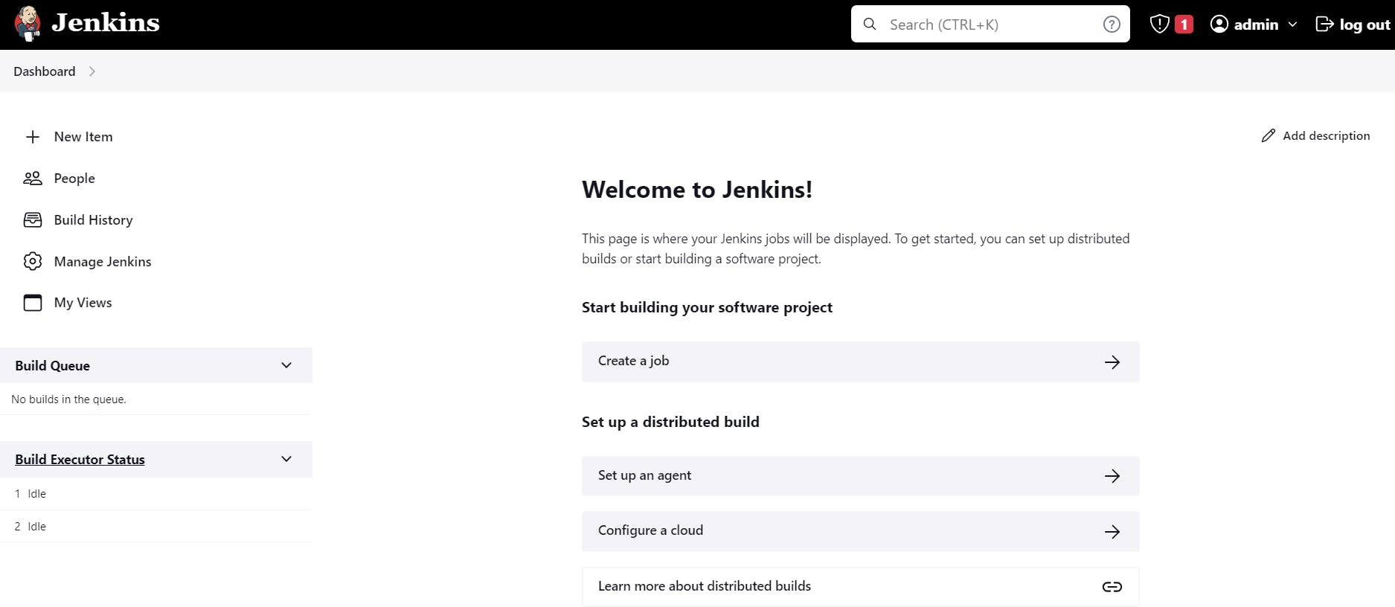
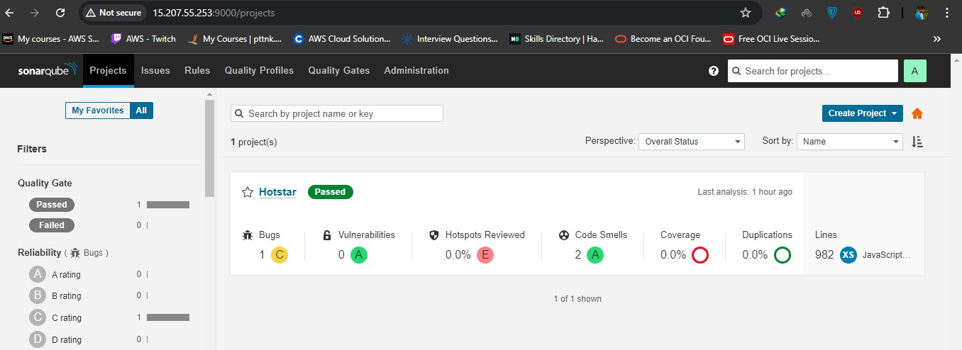
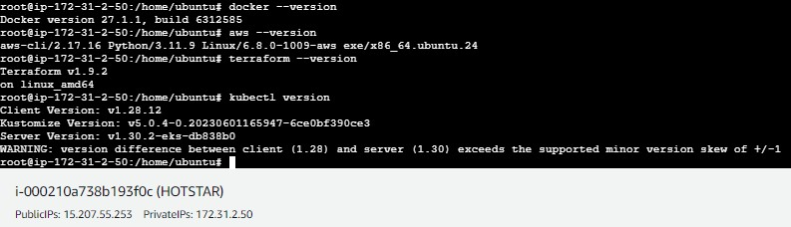
Now Copy the public IP again and paste it into a new tab in the browser with 9000
Note:- Initial username & password both are admin, you will have to change as per your choice
Step 3A: Jenkins Job Configuration
That is done now go to Jenkins and add a terraform plugin to provision the AWS EKS using the Pipeline Job.
Go to Jenkins dashboard –> Manage Jenkins –> Plugins
Available Plugins, Search for and install it.
Terraform

Slide 7
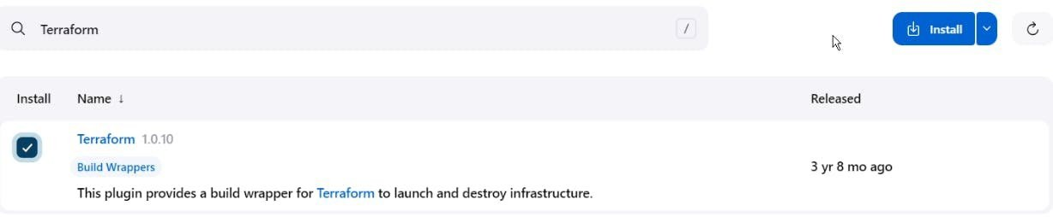

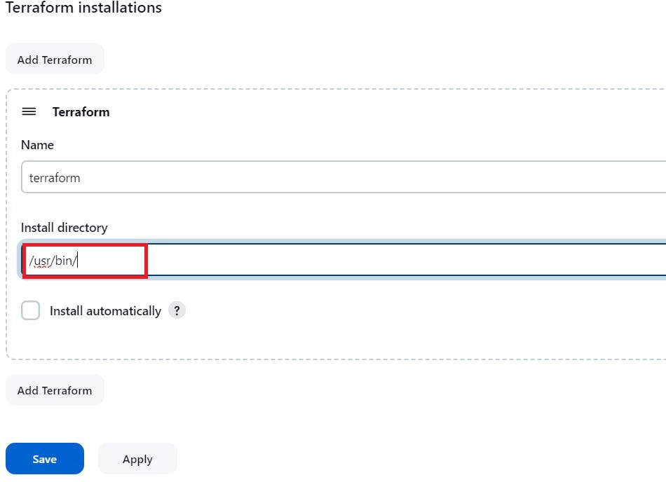
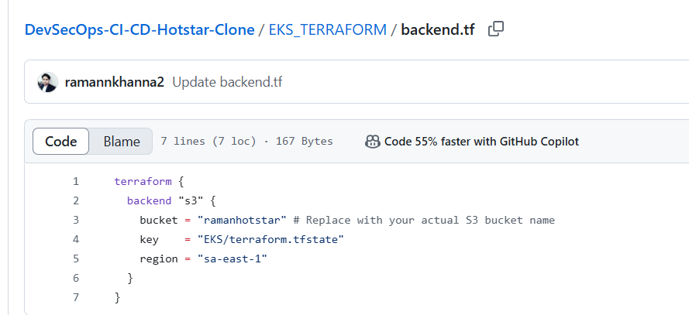
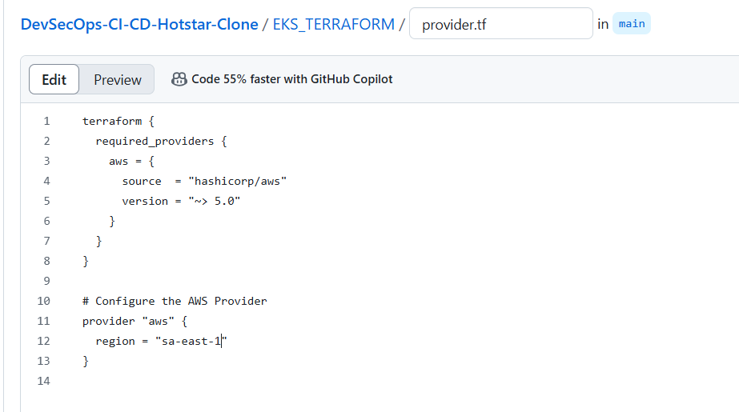
let’s find the path to our Terraform (we will use it in the tools section of Terraform)
which terraform
Now come back to Manage Jenkins –> Tools
Add the terraform in Tools
Apply and save.
CHANGE YOUR S3 BUCKET NAME IN THE
BACKEND.TF

Slide 8
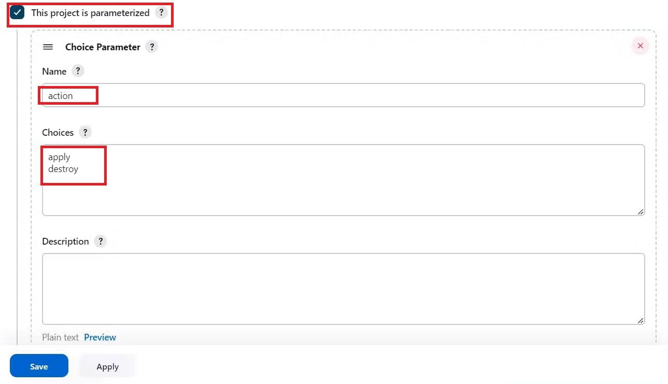
Now create a new job for the Eks provision
I want to do this with build parameters to apply and destroy while building only.
you have to add this inside job like the below image
Let’s add a pipeline :
pipeline{
agent any
stages {
stage('Checkout from Git'){
steps{
git branch: 'main', url: 'https://github.com/ramannkhanna2/DevSecOps-CI-CD-Hotstar-Clone.git'
}
}
stage('Terraform version'){
steps{
sh 'terraform --version'
}
}
stage('Terraform init'){
steps{
dir('EKS_TERRAFORM') {
sh 'terraform init'
}
}
}
stage('Terraform validate'){
steps{
dir('EKS_TERRAFORM') {
sh 'terraform validate'
}
}
}
stage('Terraform plan'){
steps{
dir('EKS_TERRAFORM') {
sh 'terraform plan'
}
}
}
stage('Terraform apply/destroy'){
steps{
dir('EKS_TERRAFORM') {
sh 'terraform ${action} --auto-approve'
}
}
}
}
}

Slide 9
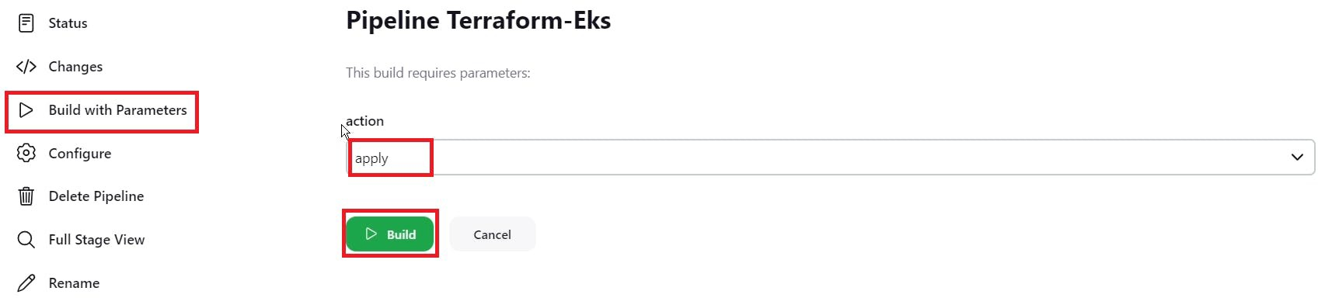
let’s apply and save and Build with parameters and select action as apply

Slide 10
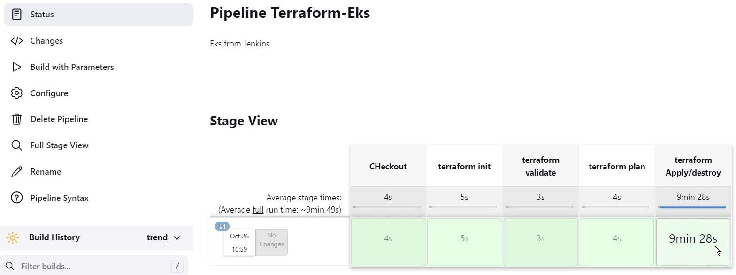
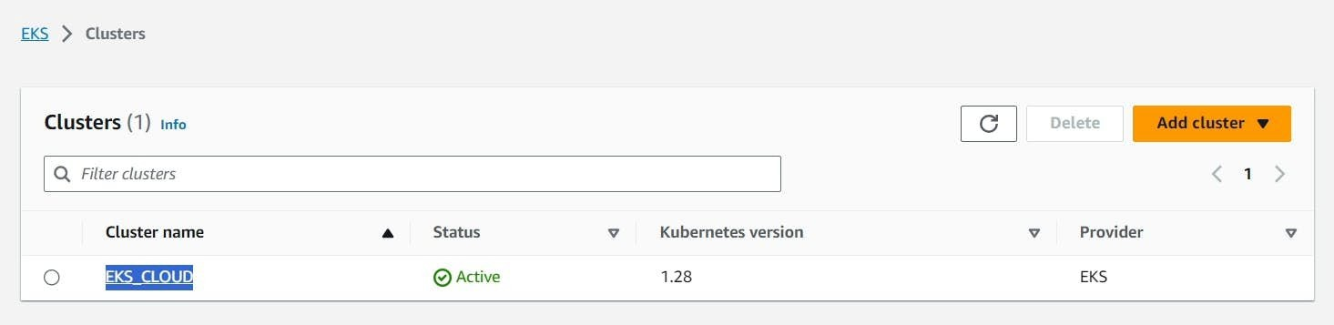
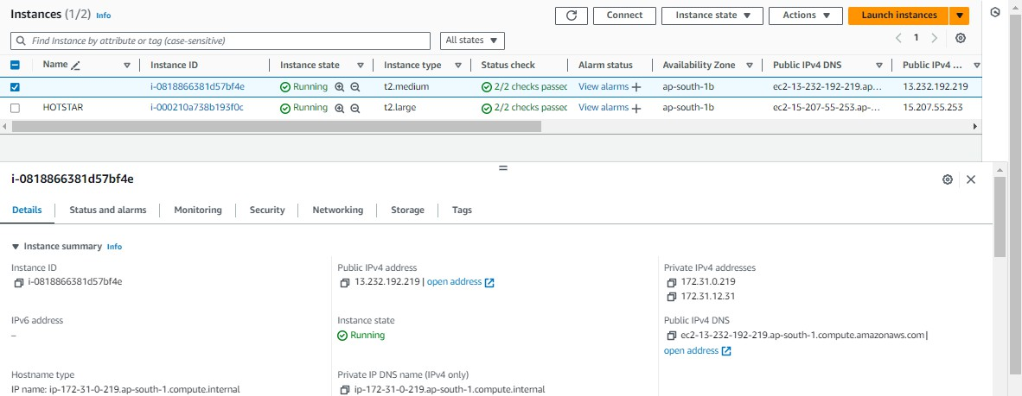
Check in Your Aws console whether it created EKS or not.
Ec2 instance is created for the Node group
Step 3B: Hotstar job
Go to Jenkins dashboard
Manage Jenkins –> Plugins –> Available Plugins

Slide 11
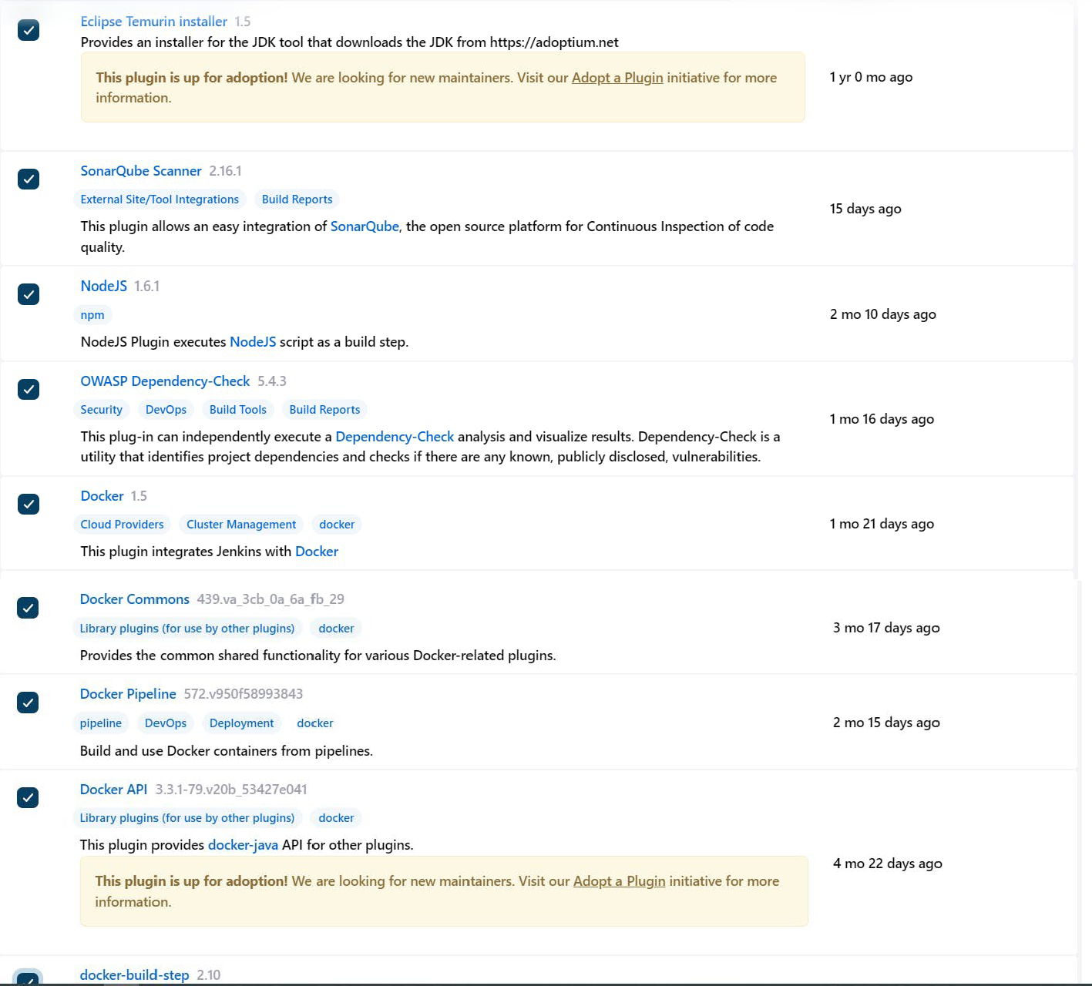
Search for the Below Plugins
Eclipse Temurin installer
Sonarqube Scanner
NodeJs
Docker
Docker Commons
Docker Pipeline
Docker API
Docker-build-step

Slide 12
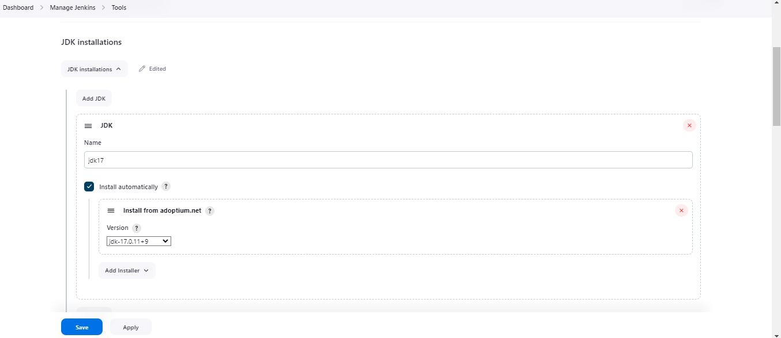
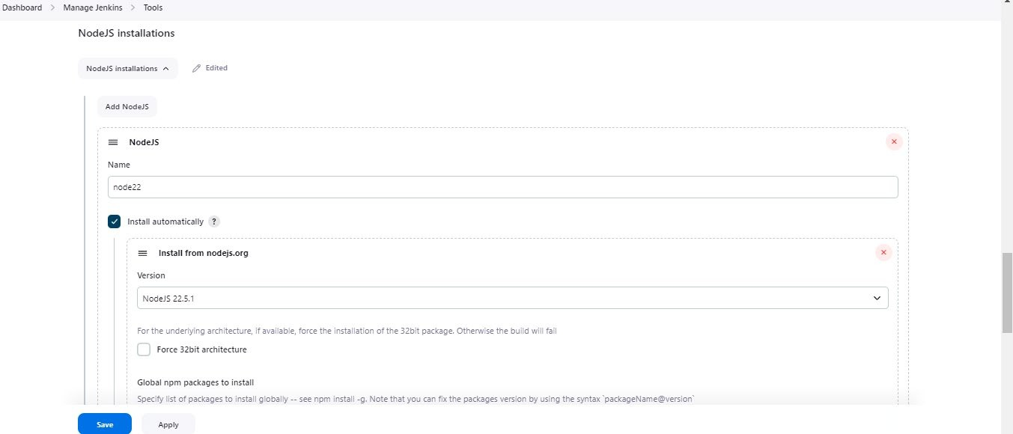
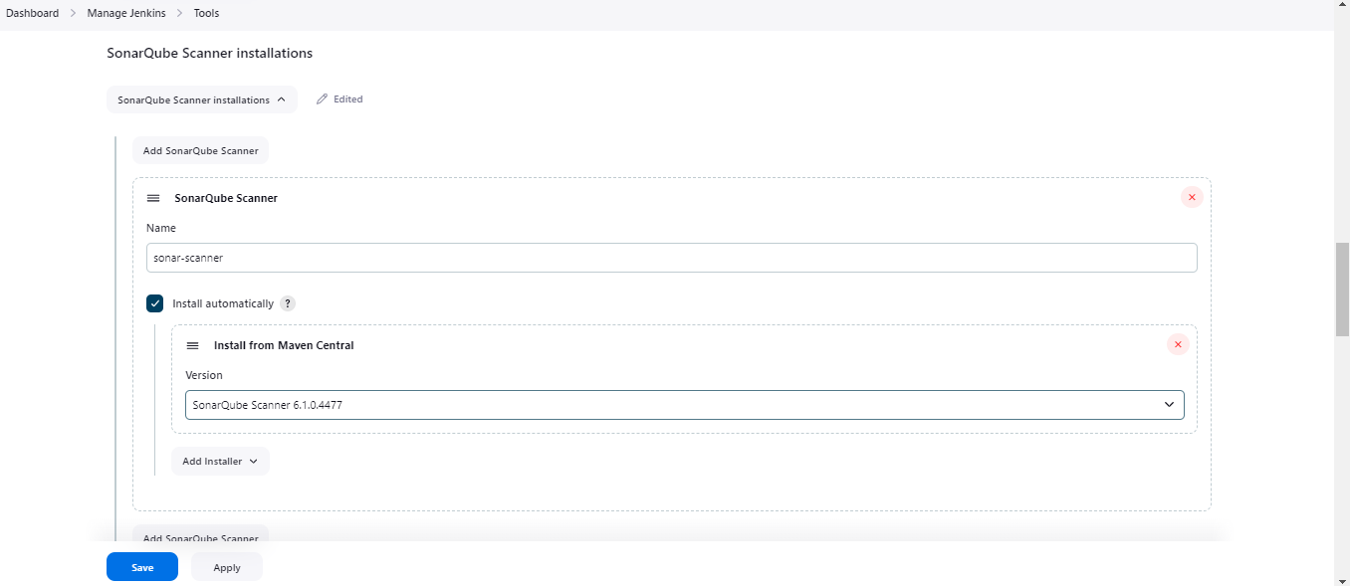
Configure in Global Tool Configuration
Go to Manage Jenkins → Tools → Install JDK(17) and NodeJs(22)→ Click on Apply and Save
For Sonarqube use the latest version

Slide 13
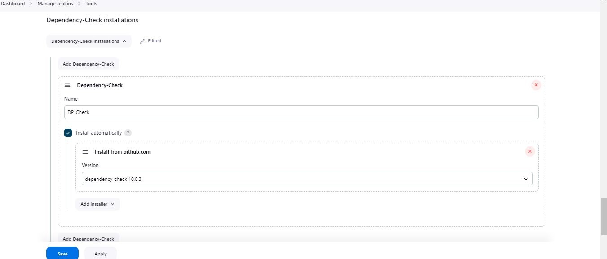
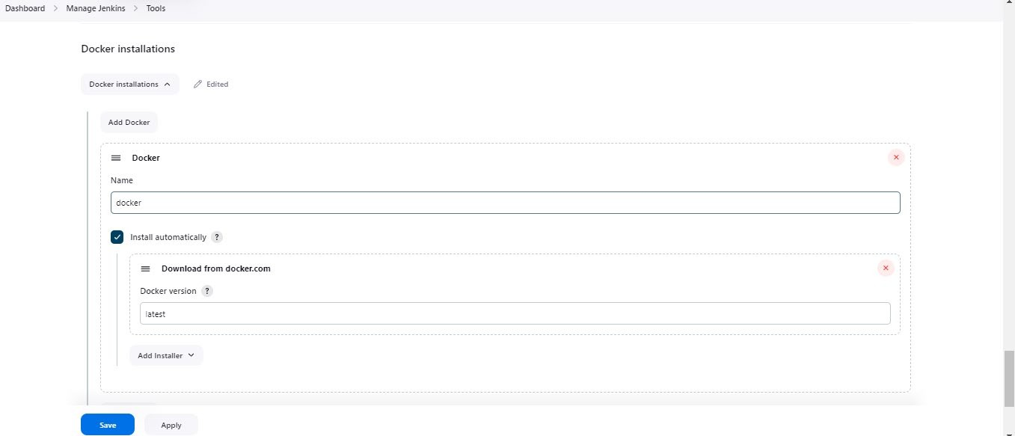
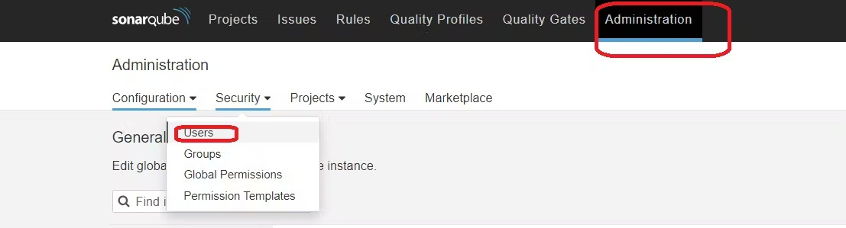
For Owasp use the 10.0.3 version
Use the latest version of Docker
Click apply and save.
Configure Sonar Server in Manage Jenkins
Grab the Public IP Address of your EC2 Instance, Sonarqube works on Port 9000, so <Public IP>:9000. Goto
your Sonarqube Server. Click on Administration → Security → Users → Click on Tokens and Update Token
→ Give it a name → and click on Generate Token

Slide 14
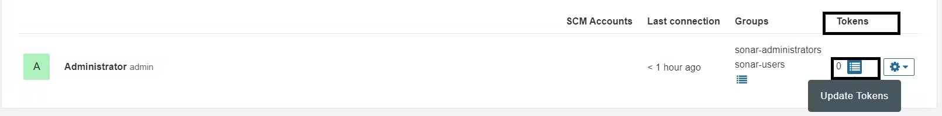
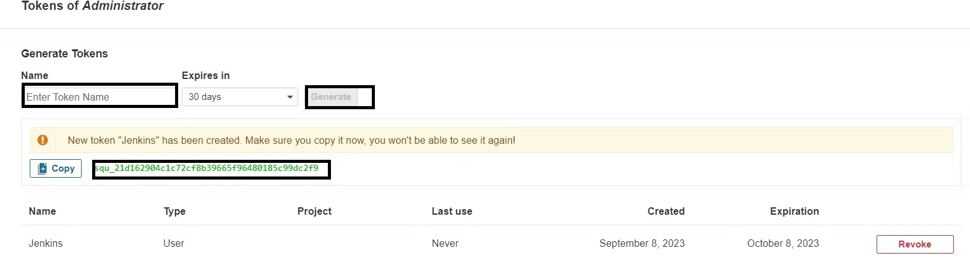
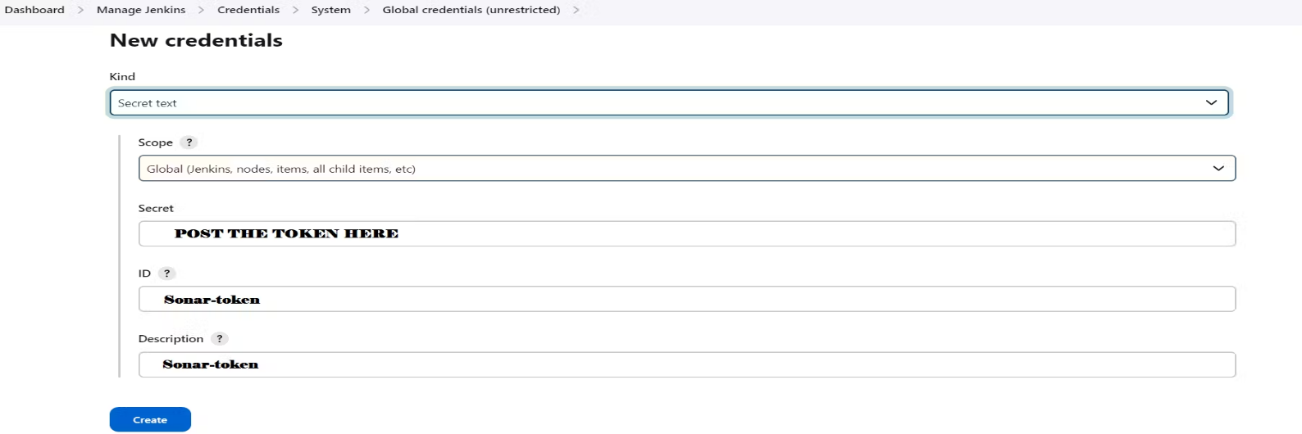
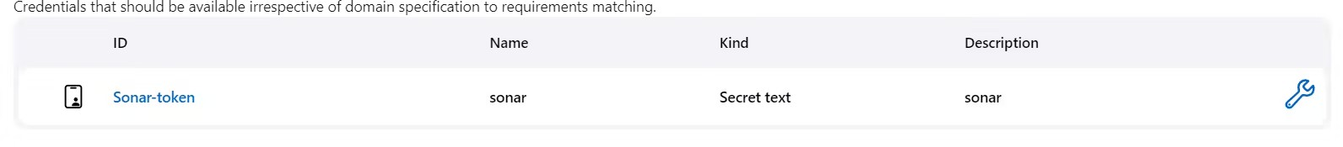
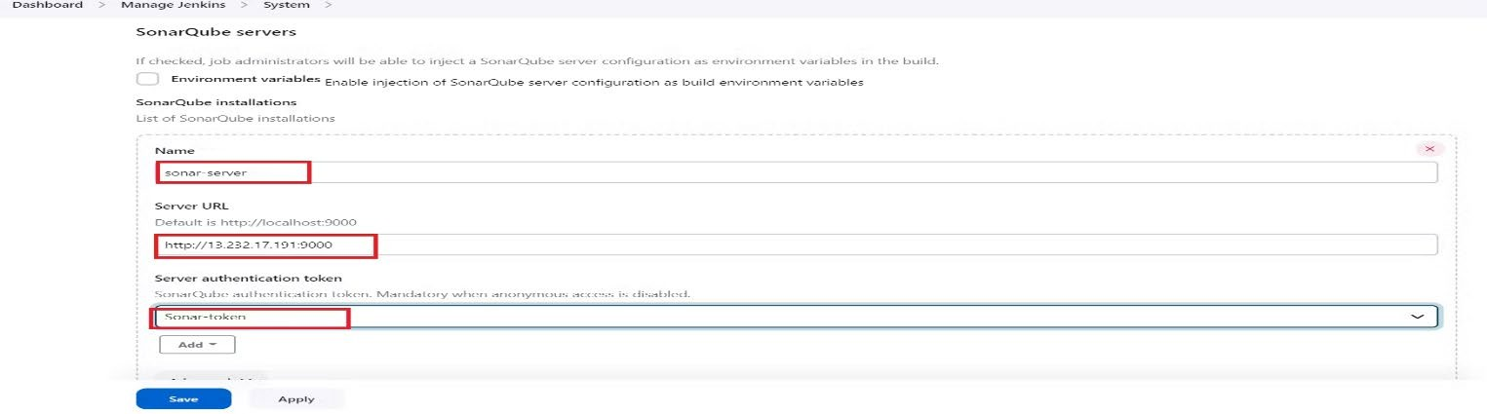
click on update Token
Create a token with a name and generate
copy Token
Go to Jenkins Dashboard → Manage Jenkins → Credentials → Add Secret Text. It should look like this
You will this page once you click on create
Now, go to Dashboard → Manage Jenkins → System and Add like the below image.

Slide 15
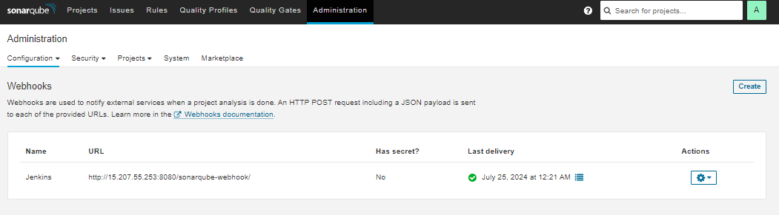
Click on Apply and Save
In the Sonarqube Dashboard add a quality gate also Administration–> Configuration–>Webhooks
Click on Create Add details
Now add Docker credentials to the Jenkins to log in and push the image
Manage Jenkins –> Credentials –> global –> add credential
Add DockerHub Username and Password under Global Credentials Now install Docker Scout on instance CLI;
docker login #use credentials to login
curl -sSfL https://raw.githubusercontent.com/docker/scout-cli/main/install.sh | sudo sh -s -- -b /usr/local/bin
Pipeline :

Slide 16
pipeline {
agent any
tools {
jdk 'jdk17'
nodejs 'node22'
}
environment {
SCANNER_HOME = tool 'sonar-scanner'
}
stages {
stage('Clean Workspace') {
steps {
cleanWs()
}
}
stage('Checkout from Git') {
steps {
git branch: 'main', url: 'https://github.com/ramannkhanna2/DevSecOps-CI-CD-Hotstar-Clone.git'
}
}
stage('SonarQube Analysis') {
steps {
withSonarQubeEnv('sonar-server') {
sh '''$SCANNER_HOME/bin/sonar-scanner \
-Dsonar.projectName=Hotstar \
-Dsonar.projectKey=Hotstar'''
}
}
}
stage('Quality Gate') {
steps {
script {
waitForQualityGate abortPipeline: false, credentialsId: 'Sonar-token'
}
}
}
stage('Install Dependencies') {
steps {
sh "npm install"
}
}
stage('Docker Scout Filesystem Scan') {
steps {
script {
withDockerRegistry(credentialsId: 'docker-creds', toolName: 'docker') {
sh 'docker-scout quickview fs://.'
sh 'docker-scout cves fs://.'
}
}
}
}
stage('Docker Build & Push') {
steps {
script {
withDockerRegistry(credentialsId: 'docker-creds', toolName: 'docker') {
sh "docker build -t hotstar ."
sh "docker tag hotstar ramann123/hotstar:latest"
sh "docker push ramann123/hotstar:latest"
}
}
}
}
stage('Docker Scout Image Scan') {
steps {
script {
withDockerRegistry(credentialsId: 'docker-creds', toolName: 'docker') {
sh 'docker-scout quickview ramann123/hotstar:latest'
sh 'docker-scout cves ramann123/hotstar:latest'
sh 'docker-scout recommendations ramann123/hotstar:latest'
}
}
}
}
}
}

Slide 18
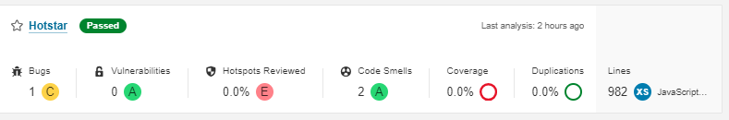
Click on Apply and save. Build now
To see the report, you can go to Sonarqube Server and go to Projects.
You can see the report has been generated and the status shows as passed.

Slide 19
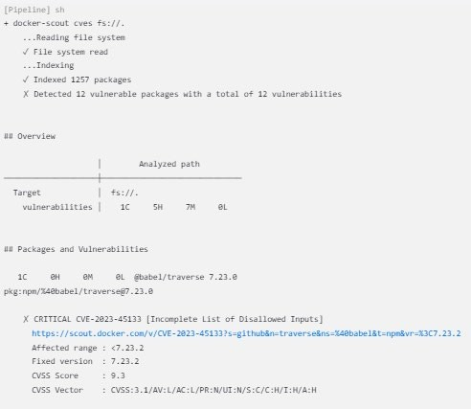
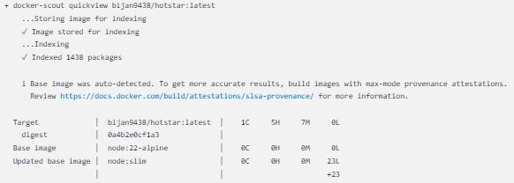
Let’s See Docker Scout File scan report
When you log in to Dockerhub, you will see a new image is created
Let’s See Docker Scout Image analysis

Slide 20
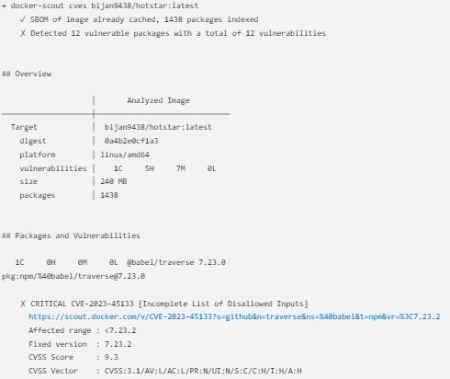
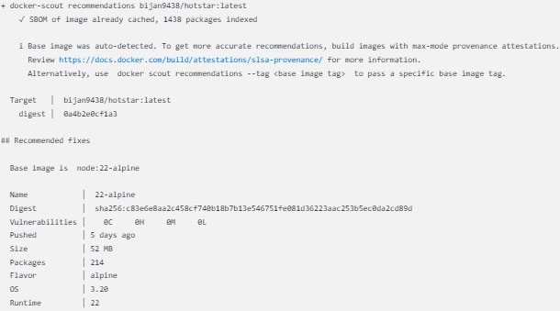
Cves
Recommendations
Deploy to Container
<ec2publicip:3000>

Slide 21
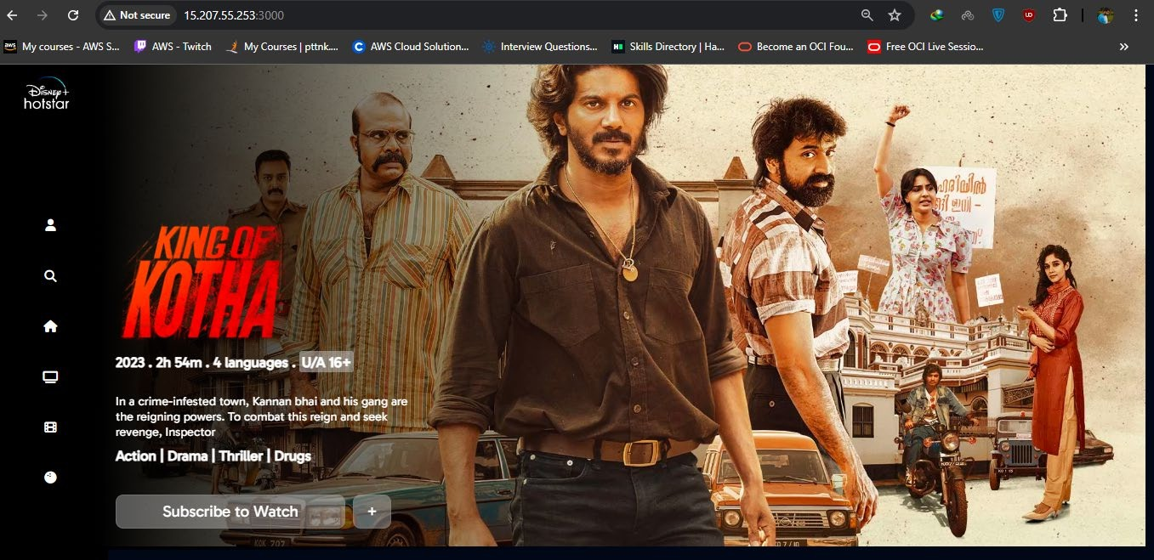
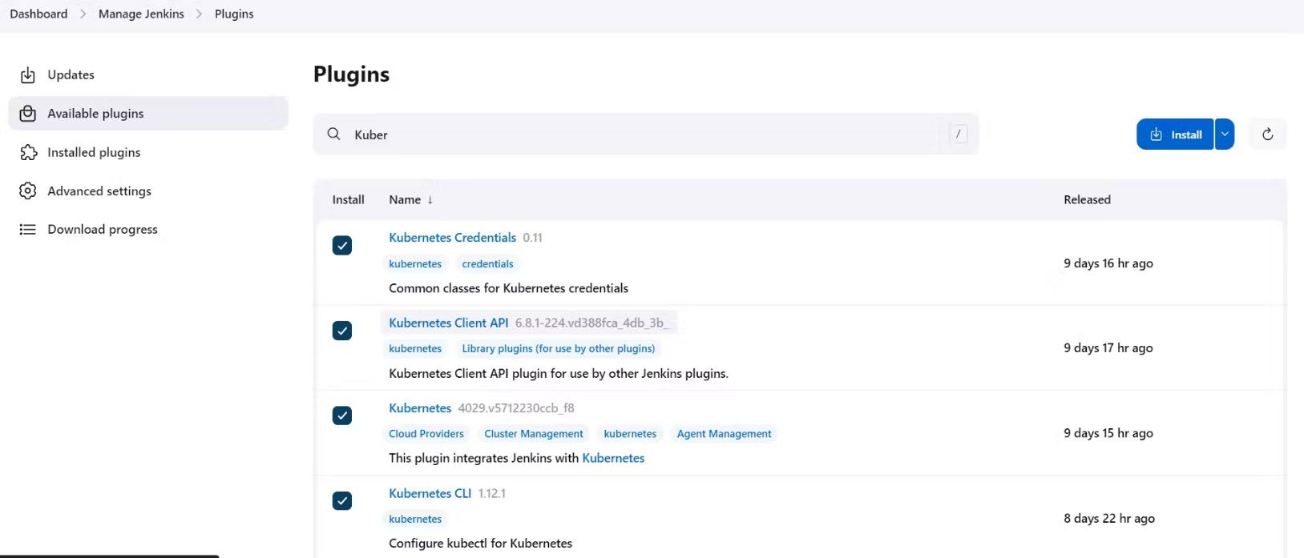
Output
Go to instance CLI and write;
aws eks update-kubeconfig --name EKS_CLOUD --region sa-east-1
Let’s see the nodes
kubectl get nodes
Now Give this command in CLI
cat /root/.kube/config
Copy the config file to Jenkins master or the local file manager and save it
Install Kubernetes Plugin, Once it’s installed successfully

Slide 22
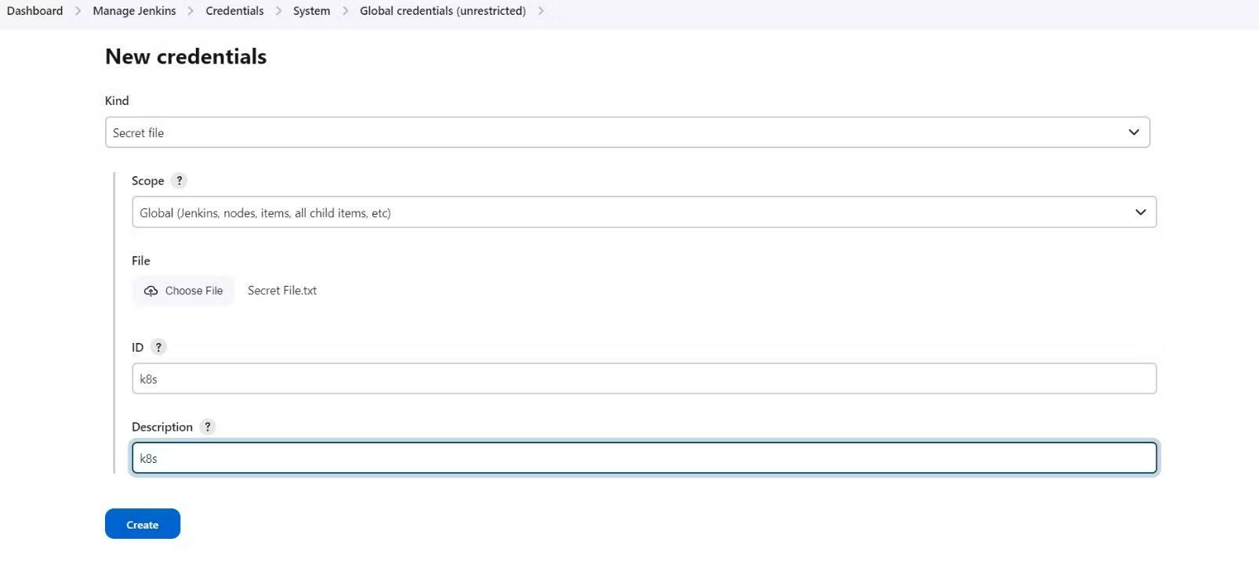
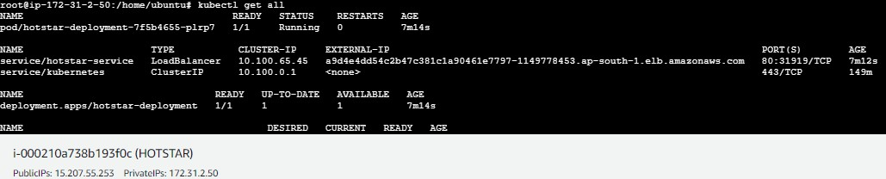
goto manage Jenkins –> manage credentials –> Click on Jenkins global –> add credentials
final step to deploy on the Kubernetes cluster
stage('Deploy to kubernets'){ steps{
script{
dir('K8S') {
withKubeConfig(caCertificate: '', clusterName: '', contextName: '', credentialsId: 'k8s', namespace: '', restrictKubeConfigAccess: false, serverUrl: '') {
sh 'kubectl apply -f deployment.yml' sh 'kubectl apply -f service.yml'
}
}
}
}
}
Give the command after pipeline success
kubectl get all

Slide 23
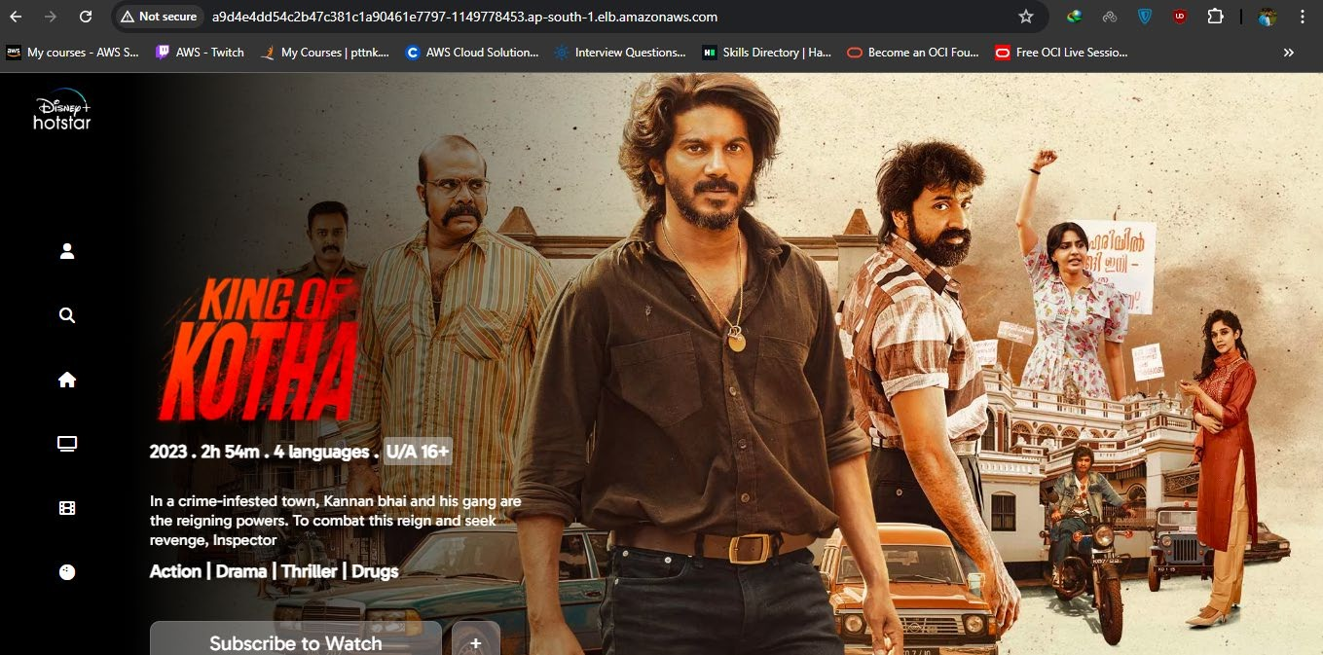
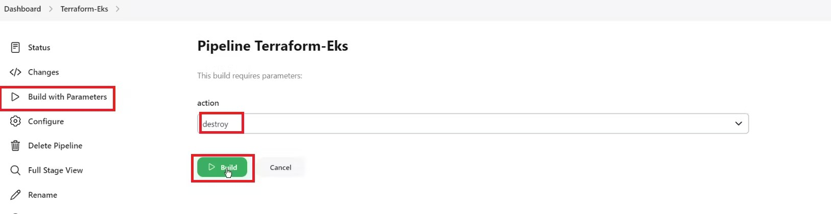
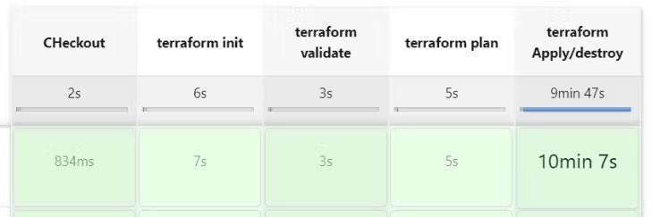
Copy the External IP and paste it in your browser, You will see output like this.
Step 4: Destruction
Now Go to Jenkins Dashboard and click on Terraform-Eks job
And build with parameters and destroy action It will delete the EKS cluster that provisioned
After 10 minutes cluster will delete and wait for it. Don’t remove ec2 instance till that time.

Slide 24
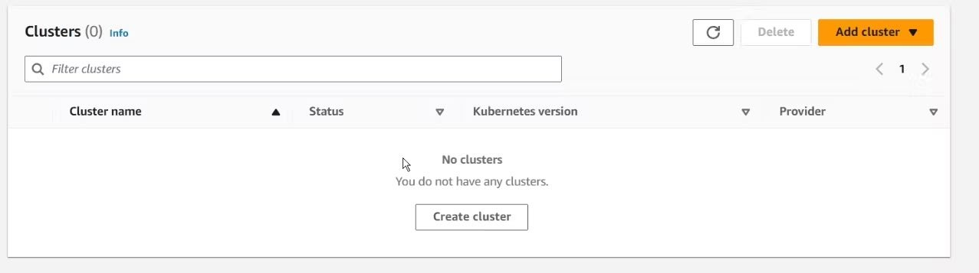
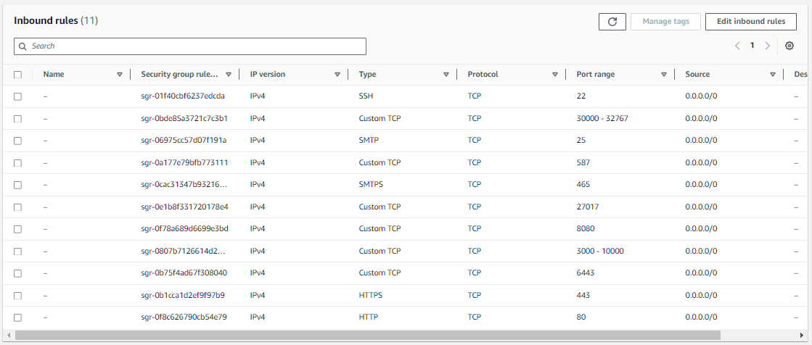
Cluster deleted
Delete the Ec2 instance & IAM role.
Check the load balancer also if it is deleted or not.
Finally completing the journey of deploying Hotstar clone using DevSecOps practices on AWS!
This process has highlighted the power of integrating security measures seamlessly into the deployment pipeline, ensuring not only efficiency but also a robust shield against potential threats.
Key Highlights:
Leveraging AWS services, Docker, Jenkins, and security tools, we orchestrated a secure and automated deployment pipeline.
Implementing DevSecOps principles helped fortify the application against vulnerabilities through continuous security checks.
The seamless integration of static code analysis, container security, and automated deployment showcases the strength of DevSecOps methodologies.
PORTS(UNLOCKED FOR THIS PROJECT):

