Slide 1

CpSc 8430: Deep Learning
Homework 3

Slide 2
Copy Right Notice
Most slides in this presentation are adopted from slides of text book and various sources. The Copyright belong to the original authors. Thanks!

Slide 3

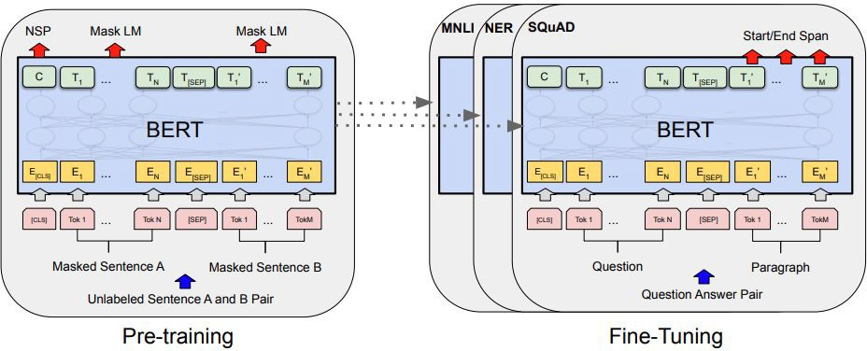
BERT
https://arxiv.org/abs/1810.04805

Slide 4
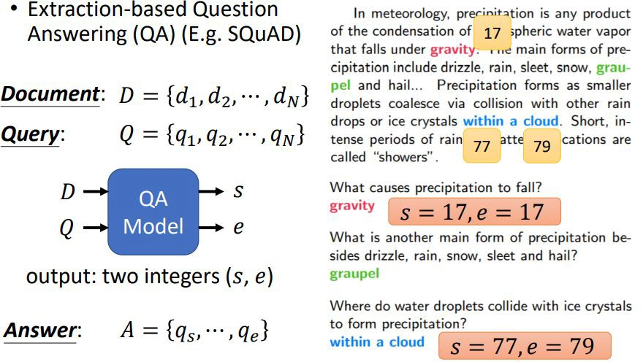
Task: Extractive Question Answering

Slide 5
Dataset
Spoken-SQuAD : A spoken question answering dataset on SQuAD
https://github.com/chiahsuan156/Spoken-SQuAD
https://arxiv.org/pdf/1804.00320.pdf
https://paperswithcode.com/sota/spoken-language-understanding-on-spoken-squad
In SpokenSQuAD, the document is in spoken form, the input question is in the form of text and the answer to each question is always a span in the document. We conducted the following procedures to generate spoken documents from the original SQuAD dataset. First, we used Google text-to-speech system to generate the spoken version of the articles in SQuAD. Then we utilized CMU Sphinx to generate the corresponding ASR transcriptions. In this study, we left the questions in the text form. We used SQuAD training set to generate the training set of Spoken SQuAD, and SQuAD development set was used to generate the testing set for Spoken SQuAD. If the answer of a question did not exist in the ASR transcriptions of the associated article, we removed the question-answer pair from the dataset.

Slide 6
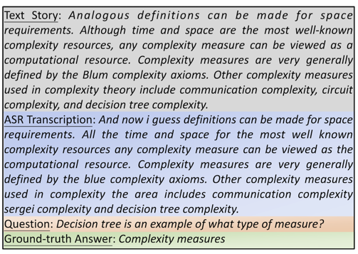
Dataset

Slide 7
Dataset
This dataset collected 37,111 question answer pairs as the training set (Word Error Rate 22.77%) and 5,351 as the testing set (Word Error Rate 22.73%).
To test the comprehension ability of machine in real life scenario under worse audio quality, we further added two different levels of white noise into the audio files of testing set to obtain different WERs.
Testing Set | No noise | Noise V1 | Noise V2
WER(%) | 22.73 | 44.22 | 54.82

Slide 8
Tokenization
'Professor Feng Luo Deep Learning Course'
tokenize
[‘professor', ‘feng', ‘luo', ‘deep', ‘learning', ‘course']
tokens_to_ids
[3330, 2131, 3675, 3136, 2956, 10550]

Slide 9

Tokenization
BERT
input_ids:
[SEP] [PAD] [PAD]
token_type_ids: | 0 | 0 | 0 | 0 | 1 | 1 | 1 | 1 | 0 | 0
attention_mask: | 1 | 1 | 1 | 1 | 1 | 1 | 1 | 1 | 0 | 0

Slide 10
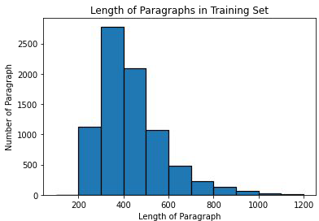
Why Long Paragraph is an Issue?
Total sequence length = question length + paragraph length + 3 (special tokens)
Maximum input sequence length of BERT is restricted to 512, why?
Self-Attention in transformer has complexity
Therefore, we may not be able to process the whole paragraph. What can we do?

Slide 11
Training
We know where the answer is in training!
Assumption:
Simple solution:
Info needed to answer the question can be found near the answer!
Just draw a window (as large as possible) around the answer!
e.g. window size = max_paragraph_len = 32
Analogous definitions can be made for space requirements. Although time and space are the most well-known complexity resources, any complexity measure can be viewed as a computational resource. Complexity measures are very generally defined by the Blum complexity axioms. Other complexity measures used in complexity theory include communication complexity, circuit complexity, and decision tree complexity.
Question: Decision tree is an example of what type of measure?
Ground-t ruth Answer: Complexity measures

Slide 12
Testing
We do not know where the answer is in testing
e.g. window size = max_paragraph_len = 32
split into windows!
For each window, model predicts a start score and an end score
take the maximum to be answer!
 | start score | start position | end score | end position | total score
window 1 | 0.5 | 23 | 0.4 | 26 | 0.9
window 2 | 0.3 | 35 | 0.7 | 37 | 1.0
Answer:
position 35 to 37

Slide 13
Hints for beating baselines
Estimated training time
Simple:
Sample code
Medium:
Apply linear learning rate decay
Change value of “doc_stride”
Strong:
Improve preprocessing
Try other pretrained models
Boss:
Improve postprocessing
Further improve the above hints
 | K80 | T4 | T4 (FP16) | P100 | V100
Simple | 40m | 20m | 8m | 10m | 7m
Medium | 40m | 20m | 8m | 10m | 7m
Strong | 2h | 1h | 25m | 35m | 20m
Boss | 12.5h | 6h | 2.5h | 4.5h | 2h
Training Tips (Optional):
Automatic mixed precision (fp16)
Gradient accumulation
Ensemble

Slide 14
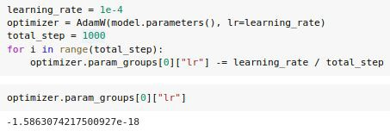
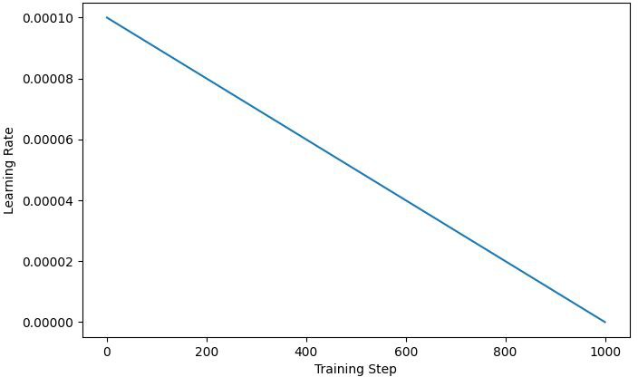
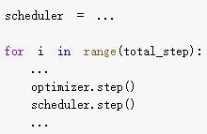
Linear Learning rate decay
Method 1: Adjust learning rate manually
Decrement optimizer.param_groups[0][“lr”] by learning_rate / total training step per step
Decrement learning rate to zero linearly
This block is only an example! You only need to add 1 or 2 lines
Check whether learning rate after training is very close to zero
Adjust learning rate automatically by scheduler
Method 2:
huggingface (Recommended)
pytorch
Link Link
You may also try other learning rate schedules (e.g. warmup)!
You only need to add 3 or 4 lines

Slide 15

Doc stride
Analogous definitions can be made for space requirements. Although time and space are the most well-known complexity resources, any complexity measure can be viewed as a computational resource. Complexity measures are very generally defined by the Blum complexity axioms. Other complexity measures used in complexity theory include communication complexity, circuit complexity, and decision tree complexity.
start position of 2nd window
doc_stride = distance between the start position of two consecutive windows
start position of 1st window
doc_stride is set to “max_paragraph_len” in sample code (i.e. no overlap) What if answer is near the boundary of windows or across windows?
Hint: Overlapping windows

Slide 16
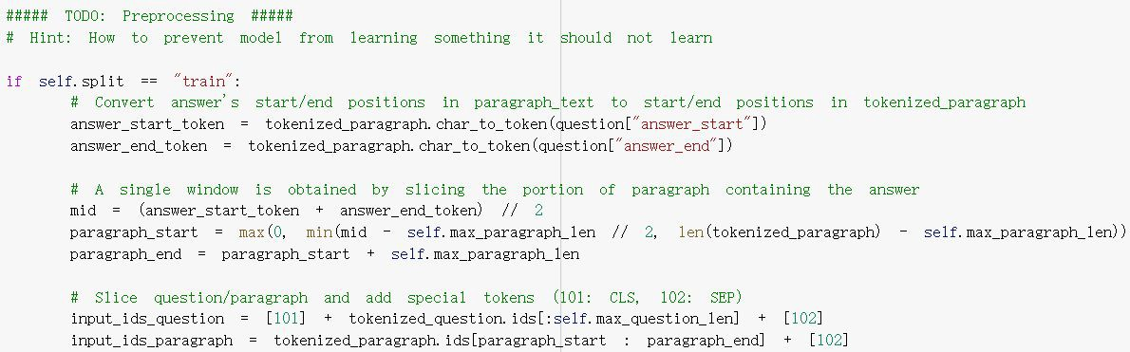
Preprocessing
Hint:
How to prevent model from learning something it should not learn during training? (i.e. answers are not always near the middle of window)

Slide 17

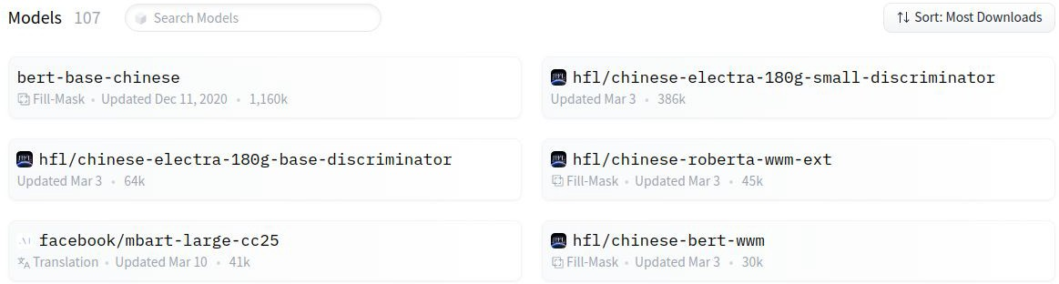
Other pretrained models
You can choose any model you like! [Link to pretrained models in huggingface]
Note 1:
You are NOT allowed to use pretrained models outside huggingface! (Violation = cheating = ﬁnal grade x 0.9)
Some models have describing details of the model
Changing models may lead to error message, try it solve it yourself
Note 2:
Note 3:

Slide 18
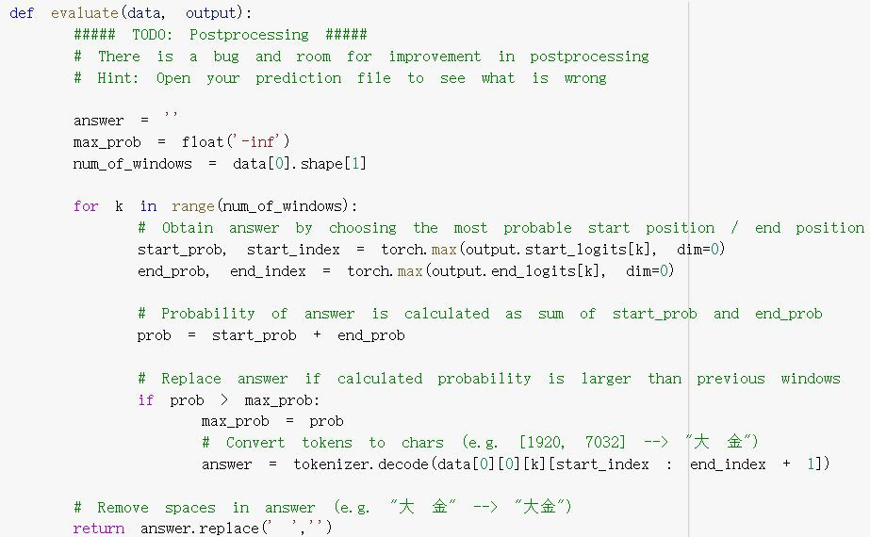
Postprocessing
Hint:
Open your prediction ﬁle to see what is wrong
(e.g. what if predicted end_index < predicted start_index?)

Slide 19
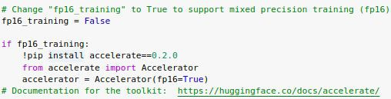

Training Tip: Automatic mixed precision
PyTorch trains with 32-bit ﬂoating point (FP32) arithmetic by default
Automatic Mixed Precision (AMP) enables automatic conversion of certain GPU operations from FP32 precision to half-precision (FP16)
Oﬀer about 1.5-3.0x speed up while maintaining accuracy
Estimated training time
 | T4 | T4 (FP16)
Simple | 20m | 8m
Medium | 20m | 8m
Strong | 1h | 25m
Boss | 6h | 2.5h
Warning: only work on some gpu
(e.g. T4, V100)
accelerate documentation
Intro to native pytorch automatic mixed precision
Reference:

Slide 20
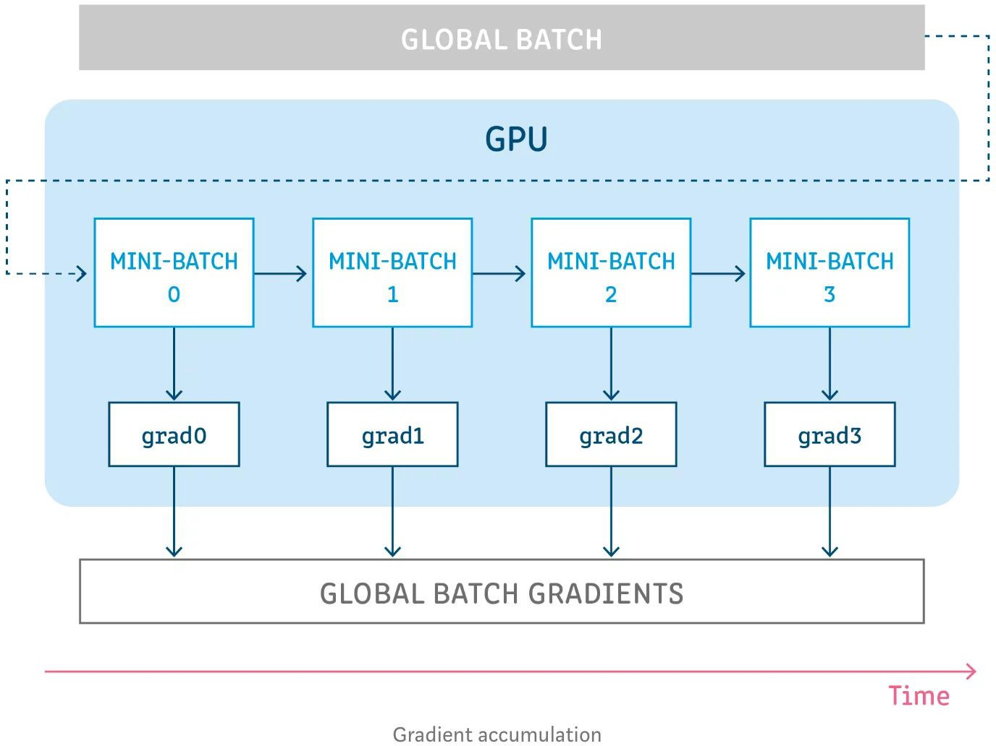

Training Tip: Gradient accumulation
Use it when gpu memory is not enough but you want to use larger batch size
Split global batch into smaller mini-batches
For each mini-batch: Accumulate gradient without updating model parameters
Update model parameters
Reference:
Gradient Accumulation in PyTorch

Slide 21
Submission & Rules
Deadline: April. 1st 23:59
Allow package：
python 3
TensorFlow/pytorch ONLY for CS and ECE student
For non-CS/ECE students, Keras is allowed.

Slide 22
Submission & Rules
For HW3：
Submit a report on Canvas
Submit your code to github.

