Slide 1

Random Forest

Slide 2
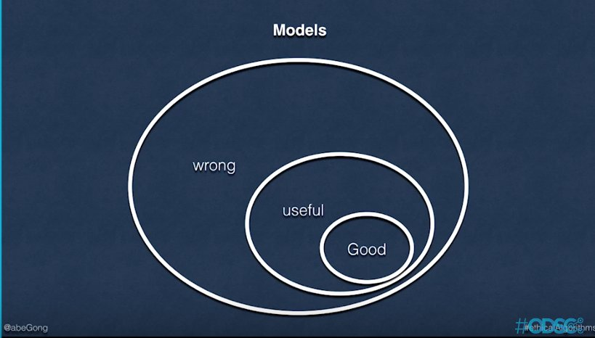
All models are wrong, but some are useful
-George E. P. Box

Slide 3
Scenario: There is a new movie released last week and you are unsure if you should go and watch it or not. You think probably you should ask someone who has seen the movie.
Your friend John has seen the movie. You ask John if he liked the movie. He rates the movie: | There are 10 more friends who have seen the movie. You ask them if they liked the movie. They rate the movie:

Slide 4
Introduction
Random forest is a popular ensemble method used for classification as well as regression problems
Ensemble method is a combination of multiple models making prediction.
Helps in building a stable model.
It is multiple decision trees making prediction simultaneously
Final prediction is the combination of all the individual prediction

Slide 5
Limitations of decision trees
High error rate when modelling unseen data i.e. they overfit
Decision trees are unstable. Slight change in training data changes the tree structure drastically
Hence not commonly used for industrial problem solving.

Slide 6
Random forest functioning
Multiple trees instead of one, final prediction is mean/median/mode of all
Data going in for each tree is not the same. Randomization makes sure trees are not exactly same
Commonly tuned hyperparameters are- n_estimators, max_depth, max_features, criterion, max_leaf_nodes, min_impurity_split, bootstrap etc.

Slide 7
Advantages of random forest
Due to multiple models’ averaging effect, the tendency to overfit is reduced
Stable and robust model. Small changes in the data do not cause drastic changes in the model
Missing values do not affect the model much
Tree building process is parallel. Hence efficient from execution perspective

Slide 8
Limitations of random forest
Parallel computation requires more computational resources
Intutive understanding of the model is difficult
Fails when the class to be modelled is rare class (eg. high segmented customer behaviour, credit card fault detection etc.)

Slide 9
Demonstration

