Slide 1
C17-Wasserstein Generative Adversarial Network (WGAN)
Presented by:
Tirath Sojitra (110029415),
Sanketkumar Patel (110023916)

Slide 2
What are GAN’s?
It is an unsupervised type of learning.
Two models, generator and discriminator, competing against each other. Generators model tries to trick discriminator by producing fake results. On the other hand, discriminator tries not to get trick [1].
GANs work on probability distributions.
Various distances are used to calculate the distance between two probability distributions.
Cost function are implemented to converge this distance.

Slide 3
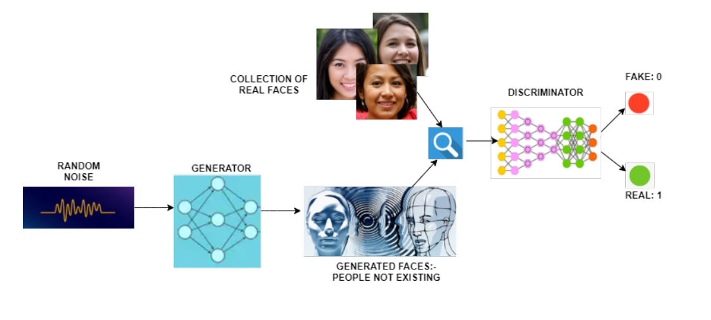
What are GAN’s? (cont.)
Flow chart of GAN’s. Source: Medium.com

Slide 4
Distance used by GAN’s
Jensen-Shannon divergence is used for GAN’s.
JS(P_{r},P_{g}) = KL(P_{r}||P_{m}) + KL(P_{g}||P_{m}) (1)
where P_{m} is the average of P_{r} and P_{g}
KL(P_{r}||P_{g}) = ∫ log(P_{r}/P_{g}) P_{r} dx (2)

Slide 5
Limitations of GAN’s
During the training, generator may produce the same output which results into mode collapse [1].
If either discriminator or generator behaves badly and doesn’t provide proper feedback then loss function cannot represent the reality and learning stops [1].

Slide 6
WGAN

Slide 7
Wasserstein GAN
Wasserstein GAN is an extension of the traditional GAN. The loss function of WGAN actually means something.
It uses Wasserstein distance to find the distance between probability distributions [3].
Furthermore, WGAN has replaced the discriminator network with a critic function which doesn’t bound the output between 0 to 1 [2].
Instead, WGAN provide scalar value to define correctness of the given image [2].

Slide 8
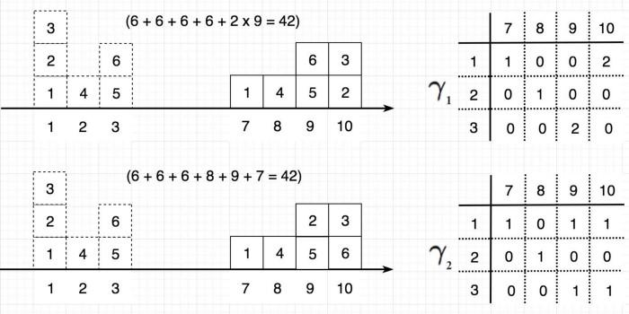
Wasserstein Distance
The Wasserstein distance is the minimum cost of transporting mass in converting the data distribution q to the data distribution p. [4]
Transport Plan of moving distributions. Source: Medium.com [4]

Slide 9
Wasserstein Distance
W(P_{r},P_{g}) = inf E_{(x,y) ~ ℽ}[||x-y||] (3)
ℽ ∈ ℿ(P_{r},P_{g})
ℿ(P_{r},P_{g}) represents the joint set of all the possible transport plan ℽ(x,y).
ℽ(x,y) states the cost to transport distribution from x to y in order to make probability distribution x same as y [4].

Slide 10
Wasserstein GAN
According to Kantorovich-Rubinstein duality principle [3], the Wasserstein distance equation can be written as:
W(P_{r},P_{θ})= sup {E_{(x~Pr)}[f(x)] - E_{(x~Pθ)}[f(x)]} (4)
||f||_{L}≤1
Discriminator/Critic function want to maximize equation 4
Generator wants to minimize equation 4

Slide 11
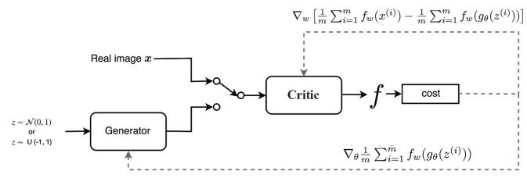
Wasserstein GAN
Network design of WGAN. Source: Medium.com [4]

Slide 12
Why other distances differ from EM distance?
Considering the real data distribution to be located at (0,y) and generated data at (θ,y) where θ is non-zero. So goal is to move P(θ) close to P(0).
W(P₀,P_{θ})=|θ| (6)
JS(P₀,P_{θ})= log2 ; if θ != 0 (7)
=0 ; if θ=0
KL(P₀||P_{θ})= ∞ ; if θ != 0 (8)
= 0 ; if θ=0

Slide 13
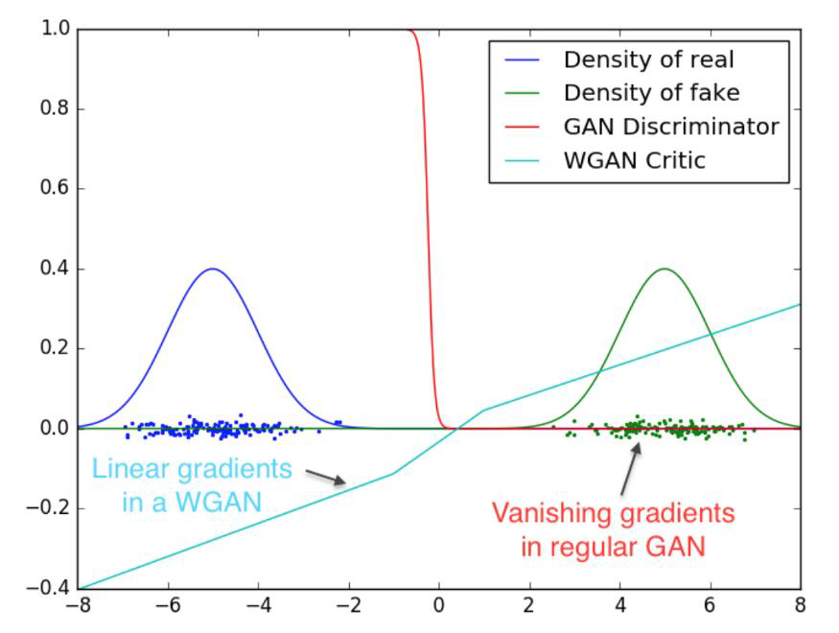
Gradient comparison of GAN and WGAN. Source: WGAN paper [3]

Slide 14
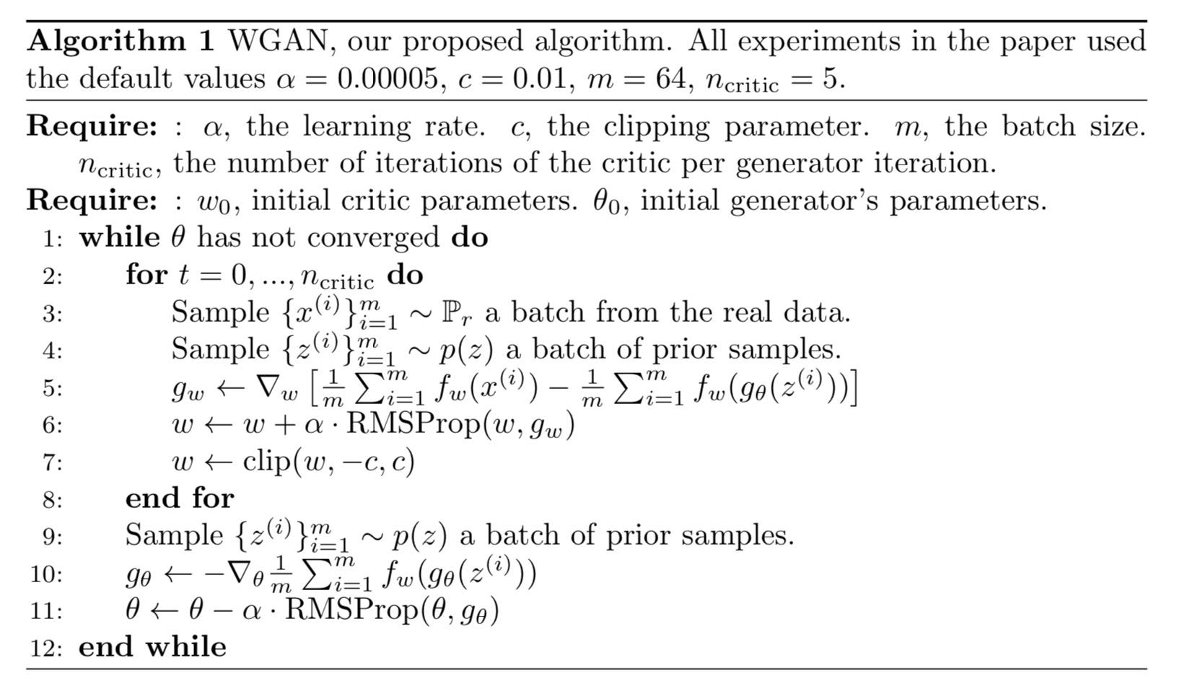
Algorithm for the Wasserstein Generative Adversarial Networks. Source: Wasserstein GAN paper [3]

Slide 15
Strength and weakness of WGAN
Strengths:
WGAN prevents mode from collapsing
Improved stability
Loss here means something
Weakness:
Slow convergence after weight clipping
Vanishing gradients (when clipping window is too small)

Slide 16
Applications of WGAN
Synthesize image
Synthesising chemical formula of drugs
Biology

Slide 17
References
L. Weng, “From GAN to WGAN,” Lil'Log, 20-Aug-2017. [Online]. Available: https://lilianweng.github.io/lil-log/2017/08/20/from-GAN-to-WGAN.html. [Accessed: 04-Mar-2021].
J. Brownlee, “A Gentle Introduction to Generative Adversarial Networks (GANs),” Machine Learning Mastery, 19-Jul-2019. [Online]. Available: https://machinelearningmastery.com/what-are-generative-adversarial-networks-gans/. [Accessed: 04-Mar-2021].
M. Arjovsky, S. Chintala, and L. Bottou, “Wasserstein GAN,” arxiv.org. [Online]. Available: https://arxiv.org/pdf/1701.07875.pdf. [Accessed: 04-Mar-2021].
Hui, J. (2020, March 05). GAN - Wasserstein gan & WGAN-GP. Retrieved March 06, 2021, from https://jonathan-hui.medium.com/gan-wasserstein-gan-wgan-gp-6a1a2aa1b490

Slide 18
Thank you!

